Slide 1

Health of Children and Young People in Wales
Health and use of health services indicator summary
November 2013

Slide 2
Copyright
© 2013 Public Health Wales NHS Trust
Material contained in this document may be reproduced without prior permission provided it is done so accurately and is not used in a misleading context.
Acknowledgement to Public Health Wales NHS Trust to be stated.
Copyright in the typographical arrangement, design and layout belongs to Public Health Wales NHS Trust.

Slide 3
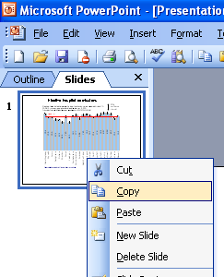
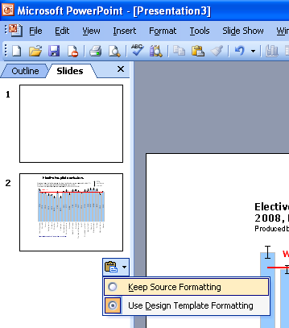
Instructions to copy a slide
To copy a slide for use in a presentation:
1. Right-click on the slide you wish to copy from the list on the left-hand side (the ‘slides’ tab) when in normal view and select ‘Copy’ from the list.
Go to your presentation and right-click where you want the copied slide to appear in the ‘slides’ tab and select ‘paste’ from the list.
On being pasted into your presentation a small clipboard icon with a black arrow will appear near the bottom right-hand corner of the newly pasted slide. Click on the arrow to show the drop-down menu and select “Keep Source Formatting” from the list. The slide will then appear as seen in the original presentation.

Slide 4

Using these slides
These slides form part of the Health of children and young people in Wales report published by the Public Health Wales Observatory. All charts and maps in this PowerPoint file relate to the ‘Health and use of health services’ chapter of the report which can be accessed by clicking on the icon to the right when in ‘slide show’ view.
The full report along with: 22 local authority profiles, a technical guide, data files, additional PowerPoint files can be found: www.publichealthwalesobservatory.wales.nhs.uk/childprofile
This presentation can be used as a whole or as individual slides.
For further information:
  Email: publichealthwalesobservatory@wales.nhs.uk

Slide 5
% of persons aged 11-16 who rated their health as excellent or good, 2009/10
Produced by Public Health Wales Observatory, using HBSC (WG)

Slide 6
% of persons aged 11-16 rating their health as excellent or good, stratified by Family Affluence Scale (FAS), age and gender, Wales, 2009/10
Produced by Public Health Wales Observatory, using HBSC (WG)

Slide 7
% of persons aged 11-16 scoring six or higher on self rated quality of life, 2009/10
Produced by Public Health Wales Observatory, using HBSC (WG)

Slide 8
% of males and females aged 0-24 with a long-term health problem or disability, 2011
Produced by Public Health Wales Observatory, using Census 2011 (ONS)

Slide 9
% of persons aged 11-16 who reported having three or more close friends of the same gender, 2009/10
Produced by Public Health Wales Observatory, using HBSC (WG)

Slide 10
% of persons aged 11-16 reporting being bullied in the last couple of months, 2009/10
Produced by Public Health Wales Observatory, using HBSC (WG)

Slide 11
Persons aged 12-24 admitted to hospital with a primary diagnosis of eating disorder, Wales, 2002-2011
Produced by Public Health Wales Observatory, using PEDW (NWIS) & MYE (ONS)

Slide 12
Estimated number of children and young people aged 5-16 with any mental health disorder, 2011
Produced by Public Health Wales Observatory, using Green et al (2004) & MYE (ONS)

Slide 13
% of patients on primary care chronic conditions register with asthma, persons aged under 25, February 2012
Produced by Public Health Wales Observatory, using Audit+ (NWIS)

Slide 14
Incidence of cancer*, persons aged 0-24, EASR per 100,000 population, 2007-11
Produced by Public Health Wales Observatory, using MYE (ONS) & cancer registrations (WCISU)

Slide 15
Cancer registration rates by cancer site for persons aged 0-24, Wales, 1998 - 2011
Produced by Public Health Wales Observatory, using MYE (ONS) & cancer registrations (WCISU)

Slide 16
Cancer registration rates by age and sex, Wales, 1998-2011
Produced by Public Health Wales Observatory, using MYE (ONS) & cancer registrations (WCISU)

Slide 17
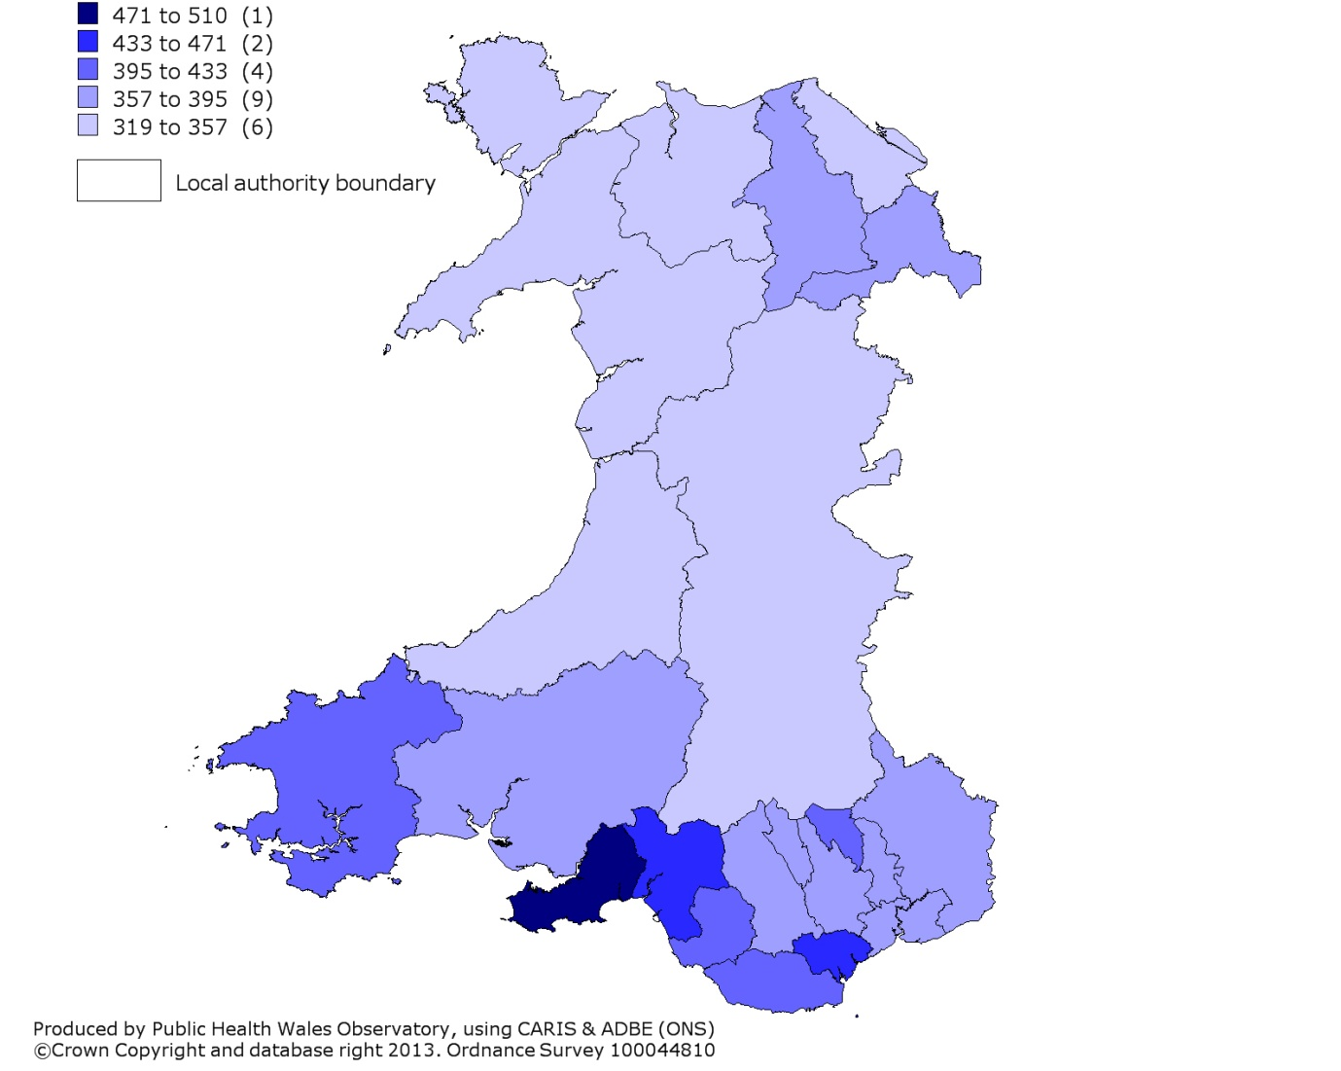
Cases of congenital anomalies, EUROCAT definition, 1998-2011
Local authority, gross rate per 10,000 total births

Slide 18
Selected cases of congenital anomalies, year of end of pregnancy between 1998 and 2006
Produced by Public Health Wales Observatory, using CARIS (PHW) & MYE (ONS)

Slide 19
Average number of decayed, missing or filled teeth, children aged 5 years, 2011/12
Produced by Public Health Wales Observatory, using WOHIU

Slide 20
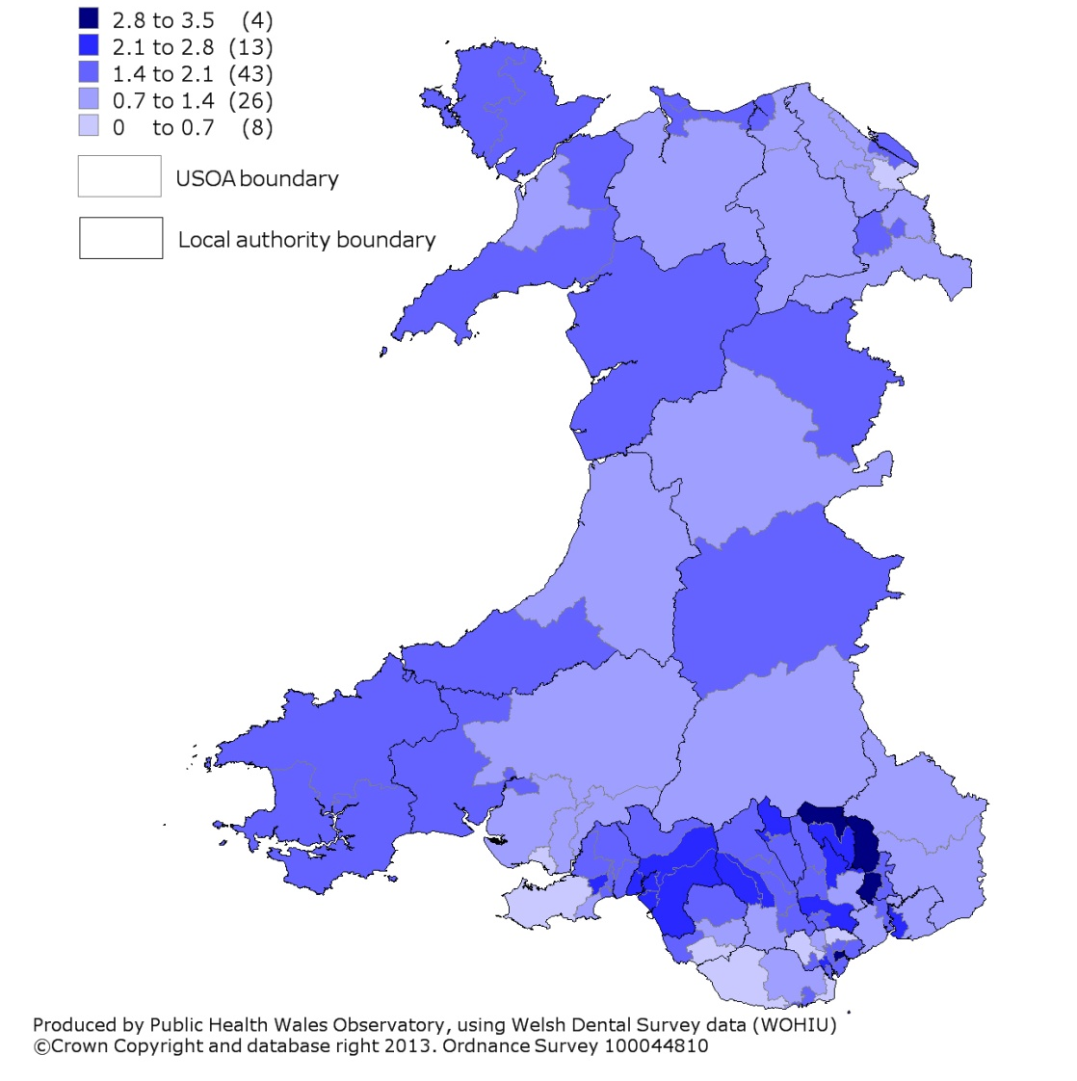
Average number of decayed, missing or filled teeth, children aged 5 years, 2011/12
2001 USOA, average

Slide 21
% of persons aged 11-16 who reported brushing their teeth more than once a day, 2009/10
Produced by Public Health Wales Observatory, using HBSC (WG)

Slide 22
Rate per 1,000 of all attendances* to emergency departments in Wales by Welsh Residents, 2011
Produced by Public Health Wales Observatory, using EDDS(NWIS)

Slide 23
Repeat attendances* to emergency departments, persons aged 0-24, Wales, 2011
Produced by Public Health Wales Observatory, using EDDS (NWIS)

Slide 24
Emergency department attendees, rate per 1,000, Wales, 2011
Produced by Public Health Wales Observatory, using EDDS (NWIS)

Slide 25
Emergency admissions*, persons aged 0-24, EASR per 1,000, 2011
Produced by Public Health Wales Observatory, using PEDW (NWIS) & MYE (ONS)

Slide 26
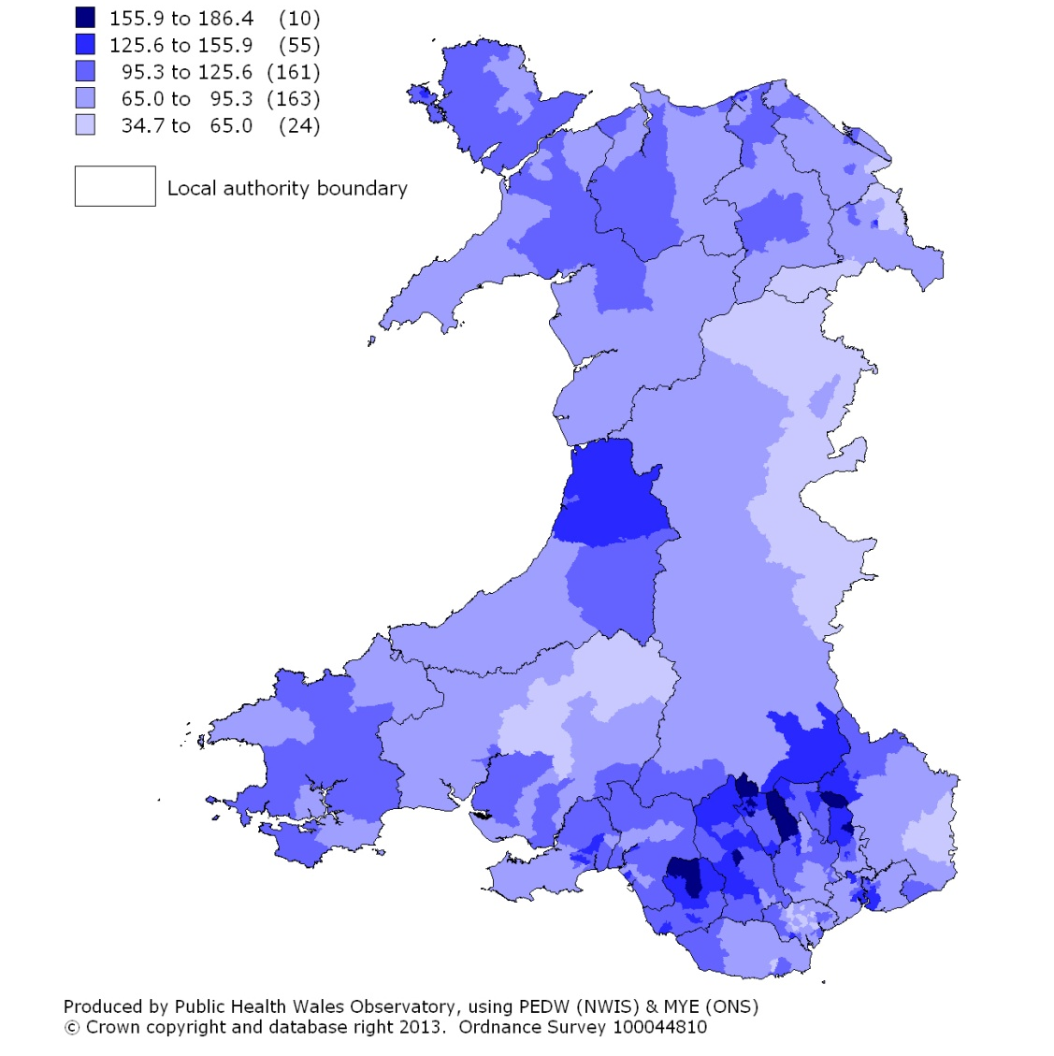
Emergency admissions for persons aged 0-24, 2011
2001 MSOA, EASR per 1,000

Slide 27
Emergency admissions* by deprivation fifth, persons aged 0-24, Wales, EASR per 1,000, 2011
Produced by Public Health Wales Observatory, using PEDW (NWIS), MYE (ONS) & WIMD 2011 (WG)

Slide 28
Emergency admissions* by main cause for persons aged 0-24, Wales, 2011
Produced by Public Health Wales Observatory, using PEDW (NWIS)

Slide 29
Hospital admissions for injuries, persons aged 0-24, EASR per 100,000, Wales, 2002-2011
Produced by Public Health Wales Observatory, using PEDW (NWIS) & MYE (ONS)

Slide 30
Admissions for pedestrian injuries by fifth of deprivation, children aged 5-14, Wales, rate per 100,000, 2006-2010
Produced by Public Health Wales Observatory, using PEDW (NWIS), MYE (ONS) & WIMD 2011 (WG)

Slide 31
Number of road traffic casualties, persons aged 0-24, Wales, 2005-2012
Produced by Public Health Wales Observatory, using Road accidents and safety data (STATS19)

Slide 32
Number of road traffic casualties by casualty type, persons aged 25 and under, Wales, 2005-2011
Produced by Public Health Wales Observatory, using Road accidents and safety data (STATS19)

