Slide 1

Health of Children and Young People in Wales Immunisations and screening indicator summary
November 2013

Slide 2
Copyright
© 2013 Public Health Wales NHS Trust
Material contained in this document may be reproduced without prior permission provided it is done so accurately and is not used in a misleading context.
Acknowledgement to Public Health Wales NHS Trust to be stated.
Copyright in the typographical arrangement, design and layout belongs to Public Health Wales NHS Trust.

Slide 3
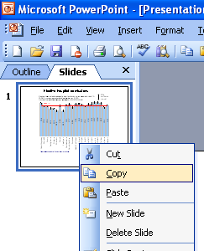
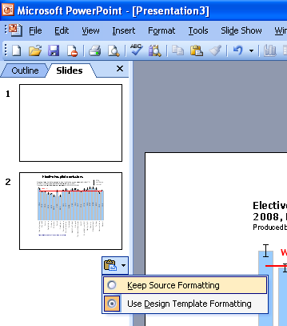
Instructions to copy a slide
To copy a slide for use in a presentation:
1. Right-click on the slide you wish to copy from the list on the left-hand side (the ‘slides’ tab) when in normal view and select ‘Copy’ from the list.
Go to your presentation and right-click where you want the copied slide to appear in the ‘slides’ tab and select ‘paste’ from the list.
On being pasted into your presentation a small clipboard icon with a black arrow will appear near the bottom right-hand corner of the newly pasted slide. Click on the arrow to show the drop-down menu and select “Keep Source Formatting” from the list. The slide will then appear as seen in the original presentation.

Slide 4

Using these slides
These slides form part of the Health of children and young people in Wales report published by the Public Health Wales Observatory. All charts and maps in this PowerPoint file relate to the ‘Immunisations and screening’ chapter of the report which can be accessed by clicking on the icon to the right when in ‘slide show’ view.
The full report along with: 22 local authority profiles, a technical guide, data files, additional PowerPoint files can be found: www.publichealthwalesobservatory.wales.nhs.uk/childprofile
This presentation can be used as a whole or as individual slides.
For further information:
Email: publichealthwalesobservatory@wales.nhs.uk

Slide 5
% of children up to date with routine immunisations by 4 years of age, 2012
Produced by Public Health Wales Observatory, using CDSC & VPDP (PHW)

Slide 6
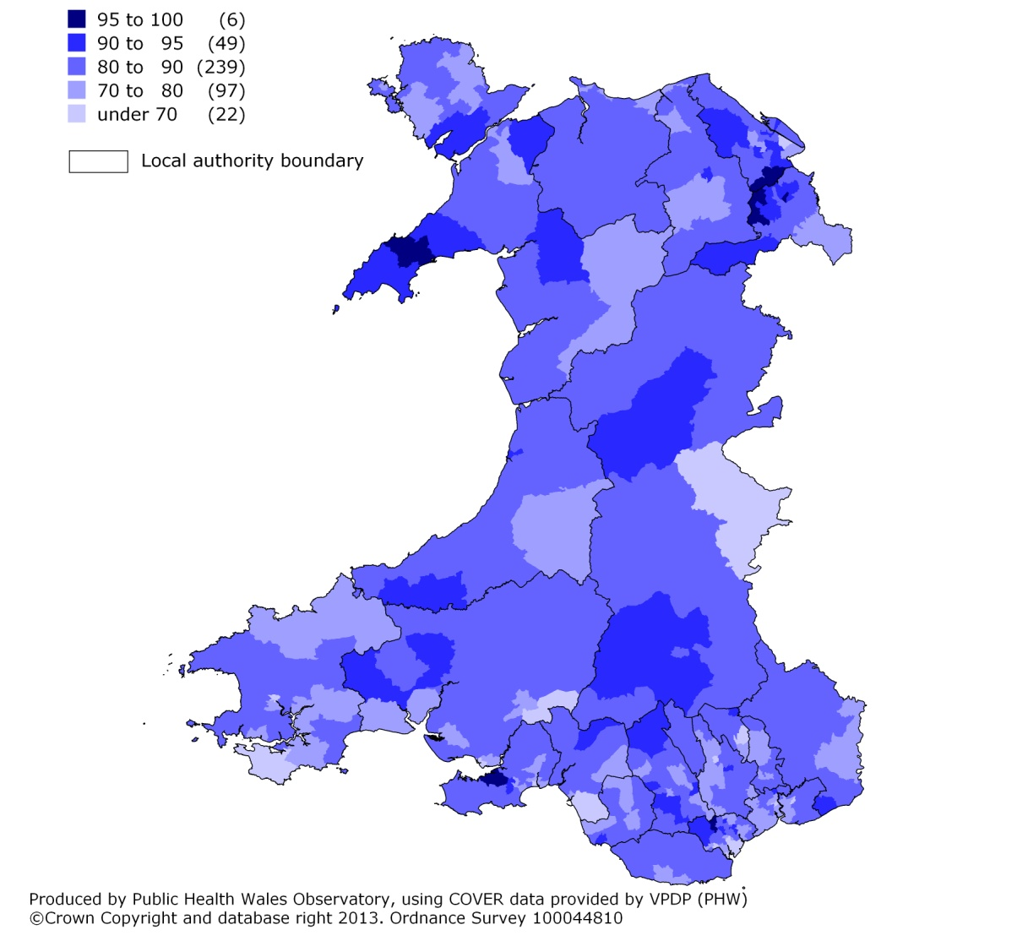
% of children up to date with immunisations by 4 years of age, Wales MSOAs, 2012 2001 MSOA, percentage

Slide 7
% of children who are up to date with their routine immunisations at 4 years of age by deprivation fifth, Wales, 2012
Produced by Public Health Wales Observatory, using CDSC & VPDP (PHW); WIMD 2011 (WG)

Slide 8
% of persons aged 16 who have completed a 2 dose course of the MMR vaccine, 2012
Produced by Public Health Wales Observatory, using CDSC & VPDP (PHW)

Slide 9
% of girls completing a 3 dose course of HPV vaccine, school year 9, 2012/13
Produced by Public Health Wales Observatory, using CDSC & VPDP (PHW)

Slide 10
% babies screened by the newborn hearing screening programme and those then referred for a hearing assessment, 2011/12
Produced by Public Health Wales Observatory, using NBHSW Annual Report, March 2013

