Slide 1

Health of Children and Young People in Wales Health related behaviours indicator summary
November 2013

Slide 2
Copyright
© 2013 Public Health Wales NHS Trust
Material contained in this document may be reproduced without prior permission provided it is done so accurately and is not used in a misleading context.
Acknowledgement to Public Health Wales NHS Trust to be stated.
Copyright in the typographical arrangement, design and layout belongs to Public Health Wales NHS Trust.

Slide 3
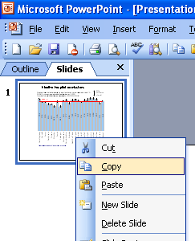
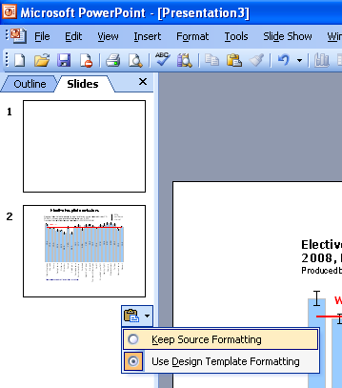
Instructions to copy a slide
To copy a slide for use in a presentation:
1. Right-click on the slide you wish to copy from the list on the left-hand side (the ‘slides’ tab) when in normal view and select ‘Copy’ from the list.
Go to your presentation and right-click where you want the copied slide to appear in the ‘slides’ tab and select ‘paste’ from the list.
On being pasted into your presentation a small clipboard icon with a black arrow will appear near the bottom right-hand corner of the newly pasted slide. Click on the arrow to show the drop-down menu and select “Keep Source Formatting” from the list. The slide will then appear as seen in the original presentation.

Slide 4

Using these slides
These slides form part of the Health of children and young people in Wales report published by the Public Health Wales Observatory. All charts and maps in this PowerPoint file relate to the ‘Health related behaviours’ chapter of the report which can be accessed by clicking on the icon to the right when in ‘slide show’ view.
The full report along with: 22 local authority profiles, a technical guide, data files, additional PowerPoint files can be found: www.publichealthwalesobservatory.wales.nhs.uk/childprofile
This presentation can be used as a whole or as individual slides.
For further information:
Email: publichealthwalesobservatory@wales.nhs.uk

Slide 5
% of persons aged 11-16* who reported eating at least one piece of fruit, daily, 2009/10
Produced by Public Health Wales Observatory, using HBSC (WG)

Slide 6
% of persons aged 11-16* who reported eating vegetables every day, 2009/10
Produced by Public Health Wales Observatory, using HBSC (WG)

Slide 7
% of persons aged 16-24 who reported eating five or more portions of fruit and vegetables the previous day, 2008-2011
Produced by Public Health Wales Observatory, using WHS (WG) & MYE (ONS)

Slide 8
% of children aged 4-15 who reported undertaking physical activity for an hour or more every day, 2007-2011
Produced by Public Health Wales Observatory, using WHS (WG) & MYE (ONS)

Slide 9
% of persons aged 16-24 who reported undertaking 30 minutes of moderate or vigorous physical activity on 5 or more days, 2008-2011
Produced by Public Health Wales Observatory, using WHS (WG) & MYE (ONS)

Slide 10
% of children aged 4-5 who are overweight or obese, 2011/12
Produced by Public Health Wales Observatory, using CMP (NWIS)

Slide 11
% of persons aged 11-16* who are overweight or obese, 2009/10
Produced by Public Health Wales Observatory, using HBSC (WG)

Slide 12
% of persons aged 11-16 who are overweight or obese, stratified by Family Affluence Scale (FAS), Wales*, 2009/10
Produced by Public Health Wales Observatory, using HBSC (WG)

Slide 13
% of persons aged 16-24 who are overweight or obese, 2008-2011
Produced by Public Health Wales Observatory, using WHS (WG) & (MYE (ONS)

Slide 14
% of persons aged 11-16 who reported smoking at least once a week, stratified by Family Affluence Scale (FAS), Wales, 2009/10
Produced by Public Health Wales Observatory, using HBSC (WG)

Slide 15
% of persons aged 16-24 who reported currently being a smoker (daily or occasionally), 2008-2011
Produced by Public Health Wales Observatory, using WHS (WG) & MYE (ONS)

Slide 16
% of persons aged 11-16* who reported drinking alcohol at least once a week, 2009/10
Produced by Public Health Wales Observatory, using HBSC (WG)

Slide 17
% of persons aged 11-16 who reported drinking alcohol at least once a week, stratified by Family Affluence Scale (FAS), Wales, 2009/10
Produced by Public Health Wales Observatory, using HBSC (WG)

Slide 18
% of persons aged 16-24 who reported drinking above the recommended guidelines on at least one day in the previous week, 2008-2011
Produced by Public Health Wales Observatory, using WHS (WG) & MYE (ONS)

Slide 19
% of persons aged 11-16 who reported using any illicit drug in the last year, 2009/10
Produced by Public Health Wales Observatory, using HBSC (WG)

Slide 20
% of persons aged 11-16 who reported using any drug in the last year, stratified by Family Affluence Scale (FAS), Wales, 2009/10
Produced by Public Health Wales Observatory, using HBSC (WG)

Slide 21
Number of referrals for substance misuse, persons aged 0-24, Wales, 2008/09 – 2011/12
Produced by Public Health Wales Observatory, using WNDSM (NWIS)

Slide 22
Referrals for substance misuse, persons aged 0-24, incidence rate per 100,000, 2011/12
Produced by Public Health Wales Observatory, using WNDSM (NWIS)

Slide 23
Tests for gonorrhoea and chlamydia in persons aged 15-24 by area of residence, rate per 1,000 population
Produced by Public Health Wales Observatory, using SWS data provided by CDSC (PHW) & MYE (ONS)

Slide 24
New episodes of chlamydia and gonorrhoea reported to GUM clinics, Wales, 2001-2011
Produced by Public Health Wales Observatory, using KC60 & SWS data* provided by CDSC (PHW)

Slide 25
Teenage conceptions, rate per 1,000 females†, 2011
Produced by Public Health Wales Observatory, using conceptions data (ONS)

Slide 26
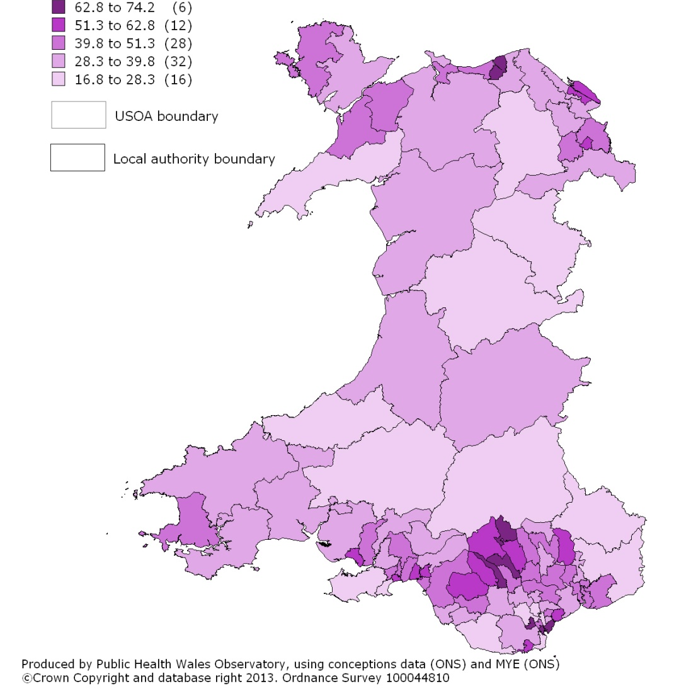
Teenage conceptions, females aged under 18, Wales, 2007-2011
2001 USOA, rate per 1,000 females aged 15-17

Slide 27
Conceptions in females aged under 16 years by fifth of deprivation, Wales, rate per 1,000 population aged 13-15, 2006-2010
Produced by Public Health Wales Observatory, using conceptions data (ONS) & WIMD 2011 (WG)

Slide 28
Legal abortions, females, crude rate per 1,000, 2011
Produced by Public Health Wales Observatory, using Department of Health data & MYE (ONS)

Slide 29
Legal abortions, females, crude rate per 1,000, 2003-2011
Produced by Public Health Wales Observatory, using Department of Health data

