Slide 1

Health of Children and Young People in Wales Families and education indicator summary
November 2013

Slide 2
Copyright
© 2013 Public Health Wales NHS Trust
Material contained in this document may be reproduced without prior permission provided it is done so accurately and is not used in a misleading context.
Acknowledgement to Public Health Wales NHS Trust to be stated.
Copyright in the typographical arrangement, design and layout belongs to Public Health Wales NHS Trust.

Slide 3
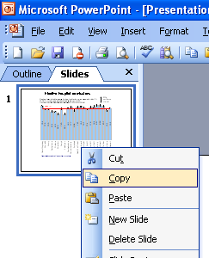
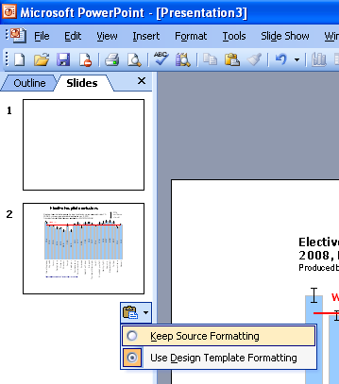
Instructions to copy a slide
To copy a slide for use in a presentation:
1. Right-click on the slide you wish to copy from the list on the left-hand side (the ‘slides’ tab) when in normal view and select ‘Copy’ from the list.
Go to your presentation and right-click where you want the copied slide to appear in the ‘slides’ tab and select ‘paste’ from the list.
On being pasted into your presentation a small clipboard icon with a black arrow will appear near the bottom right-hand corner of the newly pasted slide. Click on the arrow to show the drop-down menu and select “Keep Source Formatting” from the list. The slide will then appear as seen in the original presentation.

Slide 4

Using these slides
These slides form part of the Health of children and young people in Wales report published by the Public Health Wales Observatory. All charts and maps in this PowerPoint file relate to the ‘Families and education’ chapter of the report which can be accessed by clicking on the icon to the right when in ‘slide show’ view.
The full report along with: 22 local authority profiles, a technical guide, data files, additional PowerPoint files can be found: www.publichealthwalesobservatory.wales.nhs.uk/childprofile
This presentation can be used as a whole or as individual slides.
For further information:
Email: publichealthwalesobservatory@wales.nhs.uk

Slide 5
% of all households where there is a lone parent with dependent children, 2011
Produced by Public Health Wales Observatory, using Census 2011 (ONS)

Slide 6
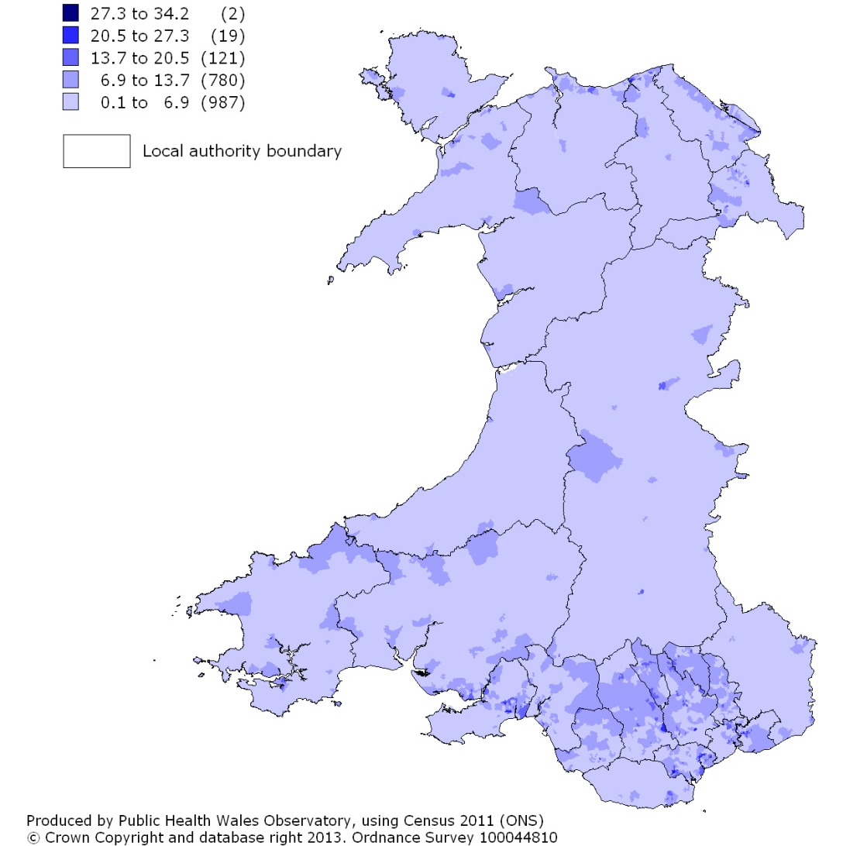
% of all households where there is a lone parent with dependent children, 2011 2011 LSOA, percentage

Slide 7
% of households with dependent children where one person has a long-term condition or disability, 2011
Produced by Public Health Wales Observatory, using Census 2011 (ONS)

Slide 8
% of persons aged 0-24 who provide unpaid care, 2011
Produced by Public Health Wales Observatory, using Census 2011 (ONS)

Slide 9
% of persons aged 0-24 who provide unpaid care, Wales, 2011
Produced by Public Health Wales Observatory, using Census 2011 (ONS)

Slide 10
Number of children looked after by the local authority in foster placements, Wales, 2003-2012
Produced by Public Health Wales Observatory, using Children’s Services data (StatsWales)

Slide 11
Rate of children per 10,000 population aged 0-17 on the Child Protection Register, March 2012
Produced by Public Health Wales Observatory, using Children’s Services data (WG) & MYE (ONS)

Slide 12
Rate per 10,000 population of children in need aged 0-17 (excluding unborn children), March 2012
Produced by Public Health Wales Observatory, using Children in Need Census (WG) and MYE (ONS)

Slide 13
% of pupils eligible for free school meals, persons aged 5-15 years, 2011/12
Produced by Public Health Wales Observatory, using PLASC (WG)

Slide 14
% of half day sessions missed due to unauthorised absences, children aged 5-15, 2010/11
Produced by Public Health Wales Observatory, using Local Education Authority data (StatsWales)

Slide 15
% of pupils with a statement of special educational need, children aged 5-15, 2010/11
Produced by Public Health Wales Observatory, using School Census (StatsWales)

Slide 16
Key Stage 4 educational attainment mean scores, 2009-2011
Produced by Public Health Wales Observatory, using PLASC (WG)

Slide 17
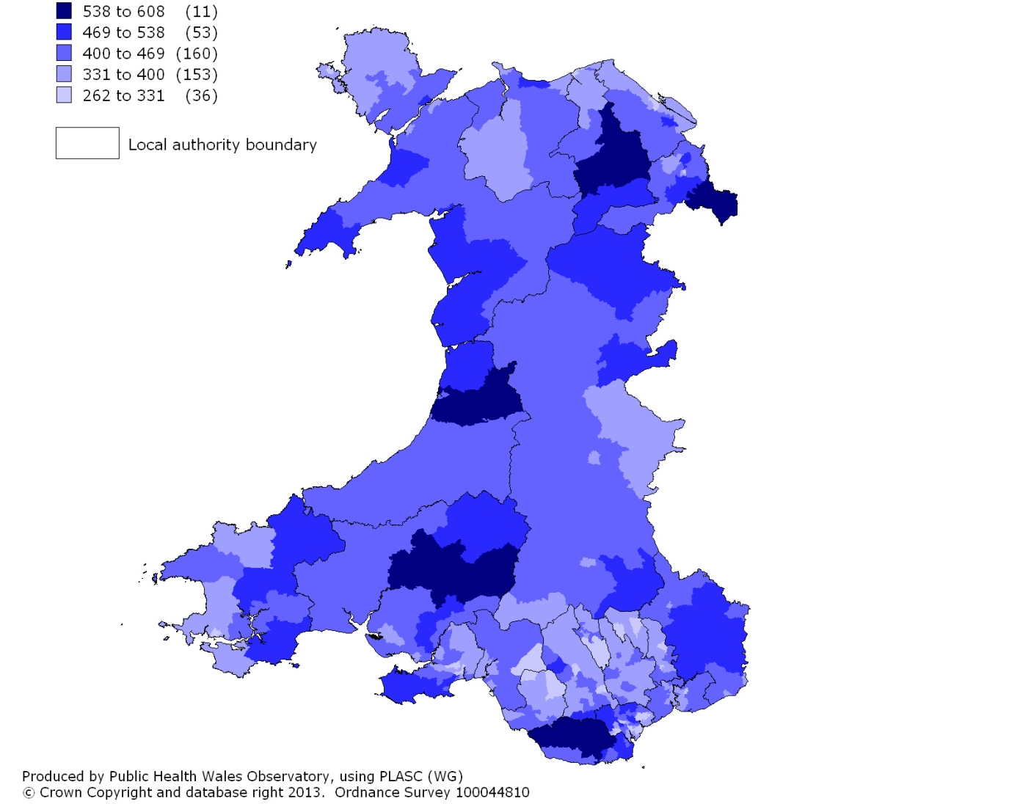
Key Stage 4 educational attainment mean scores, Wales MSOAs, 2009-2011 2001 MSOA, mean score

Slide 18
% of persons aged 16-24 going on to UK Higher Education Institutions, first year undergraduates*, 2004-2011
Produced by Public Health Wales Observatory, using HESA (WG) and MYE (ONS)

