Slide 1

Health of Children and Young People in Wales Socio-economic and environmental conditions indicator summary
November 2013

Slide 2
Copyright
© 2013 Public Health Wales NHS Trust
Material contained in this document may be reproduced without prior permission provided it is done so accurately and is not used in a misleading context.
Acknowledgement to Public Health Wales NHS Trust to be stated.
Copyright in the typographical arrangement, design and layout belongs to Public Health Wales NHS Trust.

Slide 3
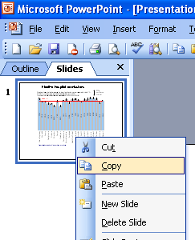
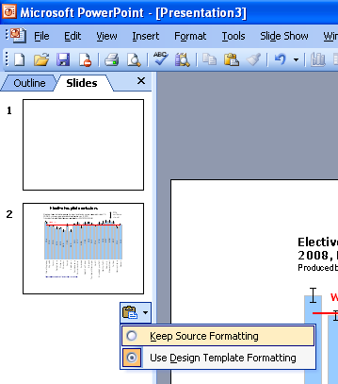
Instructions to copy a slide
To copy a slide for use in a presentation:
1. Right-click on the slide you wish to copy from the list on the left-hand side (the ‘slides’ tab) when in normal view and select ‘Copy’ from the list.
Go to your presentation and right-click where you want the copied slide to appear in the ‘slides’ tab and select ‘paste’ from the list.
On being pasted into your presentation a small clipboard icon with a black arrow will appear near the bottom right-hand corner of the newly pasted slide. Click on the arrow to show the drop-down menu and select “Keep Source Formatting” from the list. The slide will then appear as seen in the original presentation.

Slide 4

Using these slides
These slides form part of the Health of children and young people in Wales report published by the Public Health Wales Observatory. All charts and maps in this PowerPoint file relate to the ‘Socio-economic and environmental conditions’ chapter of the report which can be accessed by clicking on the icon to the right when in ‘slide show’ view.
The full report along with: 22 local authority profiles, a technical guide, data files, additional PowerPoint files can be found: www.publichealthwalesobservatory.wales.nhs.uk/childprofile
This presentation can be used as a whole or as individual slides.
For further information:
Email: publichealthwalesobservatory@wales.nhs.uk

Slide 5
% of children living in poverty, persons aged under 20, 2010
Produced by Public Health Wales Observatory, using DWP

Slide 6
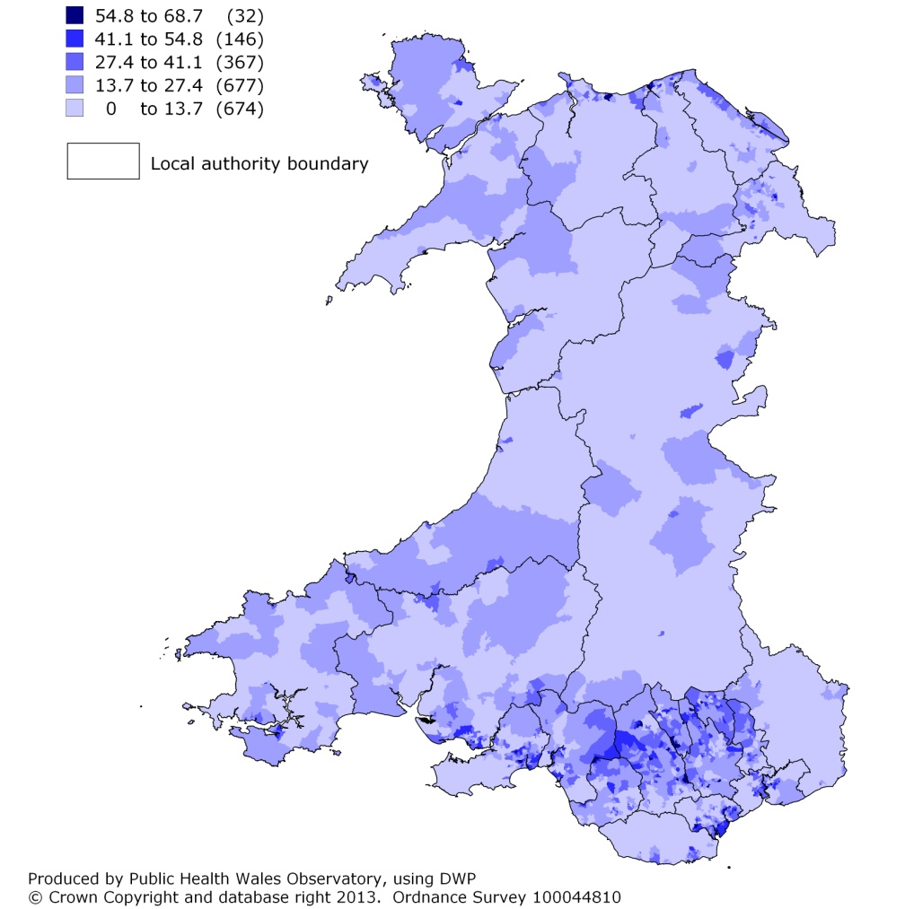
% of children living in poverty, persons aged under 20, 2010 2001 LSOA, percentage

Slide 7
% LSOAs in the most deprived tenth, Welsh Index of Multiple Deprivation 2011 Child Index
Produced by Public Health Wales Observatory, using WIMD 2011 (WG)

Slide 8
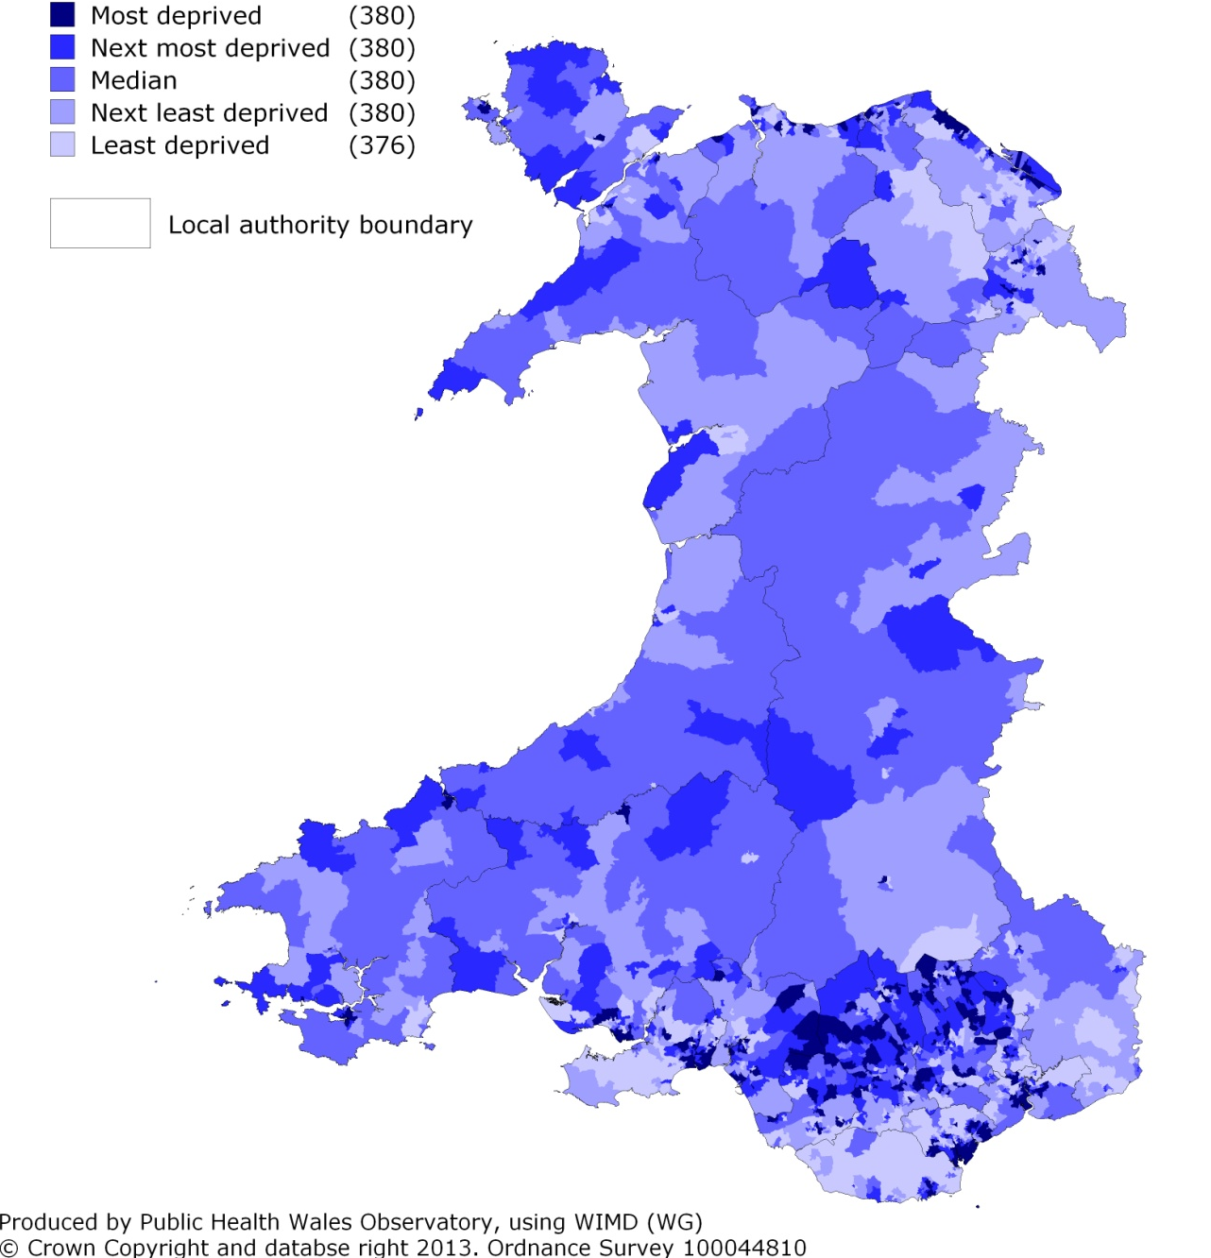
Welsh Index of Multiple Deprivation 2011 Child Index 2001 LSOA, fifths of deprivation

Slide 9
% of year 11 school leavers known not to be in education, employment or training (NEET), 2011
Produced by Public Health Wales Observatory, using Careers Wales (StatsWales)

Slide 10
% of persons aged 16-24 who are unemployed (excluding students), 2011
Produced by Public Health Wales Observatory, using Census 2011 (ONS)

Slide 11
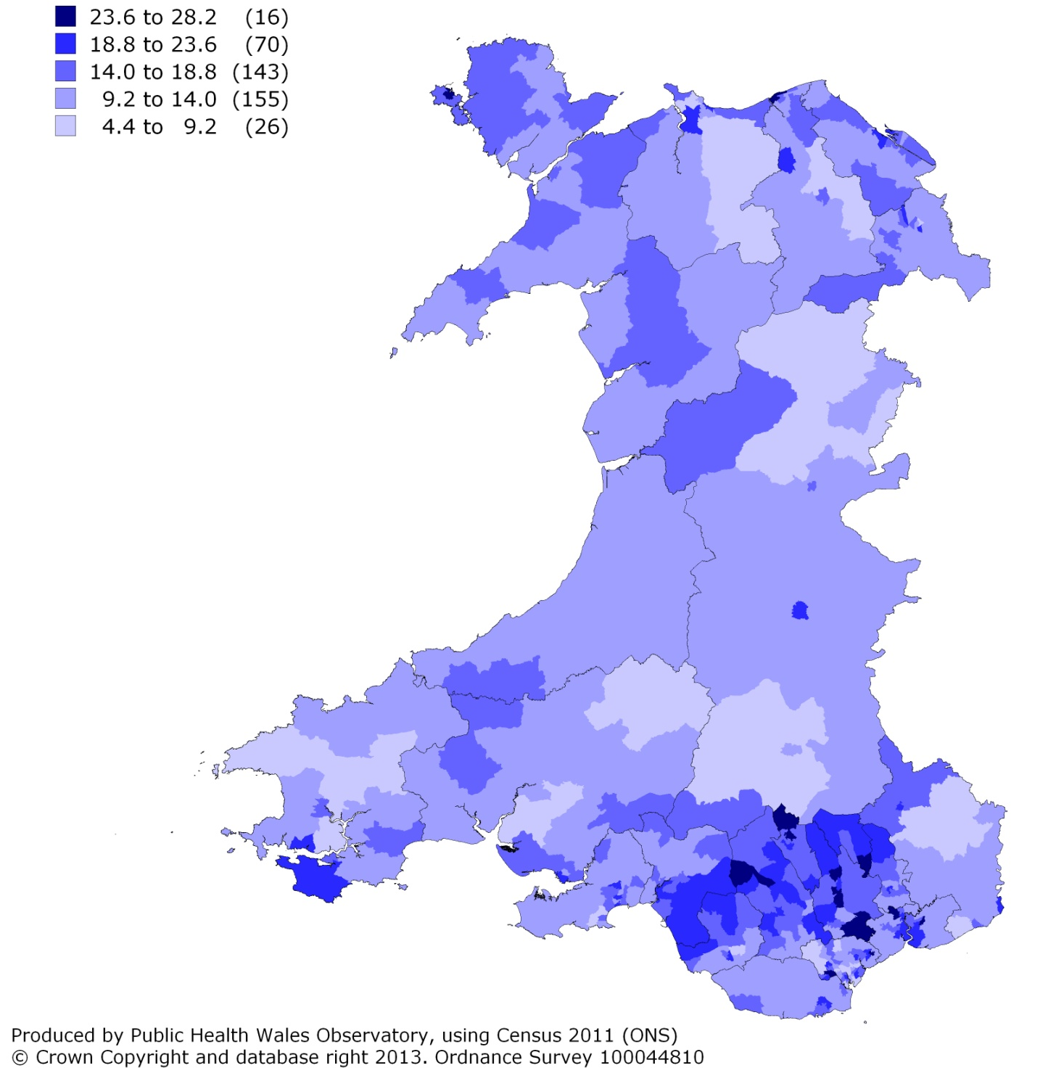
% of persons aged 16-24 who are unemployed (excluding students), 2011 2011 MSOA, percentage

Slide 12
% of households with dependent children that have more than 1.5 persons per bedroom by tenure, 2011
Owned or shared ownership
Social rented
Private rented
Produced by Public Health Wales Observatory, using Census 2011 (ONS)

Slide 13
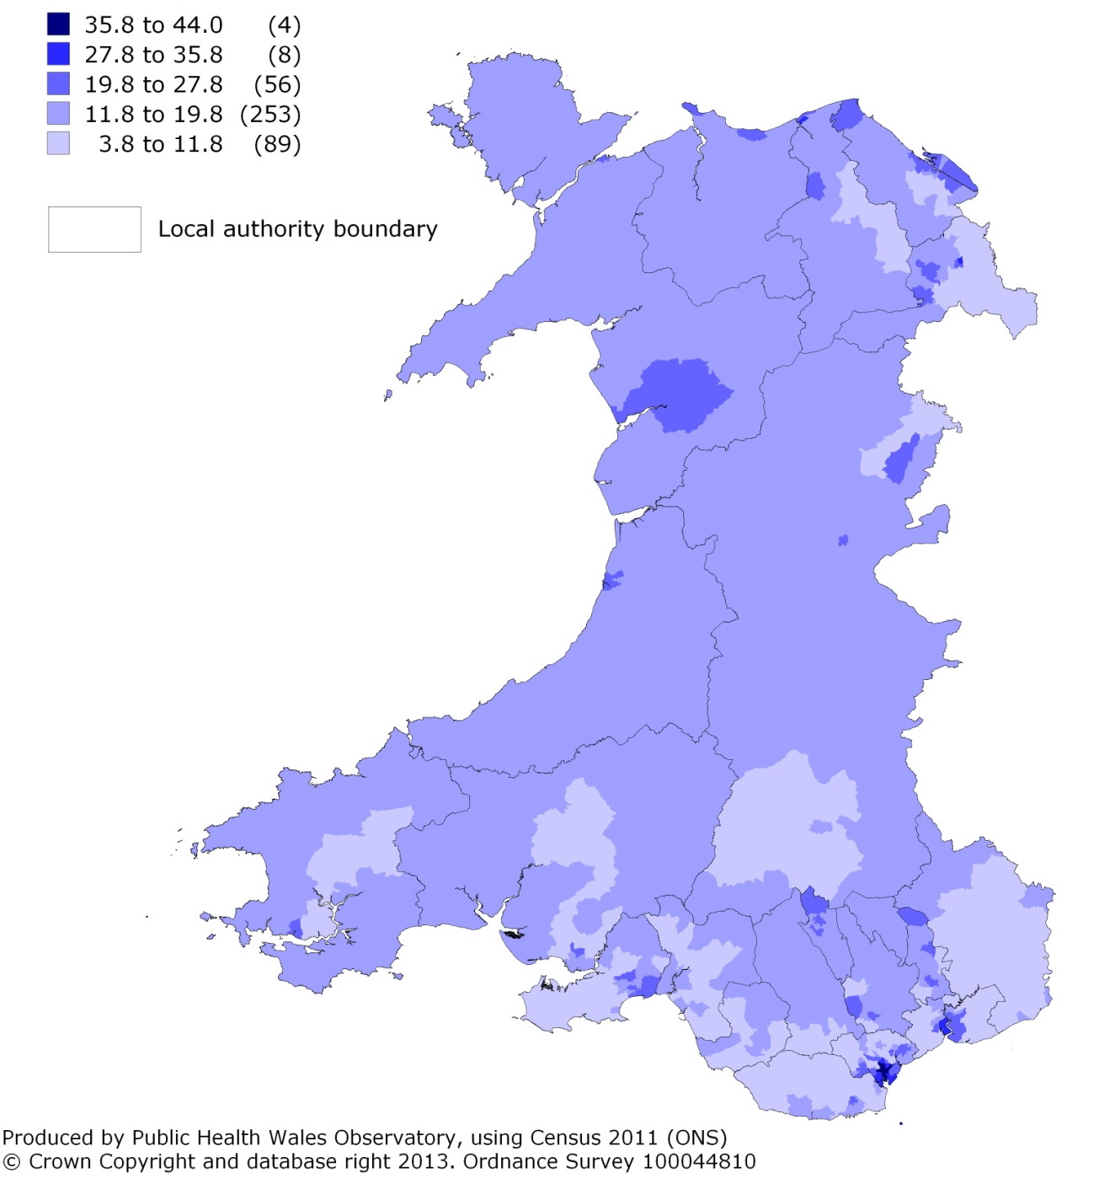
% of households with dependent children that have more than 1.5 persons per bedroom, 2011 2011 MSOA, percentage

