Slide 1

Health of Children and Young People in Wales
Population and births indicator summary
November 2013

Slide 2
Copyright
© 2013 Public Health Wales NHS Trust
Material contained in this document may be reproduced without prior permission provided it is done so accurately and is not used in a misleading context.
Acknowledgement to Public Health Wales NHS Trust to be stated.
Copyright in the typographical arrangement, design and layout belongs to Public Health Wales NHS Trust.

Slide 3
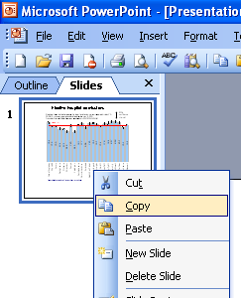
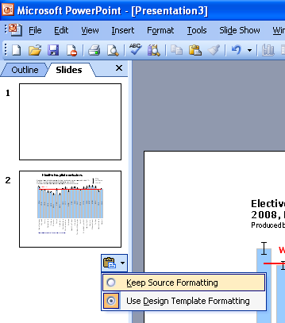
Instructions to copy a slide
To copy a slide for use in a presentation:
1. Right-click on the slide you wish to copy from the list on the left-hand side (the ‘slides’ tab) when in normal view and select ‘Copy’ from the list.
Go to your presentation and right-click where you want the copied slide to appear in the ‘slides’ tab and select ‘paste’ from the list.
On being pasted into your presentation a small clipboard icon with a black arrow will appear near the bottom right-hand corner of the newly pasted slide. Click on the arrow to show the drop-down menu and select “Keep Source Formatting” from the list. The slide will then appear as seen in the original presentation.

Slide 4

Using these slides
These slides form part of the Health of children and young people in Wales report published by the Public Health Wales Observatory. All charts and maps in this PowerPoint file relate to the ‘Population and births’ chapter of the report which can be accessed by clicking on the icon to the right when in ‘slide show’ view.
The full report along with: 22 local authority profiles, a technical guide, data files, additional PowerPoint files can be found: http://www.publichealthwalesobservatory.wales.nhs.uk/childprofile
This presentation can be used as a whole or as individual slides.
For further information:
  Email: publichealthwalesobservatory@wales.nhs.uk

Slide 5
% of population by age group, 2011
Produced by Public Health Wales Observatory, using MYE (ONS)

Slide 6
% of population aged 0-24 by school age group, 2011
Produced by Public Health Wales Observatory, using MYE (ONS)

Slide 7
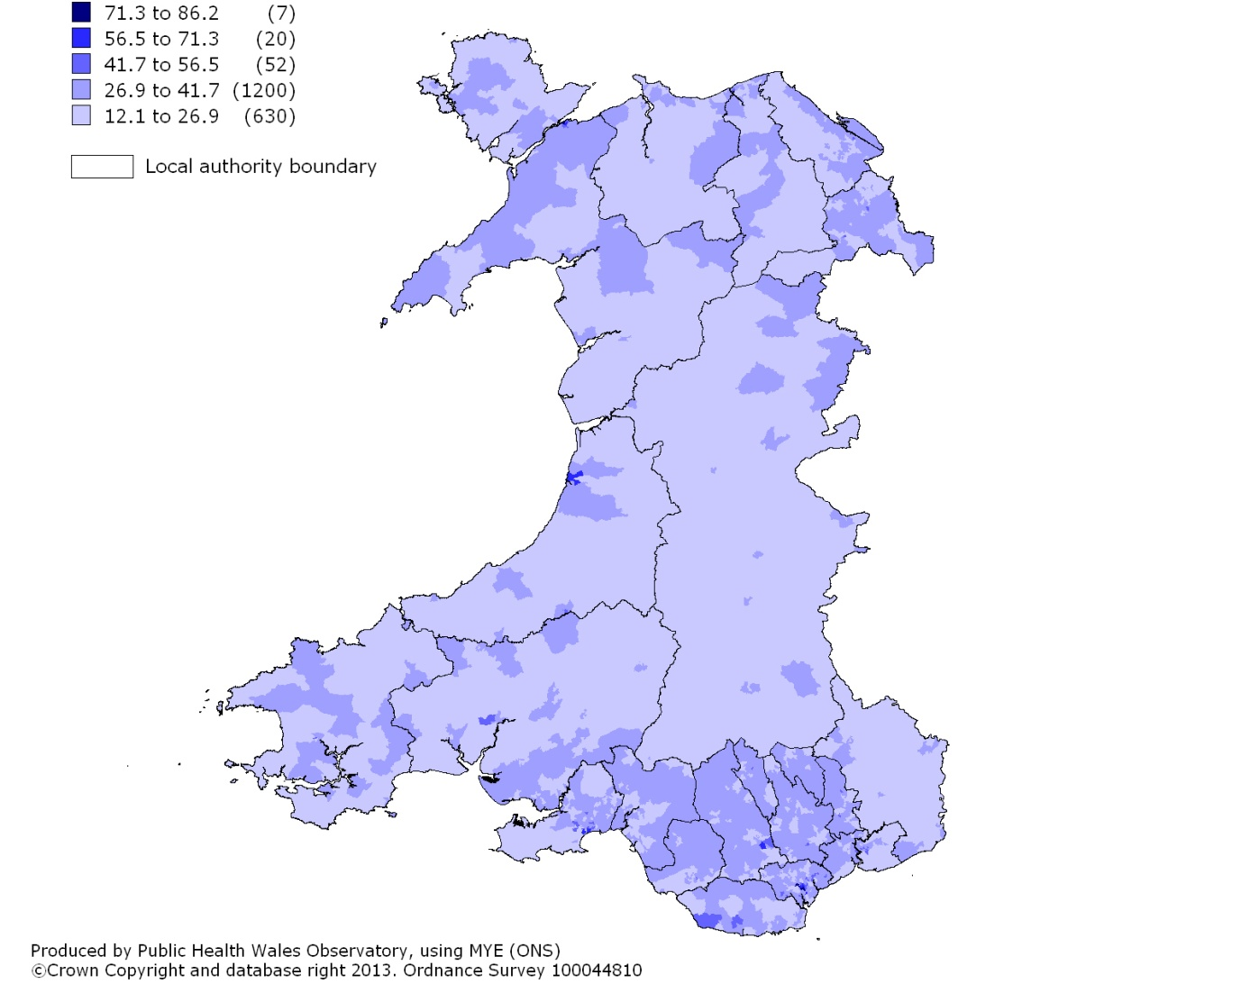
% of population aged 0-24, 2011
2011 LSOA, percentage

Slide 8
Population change, past trends and projections, persons aged 0-24, 2002-2033
Produced by Public Health Wales Observatory, using MYE (ONS) & 2008-based population projections for 2012-33 (StatsWales)

Slide 9
Total fertility rate, 2011
Produced by Public Health Wales Observatory, using VS1 (ONS)

Slide 10
% of babies born preterm (<37 weeks gestation at birth), 2011
Produced by Public Health Wales Observatory, using NCCHD (NWIS)

Slide 11
% of low birth weight babies (under 2500g), singleton live births, 2011
Produced by Public Health Wales Observatory, using NCCHD (NWIS)

Slide 12
% of babies breastfed at birth, 2011
Produced by Public Health Wales Observatory, using NCCHD (NWIS)

