Slide 1

Health of Children and Young People: Conwy
November 2013

Slide 2
Copyright
© 2013 Public Health Wales NHS Trust
Material contained in this document may be reproduced without prior permission provided it is done so accurately and is not used in a misleading context.
Acknowledgement to Public Health Wales NHS Trust to be stated.
Copyright in the typographical arrangement, design and layout belongs to Public Health Wales NHS Trust.

Slide 3
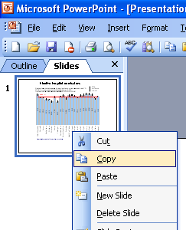
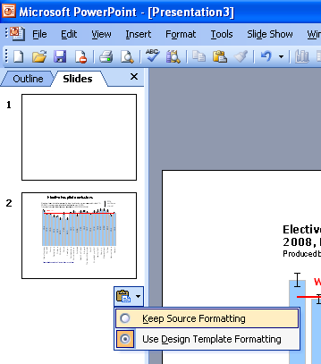
Instructions to copy a slide
To copy a slide for use in a presentation:
1. Right-click on the slide you wish to copy from the list on the left-hand side (the ‘slides’ tab) when in normal view and select ‘Copy’ from the list.
Go to your presentation and right-click where you want the copied slide to appear in the ‘slides’ tab and select ‘paste’ from the list.
On being pasted into your presentation a small clipboard icon with a black arrow will appear near the bottom right-hand corner of the newly pasted slide. Click on the arrow to show the drop-down menu and select “Keep Source Formatting” from the list. The slide will then appear as seen in the original presentation.

Slide 4
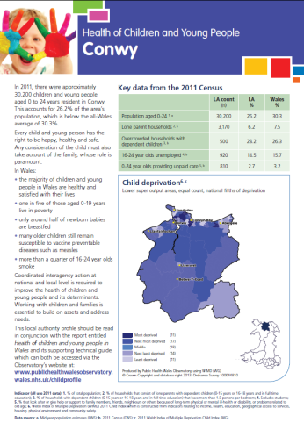
Using these slides
These slides form part of the Health of children and young people local profiles published by the Public Health Wales Observatory. All charts and maps in this PowerPoint file relate to the Conwy local authority profile which can be accessed by clicking on the icon to the right when in ‘slide show’ view.
The 22 local authority profiles along with: the Wales report, a technical guide, data files, additional PowerPoint files can be found: http://www.publichealthwalesobservatory.wales.nhs.uk/childprofile
This presentation can be used as a whole or as individual slides.
For further information:
  Email: publichealthwalesobservatory@wales.nhs.uk

Slide 5
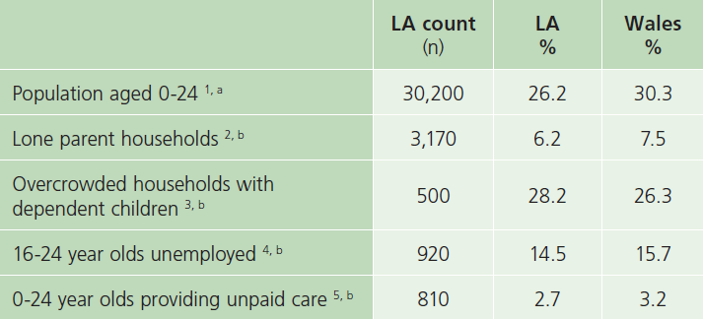
Key data from the 2011 Census
Produced by Public Health Wales Observatory, using 2011 Census (ONS)

Slide 6
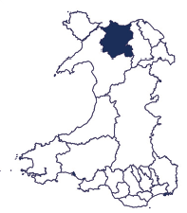
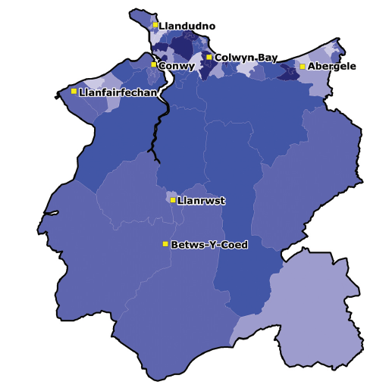
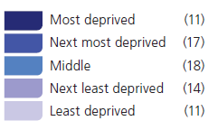
Child deprivation
Lower super output areas, equal count, national fifths of deprivation
Produced by Public Health Wales Observatory, using 2011 Welsh Index of Multiple Deprivation Child Index (WG)
© Crown Copyright and database right 2013. Ordnance Survey 100044810

Slide 7
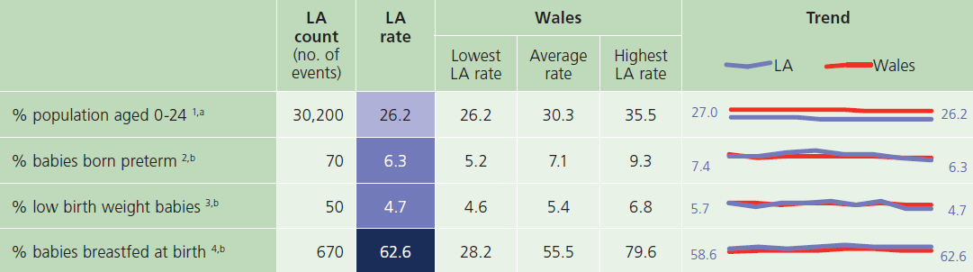
Population and births

Slide 8
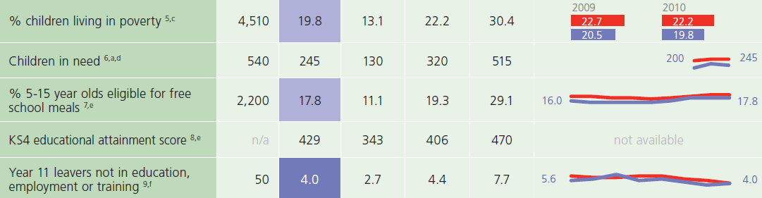
Wider determinants

Slide 9
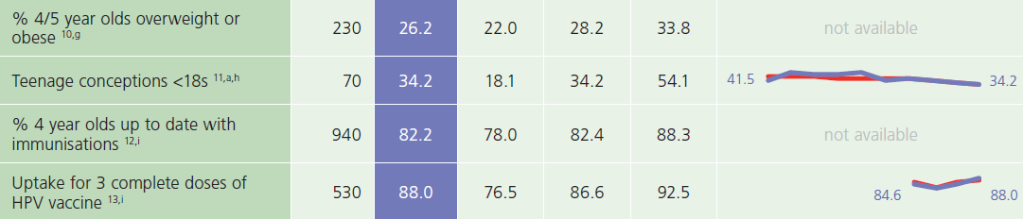
Behaviour and immunisations

Slide 10
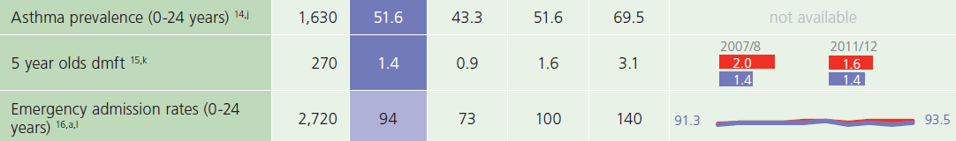
Health and use of services

Slide 11
Deaths

