Slide 1


Cardiovascular disease indicators: charts by health board and local authority
August 2013

Slide 2
Copyright
© 2013 Public Health Wales Observatory
Material contained in this document may be reproduced without prior permission provided it is done so accurately and is not used in a misleading context.
Acknowledgement to Public Health Wales Observatory to be stated.
Copyright in the typographical arrangement, design and layout belongs to Public Health Wales Observatory.

Slide 3
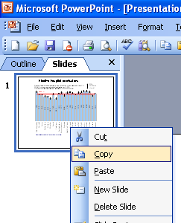
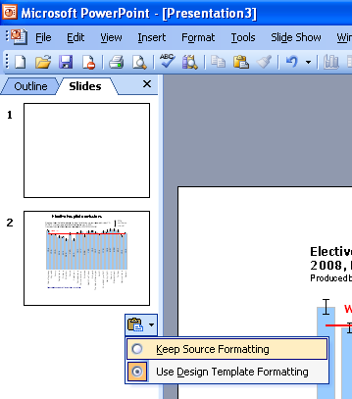
Instructions to copy a slide
To copy a slide for use in a presentation:
1. Right-click on the slide you wish to copy from the list on the left-hand side (the ‘slides’ tab) when in normal view and select ‘Copy’ from the list.
Go to your presentation and right-click where you want the copied slide to appear in the ‘slides’ tab and select ‘paste’ from the list.
On being pasted into your presentation a small clipboard icon with a black arrow will appear near the bottom right-hand corner of the newly pasted slide. Click on the arrow to show the drop-down menu and select “Keep Source Formatting” from the list. The slide will then appear as seen in the original presentation.

Slide 4
Using these slides
These slides are a resource to demonstrate examples of findings from ‘CVD Webpage's’ published by the Public Health Wales Observatory.
The presentation can be used as a whole or as individual slides.
Please acknowledge the work of the Public Health Wales Observatory when using these slides.

Slide 5
Adults who smoke, 2010-2011
Age-standardised percentage, persons, age 16+, Wales health boards
Produced by Public Health Wales Observatory, using Welsh Health Survey (WG)

Slide 6
Adults who smoke, 2010-2011
Age-standardised percentage, persons, age 16+, Wales local authorities
Produced by Public Health Wales Observatory, using Welsh Health Survey (WG)

Slide 7
Adults who reported being obese, 2010-2011
Age-standardised percentage, persons, Body Mass Index >=30, age 16+, Wales health boards
Produced by Public Health Wales Observatory, using Welsh Health Survey (WG)

Slide 8
Adults who reported being obese, 2010-2011
Age-standardised percentage, persons, Body Mass Index >=30, age 16+, Wales local authorities
Produced by Public Health Wales Observatory, using Welsh Health Survey (WG)

Slide 9
Patients with CHD on GP practice registers, 2012
Age-standardised percentage, persons, all ages, Wales health boards
Produced by Public Health Wales Observatory, using (QOF) Audit + (NWIS)

Slide 10
Patients with CHD on GP practice registers, 2012
Age-standardised percentage, persons, all ages, Wales local authorities
Produced by Public Health Wales Observatory, using (QOF) Audit + (NWIS)

Slide 11
Patients with hypertension on GP practice registers, 2012
Age-standardised percentage, persons, all ages, Wales health boards
Produced by Public Health Wales Observatory, using (QOF) Audit + (NWIS)

Slide 12
Patients with hypertension on GP practice registers, 2012
Age-standardised percentage, persons, all ages, Wales local authorities
Produced by Public Health Wales Observatory, using (QOF) Audit + (NWIS)

Slide 13
Patients with stroke on GP practice registers, 2012
Age-standardised percentage, persons, all ages, Wales health boards
Produced by Public Health Wales Observatory, using (QOF) Audit + (NWIS)

Slide 14
Patients with stroke on GP practice registers, 2012
Age-standardised percentage, persons, all ages, Wales local authorities
Produced by Public Health Wales Observatory, using (QOF) Audit + (NWIS)

Slide 15
Stroke emergency admissions, 2009/10-2011/12
European age-standardised rate per 100,000, persons, all ages, Wales health boards
Produced by Public Health Wales Observatory, using PEDW (NWIS) & MYE (ONS)

Slide 16
Stroke emergency admissions, 2009/10-2011/12
European age-standardised rate per 100,000, persons, all ages, Wales local authorities
Produced by Public Health Wales Observatory, using PEDW (NWIS) & MYE (ONS)

Slide 17
CHD emergency admissions, 2009/10-2011/12
European age-standardised rate per 100,000, persons, all ages, Wales health boards
Produced by Public Health Wales Observatory, using PEDW (NWIS) & MYE (ONS)

Slide 18
CHD emergency admissions, 2009/10-2011/12
European age-standardised rate per 100,000, persons, all ages, Wales local authorities
Produced by Public Health Wales Observatory, using PEDW (NWIS) & MYE (ONS)

Slide 19
Revascularisation rates, 2009/10-2011/12
European age-standardised rate per 100,000, persons, all ages, Wales health boards
Produced by Public Health Wales Observatory, using PEDW (NWIS) & MYE (ONS)

Slide 20
Revascularisation rates, 2009/10-2011/12
European age-standardised rate per 100,000, persons, all ages, Wales local authorities
Produced by Public Health Wales Observatory, using PEDW (NWIS) & MYE (ONS)

Slide 21
Angiography rates, 2009/10-2011/12
European age-standardised rate per 100,000, persons, all ages, Wales health boards
Produced by Public Health Wales Observatory, using PEDW (NWIS) & MYE (ONS)

Slide 22
Angiography rates, 2009/10-2011/12
European age-standardised rate per 100,000, persons, all ages, Wales local authorities
Produced by Public Health Wales Observatory, using PEDW (NWIS) & MYE (ONS)

Slide 23
CVD mortality under 75, 2009-2011
European age-standardised rate per 100,000, (adjusted for coding change,
ICD-10 I00-I99), persons, Wales health boards
Produced by Public Health Wales Observatory, using ADDE & MYE (ONS)

Slide 24
CVD mortality under 75, 2009-2011
European age-standardised rate per 100,000, (adjusted for coding change, ICD-10 I00-I99), persons, Wales local authorities
Produced by Public Health Wales Observatory, using ADDE & MYE (ONS)

Slide 25
Stroke mortality, 2009-2011
European age-standardised rate per 100,000, adjusted for coding change, persons, all ages, Wales health boards
Produced by Public Health Wales Observatory, using ADDE & MYE (ONS)

Slide 26
Stroke mortality, 2009-2011
European age-standardised rate per 100,000, adjusted for coding change, persons, all ages, Wales local authorities
Produced by Public Health Wales Observatory, using ADDE & MYE (ONS)

Slide 27
Cardiovascular disease web resource
- data download for charts in this presentation
- web pages with information on CVD
- interactive data file with CVD indicators
- PowerPoint file for CVD indicator charts
- technical guide for CVD indicators www.publichealthwalesobservatory.wales.nhs.uk/cardiovascular
Public Health Wales Observatory
Web: www.publichealthwalesobservatory.wales.nhs.uk
Email: publichealthwalesobservatory@wales.nhs.uk
Further information

