Slide 1


Cardiovascular disease: charts shown on the web pages
August 2013

Slide 2
Copyright
© 2013 Public Health Wales Observatory
Material contained in this document may be reproduced without prior permission provided it is done so accurately and is not used in a misleading context.
Acknowledgement to Public Health Wales Observatory to be stated.
Typographical copyright lies with Public Health Wales NHS Trust.

Slide 3

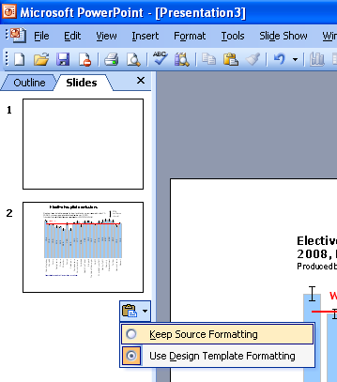
Instructions to copy a slide
To copy a slide for use in a presentation:
1. Right-click on the slide you wish to copy from the list on the left-hand side (the ‘slides’ tab) when in normal view and select ‘Copy’ from the list.
Go to your presentation and right-click where you want the copied slide to appear in the ‘slides’ tab and select ‘paste’ from the list.
On being pasted into your presentation a small clipboard icon with a black arrow will appear near the bottom right-hand corner of the newly pasted slide. Click on the arrow to show the drop-down menu and select “Keep Source Formatting” from the list. The slide will then appear as seen in the original presentation.

Slide 4
Using these slides
These slides contain the charts shown on the cardiovascular disease (CVD) web pages produced by the Public Health Wales Observatory.
The presentation can be used as a whole or as individual slides.
Please acknowledge the work of the Public Health Wales Observatory when using these slides.

Slide 5
Reported risk factors for CVD, 2011
Age-standardised percentage, persons, age 16+, Wales
Produced by Public Health Wales Observatory, using Welsh Health Survey (WG)

Slide 6
Number of deaths from CVD by cause, 2005-2011
Persons, all ages, Wales , ICD-10 I00-I99
Produced by Public Health Wales Observatory, using ADDE (ONS)

Slide 7
Patients with CHD on GP practice registers, 2012
Percentage, persons, all ages, Wales
Produced by Public Health Wales Observatory, using (QOF) Audit + (NWIS)

Slide 8
Mortality from CVD under 75, 2008-10
European age-standardised rate per 100,000, by deprivation fifth, persons, Wales, ICD-10 I00-I99
Produced by Public Health Wales Observatory, using ADDE/MYE (ONS), WIMD (WG)

Slide 9
Emergency admissions for CVD by primary condition, 2011/12
Persons, all ages,
Wales ,
ICD-10 I00-I99
Produced by Public Health Wales Observatory, using PEDW (NWIS)

Slide 10
Mortality from CVD under 75, 1996-2010
European age-standardised rate per 100,000, persons, ICD-10 I00-I99, Wales and selected European countries
Produced by Public Health Wales Observatory, using data from DMDB (WHO), Public Health England and NHS Wales Informatics Service

Slide 11
Mortality from
CVD aged under 75, 2009
European age-standardised
rate per 100,000, persons, ICD-10 I00-I99, Wales and selected European countries
Produced by Public Health Wales Observatory, using data from DMDB (WHO), Public Health England and NHS Wales Informatics Service

Slide 12
Cardiovascular disease web resource
- data download for charts in this presentation
- web pages with information on CVD
- interactive data file with CVD indicators
- PowerPoint file for CVD indicator charts
- technical guide for CVD indicators www.publichealthwalesobservatory.wales.nhs.uk/cardiovascular
Public Health Wales Observatory
Web: www.publichealthwalesobservatory.wales.nhs.uk
Email: publichealthwalesobservatory@wales.nhs.uk
Further information

