Slide 1

The Burden of Injury in Wales
November 2012

Slide 2
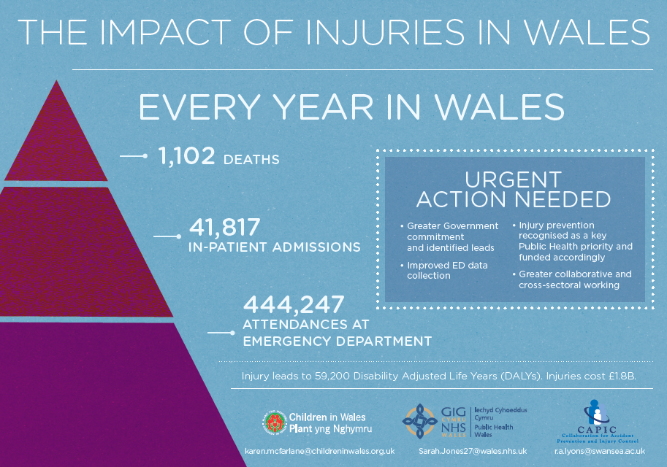

Slide 3
Copyright
© 2012 Public Health Wales NHS Trust and Swansea University.
Material contained in this document may be reproduced without prior permission provided it is done so accurately and is not used in a misleading context.
Acknowledgement to Public Health Wales NHS Trust and Swansea University to be stated.
Copyright in the typographical arrangement, design and layout belongs to Public Health Wales NHS Trust and Swansea University.

Slide 4
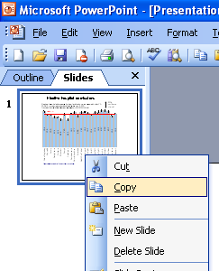
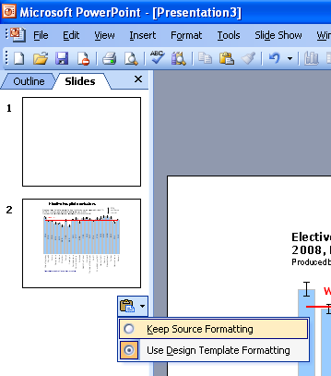
Instructions to copy a slide
To copy a slide for use in a presentation:
1. Right-click on the slide you wish to copy from the list on the left-hand side (the ‘slides’ tab) when in normal view and select ‘Copy’ from the list.
Go to your presentation and right-click where you want the copied slide to appear in the ‘slides’ tab and select ‘paste’ from the list.
On being pasted into your presentation a small clipboard icon with a black arrow will appear near the bottom right-hand corner of the newly pasted slide. Click on the arrow to show the drop-down menu and select “Keep Source Formatting” from the list. The slide will then appear as seen in the original presentation.

Slide 5
2. Background

Slide 7
Burden of disease, illness, ill-health and injuries globally, in high income countries, in Europe and for the UK in terms of mortality rates and premature years of life lost.
Produced by Public Health Wales and Swansea University, using data from WHO (2011)

Slide 10
3. Methods

Slide 11
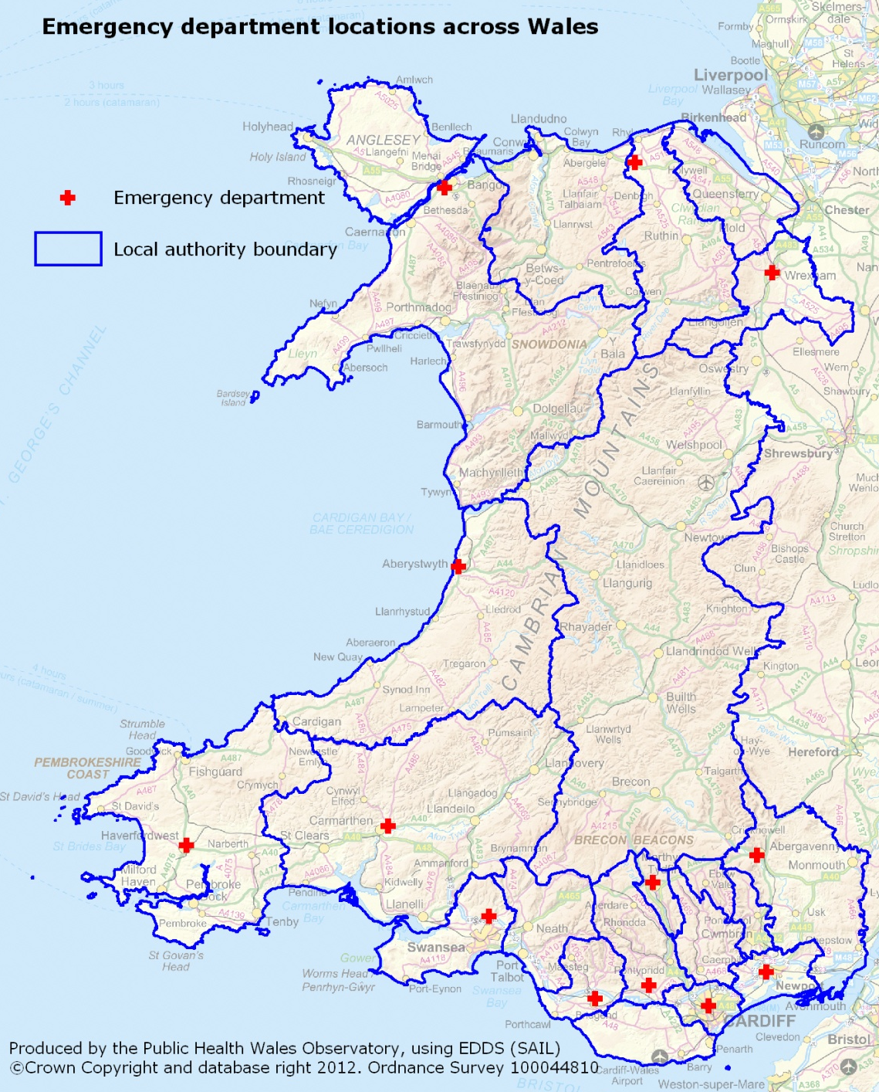

Slide 12
4. All injuries

Slide 13
Summary estimate of epidemiology of deaths and health care use related to injuries in Wales in 2009
Produced by Public Health Wales and Swansea University, using EDDS & PEDW (NWIS), ADDE (ONS)
1,102
Deaths
41,817
In-patient admissions
444,247
Attendances at Emergency Department

Slide 15
Injury deaths and death rates 1990-1998.
Source: CAPIC, 2002

Slide 17
Relative contributions of YLDs and YLLs to overall burden of disease (DALY) in Wales, 2009
Produced by Public Health Wales and Swansea University, using PEDW (NWIS), ADDE (ONS)

Slide 18
5. Injuries by age and sex

Slide 19
Summary estimate of epidemiological burden of injuries to males and females in Wales in 2009
Produced by Public Health Wales and Swansea University, using EDDS & PEDW (NWIS), ADDE (ONS)
Males
Females
700
Deaths
21,890
In-patient admissions
237,453
Attendances at Emergency Department
402
Deaths
19,927
In-patient admissions
206,794
Attendances at Emergency Department

Slide 26
Burden of injuries in Wales, by sex, 2009

Slide 29
6. Injuries and socio economic status

Slide 48
7. Summary of injuries by type

Slide 53
8. Motor vehicle traffic crash injuries

Slide 54
Summary estimate of epidemiology of road traffic crashes in Wales in 2009
Produced by Public Health Wales and Swansea University, using EDDS & PEDW (NWIS), ADDE (ONS)
126
Deaths
1,666
In-patient admissions
12,933
Attendances at Emergency Department

Slide 59
Local authority areas with the highest and lowest MVTC in-patient admission rates per 100,000, 2009
Produced by Public Health Wales and Swansea University, using PEDW (NWIS) and MYE (ONS)

Slide 60
Relative burden of MVTC injuries in Wales, by sex and age, 2009
Produced by Public Health Wales and Swansea University, using PEDW (NWIS), ADDE (ONS)

Slide 61
9. Fall injuries

Slide 62
Summary estimate of epidemiology of falls in Wales in 2009
Produced by Public Health Wales and Swansea University, using EDDS & PEDW (NWIS), ADDE (ONS)
252
Deaths
20,058
In-patient admissions
44,257
Attendances at Emergency Department

Slide 67
Local authority areas with the highest and lowest fall related in-patient admission rates per 100,000 population, 2009
Produced by Public Health Wales and Swansea University, using PEDW (NWIS) and MYE (ONS)

Slide 68
Relative burden of fall injuries in Wales, by sex and age, 2009
Produced by Public Health Wales and Swansea University, using PEDW (NWIS), ADDE (ONS)

Slide 69
10. Drowning

Slide 71
11. Burns

Slide 72
Summary estimate of epidemiology of burns in Wales in 2009
Produced by Public Health Wales and Swansea University, using EDDS & PEDW (NWIS), ADDE (ONS)
29
Deaths
405
In-patient admissions
909
Attendances at Emergency Department

Slide 76
Relative burden of burn injuries in Wales, by sex and age, 2009
Produced by Public Health Wales and Swansea University, using PEDW (NWIS), ADDE (ONS)

Slide 77
12. Poisonings

Slide 78
Summary estimate of epidemiology of poisonings in Wales in 2009
Produced by Public Health Wales and Swansea University, using EDDS & PEDW (NWIS), ADDE (ONS)
157
Deaths
7415 In-patient Admissions
901
Attendances at Emergency Department

Slide 83
Local authority areas with the highest and lowest poisoning related in-patient admission rates per 100,000, 2009
Produced by Public Health Wales and Swansea University, using PEDW (NWIS) and MYE (ONS)

Slide 84
Relative burden of poisoning in Wales, by sex and age, 2009
Produced by Public Health Wales and Swansea University, using PEDW (NWIS) & ADDE (ONS)

Slide 85
13. Intent

Slide 89
Burden of self harm injuries, 2009
Produced by Public Health Wales and Swansea University, using PEDW (NWIS), ADDE (ONS)
Self harm

Slide 90
Burden of assault injuries, 2009
Produced by Public Health Wales and Swansea University, using PEDW (NWIS), ADDE (ONS)
Assault

Slide 91
14. Injuries by health board

Slide 105
16. Injuries by local authority

Slide 113
17. Appendices

