Slide 1

Our Healthy Future Indicators – summary of charts
October 2015

Slide 2
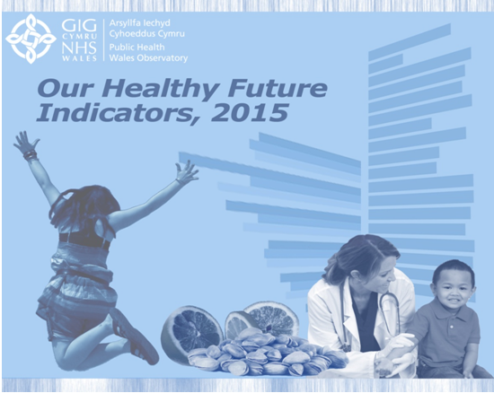
Introduction
These slides are one of the products from the Public Health Wales Observatory's Our Healthy Future Indicators (2015) publication http://www.wales.nhs.uk/sitesplus/922/page/83567
The indicators have been produced to support the Welsh Government’s strategic framework: http://gov.wales/topics/health/cmo/healthy/?lang=en
This is an interim update pending the development of indicators for the Public Health Outcomes Framework.

Slide 3
Copyright
© 2015 Public Health Wales Observatory
Material contained in this document may be reproduced without prior permission provided it is done so accurately and is not used in a misleading context.
Acknowledgement to Public Health Wales Observatory to be stated.
Copyright in the typographical arrangement, design and layout belongs to Public Health Wales Observatory.

Slide 4
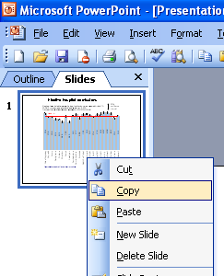
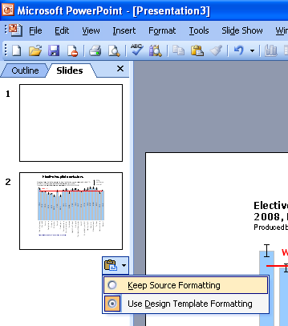
Instructions to copy a slide
To copy a slide for use in a presentation:
1. Right-click on the slide you wish to copy from the list on the left-hand side (the ‘slides’ tab) when in normal view and select ‘Copy’ from the list.
Go to your presentation and right-click where you want the copied slide to appear in the ‘slides’ tab and select ‘paste’ from the list.
On being pasted into your presentation a small clipboard icon with a black arrow will appear near the bottom right-hand corner of the newly pasted slide. Click on the arrow to show the drop-down menu and select “Keep Source Formatting” from the list. The slide will then appear as seen in the original presentation.

Slide 5
Using these slides
This presentation can be used as a whole or as individual slides.
It is recommended that the interactive data file is used for copying images of charts to use in other documents. The interactive data file and additional information about the indicators can be accessed: http://www.wales.nhs.uk/sitesplus/922/page/83567
Please acknowledge the work of the Public Health Wales Observatory when using these slides.

Slide 6
Inequality gap in life expectancy (SII in years), 2009-2013
All ages, Wales health boards
Males
Females
Produced by Public Health Wales Observatory, using PHM & MYE (ONS), WIMD 2014 (WG)

Slide 7
Inequality gap in life expectancy (SII in years), 2009-2013
All ages, Wales local authorities
Males
Females
Produced by Public Health Wales Observatory, using PHM & MYE (ONS), WIMD 2014 (WG)

Slide 8
% of adults free from a common mental disorder*,
2013-2014
Age-standardised percentage, persons aged 16+, Wales health boards
95% confidence interval
80
76
74
75
70
71
*as measured by a Mental Health Inventory 5 score >60
Produced by Public Health Wales Observatory, using Welsh Health Survey (WG)

Slide 9
% of adults free from a common mental disorder*,
2013-2014
Age-standardised percentage, persons aged 16+, Wales local authorities
95% confidence interval
*as measured by a Mental Health Inventory 5 score >60
Produced by Public Health Wales Observatory, using Welsh Health Survey (WG)

Slide 10
% of adults who reported being a current smoker,
2013-2014
Age-standardised percentage, persons aged 16+, Wales Health Boards
95% confidence interval
Produced by Public Health Wales Observatory, using Welsh Health Survey (WG)

Slide 11
% of adults who reported being a current smoker,
2013-2014
Age-standardised percentage, persons aged 16+, Wales local authorities
95% confidence interval
Produced by Public Health Wales Observatory, using Welsh Health Survey (WG)

Slide 12
Average days with 30 minutes moderate or vigorous physical activity (capped), reported by adults, 2013-2014
Age-standardised percentage, persons aged 16+, Wales health boards
95% confidence interval
Produced by Public Health Wales Observatory, using Welsh Health Survey (WG)

Slide 13
Average days with 30 minutes moderate or vigorous physical activity (capped), reported by adults, 2013-2014
Age-standardised percentage, persons aged 16+, Wales local authorities
95% confidence interval
Produced by Public Health Wales Observatory, using Welsh Health Survey (WG)

Slide 14
% of adults eating five portions of fruit and vegetables the previous day, 2013-2014
Age-standardised, persons aged 16+, Wales health boards
95% confidence interval
Produced by Public Health Wales Observatory, using Welsh Health Survey (WG)

Slide 15
% of adults eating five portions of fruit and vegetables the previous day, 2013-2014
Age-standardised, persons aged 16+, Wales local authorities
95% confidence interval
95% confidence interval
95% confidence interval
Produced by Public Health Wales Observatory, using Welsh Health Survey (WG)

Slide 16
% of adults obese or overweight (BMI*>=25), 2013-2014
Age-standardised, persons aged 16+, Wales health boards
95% confidence interval
* BMI = Body Mass Index
Produced by Public Health Wales Observatory, using Welsh Health Survey (WG)

Slide 17
% of adults obese or overweight (BMI*>=25), 2013-2014
Age-standardised, persons aged 16+, Wales local authorities
95% confidence interval
* BMI = Body Mass Index
Produced by Public Health Wales Observatory, using Welsh Health Survey (WG)

Slide 18
Alcohol-specific hospital admissions (person-based), 2013
European age-standardised rate per 100,000, persons, all ages, Wales health boards
95% confidence interval
Produced by Public Health Wales Observatory, using PEDW (NWIS) & MYE (ONS)

Slide 19
Alcohol-specific hospital admissions (person-based), 2013
European age-standardised rate per 100,000, all ages, Wales health boards
Males
Females
95% confidence interval
95% confidence interval
Produced by Public Health Wales Observatory, using PEDW (NWIS) & MYE (ONS)

Slide 20
Alcohol-specific hospital admissions (person-based), 2013
European age-standardised rate per 100,000, persons all ages, Wales local authorities
95% confidence interval
Produced by Public Health Wales Observatory, using PEDW (NWIS) & MYE (ONS)

Slide 21
Alcohol-specific hospital admissions (person-based), 2013
European age-standardised rate per 100,000, all ages by sex, Wales local authorities
Males
Females
95% confidence interval
95% confidence interval
Produced by Public Health Wales Observatory, using PEDW (NWIS) & MYE (ONS)

Slide 22
Rate of conceptions among females under 18, 2013
Per 1,000 females aged 15-17, Wales health boards
95% confidence interval
Produced by Public Health Wales Observatory, using Conceptions data & MYE (ONS)

Slide 23
Rate of conceptions among females under 18, 2013
Per 1,000 females aged 15-17, Wales local authorities
95% confidence interval
Produced by Public Health Wales Observatory, using Conceptions data & MYE (ONS)

Slide 24
Admissions for hip fractures, 2013
European age-standardised rate per 100,000, persons aged 65+, Wales health boards
95% confidence interval
Produced by Public Health Wales Observatory, using PEDW (NWIS) & MYE (ONS)

Slide 25
Admissions for hip fractures, 2013
European age-standardised rate per 100,000, aged 65+, by sex, Wales health boards
Males
Females
95% confidence interval
95% confidence interval
Produced by Public Health Wales Observatory, using PEDW (NWIS) & MYE (ONS)

Slide 26
Admissions for hip fractures, 2013
European age-standardised rate per 100,000, persons aged 65+, Wales local authorities
95% confidence interval
Produced by Public Health Wales Observatory, using PEDW (NWIS) & MYE (ONS)

Slide 27
Admissions for hip fractures aged 65+, 2013
European age-standardised rate per 100,000, persons by sex, Wales local authorities
Males
Females
95% confidence interval
95% confidence interval
Produced by Public Health Wales Observatory, using PEDW (NWIS) & MYE (ONS)

Slide 28
Uptake of scheduled childhood vaccinations, 2013/2014 (FY)
Percentage, children at age 4, Wales health boards
95% confidence interval
Produced by Public Health Wales Observatory, using NCCHD

Slide 29
Uptake of scheduled childhood vaccinations, 2013/2014 (FY)
Percentage, children at age 4, Wales local authorities
95% confidence interval
Produced by Public Health Wales Observatory, using NCCHD

Slide 30
Gap in the employment rate, 2013-2014 (FY)
Percentage difference, persons aged 16 – 64, Wales health boards
95% confidence interval
Produced by Public Health Wales, using APS data supplied by the Welsh Government

Slide 31
Gap in the employment rate, 2013-2014 (FY)
Percentage difference, persons aged 16 – 64, Wales local authorities
95% confidence interval
Produced by Public Health Wales, using APS data supplied by the Welsh Government

Slide 32
Further information
Our Healthy Future Indicators (2015)
http://www.wales.nhs.uk/sitesplus/922/page/83567
Background information
Interactive data file of the charts with supporting data tables
PowerPoint file of the charts
Technical guide
Public Health Wales Observatory
Web: www.publichealthwalesobservatory.wales.nhs.uk
Email: publichealthwalesobservatory@wales.nhs.uk

