Slide 1

Our Healthy Future Indicators – summary of charts
March 2013

Slide 2
Copyright
© 2013 Public Health Wales Observatory
Material contained in this document may be reproduced without prior permission provided it is done so accurately and is not used in a misleading context.
Acknowledgement to Public Health Wales Observatory to be stated.
Copyright in the typographical arrangement, design and layout belongs to Public Health Wales Observatory.

Slide 3
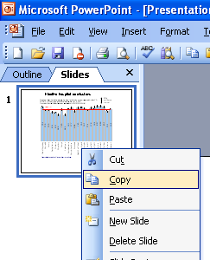
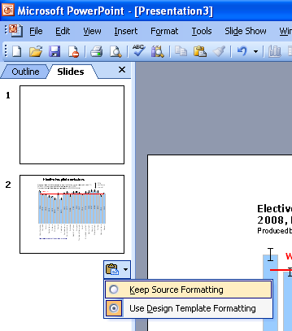
Instructions to copy a slide
To copy a slide for use in a presentation:
1. Right-click on the slide you wish to copy from the list on the left-hand side (the ‘slides’ tab) when in normal view and select ‘Copy’ from the list.
Go to your presentation and right-click where you want the copied slide to appear in the ‘slides’ tab and select ‘paste’ from the list.
On being pasted into your presentation a small clipboard icon with a black arrow will appear near the bottom right-hand corner of the newly pasted slide. Click on the arrow to show the drop-down menu and select “Keep Source Formatting” from the list. The slide will then appear as seen in the original presentation.

Slide 4
Inequality gap in life expectancy (SII in years), 2005-2009 All ages, Wales health boards
Males
Females
Produced by Public Health Wales Observatory, using ADDE & MYE (ONS), WIMD 2008 (WG)

Slide 5
Inequality gap in life expectancy (SII in years), 2005-2009 All ages, Wales local authorities
Males
Females
Produced by Public Health Wales Observatory, using ADDE & MYE (ONS), WIMD 2008 (WG)

Slide 6
% free from a common mental disorder*, 2009-2010
Age-standardised percentage, persons aged 16+, Wales health boards
*as measured by a Mental Health Inventory 5 score >60
Produced by Public Health Wales Observatory, using Welsh Health Survey (WG)

Slide 7
% free from a common mental disorder*, 2009-2010 Age-standardised percentage, persons aged 16+, Wales local authorities
*as measured by a Mental Health
Inventory 5 score >60
Produced by Public Health Wales Observatory, using Welsh Health Survey (WG)

Slide 8
% currently smoking, 2009-2010 Age-standardised percentage, persons aged 16+, Wales Health Boards
Produced by Public Health Wales Observatory, using Welsh Health Survey (WG)

Slide 9
% currently smoking, 2009-2010 Age-standardised percentage, aged 16+, Wales local authorities
Produced by Public Health Wales Observatory, using Welsh Health Survey (WG)

Slide 10
Average days with 30 minutes moderate or vigorous physical activity (capped), 2009-2010 Age-standardised percentage, aged 16+, Wales health boards
Produced by Public Health Wales Observatory, using Welsh Health Survey (WG)

Slide 11
Average days with 30 minutes moderate or vigorous physical activity (capped), 2009-2010
Age-standardised percentage, aged 16+, Wales local authorities
Produced by Public Health Wales Observatory, using Welsh Health Survey (WG)

Slide 12
% eating five portions of fruit and vegetables the previous day, 2009-2010 Age-standardised, persons aged 16+, Wales health boards
Produced by Public Health Wales Observatory, using Welsh Health Survey (WG)

Slide 13
% eating five portions of fruit and vegetables the previous day, 2009-2010
Age-standardised, persons aged 16+, Wales local authorities
Produced by Public Health Wales Observatory, using Welsh Health Survey (WG)

Slide 14
% obese or overweight (BMI*>=25), 2009-2010 Age-standardised, persons aged 16+, Wales health boards
Produced by Public Health Wales Observatory, using Welsh Health Survey (WG)
*BMI = Body Mass Index

Slide 15
% obese or overweight (BMI*>=25), 2009-2010
Age-standardised, persons aged 16+, Wales local authorities
Produced by Public Health Wales Observatory, using Welsh Health Survey (WG)
*BMI = Body Mass Index

Slide 16
Alcohol-specific hospital admissions*, 2010 European age-standardised rate per 100,000, persons, persons all ages, Wales health boards
Produced by Public Health Wales Observatory, using PEDW (NWIS) & MYE (ONS)
*Persons-based analysis

Slide 17
Alcohol-specific hospital admissions*, 2010 European age-standardised rate per 100,000, all ages by sex, Wales health boards
Males
Females
Produced by Public Health Wales Observatory, using PEDW (NWIS) & MYE (ONS)
*Persons-based analysis

Slide 18
Alcohol-specific hospital admissions*, 2010 European age-standardised rate per 100,000, persons all ages, Wales local authorities
Produced by Public Health Wales Observatory, using PEDW (NWIS) & MYE (ONS)
*Persons-based analysis

Slide 19
Alcohol-specific hospital admissions*, 2010 European age-standardised rate per 100,000, all ages by sex, Wales local authorities
Males
Females
Produced by Public Health Wales Observatory, using PEDW (NWIS) & MYE (ONS)
*Persons-based analysis

Slide 20
Rate of conceptions among females under 18, 2010 Per 1,000 females aged 15-17, Wales health boards
Produced by Public Health Wales Observatory, using Conceptions data & MYE (ONS)

Slide 21
Rate of conceptions among females under 18, 2010 Per 1,000 females aged 15-17, Wales local authorities
Produced by Public Health Wales Observatory, using Conceptions data & MYE (ONS)

Slide 22
Admissions for hip fractures, 2010 European age-standardised rate per 100,000, persons aged 65+, Wales health boards
Produced by Public Health Wales Observatory, using PEDW (NWIS) & MYE (ONS)

Slide 23
Admissions for hip fractures aged 65+, 2010 European age-standardised rate per 100,000, persons by sex, Wales health boards
Males
Females
Produced by Public Health Wales Observatory, using PEDW (NWIS) & MYE (ONS)

Slide 24
Admissions for hip fractures aged 65+, 2010 European age-standardised rate per 100,000, persons, Wales local authorities
Produced by Public Health Wales Observatory, using PEDW (NWIS) & MYE (ONS)

Slide 25
Admissions for hip fractures aged 65+, 2010 European age-standardised rate per 100,000, persons by sex, Wales local authorities
Males
Females
Produced by Public Health Wales Observatory, using PEDW (NWIS) & MYE (ONS)

Slide 26
Uptake of scheduled childhood vaccinations, 2011/2012 (FY) Percentage, children at age 4, Wales health boards
Produced by Public Health Wales Observatory, using NCCHD

Slide 27
Uptake of scheduled childhood vaccinations, 2011/2012 (FY) Percentage, children at age 4, Wales local authorities
Produced by Public Health Wales Observatory, using NCCHD

