Slide 1

Child Sexual Exploitation
Level 3 Training for Health Professionals
NHS Wales
CSE Strategic Planning Intervention Group
Notes:
Introduction
Introduction and introduce CSE as the area for discussion.
We will hear the terms used more are more as CSE is gathering some impetus and is a safeguarding priority.
This is a level 3 training using a training package accredited by the NHS in Wales. The training has been designed and developed in partnership with the Human Leadership Group and explores the interface between CSE and Human Trafficking.

Slide 2
OBJECTIVES
By the end of the course delegates will :
Have an understanding of Child Sexual Exploitation and recognise when a young person is at increased risk
Be able to explain their role and responsibility in line with the All Wales Guidance on Safeguarding Children & Young People at risk of abuse through Sexual Exploitation
Be able to assess, refer and support a child or young person at risk
Notes:
Link to ICD competences
Level 1 Core competences: Recognising CSA and including child trafficking and Female Genital Mutilation (FGM), understanding the risks associated with the internet and online social networking, Taking appropriate action if they have concerns
Level 2 Core competences: Able to identify and refer a child suspected of being a victim of trafficking or sexual
exploitation; at risk of FGM or having been a victim of FGM; at risk of exploitation by Radicalisers.
Learning outcome L2: To be able to identify and refer a child suspected of being a victim of trafficking and/or sexual
exploitation
Level 3 core competences: Draws on child and family-focused clinical and professional knowledge and expertise of what constitutes child maltreatment, to identify signs of sexual, physical, or emotional abuse or neglect. Will have professionally relevant core and case specific clinical competencies
Level 3 Clinical knowledge: Have an understanding of emerging evidence on child sexual exploitation and FGM,(GP)
Skills: Able to communicate effectively with children and young people, ensuring that they have the
opportunity to participate in decisions affecting them as appropriate to their age and ability
Need to understand that CSE is a form of abuse and know how to recognise it and how to respond effectively.
Need to understand what makes a child more vulnerable to the abuse whilst acknowledging that any child can become a victim.
Not just an overseas problem, this is a common misconception. It’s happening here in Wales.
Children are trafficked for the purpose of sexual exploitation.
Children are often unaware that they are in an exploitative situation
CSE is under recognised and under reported

Slide 3
WHAT IS CHILD SEXUAL EXPLOITATION?
Child sexual exploitation is a major child protection issue for communities across the UK
Is an illegal activity by people who have power over young people and use it to sexually abuse them
Can involve a broad range of exploitative activity, from seemingly ‘consensual’ relationships and informal exchanges of sex for attention, accommodation, gifts or cigarettes, through to very serious organised crime
Notes:
The UN Convention on the rights of the child clearly states that a child is anyone under the age of 18, it stipulates that the state will protect children from CSE.
CSE involves exploitative situations, contexts and relationships where young people (or a third person or persons) receive ‘something’ in return for performing and or others performing on them sexual activities
e.g food, somewhere to sleep, drugs, alcohol, cigarettes, affection, money.
Can occur through ICT without the child’s immediate recognition or consent, for example posting sexual images on the internet/mobile phones. Need to consider the dangers of the virtual world.
In all cases those exploiting children have power over them by virtue of their age, gender, intellect, physical strength and or economic resources.
Swansea University completed a piece of research and concluded that on average it takes 5 minutes for a child to agree to meet a complete stranger via online gaming, social networking.

Slide 4
CHILD SEXUAL EXPLOITATION IS….
Child sexual exploitation is the coercion or manipulation of children and young people into taking part in sexual activities. It is a form of sexual abuse involving an exchange of some form of payment which can include money, mobile phones and other items, drugs, alcohol, a place to stay, ‘protection’ or affection. The vulnerability of the young person and grooming process employed by perpetrators renders them powerless to recognise the exploitative nature of relationships and unable to give informed consent.
AWCPP 2008
Notes:
Child exploitation often referred to as CSE.
The manipulation or ‘grooming’ process involves befriending children, gaining their trust, and often feeding them drugs and alcohol, sometimes over a long period of time, before the abuse begins. The abusive relationship between victim and perpetrator involves an imbalance of power which limits the victim’s options. It is a form of abuse which is often misunderstood by victims and outsiders as consensual. Although it is true that the victim can be tricked into believing they are in a loving relationship, no child under the age of 18 can ever consent to being abused or exploited. (Barnardo’s, 2012).
Child sexual exploitation can manifest itself in different ways. It can involve an older perpetrator exercising financial, emotional or physical control over a young person. It can involve peers manipulating or forcing victims into sexual activity, sometimes within gangs and in gang-affected neighbourhoods, but not always. Exploitation can also involve opportunistic or organised networks of perpetrators who may profit financially from trafficking young victims between different locations to engage in sexual activity with multiple men (Barnardo’s, 2011).
This abuse often involves violent and degrading sexual assaults and rape. The Children’s Commissioner’s report on sexual exploitation by gangs and groups found that oral and anal rape were the most frequently reported types of abuse. Experts agree that these types of abuse are particularly humiliating and controlling, and, as such, may be preferred by those who exploit vulnerable young people (Berelowitz et al, 2012). Exploitation can also occur without physical contact when children are persuaded or forced to post indecent images of themselves online, participate in non-contact sexual activities via a webcam or smart phone, or engage in sexual conversations on a mobile phone (DfE, 2011).
Technology is widely used by perpetrators as a method of grooming and coercing victims, often through social networking sites and mobile devices (Jago et al, 2011). This form of abuse usually occurs in private, or in semi-public places such as parks, cinemas, cafes and hotels. It is increasingly occurring at ‘parties’ organised by perpetrators for the purposes of giving victims drugs and alcohol before sexually abusing them (Barnardo’s, 2012).

Slide 5
Kayleigh’s Love Story
https://leics.police.uk/categories/kayleighs-love-story-film
Notes:
Available on YouTube
5.30 minutes
Dramatic but true story of texting to murder in 15 days
High impact
Made by Leicestershire police & the Merthyr & RCT Young people’s human trafficking group.

Slide 6
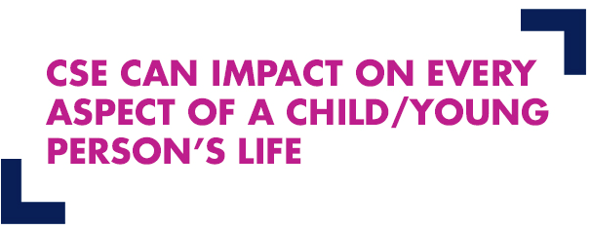
Impact of CSE
Psychological impact of child sexual exploitation
Anxiety, depression, addiction, low self-esteem, self-harm, eating disorders, PTSD, self-image, depression, nightmares, flashbacks, attachment problems.
Physiological impact of child sexual exploitation
Physical injuries, pregnancy, sexually transmitted infections, weight loss, sickness, self-harm, general ill health, sexually transmitted infections, problems with fertility, hair loss, poor diet, addictions.
Social impact of child sexual exploitation
Isolation from friends and family, education, hobbies and interests, risky/dangerous situations and people, difficulty developing and maintaining relationships, avoiding certain places and people, moving areas, social isolation.
Economic impact of child sexual exploitation
Drug/Alcohol ‘debt’, financial difficulty, stealing, unable to work, housing problems, trouble supporting children, benefit claims, difficulty accessing mainstream education.
http://safeandsoundgroup.org.uk/wp-content/uploads/2015/02/Quote1.jpg
Notes:
For discussion?
Very important when assessing a child’s needs that we consider the impact of the CSE and relate that to the three dimensions considered within the Assessment Framework
Child’s Developmental needs
Family & Environmental Factors
Parenting Capacity
We need to understand the impact of CSE so that any intervention / therapeutic support meets the needs of the child.

Slide 7
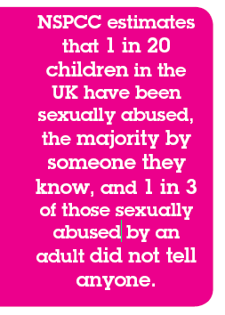
Prevalence
CSE is child sexual abuse
CSE is hidden, rarely recognised or identified
Barnardo’s report ‘Cutting Them Free’ (2012) estimated 9% of vulnerable children in Wales are at significant risk of CSE
Notes:
CSE needs to be seen in context of CSA
Component of CSA
Inquiry held by England commissioner
As a result now holding inquiry into familial CSA
Prevalence of CSA difficult to estimate
Prevalence in Wales
Currently 620,000 children living in Wales, 9 % at risk of CSE (Barnardos 2012)

Slide 8
Who can become victims?
CSE can and does happen to boys and girls of all backgrounds, races and sexuality
Adolescence is a difficult time and any vulnerable child can be groomed
Adults who groom use very subtle techniques to sexually exploit children
Children may not recognise they are being exploited and find it difficult to leave the abusive relationship
Notes:
Health professionals are often well placed to recognise that a child may be vulnerable to CSE and therefore need to respond accordingly.
Levels of risk can be identified from the range of risk indicators associated with a case. We will explore risk indicators in more detail.

Slide 9
ACTIVITY
What family or personal experiences might make a child or young person more at risk of being sexually exploited?
Notes:
Anyone can become a victim however research tells us that certain groups are at an increased vulnerability.
Work in groups and make a note of what you feel the vulnerabilities are.
Good idea to give an example e.g Looked After Child to steer them in the right direction.

Slide 10
VULNERABILITY FACTORS
Vulnerability
factors
Isolated from peers or/&
Social
networks
Family history
mental health
difficulties
Low self esteem
History
Physical and
Sexual abuse
History of
emotional
neglect
Family history
substance
misuse
Family history
domestic abuse
Breakdown family
relationships
Unsuitable /
Inappropriate
accommodation
Lack positive
relationship with
protective adult
Notes:
Give some case studies here
Zoe’s Story
Nathan’s Story
Hayley’s Story

Slide 11
Correlation between ACEs and CSE and Sexually Harmful Behaviour
 | Taith (SHB) | Seraf (CSE) | Child Protection Register
Exposure to domestic abuse | 62% | 43% | 21%
Reported sexual abuse | 40% | 29% | 7%
Reported physical abuse | 38% | 32% | 16%
Reported emotional neglect | 55% | 51% | 38%
Gwella project, Barnado’s Cymru and CASCADE, Cardiff University:
develop toolkit of evidence based interventions
Notes:
Data suggests a strong correlation between child abuse and exposure to DA and risk of CSE and SHB.
Project:
3 year project
Research and interrogation of data
Map current service and workforce capacity
Map evidence on interventions
Develop toolkit of evidence based interventions and practical solutions in responding to victims of childhood trauma and abuse

Slide 12
Digital Dangers 1
CSE online doesn’t always follow the models of sexual exploitation/vulnerabilities that we are familiar with.
Children at risk may be younger than those referred to services for offline sexual exploitation, and may not fit into standard definitions of ‘vulnerable’.
Internet and mobile devices create instant connectivity so it can become all the more difficult to identify who is at risk, how they are at risk and where they are at risk.
Certain groups, such as young people with learning difficulties, mental health problems and LGBTQ young people, appear to be particularly vulnerable to online harm.
Notes:
LGBTQ lesbian, gay, bi-sexual, transgender and questioning
Technology is widely used by perpetrators as a method of grooming and coercing victims, often through social networking sites and mobile devices (Jago et al, 2011). This form of abuse usually occurs in private, or in semi-public places such as parks, cinemas, cafes and hotels. It is increasingly occurring at ‘parties’ organised by perpetrators for the purposes of giving victims drugs and alcohol before sexually abusing them (Barnardo’s, 2012).

Slide 13
Digital Dangers 2
All the projects highlighted that some of the referrals they have been receiving in recent years do not typically display the usual indicators of child sexual exploitation (CSE).
Often, no indicators can be identified for these young people that would identify them as being at risk of sexual exploitation
A significant number come from secure, caring families but have been drawn into abusive and risky relationships through their online activities.
“Digital Dangers: the impact of technology on the sexual abuse and exploitation of children and young people”
Barnardo’s and Marie Collins Foundation. Authored by Tink Palmer 2015

Slide 14
Legislation and Guidance
Welsh Government Guidance
Safeguarding Children and Young People from Sexual Exploitation (2011)
Notes:
Welsh Government Guidance - Safeguarding Children and Young People from Sexual Exploitation Supplementary to Safeguarding Children: Working Together Under the Children Act 2004
(2011)
Ask delegates how aware they are of this guidance?
The purpose of the guidance is to support local agencies through exploring the principles of the 3 Ps:
PREVENTION - develop local prevention strategies
PROTECT - identify those at risk of being sexually exploited and put measures in place to protect them
PROSECUTE - take action to safeguard and promote the welfare of particular children and young people who are being, or may be, sexually exploited and take action against those intent on abusing and exploiting children and young people in this way - prosecute
Protecting children and young people from CSE is identified in the United Nations Convention on the Rights of the Child
The guidance identifies roles and responsibilities for health services in relation to prevention, recognition and referral to Children’s Services, information sharing, involvement in the child protection process and strategic and professional leadership within Health Boards.
Health organisations also have a key role in provision of effective interventions including support and counselling services for victims of CSE.
National Action Plan to Tackle Child Sexual Exploitation (Wales) 2015:
Prepare: getting the strategic leadership and tools in place
Prevent: ensure preventative services in place
Protect: quality assurance of the child protection process
Pursue: disruption and prosecution of perpetrators and support of victims with child centred approach.
Review of the statutory CSE guidance
Evaluation of the SERAF (Sexual Exploitation Risk Assessment Framework) assessment tool - Currently under review
Development of a national data set to capture the profile, prevalence and response to CSE in Wales.

Slide 15
Role of Health Professionals
Prevention:
  In promoting the young person’s health which includes identification of immediate and ongoing health needs,
  In offering support, counselling, and information to enable young people to understand the risks and develop strategies for staying safe
Recognition and Referral:
  Health professionals to identify and act on concerns
  Familiar with SERAF Risk Assessment Framework and actions in relation to each level of risk
Involvement in child protection process
Ongoing support and signposting to services
Child Sexual Exploitation Safeguarding Guidance 2011
Notes:
This slide summarises roles of.... According to the current guidance supported by legislation and working together
Will be updated
The Social Services and Well-being (Wales) Act 2014 places a duty on health professionals to inform local authorities if they have reasonable cause to suspect an adult or child is at risk.
Building a Brighter Future: Early Years and Childcare Plan 2013-2023 and The Healthy Child Wales programme sets out the policy framework and plan for supporting families to ensure their children attain their health and developmental potential and increase family resilience.
The Well-Being of Future Generations (Wales) Act 2015 has identified seven well-being goals which contribute to reducing the numbers of Adverse Childhood Experiences.

Slide 16
GREY AREA FOR 16/17 YEAR OLDS?
Sexual Offences Act 2003 provides that the age of consent for sexual activity is 16
Mental capacity Act applies to 16 years and older
However the fact that a young person is 16 or 17 years old and has reached the legal age of consent does not mean that they are no longer at risk of sexual exploitation.
A person is still a child if under 18 and they suffer significant harm as a result of sexual exploitation.
Their right to support and protection from harm should not be ignored or downgraded by services because they are over the age of 16, or are no longer in mainstream education
Notes:
Sexual Offences Act 2003 gives extra protection to young people who are 16/17 years old
Section 74 states that:"For the purposes of this Part, a person consents if he agrees by choice, and has the freedom and capacity to make that choice."^{[ Sexual offences act 2003}
Offences against children under the age of 18There are a number of sexual offences in the Act that apply to all children under the age of 18. These include sexual offences where there is abuse of a position of trust (ss 16 to 24) and familial child sex offences (ss 25 to 29).
The Act also provides for offences specifically to tackle the use of children in the sex industry, where a child is under 18 (ss 47 to 50). These offences are:
paying for sexual services of a child
causing or inciting child prostitution or pornography
controlling a child prostitute or a child involved in pornography
arranging or facilitating child prostitution or pornography

Slide 17
Child Sexual Exploitation Prevention Strategy for the NHS in Wales
2016-2019
Notes:
So how are we approaching the CSE issue in Wales.
The CSE Strategic Planning and Implementation Group have developed a prevention strategy that should underpin our work.

Slide 18
CSE Prevention Strategy Aims
To provide a framework for the strategic response by the NHS in Wales to identify and reduce rates of child sexual exploitation in Wales.
To ensure the NHS in Wales contributes to effective multiagency and partnership working to protect children and young people from this form of abuse at a national, regional and local level.
To ensure the framework aligns with the National Action Plan to tackle child sexual exploitation (Wales) 2015
Notes:
Explain that there is a National Action Plan and how the Prevention Strategy is aligned with this.

Slide 19
What can we do to prevent CSE?
Universal Primary Prevention –for example, adolescent friendly health services, encouraging healthy relationships
Selective Primary Prevention – focusing on groups at higher than average risk, for example, support services to teenage mothers
Secondary Prevention –responding quickly when low-level problems arise to prevent them from getting worse, for example working with looked after children, sharing information
Tertiary Help/Prevention –responding when the problem has become serious, for example, child protection process, criminal justice
Quaternary Help/Prevention – providing therapy to victims so that they do not suffer long-term harm, for example, therapy for victims of sexual exploitation or therapeutic help for looked after children.
Munro Review of Child Protection 2011
Notes:
Health are doing a lot but may not realise it
Used Prevention terms from Munro review which overlap with health definitions and provide framework for health work
Universal Primary Prevention – addressing the entire population and aiming to reduce the later incidence of problems, for example, adolescent friendly health services, Healthy Child Wales programme and encouraging healthy relationships.
7.2 Selective Primary Prevention – focusing on groups that research has indicated are at higher than average risk of developing problems, for example, Flying Start and offering support services to teenage mothers;
7.3 Secondary Prevention – aiming to respond quickly when low-level problems arise in order to prevent them from getting worse, for example working with looked after and missing children and information sharing between agencies;
7.4 Tertiary Help/Prevention – involving a response when the problem has become serious, for example, child protection process and criminal justice;
7.5 Quaternary Help/Prevention – providing therapy to victims so that they do not suffer long-term harm, for example, therapy for victims of sexual exploitation or therapeutic help for looked after children.

Slide 20
How does it all begin?
The grooming process
Notes:
Very sophisticated process which can take as little as 5 minutes or several months/years.
Current Trends
The following examples (based on the Barnardo’s 2011 report, Puppet on a String – The urgent need to cut children free from sexual exploitation, describes the different types of exploitation offenders use and how children can be coerced.
Inappropriate relationships
These usually involve one offender who has inappropriate power or control over a young person (physical, emotional or financial). One indicator may be a significant age gap. The young person may believe they are in a loving relationship.
Boyfriend model
Here the offender befriends and grooms a young person into a ‘relationship’ and then coerces or forces them to have sex with friends or associates. The boyfriend may be significantly older than the victim, but not always.
Peer-on-peer exploitation
This refers to situations where young people are forced or coerced into sexual activity by peers or associates. Sometimes this can be associated with gang activity but not always.
Gang-associated CSE
A child or young person can be sexually exploited by a gang, but this is not necessarily the reason why gangs are formed. Types of exploitation may include using sex as a weapon between rival gangs, as a form of punishment to fellow gang members and/or a means of gaining status within the hierarchy of the gang.
Organised/networked sexual exploitation or trafficking
Young people (often connected) are passed through networks, possibly over geographical distances, between towns and cities where they may be forced/coerced into sexual activity with multiple men. Often this occurs at ‘parties’, and young people who are involved may recruit others into the network. Some of this activity is described as serious organised crime and can involve the organised ‘buying and selling’ of young people by offenders. Organised exploitation varies from spontaneous networking between groups of offenders, to more serious organised crime where young people are effectively ‘sold’

Slide 21
Caught in Traffick DVD https://www.youtube.com/watch?v=HDFnTVlZE0k
Notes:
Published on 17 Oct 2014
‘Caught in Traffick’ has been produced by the Merthyr Tydfil Borough Wide Youth Forum (MTBWYF) Cabinet in partnership with MAGNET’s Up & Coming Young Reporters Project and Safer Merthyr Tydfil’s CREA8 Project, with the aim of highlighting the issue of internal human trafficking and child sexual
SARC Barnados pack?

Slide 22
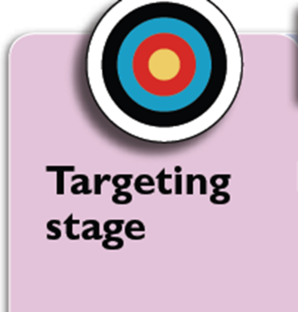
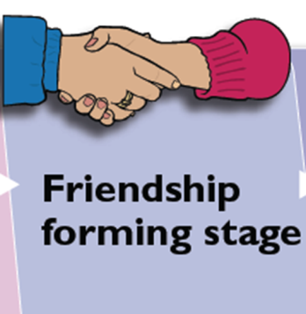

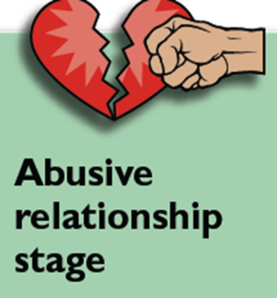
THE GROOMING STAGES:
TARGETING
FRIENDSHIP FORMING
LOVING RELATIONSHIP
ABUSIVE RELATIONSHIP.
Notes:
TARGETING - The groomer will look for a YP/group and approach them and possibly
offer something, e.g. a cigarette, drink, someone to talk to etc.
FRIENDSHIP FORMING - Spends time, gives compliments, offers favours like lifts,
a place to stay
LOVING RELATIONSHIP - A sexual relationship begins and the groomer presents
as a loving, caring person
TAKING CONTROL - Gradually ties to others are destroyed, the groomer may involve
YP in illegal activities and violence, threats and coercion can be used
ABUSIVE RELATIONSHIP - The groomer has created a ‘willing victim’. Ask the question is there such a thing as a willing victim, I would say not, by this stage they feel helpless and hopless and are victims of blackmail, threats and abuse.
The YP may be forced to have sex with others and/or be filmed performing sexual acts.
Handout on grooming indicators

Slide 23
Risk assessment of CSE
Sexual Exploitation Risk Assessment Framework SERAF
Health SERAF or Child Sexual Exploitation Risk Q
Notes:
Show the two risk assessments.
Explain where they can be used
SERAF currently under review.
A risk assessment does not replace a child protection referral, it should enhance a referral.

Slide 24
Managing a Disclosure
Exceptionally rare
Especially difficult:
  Grooming
  Exchange element
Professionals need to
  Recognise ‘at risk’ children
  Work within the risk assessment framework
Notes:
Experience, and consultation with children,
shows that they will talk about their concerns and problems to people they feel they can trust and feel comfortable with.”
Safeguarding Children in Education & Safer
Recruitment 2006, Annex B.9
A disclosure occurs when a child tells you or lets you know in some other way that he or she has been,or is being abused.
Disclosures can be direct, indirect or third party.
Disclosures do not need to be proved or validated in order to be acted upon.
All disclosures should be reported no matter where or when they happened.
A child is likely to feel scared, guilty, ashamed and confused when disclosing information.
At disclosure you must always believe the child and ensure the child recognises you believe them.

Slide 25
Sexual Exploitation Risk Assessment Framework SERAF
Vulnerabilities
Moderate risk indicators
Significant risk indicators
SERAF
  Scored into categories according to vulnerabilities and moderate/ significant risk indicators
  Categories of risk linked to safeguarding actions
Notes:
Developed in Wales
Give handout
Need to include 'health warning' - the SERAF was developed from data and research gathered in relation to children and young people who were overwhelming British born and had not been trafficked from abroad. The weighted matrix depends on information that will not be available in the majority of cases when applied to a child who has trafficked from abroad- e.g. family vulnerabilities - domestic abuse, parental mental health, parental substance misuse, risk factors such as missing from school, staying out late, use of the internet that causes concern. It may be possible to apply to a child who is accommodated after being identified as a victim of trafficking from abroad. If a child identified as a victim of trafficking they could potentially score as on the basis of significant risk indicators e.g. controlling adult. physical abuse by controlling adult would give a score of 15 (moderate risk) - they would need expressions of despair, alcohol abuse for example in addition to get 16 or above and a significant risk score. The point is the confidence of the tool in relation to children that are not known to services such as education, health, social care, police is weaker. Delegates should be made aware of this.
If there are children from outside of the UK being exploited, the toolkit can be used, but with caution.

Slide 26
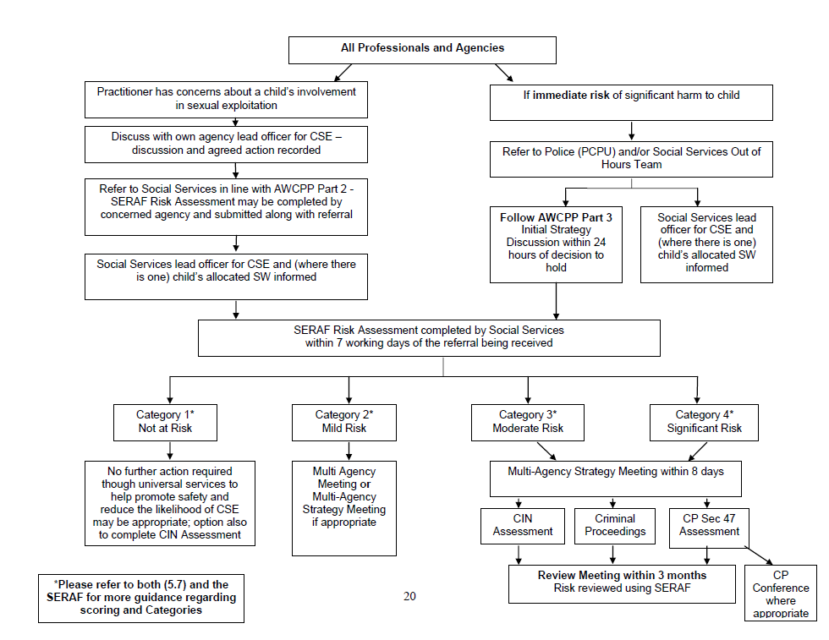
AWCPP Referral flowchart (ABMUHB)
Notes:
From the AW CPP
Provide as handout and discuss/ comments

Slide 27
Vulnerability factors - Recap
Isolated peers
Social
networks
Lack positive
relationship with
protective adult
Family history
mental health
difficulties
Unsuitable /
Inappropriate
accommodation
Low self esteem
Vulnerability
factors
Breakdown family
relationships
History
Physical and
Sexual abuse
Family history
domestic abuse
History of
emotional
neglect
Family history
substance
misuse
Notes:
History of local authority care??
Different to protocol

Slide 28
Risk Indicators?
What might the risk indicators be?
Group Activity
Notes:
Ask the delegates to think about the case studies.

Slide 29
SERAF Moderate Risk Indicators
Staying out late;
Multiple callers (unknown adults/older young people);
Use of a mobile phone that causes concern;
Expressions of despair (self-harm, overdose, eating disorder, challenging behaviour, aggression);
Use of the Internet that causes concern;
Exclusion from school or unexplained absences from or not engaged in school/college/training;
Living independently and failing to respond to attempts by worker to keep in touch;
Drugs/alcohol misuse;
Sexually Transmitted Infections (STIs);

Slide 30
SERAF Significant Risk Indicators
Disclosure of sexual/physical assault followed by withdrawal of allegation;
Peers involved in clipping/sexual exploitation
Periods of going missing overnight or longer
Older boyfriend/ relationship with controlling adult
Physical abuse by that controlling adult / physical injury without plausible explanation
Emotional abuse by that boyfriend/controlling adult
Entering/leaving vehicles driven by unknown adults
Unexplained amounts of money, expensive clothing or other item
Frequenting areas known for prostitution
Notes:
Give CSE indicator handout & Myths handout

Slide 31
Presentation to health of victims of CSE
Recurring or multiple STIs
Pregnancy and/or seeking an abortion
Sexually risky behaviour
Physical injuries
Chronic fatigue
Repeated school absence
Evidence of drug, alcohol or substance misuse
Mental health problems e.g. depression, self- harm, over-dose and eating disorders
Difficulties in forming relationships with others
Extreme array of mood swings, hostility or physical aggression
Possession of money, expensive clothes, mobile phones
Sexual health service
Obstetrics and Gynaecology
SARC
Accident and Emergency Unit
Primary care GPs, HVs
School health nurses
Substance misuse service
LAC team
Safeguarding team
CAMHS
Mental health service
Notes:
Indicators which may be more relevant within the health setting. Health professionals need to have a professional curiosity and not miss opportunities to recognise CSE and instigate the safeguarding process.

Slide 32
Priority CYP
Priority services
Looked After Children
Children with sexually transmitted infections
Children who are pregnant
Children with poor school attendance
Children who self harm/have suicidal thoughts
Children who abuse alcohol or substances
Children with behavioural issues
Children with learning disabilities
General Practice
Midwifery
Health Visiting
School Health Nursing
Sexual Health Services
Advice and Counselling Services
Child and Adolescent Mental Health Services (CAMHS)
Paediatric Services
Substance Misuse Services
Looked After Children (LAC) Teams
Accident and Emergency Services
Learning Disability Services
Notes:
Research has identified vulnerable young people and we’ve defined them as priority CYP and where they are most likely to have contact with health as priority services.
Similar structure to TTM2 on suicide and self harm

Slide 33
Health SERAF or CSERQ
Child Sexual Exploitation Risk Questionnaire
All Wales Clinical SERAF developed in sexual health services in ABUHB in 2009
Research project determined which 28 items best predict a young person, aged 13-17 years, is at high risk of CSE
4 questions identified 88% of children at high risk with 11 further questions identifying 100%

Slide 34
CSERQ4 questions
 | CSERQ4 questions | Yes / No
CSERQ1 | Have you ever stayed out overnight or longer without permission from your parent(s) or guardian?
CSERQ2 | How old is your partner or the person(s) you have sex with? Age of partner ______ Age of client/patient ______ Age difference ______ If age difference is 4 or more years then answer ‘YES’
CSERQ3 | Does your partner stop you from doing things you want to do?
CSERQ4 | Thinking about where you go to hang out, or to have sex. Do you feel unsafe there, or are your parent(s) or guardian worried about your safety?
ACTION: If one or more of CSERQ4 questions is answered in the affirmative then ask more questions and consider a child protection referral.
Notes:
The resulting CSERQ4 or best predictor questions were as follows:
Internal audit within ABUHB SRH has indicated that it most under-18s have a partner of the same age or 1-2 years difference in age. Although some 17 years old had a partner of 4-5 years older, with no other vulnerabilities or risk factors, for all other ages a four year or more age gap was unusual. Rather than have a range of different age gaps it was decided to simplify things by keeping the cut off at 4 years or more age difference. It would be up the individual clinician undertaking the assessment to weigh up the pros and cons of referring an older child (17 year old) on grounds of age difference alone where the age gap was considered appropriate.

Slide 35
11 good predictors items
4. Disclosure of sexual/physical assault followed by withdrawal of allegation?
5. Have you ever met anyone you met on the internet?
6. Expressions of despair? (self-harm, OD, eating disorder, challenging behaviour, aggression)
7. Do you drink alcohol more than once a week or binge drink?
8. Does the client have low self-esteem?
9. Exclusion from school or not engaged in, unexplained absences from school?
10. Previous STI/pregnancy/termination of pregnancy?
11. Do you live with your ‘trusted’ adult?
12. Do you have friends your own age and go out with them?
13. Do you have counselling or have extra help at school or elsewhere?
14. Does the person responsible for you have mental health/drug/alcohol problem?
Notes:
Eleven further items were required to identify the remaining 11% off the sample in the ‘high risk’ group.

Slide 36
CSERQ15
CSERQ4 and 11 good predictor questions comprise the CSERQ15 assessment.
The questions have been phrased to allow busy clinicians, particularly those who are less confident about assessing CSE risk, to be able to read straight from the page.
This will enable a more systematic approach to question asking and lead to more consistent responses from the young people themselves.
It is anticipated that child protection referrals will include responses to CSERQ4 questions together with remaining positive CSERQ15 questions plus other relevant issues.
Notes:
Need some guidance/background here

Slide 37
Case studies
Voices of children
Notes:
See.
Nathan, Zoe and Hayley Case Studies embedded into the slide
Give as handout ready for activity.

Slide 38
Examples of Health Referrals
SARC: 13 yr old ran away from residential care, and raped by 6 men in Birmingham, then ran to grandmother in Cardiff
Emergency Department: 13 yr old with recurrent presentations under influence of alcohol. CCTC identified she was being dropped at ED from back of van
Primary care: 14 yr old to GP with skin condition. She was scrubbing herself raw when coming home. Self harm episodes
Safeguarding Children's Service Lead GP
Notes:
38
Here are some examples of cases that were referred by the AHB Sexual and Reproductive Health Clinics between 2009 and 2011

Slide 39
Examples of Health Referrals
13 yr old taken to Bristol by older males, reporting multiple sexual partners
14 yr old, older boyfriend regularly takes her to hotel for “parties”. Has had sex with >100 males in past year.
Group of 15-17 years olds, multiple partners, STIs, spend nights in cars in car parks
14yr old - relationships with controlling older males, history STI / unplanned pregnancy / LAC / signs of physical violence.
Safeguarding Children's Service Lead GP
Notes:
39
Here are some examples of cases that were referred by the AHB Sexual and Reproductive Health Clinics between 2009 and 2011

Slide 40
CASE STUDIES
Using the Sexual Exploitation Risk Assessment Framework (SERAF), risk assess Nathan or Hayley & then answer the following questions:
What information/intelligence could you pass on regarding Nathan or Hayley?
What course of action would you take?
Notes:
They should inform you in question 2 that they will inform their manager of the outcome of the SERAF & arrange a multi-agency meeting to agree a safety plan & way forward.
You will tell them that as their manager you don’t feel that’s necessary & aren’t willing to sanction a multi agency meeting.
Now what will they do?
Ultimately the responsibility lies with the safeguarding lead & they have to evidence their decision.

Slide 41
Strengths and weaknesses of risk assessment framework
Strengths
Validated in sexual health setting in Wales
Pragmatic approach to assessment of a young person's risk
Supports professionals to ask challenging questions
No negative feedback from 1000s YP in ABUHB
Weaknesses
CSE doesn’t fit easily into ‘yes or no’ format
  Young people decide what responses to give
  Professionals may hide behind tool rather than developing relationship and building up trust with YP
Notes:
CSE doesn’t fit easily into yes/ no format

Slide 42
Health risk assessment – What the young people say.
‘The young people said that they wanted someone to notice that something was wrong and to be asked direct questions’
NSPCC report ‘No one noticed, no one heard - a study of disclosures of childhood abuse‘ (2013)
Notes:
Lose sight of the child.
We do the job in hand and fail to notice the associated risk.

Slide 43
Bristol SCR feedback: messages from children to professionals
Recognise that we don’t see ourselves as victims, so we won’t want to tell you or work with you. Don’t see “troublesome”, see troubled, and stick with us.
Don’t be scared of breaking confidentiality, even if we tell you not to, if you think we could be at risk, but be aware that we are scared that if the information gets back to the perpetrators they will hurt us or our families.
Notes:
So what do the children say.
Link to narrative collated from the Rochdale, Rotherham and Oxford cases.

Slide 44
Examine us when we come asking for contraception at age 13/14, especially if it’s an emergency appointment
Don’t be embarrassed to talk to us about sex, ask the difficult questions and keep asking if you suspect we may not be telling the truth – think the unthinkable, not just “underage sex”.

Slide 45
Bristol BASE (Barnardo's Against Sexual Exploitation) Hub and Spokes Project knows how to work with us, we can do things there and that makes it easier to talk.
Our families need advice quickly about what to do if we go missing. If you don’t trust us or don’t think we’re telling you the truth when we go missing, follow us.
Don’t pass us on or stop seeing us when we reach 18, we are often still vulnerable, and everyone changes over or stops at the same time. Give us help out of hours.

Slide 46
Take home messages
Always remember the child and look beyond their behaviour and consider why they are behaving like this
Always listen to what the child is telling you
Don’t dismiss what a child is telling you
Be professionally curious. If the situation doesn’t look or feel right to you, it probably isn’t right
If in doubt seek advice
Share information
Spotting the signs of child sexual exploitation NHS England
Notes:
This is everyone's business

Slide 47
Take home messages
CSE is complex, therefore the response cannot be simple or linear
No agency can address CSE in isolation; collaboration is essential
Effective services require resilient practitioners
Notes:
Listen to the voice of the child
Don’t hide behind risk assessment tools
Make sure you’re sitting round the table
July 20th first implementation meeting

Slide 48
Resources
Tea Consent (clean)
https://www.youtube.com/watch?v=fGoWLWS4-kU
NHS Strategy http://www.wales.nhs.uk/sitesplus/888/page/67421
All Wales Child Protection Procedures Review Group. All Wales Protocol, Safeguarding and Promoting the Welfare of Children who are at Risk of Abuse from Sexual Exploitation. All Wales Child Protection Procedures Review Group 2008: http://www.childreninwales.org.uk/areasofwork/safeguardingchildren/awcpprg/proceduresandprotocols/index.html

Slide 49
Film resources
Kayleigh’s Love Story (Leicestershire)
Caught in traffick (welsh)
Hidden Barnado’s Cymru
Spotting the signs (specific to health)
Operation thistle (welsh)
It’s not because he loves you (Cambridge)
Seen and Heard Children’s Society (elearning)
Real Love Rocks Barnado’s resource pack
5.30
8.00
15.00
15.46
12.00
1.55

Slide 50
Acknowledgements
Western Bay Safeguarding Board
Members of NHS Wales CSE Strategy/Plan Implementation Group including Raquel Bennett, Lynda Collier, Andrea Coombes, Janet Edmunds, Pauline Galluccio, Nikki Harvey, Tina Hitt, Sonia Mason, Natalie Morgan-Thomas, Alison Mott, Donna Newell, Sarah Russell, Velupillai Vipulendran, Jayne Wheeler-Sexton, Nikki Williams

