Slide 1
Learning from COVID-19
Helping teams to move forward

Slide 2

Welcome
By attending this workshop you will:
Have time to pause and reflect on your experience during the Covid-19 outbreak
Be able to discuss with members of your team what you have experienced and your ideas for change
Develop a plan for moving forward.

Slide 3
Etiquette
Some pointers to help this virtual meeting run smoothly:
Having your video on makes it easier to feel connected. Please keep your video turned on (if your wi-fi allows)
Please mute yourself when you are not speaking
Concentration is harder online than in person. Pay attention to your concentration levels and give yourself a break if you need to
Make your contributions succinct and clear. Pausing to think is ok!
That chat box can be used to share issues and ask questions. This is also an option if you don’t feel comfortable speaking online
The meeting may surface some difficult issues. Please take care of yourself and step outside of the ‘room’ if you need to.

Slide 4
Summary of today
Check in / Icebreaker
A chance to get to know each other better
Conversation Café
An opportunity to discuss our reflections
Break
Collective sense-making
Developing a pathway out of the crisis
Final discussion
Agreeing some key actions and offering final thoughts
Close
The workshop will take approximately 90 mins and so will finish at xxx

Slide 5

Check-in / Icebreaker
Everyone to briefly;
Introduce themselves
What is your role
What boxset or book have you been enjoying over the lockdown (and if you want – why you have enjoyed it!)

Slide 6
Conversation Cafe
Using the following as a basis for articulating your thoughts (use the framework you have completed prior to this workshop to help frame your contribution)
You are adapting and adjusting your actions and decisions all of the time – even if you are not aware of that.
Can you think of ways in which you have adapted your practice over the last few weeks that have made a beneficial difference to the care you provide?
What are the emerging new possibilities you have seen or experienced over the last few weeks that you want to continue?
What can you do differently now?

Slide 7

cc http://www.liberatingstructures.com/17-conversation-cafe/
Conversation Café
The Rules
Please stick to time. The facilitator will act as timekeeper
Round 1 (10mins): Each person introduces themselves and speaks for 1 minute, sharing what they think about the question, with no feedback or response
Round 2 (10mins): Going round again without response, each person shares thoughts and feelings having listened to everyone in the group (1 min each)
Round 3 (15mins): Open group discussion to enable people to delve deeper into the question, share any further views or reflections with others and learn more about what they have heard so far
Round 4 (10mins): Each person has 1 min to share ‘take-aways’ from the conversation.

Slide 8
cc http://www.liberatingstructures.com/17-conversation-cafe/
Conversation Café
You are adapting and adjusting your actions and decisions all of the time – even if you are not aware of that.
Can you think of ways in which you have adapted your practice over the last few weeks that have made a beneficial difference to the care you provide?
What are the emerging new possibilities you have seen or experienced over the last few weeks that you want to continue?
What can you do differently now?
Round 1 (10mins): Each person introduces themselves and speaks for 1 minute , sharing what they think about the question, with no feedback or response
Round 2 (10mins): Going round again without response, each person shares thoughts and feelings having listened to everyone in the group (1 min each)
Round 3 (15mins): Open group discussion to enable people to delve deeper into the question, share any further views or reflections with others and learn more about what they have heard so far
Round 4 (10mins): Each person has 1 min to share ‘take-aways’ from the conversation

Slide 9

Break
Stretch legs, cup of tea, home schooling!
5 mins

Slide 10
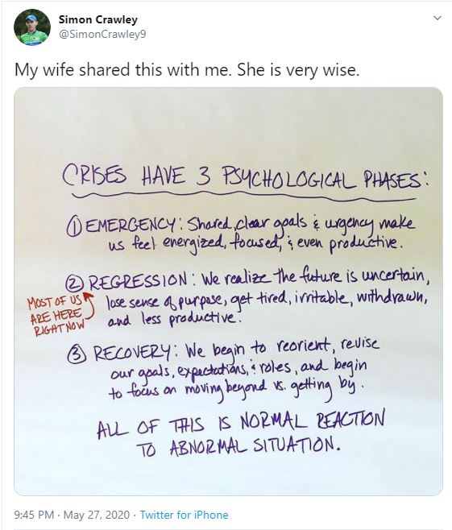
Where are you now?
Emergency: with a clear and shared goal, team energy rises and performance goes up. Reactions feel full of purpose.
Regression: people get tired, start fighting about the small stuff, and are less productive.
Recovery: teams reopen, rebuild, prepare for the future.
If You Feel Like You’re Regressing, You’re Not Alone, Harvard Business Review, 2020 https://hbr.org/2020/05/if-you-feel-like-youre-regressing-youre-not-alone

Slide 11
Collective Sense Making
Understanding crisis-response measures
Adapted from the framework produced by the RSA and Ian Burbidge
https://www.thersa.org/contentassets/007f26fb853f4f118994b819b658b331/understanding-crisis-response-measures.pdf

Slide 12
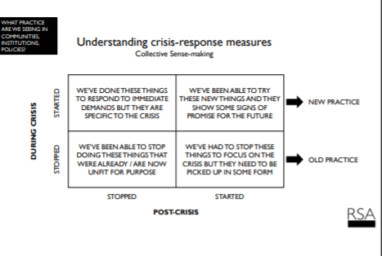

Slide 13
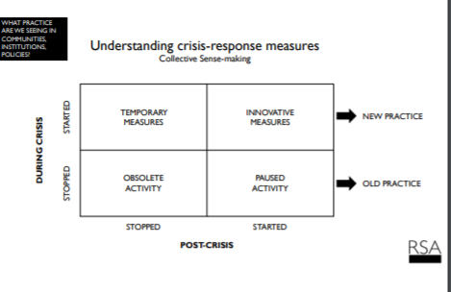

Slide 14
Developing a Pathway Out of the Crisis
Obsolete Activity
The crisis has meant teams have stopped doing things. Either because they are not fit for purpose or because the crisis has rendered them obsolete. Post-crisis we may be able to let go of some of these – not only the things the crisis has rendered impotent but those things we know are no longer fit for purpose. For some letting go can be hard to do but this might be the opportunity many have been waiting for to eliminate wasteful practice.

Slide 15
Developing a Pathway Out of the Crisis
Paused Activity
Teams will have temporarily stopped doing things in order to divert capacity to the crisis response. Many of these will need to be restarted. This exercise will help people to restart measures in a way that is sensitive to the changed context and not just simply a copy-and-paste of the pre-virus approach.

Slide 16
Developing a Pathway Out of the Crisis
Temporary Measures
Teams will have had to respond to the immediate crisis with ways of working that in the post-Covid world may be inappropriate. These measures need to be ended. Again, this may be easier said than done. While may of these ways of working will not have had time to become systematised they may represent the result of considerable physical and emotional effort and so there will be attachment to them. Some may prefer these as ways or working because of the fact they cut through governance and bureaucracy – but this may not be appropriate as things approach normal.

Slide 17
Developing a Pathway Out of the Crisis
Innovative Measures
The reduction in bureaucracy, governance and the focus and funding provided by the crisis have created an arena ripe for experimentation and innovation. A lot of this change not just in practices but in behaviours may be something teams will want to continue with post-Covid.
The post-crisis task is to help teams identify these and find ways to amplify and embed the most promising changes and innovations.

Slide 18
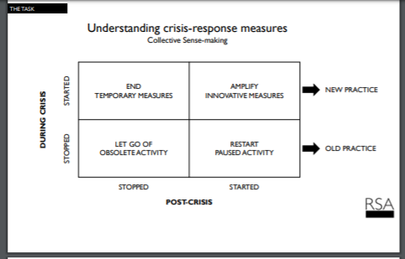

Slide 19
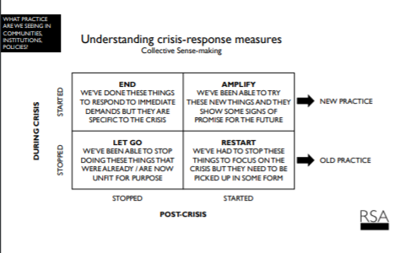
Developing a pathway out of the crisis
Exercise Instructions
Using the Chat Function, type the keyword followed by your answer.
We will do this one word at a time – please listen for instructions.
The key words are;
END – (the temporary)
AMPLIFY – (the innovative)
LET GO – (the obsolete)
RESTART – (the paused)

Slide 20
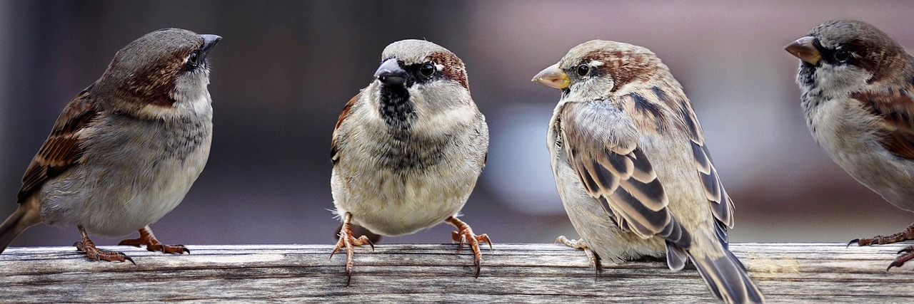
Final Discussion
Final chance to share reflections
1 minute per person – 10 minutes
Final Group chat – 5 Minutes
We will write up and share the results from the chatroom (non attributable)
What are you going to do next?

Slide 21
Close
Thank you for attending, please let us know (via chat)
WWW – What Went Well
EBI – Even Better If

Slide 22
Thank you.
This toolkit was created by Improvement Cymru for adaption by the NHS in Wales. For any queries please contact: Paul Gimson (Paul.Gimson@wales.nhs.uk) or Lois Andrews (Lois.Andrews2@wales.nhs.uk)

