Slide 1
Learning from COVID-19
Helping teams to move forward

Slide 2
Aim
A workshop to help teams reflect and act upon experience & learning gathered during COVID-19 outbreak
The NHS in Wales has experienced rapid change during the COVID-19 outbreak. There has been innovation, transformation of services and changes in ways of working and behaviour.
The aim of this package is to help teams to reflect and act upon what they have experienced.
It doesn’t replace existing efforts to collect and analyse learning. This should be done in parallel to support learning on a national scale. This package is focussed on supporting your team.

Slide 3
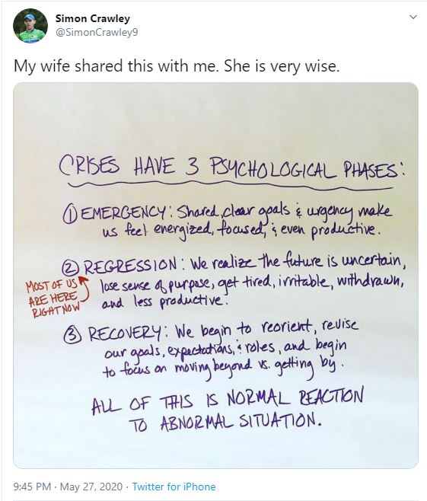
Where are you now?
Emergency: with a clear and shared goal, team energy rises and performance goes up. Reactions feel full of purpose.
Regression: people get tired, start fighting about the small stuff, and are less productive.
Recovery: teams reopen, rebuild, prepare for the future.
If You Feel Like You’re Regressing, You’re Not Alone, Harvard Business Review, 2020 https://hbr.org/2020/05/if-you-feel-like-youre-regressing-youre-not-alone

Slide 4
A Pathway to help you move forward
The Three Phase Approach
Ensure teams have a process for capturing learning in real time
When the team is ready to move on, complete the Framework for Reflective Learning
Supporting action learning in a Post-Covid Pathway Action Learning workshop

Slide 5
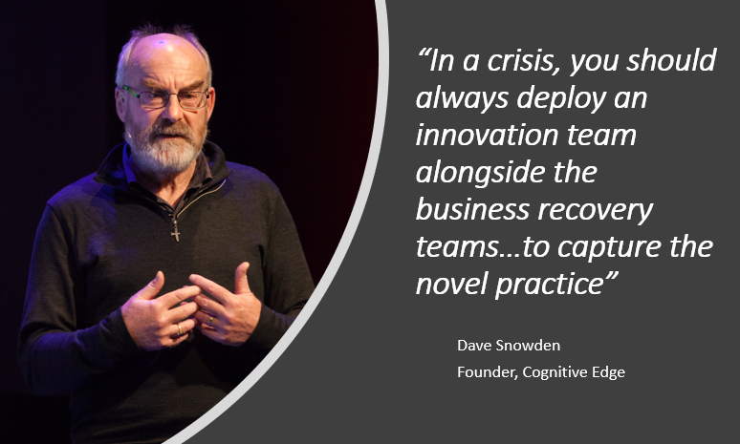
1) Capturing the Learning in Real Time
Avoiding the risk of Retrospective Coherence
Often what we remember about an event isn’t actually what happened
Our memory will be affected by factors like our own biases, other events and organisational rules
The longer you leave it the more blurred the memory will become
Develop a way of capturing learning in real time.
Is anyone deploying ‘Innovation and Learning’ people alongside COVID-19, What’s The Pont, March 2020 https://whatsthepont.blog/2020/03/18/is-anyone-deploying-innovation-and-learning-people-alongside-covid-19-response-teams/

Slide 6
2) Complete the Reflection Questionnaire
Completed individually a week or so before the workshop
The framework provides a series of questions categorised into themes. It aims to help you reflect on your experience and capture what is important.
It can be completed individually or collectively as a team.
It will support feedback to the wider teams through future workshops and action learning sets.
Answer all questions that may be relevant the process will require 20 minutes of time to complete.
You can choose to keep or share your results. Results shared will be used to help identify themes for the workshop. We won’t be storing the results centrally but we will be noting emerging issues.
When working through the questions consider the impact and importance from a personal and organisational view. Apply the following;
The How
The What
The Why
The Where
How does this make you feel, think about capturing these thoughts throughout the process.
Consider both the positive and negatives
Consider professionalism / role and responsibility
Apply honesty, openness and transparency.

Slide 7
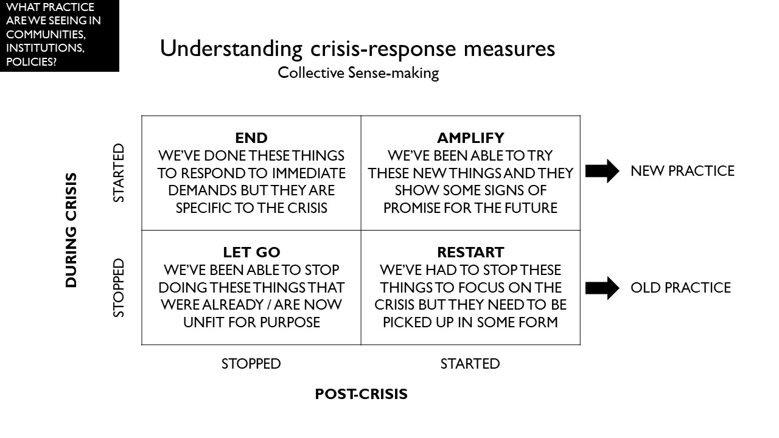
3) Supported Action Learning
Bringing together teams to use reflective practice to maximise learning and wellbeing
A facilitated workshop to help you, collectively as a team, to make sense of the learning and begin the process of developing a ‘pathway to recovery’.
Can be hosted virtually or in person when distancing regulations allow
A maximum of 10 participants who should all be from the same team
A 90 minute session followed up by a write up of the discussion

Slide 8
Summary
Helping you to develop a plan for post-COVID
We encourage you to engage in local and national efforts to capture learning as it happens
We can help you with a framework to reflect on your experience and apply this learning
To do this we will support you with a facilitated Action Learning workshop designed to help you make sense and act upon the changes that have occurred during the COVID response.

Slide 9
THANK YOU
This toolkit was created by Improvement Cymru for adaption by the NHS in Wales. For any queries please contact: Paul Gimson (Paul.Gimson@wales.nhs.uk) or Lois Andrews (Lois.Andrews2@wales.nhs.uk)

