Slide 1

May 2016
Child Measurement Programme for Wales Release 2014/15

Slide 2
Using these slides
These slides accompany the Child Measurement for Wales Release 2014/15.
These slides are a resource to demonstrate examples of findings from the Child Measurement for Wales 2014/15.
The presentation can be used as a whole or as individual slides.
Please acknowledge the work of the Child Measurement Programme when using these slides.

Slide 3
Index
Slides 6 - 7: Participation
Slides 8 -9: Healthy or underweight
Slides 10-13: Overweight or Obese
Slides 14-17: Obese
Slide 18-19: 3 years comparison data
Slide 20: Weight categories by local authorities
Slide 21: Ethnicity
Slides 22-23: Regional comparisons
Slides 24-30: Health board maps

Slide 4
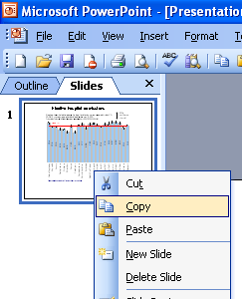
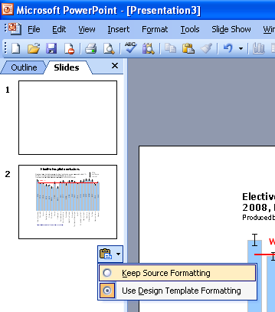
Instructions to copy a slide
To copy a slide for use in a presentation:
1. Right-click on the slide you wish to copy from the list on the left-hand side (the ‘slides’ tab) when in normal view and select ‘Copy’ from the list.
Go to your presentation and right-click where you want the copied slide to appear in the ‘slides’ tab and select ‘paste’ from the list.
On being pasted into your presentation a small clipboard icon with a black arrow will appear near the bottom right-hand corner of the newly pasted slide. Click on the arrow to show the drop-down menu and select “Keep Source Formatting” from the list. The slide will then appear as seen in the original presentation.

Slide 5
Acknowledgements
Data extraction: Gareth John (NHS Wales Informatics Service)
Data analysis: Holly Walsh (Lead Analyst), Mari Jones, Rhys Powell (Public Health Wales Observatory)
Acknowledgements:
Many thanks to families and children who participated in the Programme and to the staff in Health Boards who have supported the Programme across Wales.
Thank you to Ciaràn Humphreys, Dyfed Huws, Teri Knight, Nathan Lester, Bruce McKenzie, Kirsty Little, Rhys Gibbon, Hugo Cosh and Gareth Davies in the Public Health Wales Health Intelligence Division for advice and support. Thank you also to the Child Measurement Programme staff – Louise Megrath and Maggie Grayson and to Nicola Gordon from the Public Health Wales Health Improvement division for her contribution.

Slide 6
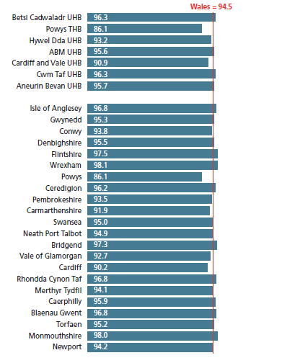
Percentage of children aged 4 to 5 years participating in a measurement programme, Wales health boards and local authorities, Child Measurement Programme for Wales, 2014/15
Produced by Public Health Wales Observatory, using CMP data (NWIS)

Slide 7
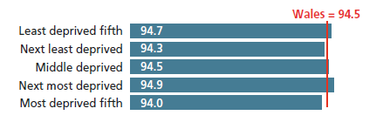
Percentage of children aged 4 to 5 years participating in a measurement programme, Welsh Index of Multiple Deprivation quintiles, Child Measurement Programme for Wales, 2014/15
Produced by Public Health Wales Observatory, using CMP data (NWIS)

Slide 8
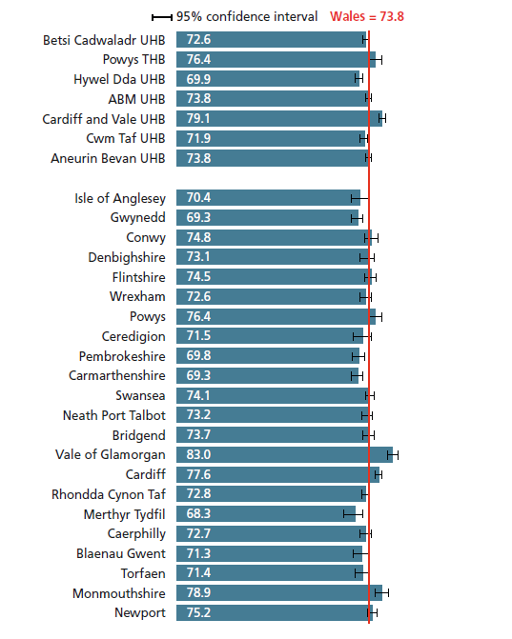
Percentage of children aged 4 to 5 years who are a healthy weight or underweight, Wales health boards and local authorities, Child Measurement Programme for Wales, 2014/15
Produced by Public Health Wales Observatory, using CMP data (NWIS)

Slide 9
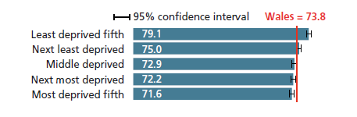
Percentage of children aged 4 to 5 years who are a healthy weight or
underweight, Welsh Index of Multiple Deprivation quintiles, Child Measurement Programme for Wales, 2014/15
Produced by Public Health Wales Observatory, using CMP data (NWIS)

Slide 10
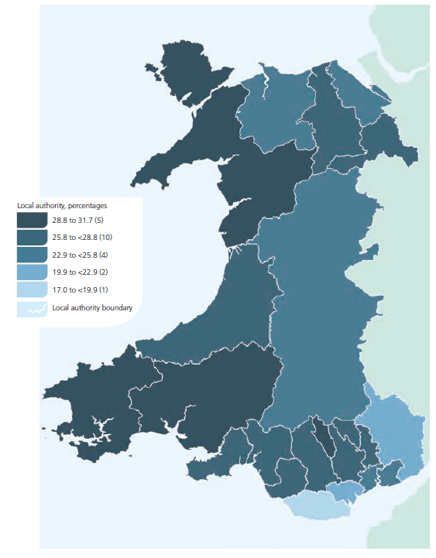
Percentage of children aged 4 to 5 years who are overweight or obese, Wales local authorities, Child Measurement Programme for Wales, 2014/15
Produced by Public Health Wales Observatory, using CMP data (NWIS)
© Crown copyright and database right 2016. Ordnance Survey 1000044810

Slide 11
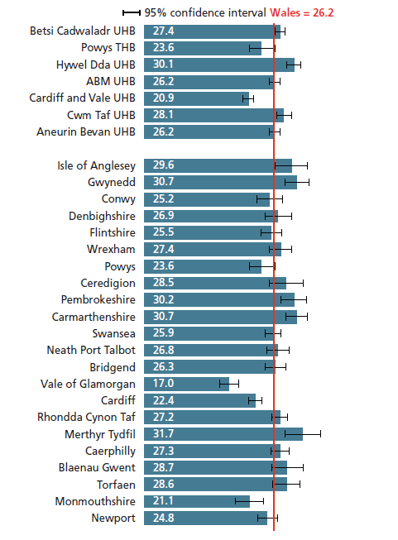
Percentage of children aged 4 to 5 years who are overweight or obese, Wales, health boards and local authorities, Child Measurement Programme for Wales, 2014/15
Produced by Public Health Wales Observatory, using CMP data (NWIS)

Slide 12
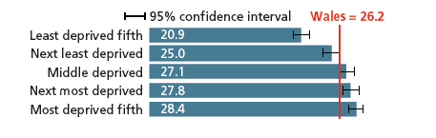
Percentage of children aged 4 to 5 years who are overweight or obese, Welsh Index of Multiple Deprivation quintiles, Child Measurement Programme for Wales, 2014/15
Produced by Public Health Wales Observatory, using CMP data (NWIS)

Slide 13
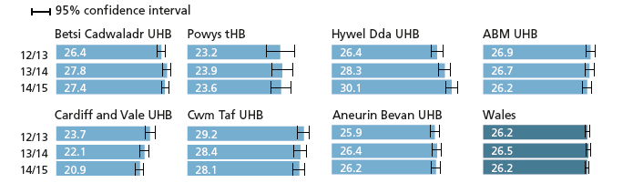
Percentage of children aged 4 to 5 years who are overweight or obese,
Wales health boards, Child Measurement Programme for Wales, 2012/13-2014/15
Produced by Public Health Wales Observatory, using CMP data (NWIS)

Slide 14
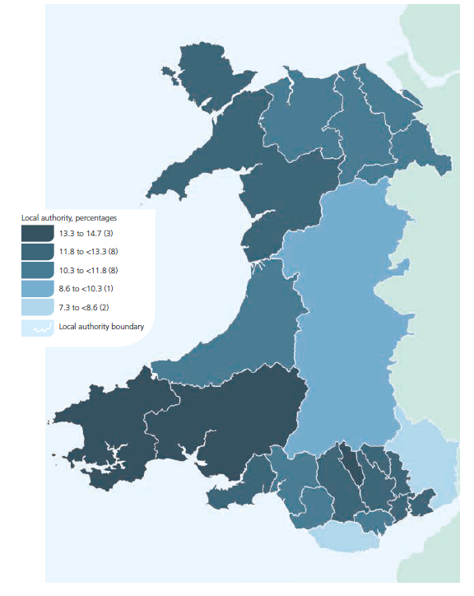
Percentage of children aged 4 to 5 years who are obese, Wales local
authorities, Child Measurement Programme for Wales, 2014/15
Produced by Public Health Wales Observatory, using CMP data (NWIS)
© Crown copyright and database right 2016. Ordnance Survey 1000044810

Slide 15
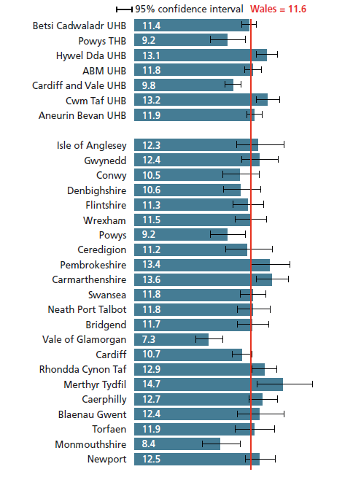
Percentage of children aged 4 to 5 years who are obese, Wales, health boards and local authorities, Child Measurement Programme for Wales, 2014/15
Produced by Public Health Wales Observatory, using CMP data (NWIS)

Slide 16
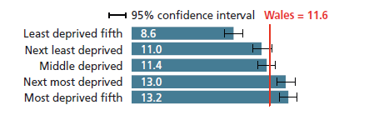
Percentage of children aged 4 to 5 years who are obese, Welsh Index of Multiple Deprivation quintiles, Child Measurement Programme for Wales, 2014/15
Produced by Public Health Wales Observatory, using CMP data (NWIS)

Slide 17
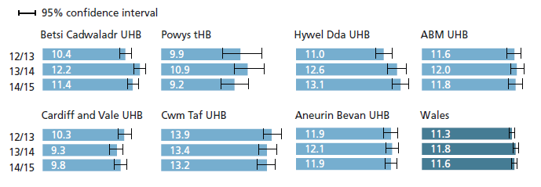
Percentage of children aged 4 to 5 years who are obese, Wales health boards, Child Measurement Programme for Wales, 2012/13-2014/15
Produced by Public Health Wales Observatory, using CMP data (NWIS)

Slide 18
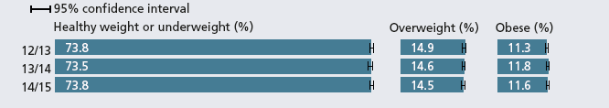
Percentage of children aged 4 to 5 years who are a healthy weight or underweight, overweight, or obese, Child Measurement Programme for Wales, 2012/13-2014/15
Produced by Public Health Wales Observatory, using CMP data (NWIS)

Slide 19
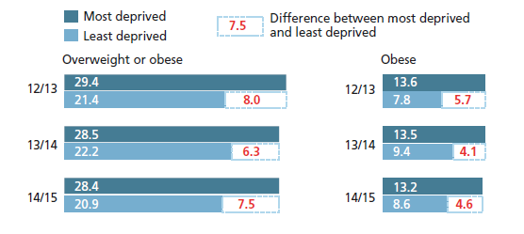
Percentage of children aged 4 to 5 years who are overweight or obese, or obese, most and least deprived fifth in Wales, Child Measurement Programme for Wales, 2012/13-2014/15
Produced by Public Health Wales Observatory, using CMP data (NWIS)

Slide 20
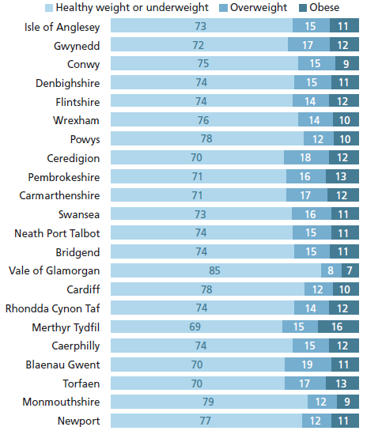
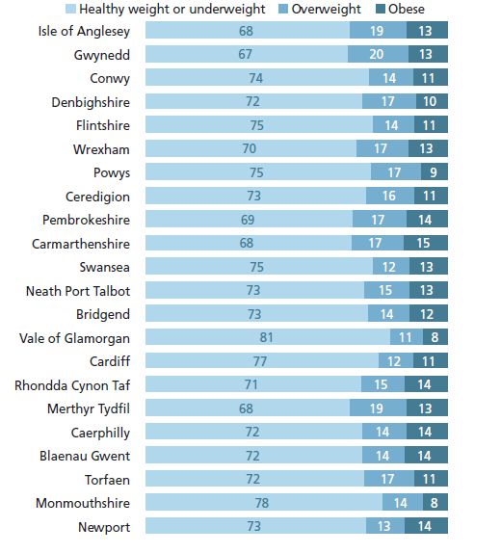
Weight category percentages, girls aged 4 to 5 years, Wales local authorities, Child Measurement Programme for Wales, 2014/15
Produced by Public Health Wales Observatory, using CMP data (NWIS)
Weight category percentages, boys aged 4 to 5 years, Wales, local authorities, Child Measurement Programme for Wales, 2014/15
Produced by Public Health Wales Observatory, using CMP data (NWIS)

Slide 21
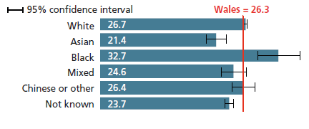
Percentage of children aged 4 to 5 years who are overweight or obese by ethnic group, Child Measurement Programme for Wales, 2012/13, 2013/14 and 2014/15 combined
Produced by Public Health Wales Observatory, using CMP data (NWIS)

Slide 22
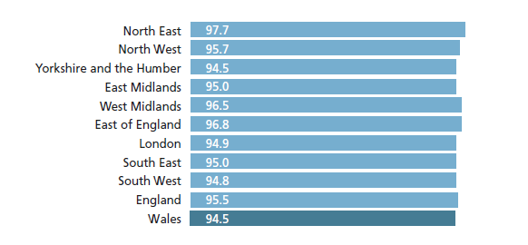
Children participating in a measurement programme, Wales, England and English regions, Child Measurement Programme for Wales and the National Child Measurement Programme (England), 2014/15
Produced by Public Health Wales Observatory using CMP data (NWIS) and NCMP data (HSCIC)

Slide 23
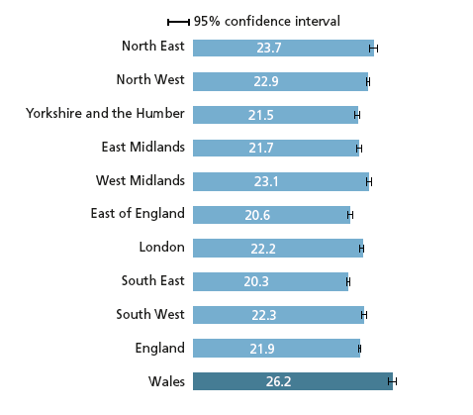
Percentage of children aged 4 to 5 years who are overweight or obese, Wales, England and English regions, Child Measurement Programme for Wales and the National Child Measurement Programme (England), 2014/15
Produced by Public Health Wales Observatory, using CMP data (NWIS) and NCMP data (HSCIC)

Slide 24
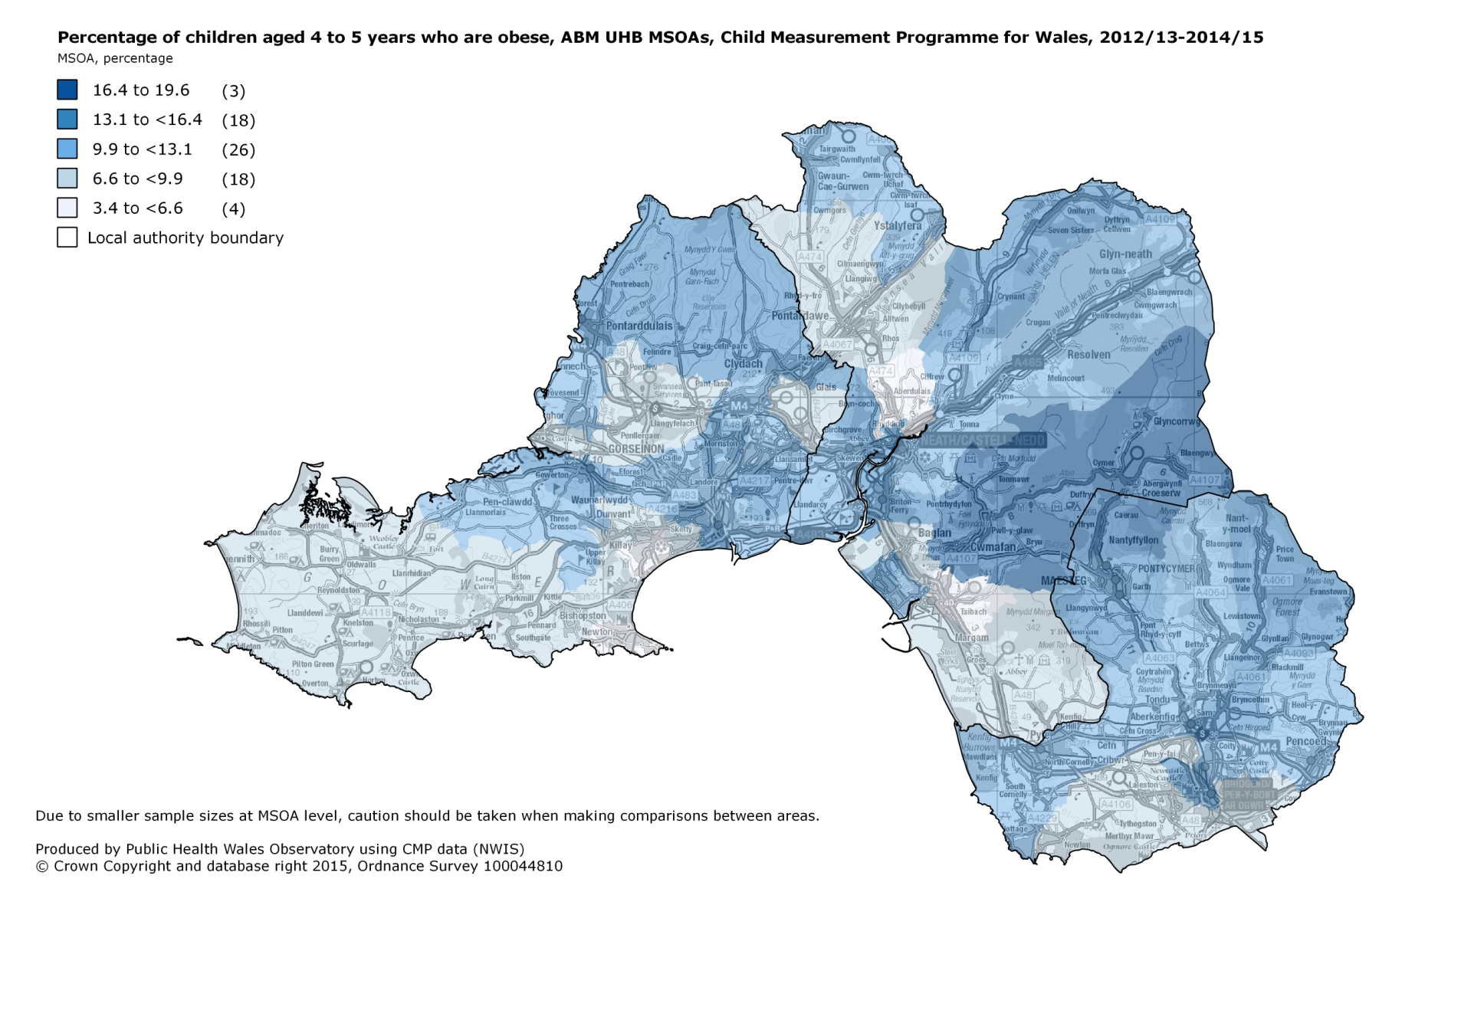
Percentage of children aged 4 to 5 years who are obese, ABM UHB MSOAs, Child Measurement Programme for Wales, 2012/13 – 2014/15
Due to smaller sample sizes at MSOA level, caution should
be taken when making comparisons between areas.
Produced by Public Health Wales Observatory, using CMP data (NWIS)
© Crown copyright and database right 2016. Ordnance Survey 1000044810

Slide 25
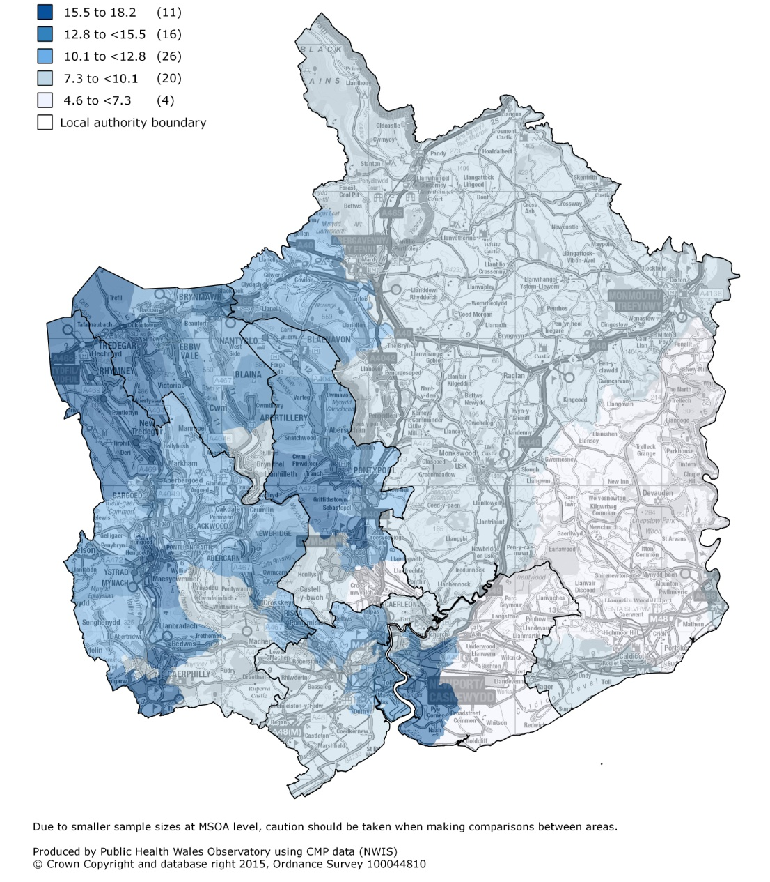
Percentage of children aged 4 to 5 years who are obese, Aneurin Bevan UHB MSOAs, Child Measurement Programme for Wales, 2012/13-2014/15

Slide 26
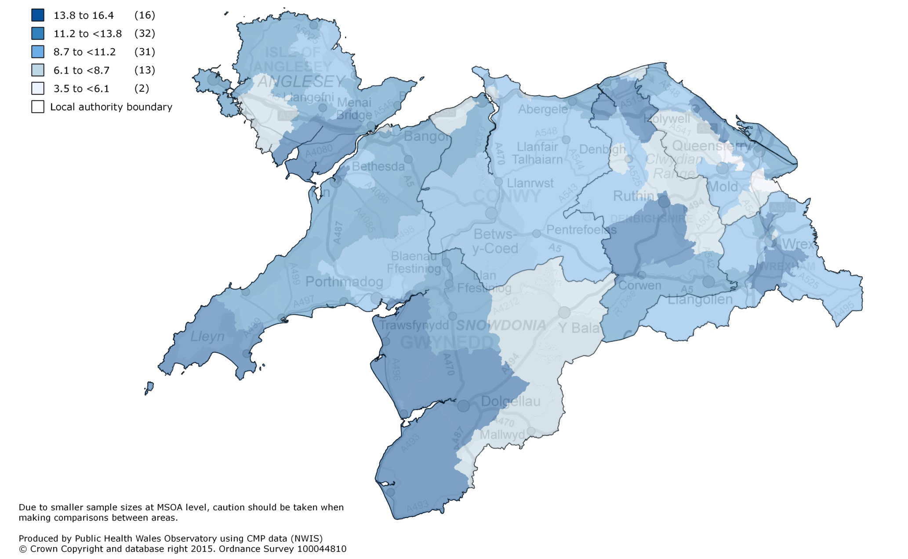
Percentage of children aged 4 to 5 years who are obese, Betsi Cadwaladr UHB MSOAs, Child Measurement Programme for Wales, 2012/13-2014/15

Slide 27
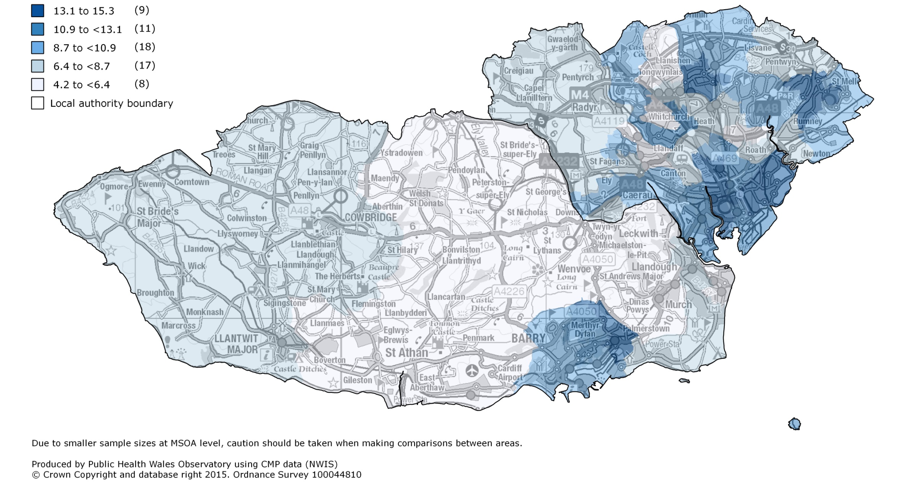
Percentage of children aged 4 to 5 years who are obese, Cardiff and Vale UHB MSOAs, Child Measurement Programme for Wales, 2012/13-2014/15

Slide 28
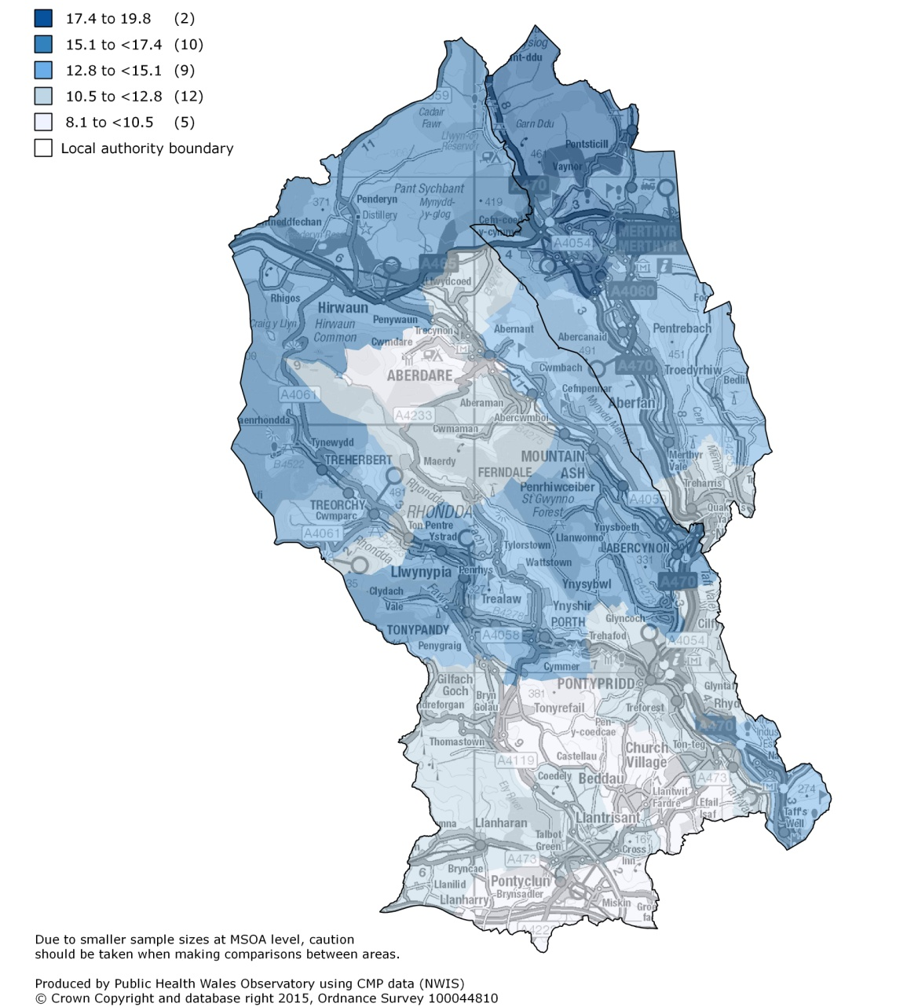
Percentage of children aged 4 to 5 years who are obese, Cwm Taf UHB MSOAs, Child Measurement Programme for Wales, 2012/13-2014/15

Slide 29
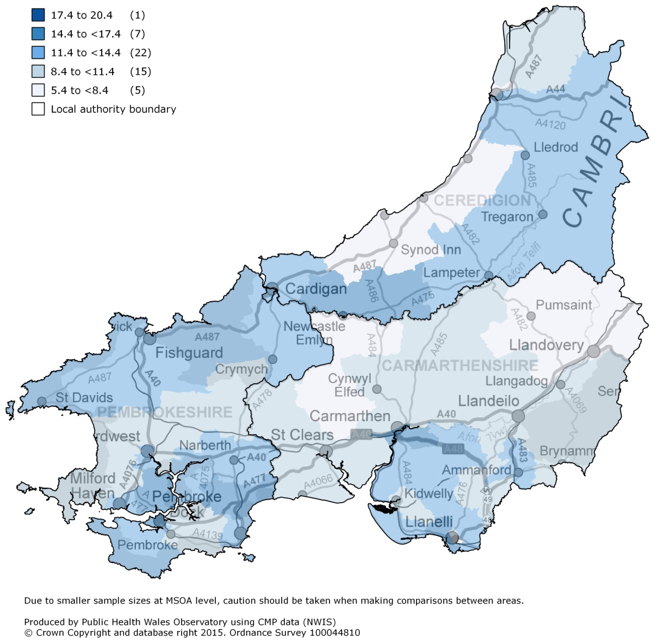
Percentage of children aged 4 to 5 years who are obese,
Hywel Dda UHB MSOAs, Child Measurement Programme
for Wales, 2012/13-2014/15

Slide 30
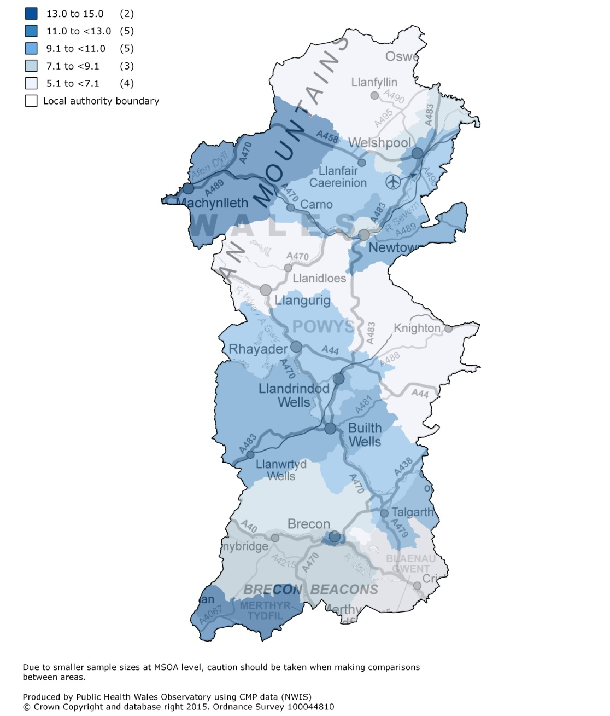
Percentage of children aged 4 to 5 years who are obese, Powys THB MSOAs, Child Measurement Programme for Wales, 2012/13-2014/15

