Slide 1
The (short) Femur
CARIS Meeting. November 2019
North Wales

Slide 2
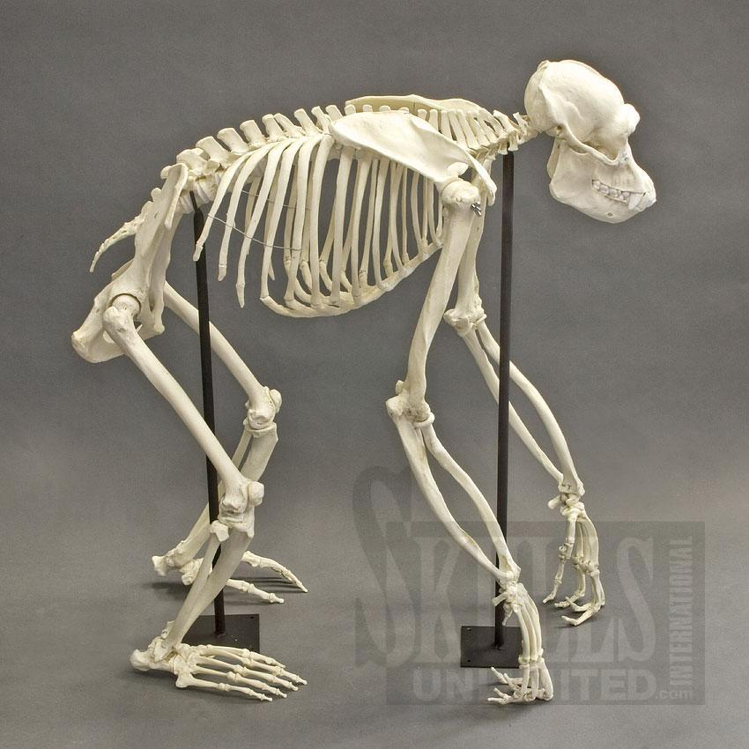
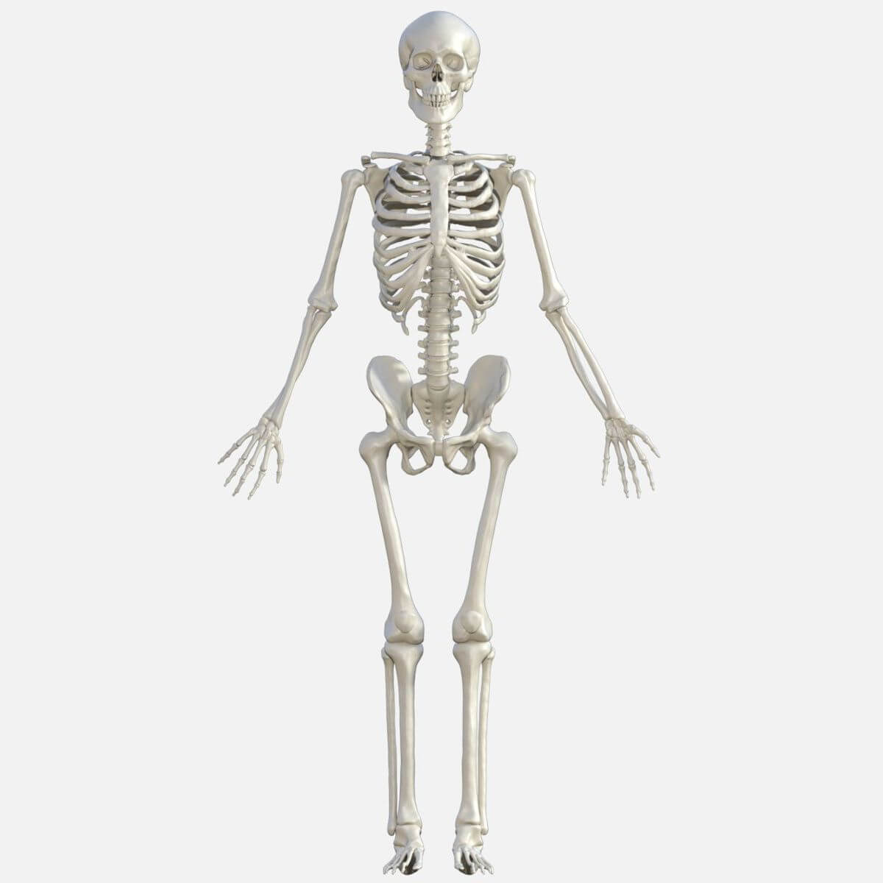
Primates. All possess 3 long bones in each limb modified hands and feet

Slide 3

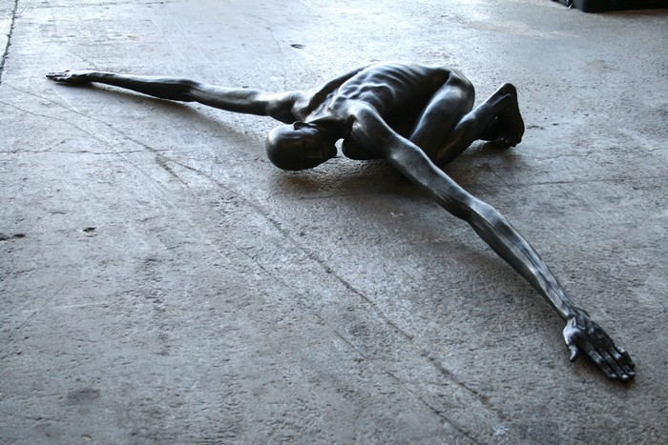
The artist and sculptur. Are the proportions right?

Slide 4
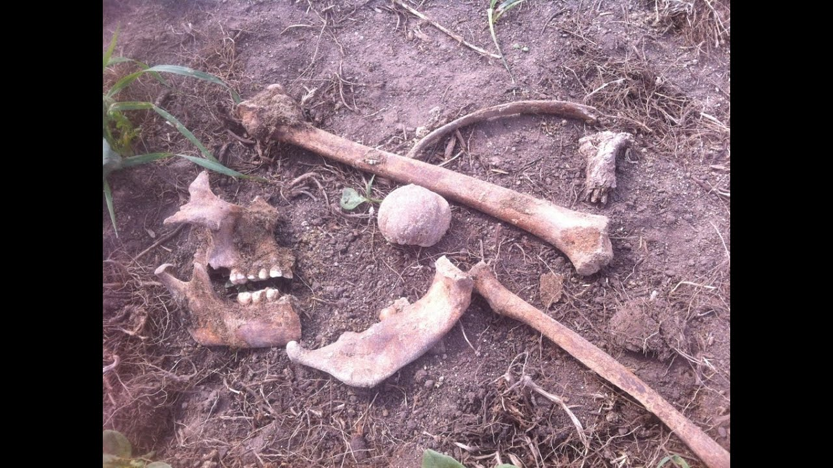
The Archeologist
Height (cm) = 2.47 x Femur length + 54.1 +/- 3.72cm

Slide 5
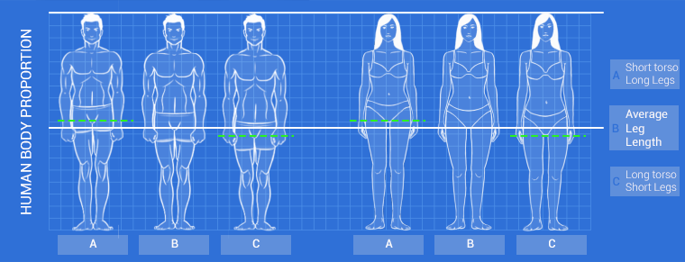
What are the components of our height? Legs and spine.

Slide 6
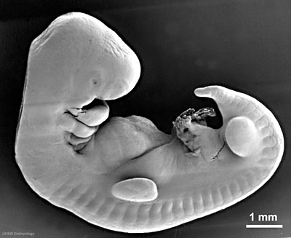
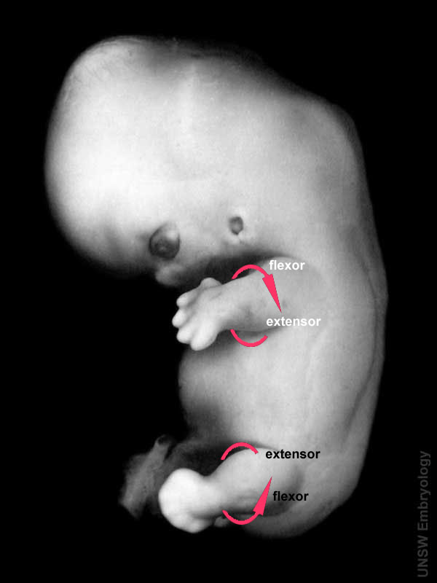
Embryology
Limb buds at 6 weeks
Limb rotation at 7 weeks in opposite directions

Slide 7
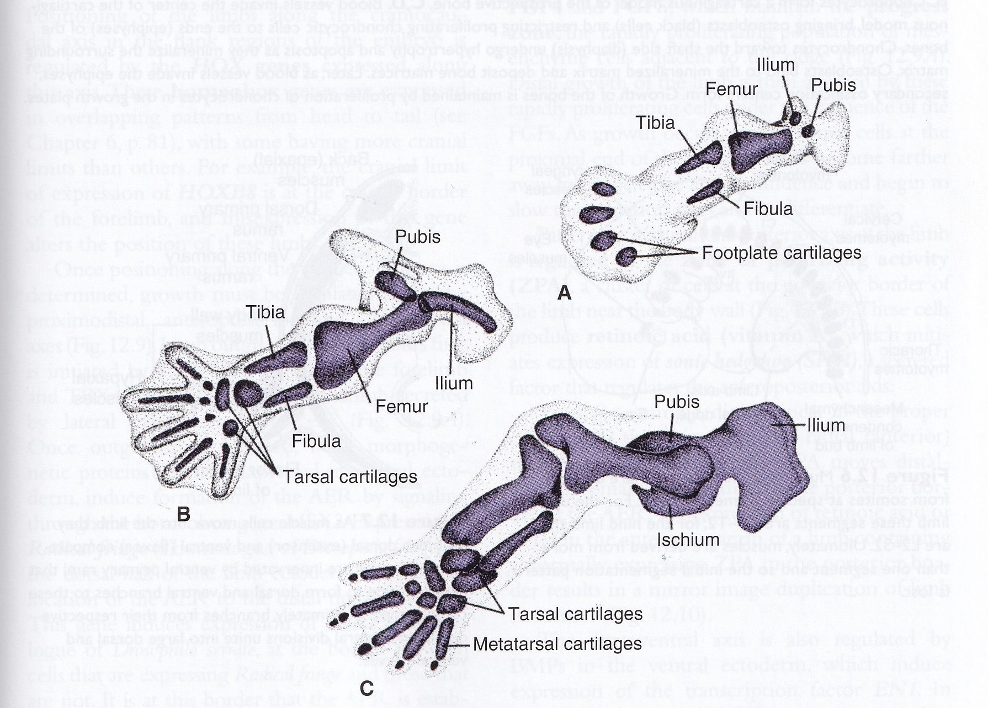
Pelvis and shoulder girdle are integral with limb development
Appendicular skeleton

Slide 8
Audit of femur length measurements on 20 week anomaly scan
Retrospective data collection
Re-audit

Slide 9
Method of audit of ultrasound measurements
Patient case note number derived from hand written maternity register for 2016 and outcome noted
RADIS search
Paired measurements of HC and FL obtained
Search commencing at 1st January 2016, first 652 entries gave 556 paired measurements
All measurements were taken from pregnancies which concluded in a live singleton birth beyond 28 weeks gestation at Wrexham.
Gestation recorded exactly in days and rounded up/down

Slide 10
Data collection issues
One third of hospital case note numbers were not recognised by RADIS, and name search was used which showed no entry for case note or another case note number.
Errors of case note number, transcription and spelling were common
All multiple births, stillbirth and miscarriages and known anomalies on scan or at birth were excluded
Data was not available for women where the anomaly scan was performed out of area, e.g. Deeside, Powys or women who came to Wrexham as I.U. transfer
Data was not used from anomaly scan when HC and FL were performed at different times due to rescan being required (e.g. high BMI)

Slide 11
Femur length (mm)
Gestation in weeks

Slide 12
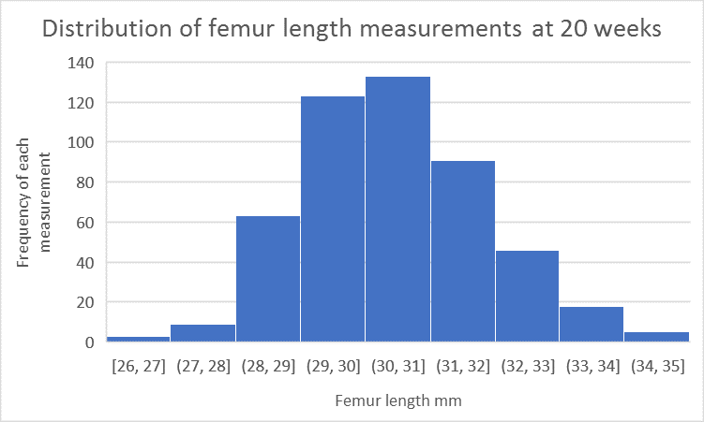
Distribution of FL measurements at 20 weeks

Slide 13
Comparison of centiles
Femur length at 20 weeks gestation
Centile | Wrexham | Chitty chart
97th | 34 mm | 36.3 mm
90th | 33 mm | 34.9 mm
50th | 31 mm | 32.1 mm
10th | 28 mm | 29.2 mm
3rd | 26.5 mm | 27.9 mm

Slide 14
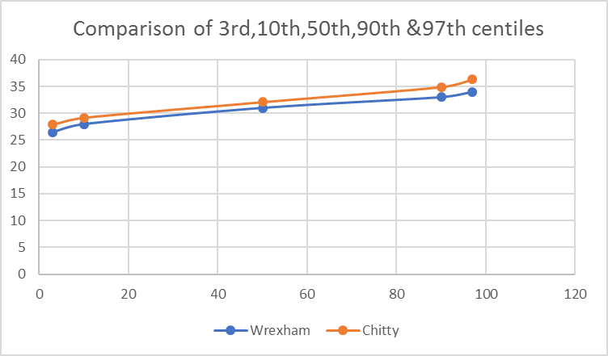
Femur length measurements (mm) at 20 week gestation.

Slide 15
Congenital short femur
Limb deficiency accounts for ~ 1 in 20,000 births
Congenital short femur –
Simple hypoplasia of the femur
Short femur with an angulated shaft
Short femur with coxa vara , often associated with a hip anomaly
Absent or deficient proximal femur
Rudimentary femur
One or both femurs can be affected, but the right is more commonly affected.

Slide 16
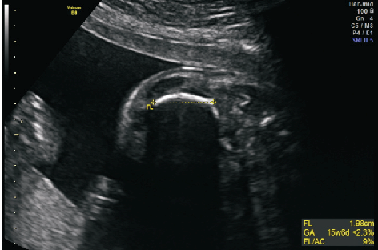
Short curved (angled) femur

Slide 17
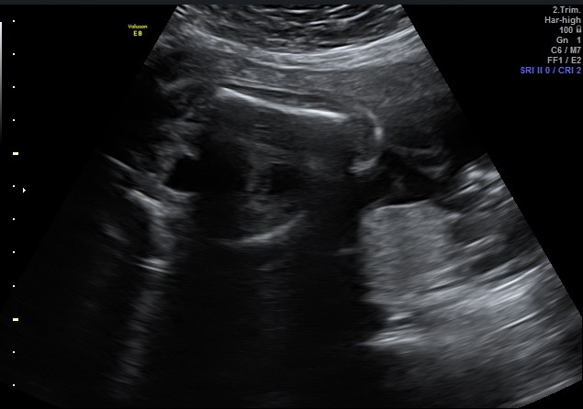
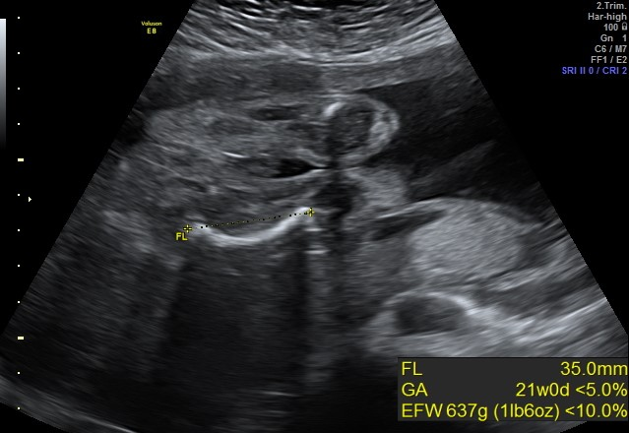
Compare femurs

Slide 18
Skeletal dysplasia
Prevalence is slightly more common 1 in 4000 births
With true dysplasias 25% are stillborn, 30% die in neonatal period
Approach to prenatal diagnosis;
Wide range of rare skeletal dysplasias and antenatal diagnosis is rarer
Incidental discovery on routine scan necessitates systematic examination of limbs, head, thorax and spine.
1) Long bone assessment
Shortening, abnormal shape, reduced echogenicity and absence of extremities / abnormal hands and feet.

Slide 19
Skeletal dysplasia evaluation
2) Fetal thorax. Several dysplasias are associated with a small thorax which causes pulmonary hypoplasia
Thoracic circumference / thoracic to head ration / thoracic to abdominal ratio. Measure thoracic circumference at the level of the four chamber view.
3) Fetal head. Look for large head, clover leaf shaped skull, prominent forehead, small face, microagnathia, abnormal ears, fractures, demineralsation.
4) Diagnostic tests: Amniocentesis , DNA analysis
Classification of skeletal dysplasias is largely based on X-ray findings

Slide 20
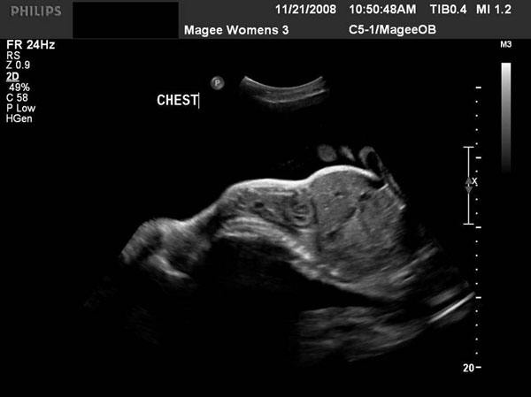
Small thorax, protruding abdomen

Slide 21

Beware the short femur

