Slide 1
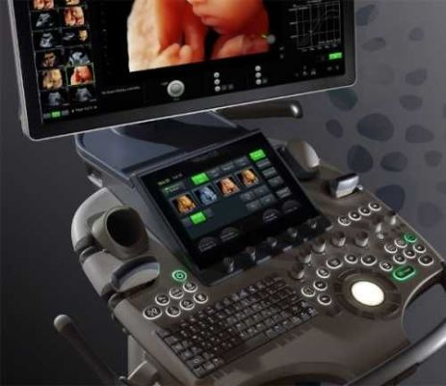
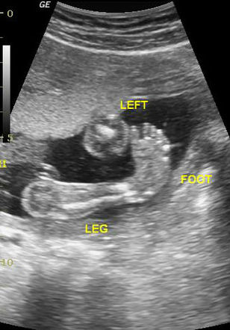
Short Long Bones
Ultrasound Assessment (2D)
Equinovarus
Achondrogenesis IA, IB, II
Atelosteogenesis I, II, III
Campomelic dysplasia, Desbuquois dysplasia
Diastrophic dyplasia
Ehler-Danlos syndrome Types VIIA and B
Hypophosphatasia
Larsen syndrome
Osteogenesis imperfecta Types II and III
Pseudodiastrophic dysplasia
Short-rib polydactyly syndromes (Types I–IV)
Thanatophoric dysplasia Types I and II

Slide 2
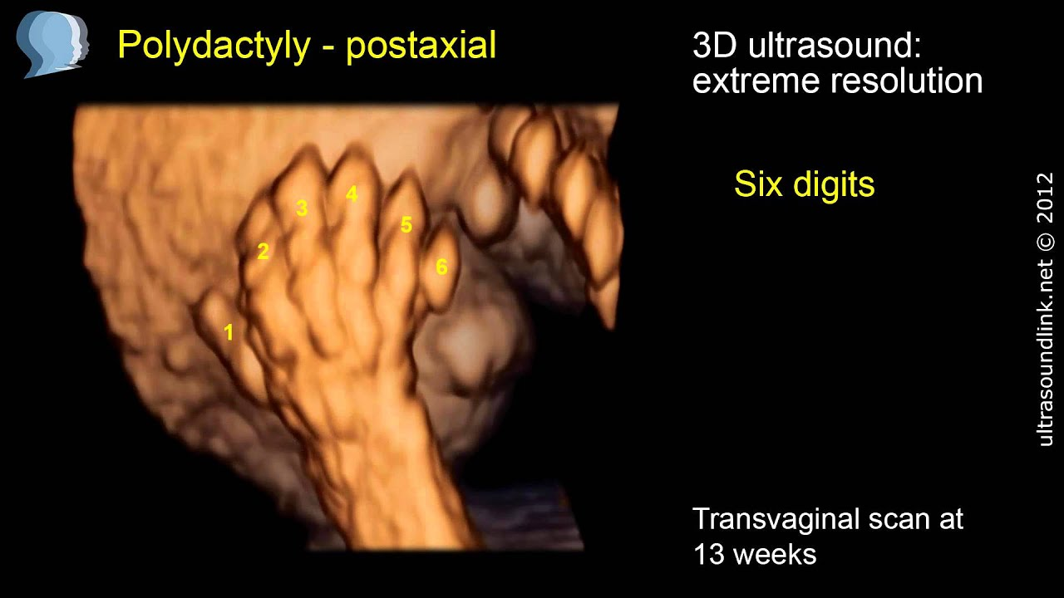
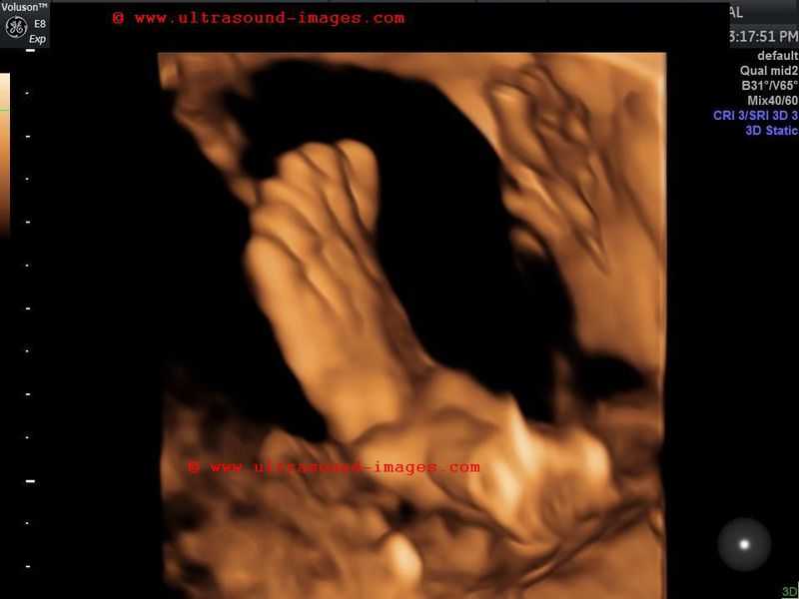
5
6
4
3
2
1
Polydactyly

Slide 3
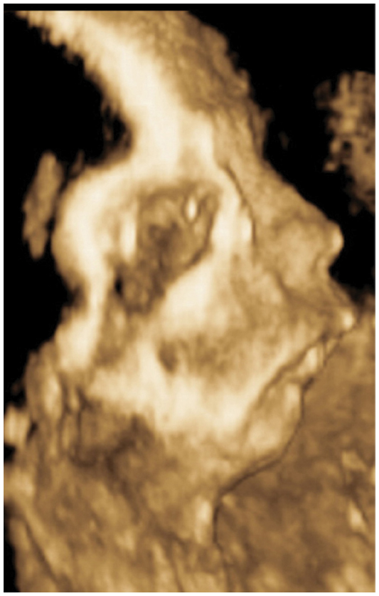
3D Ultrasound Compliments 2D
Better characterization of facial soft tissues
(surface rendering)
Micrognathia
Campomelic Dysplasia
Micrognathia

Slide 4
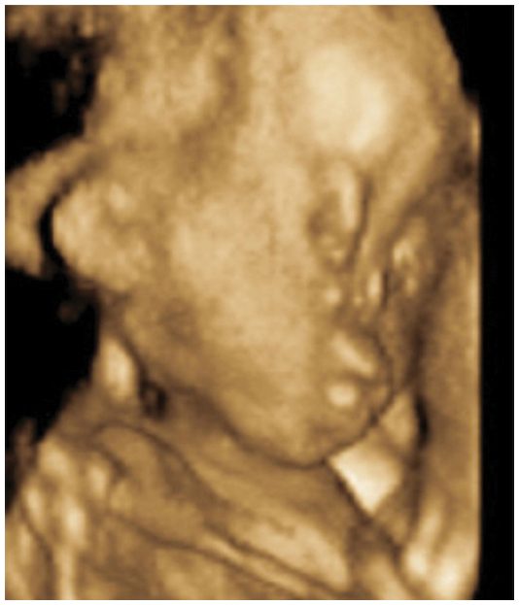
3D Ultrasound Compliments 2D
Better characterization of facial soft tissues
(surface rendering)
Mid facial hypoplasia
Chondrodysplasia Punctata
Mid
Face
Hypoplasia

Slide 5

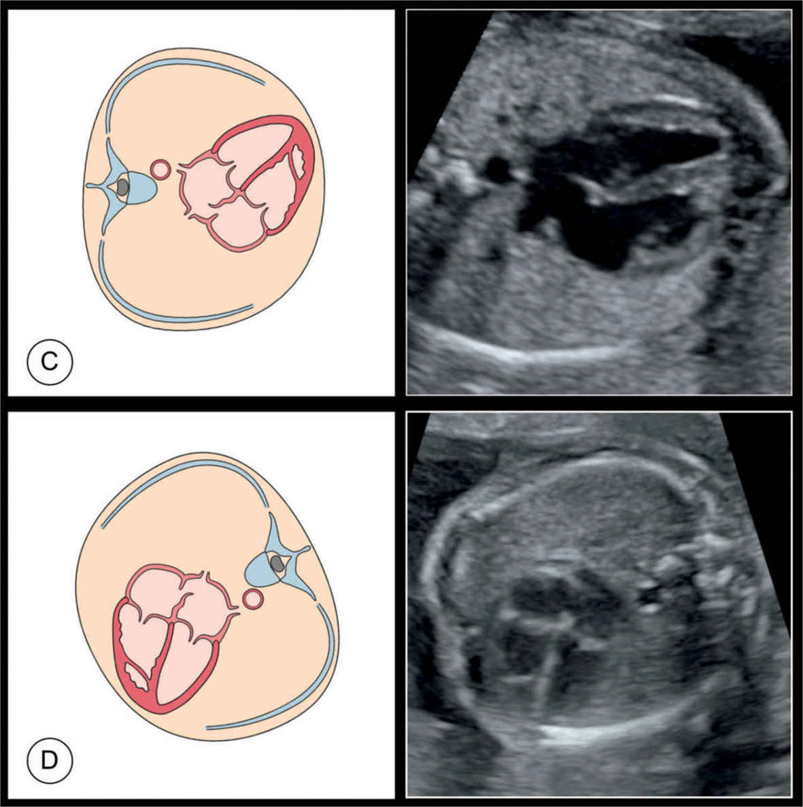
Short Long Bones
Predicting Lethality
TC:AC ratio of <0.6
Thoracic circumference <5th% (4C view)
Rib length <2/3
FL:AC ratios of <0.16
Chest:Trunk Length ratio <0.32
Hydrops
Polyhydramnios
Micrognathia
Visceral abnormalities
Thoracic Circumference
4C
View
Heart

Slide 6
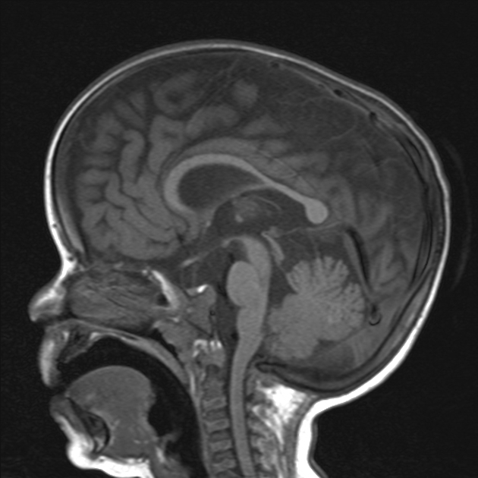
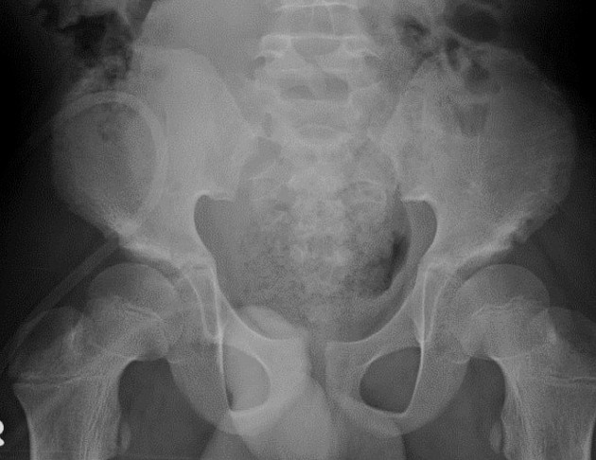
https://radiopaedia.org/articles/achondroplasia?lang=gb
Short Long Bones
Achondroplasia

Slide 7
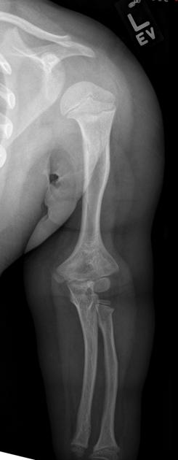
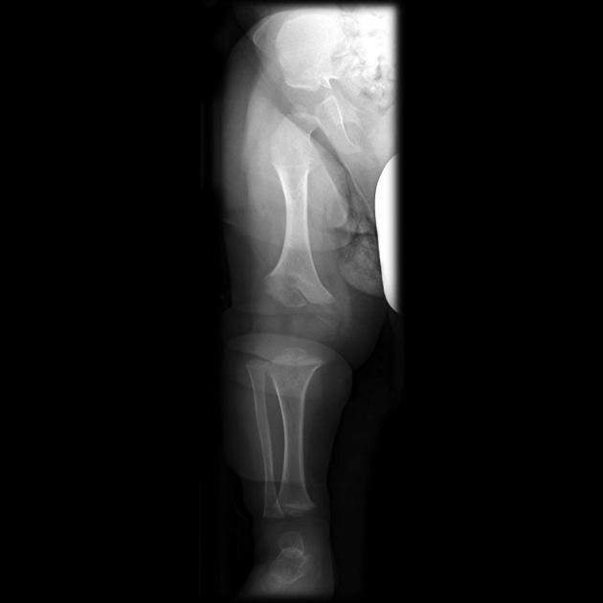
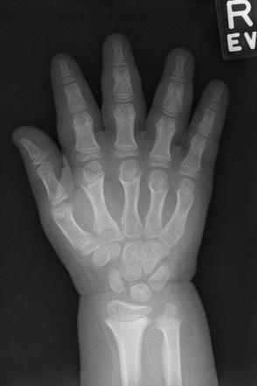
https://radiopaedia.org/articles/achondroplasia?lang=gb
Short Long Bones
Achondroplasia (Rhizomelic)

Slide 8
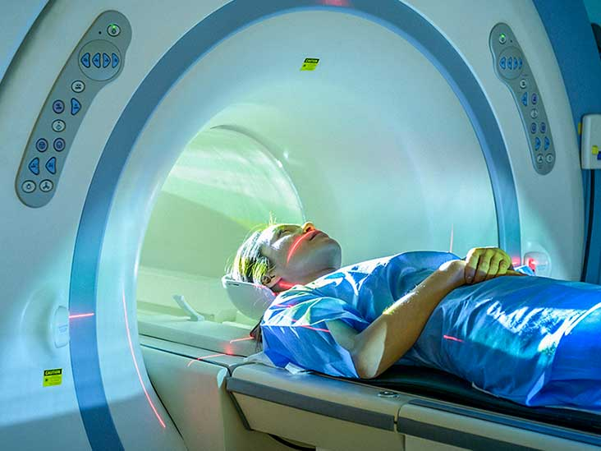
MRI

Slide 9
Short Long Bones
Fetal MRI
Fetal spine in severe scoliosis
  diastematomyelia
  vertebral malformations

Slide 10

CT SCAN

Slide 11

AMNIOCENTESIS

Slide 12
Short Long Bones
AMNIOCENTESIS
Amniocentesis
  PCR (Trisomy 21,18,13)
  Karyotype
  Array CGH
  Exome Sequencing

Slide 13

Short Long Bones
Skeletal Dysplasia - Exome Sequencing
Definitive molecular diagnosis was made in 13/16 (81%) cases.
panel of 240 genes known to cause skeletal dysplasias
Trio sequencing with expert multidisciplinary review for case selection
Timely, high diagnostic rates in fetuses with skeletal abnormalities.
Improves parental counselling and pregnancy management.
Natalie Chandler et al. Genet Med advance online publication 29 March 2018
Rapid prenatal diagnosis using targeted exome sequencing: a cohort study to assess feasibility and potential impact on prenatal counseling and pregnancy management

Slide 14
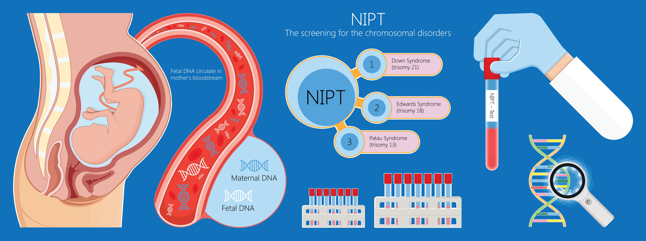
NIPD

Slide 15


Short Long Bones
Skeletal Dysplasia and NIPD
2015
Chitty LS, Mason S, Barrett AN, McKay F, Lench N, Daley R, Jenkins LA.
Non-invasive prenatal diagnosis of achondroplasia and thanatophoric dysplasia: next generation sequencing allows for a safer, more accurate and comprehensive approach. Prenat Diagn. 2015 Feb 26.

Slide 16


Vistara identifies probability for single-gene disorders that may have otherwise gone undetected prenatally (incidence 1:600)
fDNA screening for skeletal, cardiac, and neurological disorders
Ultrasound findings are not a reliable indicator
Conditions are not detected with standard microarray analysis
  • Noonan syndrome
  • Achondroplasia
  • Osteogenesis imperfecta
  • Hypochondroplasia
  • Thanatophoric Dysplasia
  • Rett syndrome
  • And 21 other conditions across 30 genes
Family history is typically not a good indicator of probability
Early identification of these conditions is clinically actionable
NIPS

Slide 17
Short Long Bones
Short Long Bones
Overall Management
Differential diagnosis
Monitoring during pregnancy
Non-lethal versus lethal
Place of delivery
Mode of delivery
Neonatal resuscitation (ENT, EXIT)
Recurrence

Slide 18
Short Long Bones
Recurrence Depends on Aetiology
IUGR
  Pre-eclampsia, APLS
Skeletal Dysplasia
  Autosomal dominant
  Autosomal recessive
  X-linked disorders
  Imprinting errors
  Somatic mosaicism
Genetic
Teratogen exposure

Slide 19

THANK
YOU

