Slide 1

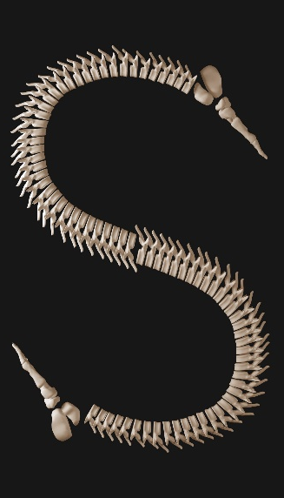
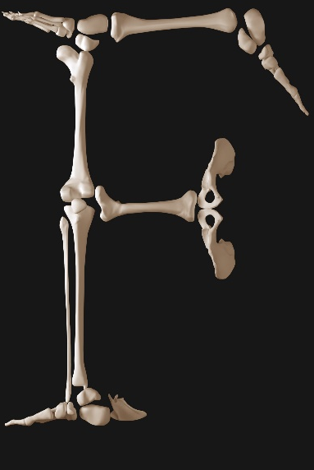
HORT EMURS
Dr Robert Bryan Beattie MD FRCOG
Consultant in Fetal Medicine
Cardiff and Vale University Health Board

Slide 2

Short Long Bones
Short Femurs
FL <5th% at Anomaly Scan
Consider the possibility of skeletal dysplasia
Check long bones, the shape of the head and chest.
  If abnormality suspected refer for further assessment.
  If no obvious abnormality repeat scan in four weeks
Repeat Scan
  If abnormality suspected refer for further assessment.
  If no obvious abnormality and no features of skeletal dysplasia or growth restriction/ placental insufficiency then no further follow up is required

Slide 3
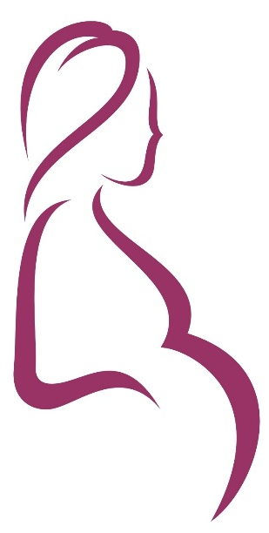
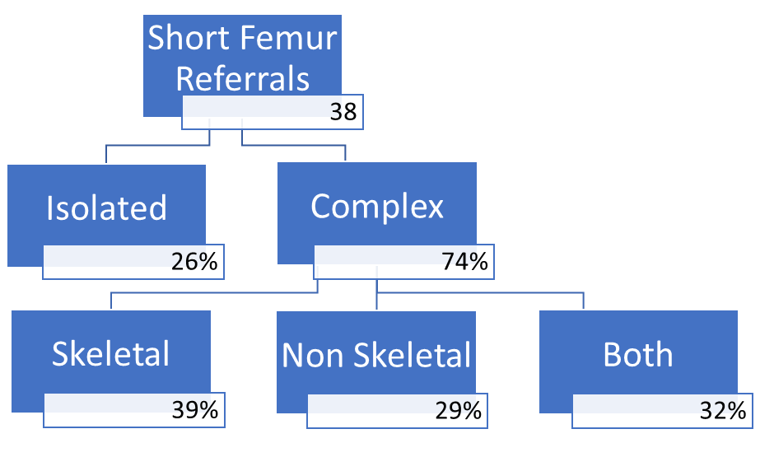
Short Long Bones
Short Femurs (FMU Audit E Dillon 2018)

Slide 4
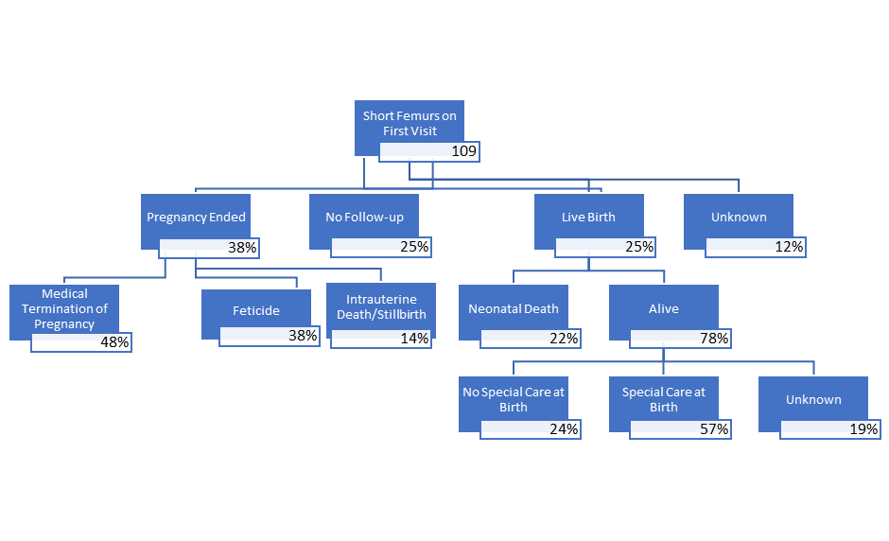
Short Long Bones
Short Femurs (FMU Audit E Dillon 2018)

Slide 5

DIFFERENTIAL DIAGNOSIS

Slide 6

Short Long Bones
International Skeletal Dysplasia Society
ISDS charity promotes scientific study in skeletal dysplasias & dysostoses
Nosology and Classification of Genetic Skeletal Disorders: 2010 Revision
  456 conditions in 40 categories - molecular, biochemical and radiographic criteria.
  316 associated with mutations in one or more of 226 individual genes
  molecular genetics plays significant role in the diagnosis of skeletal dysplasias
Prenatal Diagnosis of Skeletal Dysplasia
  Unexplained increased NT
  Short femurs on ultrasound
  Family or prior history of skeletal dysplasia
  Accurate classification only 50%
  Osteogenesis imperfecta type II, thanatophoric dysplasia and achondrogenesis type II (40%)

Slide 7

Short Long Bones
Differential Diagnosis
Constitutionally small
Growth restriction (placental insufficiency)
Symmetrically small for dates (alcohol, smoking)
Viral infection (Rubella, CMV, Toxoplasmosis, Syphilis, Varicella)
Chromosomally abnormal fetus (Down Syndrome)
Genetic syndrome
Skeletal dysplasia (non-lethal or lethal)
Focal bone abnormalities

Slide 8
Short Long Bones
Prenatal Assessment
Ultrasound
    Growth
    AFI
    Doppler
    Anatomical Review
    Long bones and foot length
Chromosome and genetics tests
Viral Screen
CT Scan
MRI
Post Mortem (if IUD/TOP)

Slide 9
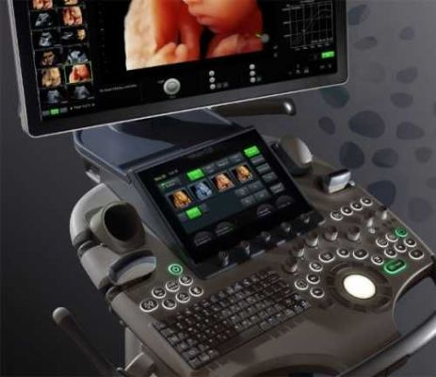
ULTRASOUND

Slide 10
Short Long Bones
Ultrasound Assessment (2D)
HC, AC, Thoracic circumference (based on first trimester dating)
Length of the long bones (femurs, humerus, radius, ulna, tibia, fibula, and clavicle)
Shape of long bones (straight, curved, bilateral vs. unilateral)
Appearance of the metaphyseal ends (spikes, irregularities)
Echodensity of long bones (well mineralized, poorly mineralized)
Foot (size and shape. femur:foot ratio 1.0)
Hands (number of digits, shape of phalanges, mineralization patterns)
Lateral view of the chest
Cranium and vertebral bodies (mineralization and shape)
Scapula and mandible (size and shape)
Secondary epiphyses (calcaneus >20 wks and knee epiphyses >28 wks)
Fetal profile (frontal bossing, presence of nasal bone, micrognathia)
Abnormal posturing of the extremities
Other congenital anomalies

Slide 11
Short Long Bones
Ultrasound Assessment (2D)
HC |------o-------|
AC |------o-------|
TC |------o-------|
FL |------o-------|
Tib |------o-------|
Fib |------o-------|
Hum |------o-------|
Rad |------o-------|
Uln |------o-------|
Foot |------o-------|
AFI |------o-------|
RI |------o-------|
HC |------o-------|
AC |------o-------|
TC |------o-------|
FL |------o-------|
Tib |------o-------|
Fib |------o-------|
Hum |------o-------|
Rad |------o-------|
Uln |------o-------|
Foot |------o-------|
AFI |------o-------|
RI |------o-------|
HC |------o-------|
AC |------o-------|
TC |------o-------|
FL |------o-------|
Tib |------o-------|
Fib |------o-------|
Hum |------o-------|
Rad |------o-------|
Uln |------o-------|
Foot |------o-------|
AFI |------o-------|
RI |------o-------|
Asymmetric IUGR
Placental Insufficiency
Symmetrical IUGR
Small Gestatonal Age
Skeletal Dysplasia
Rhizomelic

Slide 12
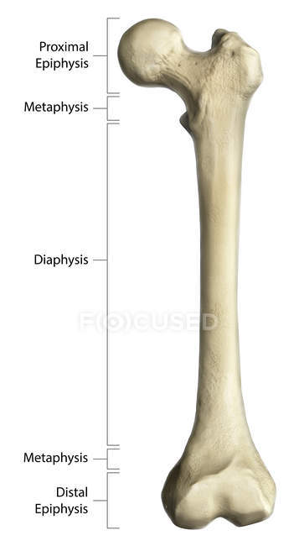
Short Long Bones
Types of Shortening
Type of shortening | Examples | Location | Examples
Rhizomelic Proximal Humerus/Femur | Achondroplasia | Epiphyseal | Chondrodysplasia punctata Spondyloepiphyseal dysplasia
Mesomelic Midlle Rad,Uln,Tib,Fib | Mesomelic dysplasia | Metaphyseal | Achondroplasia Chondroectodermal dysplasia
Acromelic Distal Hands,Feet | Acrodysostosis | Diaphyseal | Progressive diaphyseal dysplasia
Micromelic All Parts | Achondrogenesis | Combination | Spondylo-epimetaphyseal dysplasia Metatropic dysplasia Mucopolysaccharidoses

Slide 13
Short Long Bones
Ultrasound Assessment (2D)
Poor mineralization of the calvarium
Achondrogenesis IA
Cleidocranial dysplasia
Hypophosphatasia
Osteogenesis imperfecta Type II

Slide 14
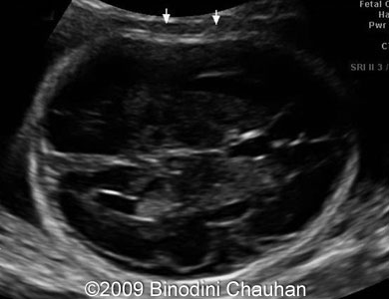
Compression of Skull
Osteogenesis Imperfecta
Poo

Slide 15
Short Long Bones
Ultrasound Assessment (2D)
Bent/bowed bones by ultrasound
Achondrogenesis IA, IB
Antley-Bixler syndrome
Atelosteogenesis I, II, III
Campomelic dysplasia
Diastrophic dyplasia
Hypophosphatasia
Osteogenesis Types II and III
Short-rib polydactyly syndromes (Types I–IV)
Stuve-Wiedemann syndrome
Thanatophoric dysplasia Types I and II

Slide 16
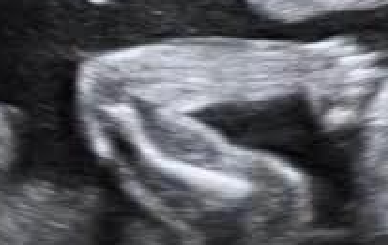
Bowed Humerus

Slide 17
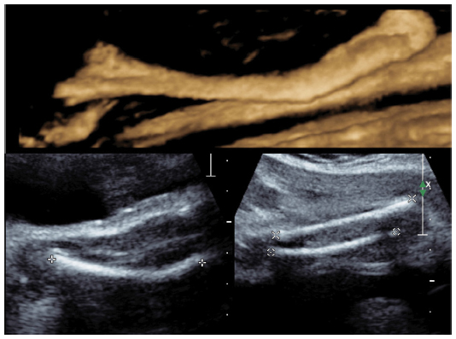
3D Ultrasound Compliments 2D
Enhanced visualization of femoral and tibial bowing
Platylospondelic lethal chondrodysplasia

Slide 18
Short Long Bones
Ultrasound Assessment (2D)
Poor mineralization of the vertebrae
Achondrogenesis IA, IB, II
Atelosteogenesis I, II, III
Opsismodysplasia
SMD—sedaghatian type
Thanatophoric dysplasia Types I and II

Slide 19
Short Long Bones
Ultrasound Assessment (2D)
Absent/hypoplastic scapula
Campomelic dysplasia

