Slide 1
Perthes Disease in Wales (1998-2014)
A preliminary investigation into its epidemiology
CARIS annual meeting
Ysbyty Gwynedd
20th November 2019

Slide 2
Background:
Affect hips on children
Classified by Orphanet as a rare disease of unknown prevalence
Unknown aetiology but vascular interruption has been proposed

Slide 3
Method:
2 databases explored : Community Childhealth Database and Patient Episode Database Wales.
ICD10 code for Perthes disease M91.1 was used and 113 cases were analysed.
Post code and Welsh Index of Multiple Deprivation used for deprivation scores.
CARIS register used to identify any associated congenital anomalies.

Slide 4
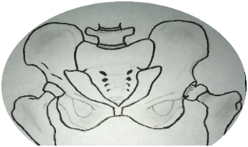
Results:
Right sided
32%
N = 36
Left sided
50%
N = 57
Bilateral
6%
N = 7

Slide 5
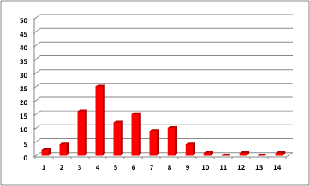
Age at diagnosis
Years

Slide 6
Sex ratio

Slide 7
Associated anomalies

Slide 8
Link with deprivation
Percentage of cases reported
Most deprived
Least deprived

Slide 9
Conclusion:
A rare condition causing hip pain in children, more common in boys and more common in the left hip.
Well known association with deprivation also seen in Wales.
Preliminary Welsh results suggest a prevalence of around 5 per 10,000 live births or an incidence of around 1.5 in 100,000 in the childhood population.
Other countries have widely varying incidence rates.
From 2007 , lower rates have been reported in Wales which may reflect the nature of the timing of diagnosis.

