Slide 1
Geographical variation in congenital anomaly prevalence rates in Wales
Bethan Bowden, Speciality Registrar in Public Health
20th November 2019

Slide 2
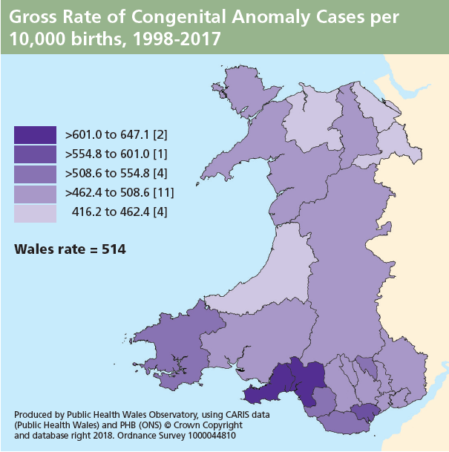
Background
What is the problem?
CARIS annual report demonstrates variation in prevalence across Wales
Higher rate of congenital anomaly cases in Swansea and Neath Port Talbot Local Authorities
Explained due to location of CARIS office in Swansea
Geographical variation in congenital anomaly prevalence rates in Wales

Slide 3
Background
What is the reason?
Bias – a systematic error that influences the results
Reporting into CARIS is different in different areas
Reporting into CARIS is greater in Swansea than other areas
Results in higher prevalence rates above All-Wales
Chance
No real difference exists
True
Real difference exists due to difference in population
Geographical variation in congenital anomaly prevalence rates in Wales

Slide 4
Approach to investigation
Key questions
When do the high prevalence rates in Swansea Bay occur?
Are the high prevalence rates in major or minor conditions?
Which systems or conditions account for the high prevalence rates?
Is there a difference in who is notifying cases to CARIS across Wales?
Geographical variation in congenital anomaly prevalence rates in Wales

Slide 5
Exploratory data analysis
By time
Prevalence rates presented from 1998 to current year
Explored prevalence rates for individual years
All cases from 1998 to 2016 = 32726
Analysed using new health board boundaries
Geographical variation in congenital anomaly prevalence rates in Wales

Slide 6
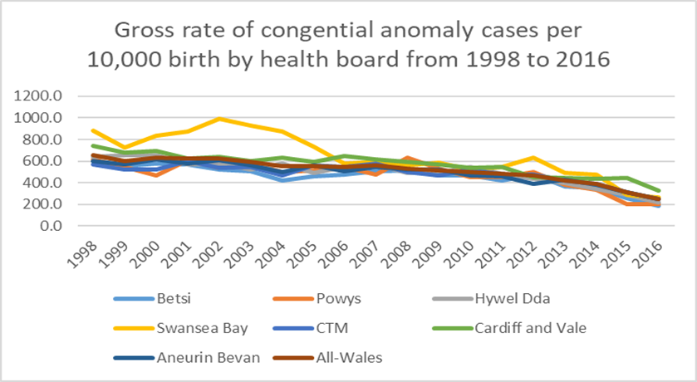
Exploratory data analysis
Analysis by time
High prevalence in Swansea Bay in early years of CARIS
Statistically significant higher prevalence rates in 1998 & 2000 - 2005
Prevalence rates for Swansea Bay return to All-Wales rates from 2006 onwards
Geographical variation in congenital anomaly prevalence rates in Wales

Slide 7
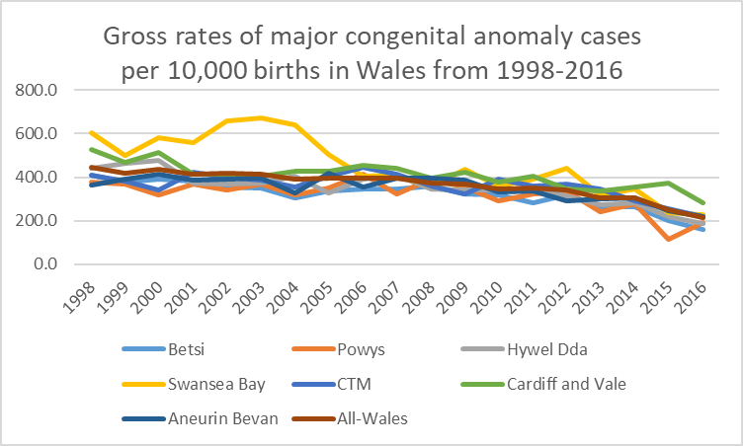
Exploratory data analysis
Analysis by disease severity
EUROCAT definition
Excluded spontaneous foetal loss before 20 weeks
Excluded minor anomalies
Higher prevalence in Swansea Bay but smaller peak
Statistically significant higher prevalence in 2001-2004
Geographical variation in congenital anomaly prevalence rates in Wales

Slide 8
Exploratory data analysis
Analysis by EUROCAT subgroups
No significant difference in congenital prevalence rates:
Nervous system
Ear, face and neck
Congenital heart defects
Respiratory
Oro-facial clefts
Abdominal wall defects
Genital
Other anomalies/syndromes
Chromosomal
Significant difference in congenital prevalence rates:
Eye
Digestive (1998 only)
Urinary
Limb
Geographical variation in congenital anomaly prevalence rates in Wales

Slide 9
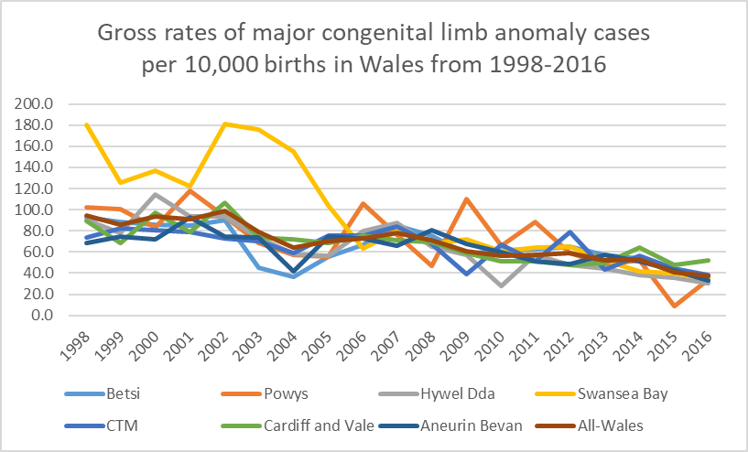
Analysis by system
Limb
Higher prevalence rates from 1998 to 2005
Statistically significant higher rates in 1998, 2002 to 2004
High numbers of dysplastic hips (unilateral and bilateral) reported in Swansea Bay with statistically significant higher rates in 2000, 2002 to 2004
High numbers of talipes equinovarus reported in Swansea Bay with statistically significant higher rates in 2002 to 2004
Geographical variation in congenital anomaly prevalence rates in Wales

Slide 10
Analysis by condition
High prevalence conditions
ICD-10 code | Anomaly | High prevalence | Statistically significant
Q10.0 | Congenital ptosis | 2002-03, 2005-07, 2013-14 | 2007
Q21.1 | Atrial septal defect | 2001 & 2002 | 2002
Q21.11 | Patent foramen ovale | 1998 to 2005 | 1998, 2002, 2004
Q31.5 | Laryngomalacia | 2001, 2004-05, 2007 | 2004, 2007
Q62.0 | Congenital hydronephrosis | 2000-05 | 2000-03
Q68.0 | Torticollis | 2003 & 2004 | 2004
Anomalies with spectrum of severity and clinical significance

Slide 11
Exploratory data analysis
Analysis by notification source from 2008 onwards
Patterns of notification different in Swansea Bay in comparison to Rest of Wales
Geographical variation in congenital anomaly prevalence rates in Wales

Slide 12
Exploratory data analysis
Analysis by notification source
Statistically significant higher rates of reporting in Swansea Bay in comparison with other health boards from:
Paediatricians
CARIS staff
Ophthalmologists
Cannot analyse pre-2008 data due to high missing data
No known change in patterns of clinician reporting
Geographical variation in congenital anomaly prevalence rates in Wales

Slide 13
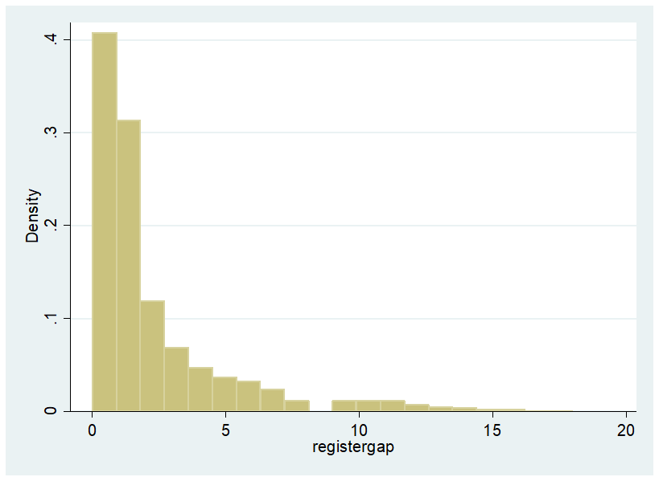
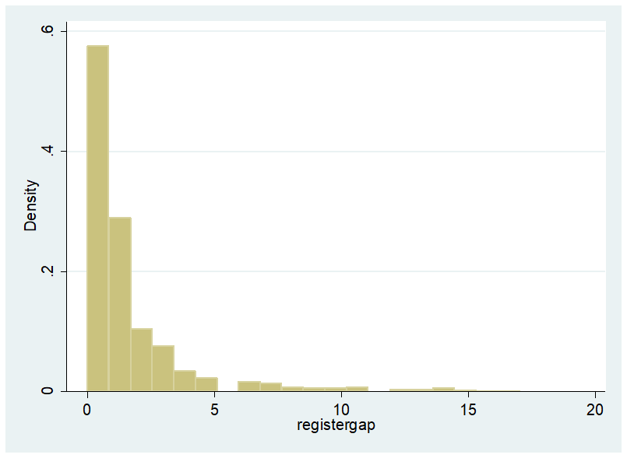
Statistical analysis
Registration gap
Gap between end of pregnancy and notification to CARIS
Shorter gap indicates clinician referral
Longer gap indicates secondary care data such as PEDW
Rest of Wales
Swansea Bay
Mann-Whitney U test to compare difference between registration gap in Swansea Bay and Rest of Wales
Statistically significant p <0.001
Geographical variation in congenital anomaly prevalence rates in Wales

Slide 14
Conclusions
What have we found?
Historical high prevalence rates for Swansea Bay
Excluding minor anomalies reduces magnitude of trend
Specific conditions identified – on spectrum of disease severity
Higher rates of reporting from specific notification sources
Geographical variation in congenital anomaly prevalence rates in Wales

Slide 15
Recommendations
What do we do now?
Greater understanding of how changes in policy and practice influence data into CARIS
EUROCAT definitions
Antenatal Screening Wales policies and procedures
Consider most appropriate time frame for annual report
Continue to monitor and review geographical variation:
Prevalence rates
Source of notification
Geographical variation in congenital anomaly prevalence rates in Wales

