Slide 1
An epidemiological analysis of sirenomelia in Wales: is sirenomelia more prevalent in Wales than the rest of Europe and are there clusters of Welsh cases?
Chris Emmerson, Public Health Specialty Registrar
CARIS Annual Meeting 2019

Slide 2
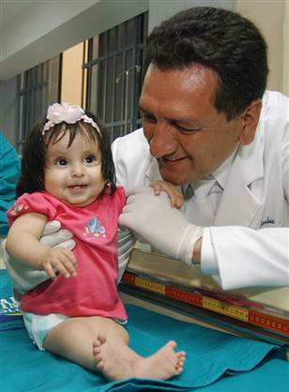
Sirenomelia
Rare congenital condition:
  serious defects of urogenital and gastrointestinal tract and spine
  single midline limb
  live births rare
Occurs early in fetal developmental
No definitive evidence on cause
No treatment

Slide 3
Sirenomelia in Wales
Cases of Sirenomelia recorded in Wales, 1998-2016 (n=17)
Notes:
We can see that there appear to have been more cases in specific years (2007) and over periods of years (1999-2002).
However, the numbers are small and these are figures for the whole of Wales, so if there are clusters (obviously one of our main concerns where we have higher-than-expected prevalence of a congenital anomaly with the possibility of an environmental link) we would need more detailed analysis than the epi curve alone can give us

Slide 4
Results: prevalence of Sirenomelia in Europe
NB – vertical axis trimmed, FWI upper CI=12.85
Notes:
Note the upper limit has been trimmed as the upper CI for French West Indies (technically part of France)
EUROCAT mean 1998-2016 was 1 per 100,000 – therefore consistent with previous studies
Orioli 2011 identified NE Italy and Hungary as the only other regions apart from Wales to show sign higher rates – only Wales comes through on this study (no Hungarian data included)

Slide 5
Results: Prevalence of Sirenomelia in Wales and Europe over time
Notes:
Used 3 year rolling averages, calculated by Observatory, so that meaningful confidence intervals could be calculated
Two periods (end of 1990s/start of 2000s and towards end of first decade of this century) where Wales seems to have gone above EUROCAT rate

Slide 6
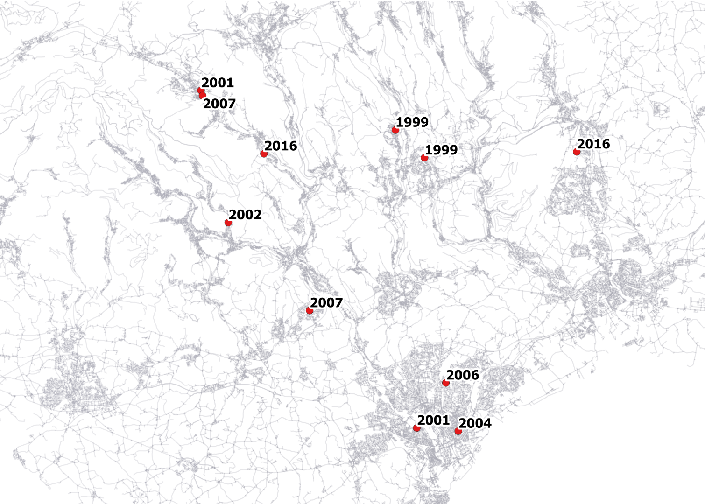
Mapping cases in South Wales
Sirenomelia in South East Wales: 11 cases, 1998-2016 mapped with roads
Notes:
This map shows the cases in South East Wales. The three cases at the bottom are in Cardiff, then we have a couple very close together in the NW of this map, in the Aberdare area, and a couple within a few km around Bargoed/Blackwood, with four others also around the Valleys area

Slide 7
Acknowledgements
David Tucker, CARIS Manager, Public Health Wales
Linda Bailey, former Consultant in Public Health, Health Intelligence, Public Health Wales
Dr Ceri White, former Principal Statistician, WCISU, Public Health Wales
Rhian Hughes, Observatory, Public Health Wales
Dr Monica Lanzoni, EUROCAT
Dr Sarah Jones and Dr Huw Brunt, Consultants in Environmental Health Protection, Public Health Wales
EUROCAT registry leads

