Slide 1

Trisomies The Early Neonatal Period
20th Annual CARIS Meeting
Maha Mansour
Neonatal Unit
Singleton Hospital

Slide 2
Outline
The 3 known human trisomies
with main focus on T21
focus on early life
Acknowledge personal experience
parents in the audience
as clinicians

Slide 3
Trisomy 21 Down Sx

Slide 4
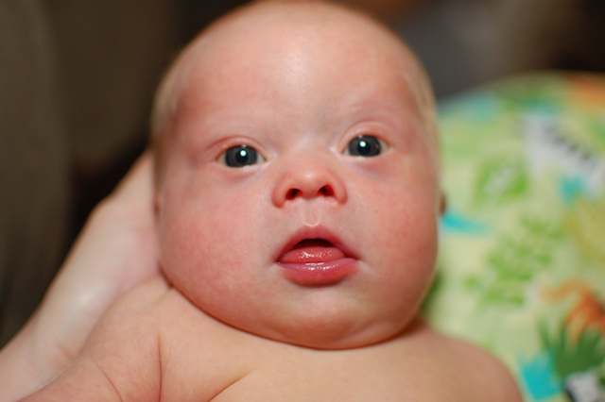
First impressions
Initial ‘suspicions’ (antenatal / postnatal)
Clinical diagnosis
“group of concurrent
medical observations”
Face & head
Hypotonia
Hands & feet
Genetics
First interactions with parents

Slide 5
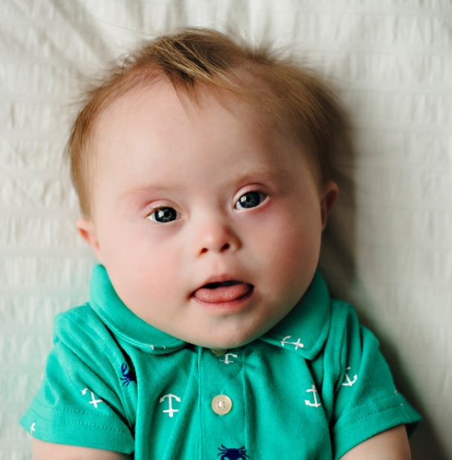
Time with Parents
Impossible to predict future strengths & weaknesses of any baby
Babies learn best when parents less stressed
→ empower parents
→ spend time with baby
→ point out the strengths
Peer support

Slide 6
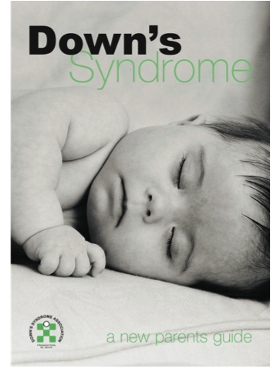
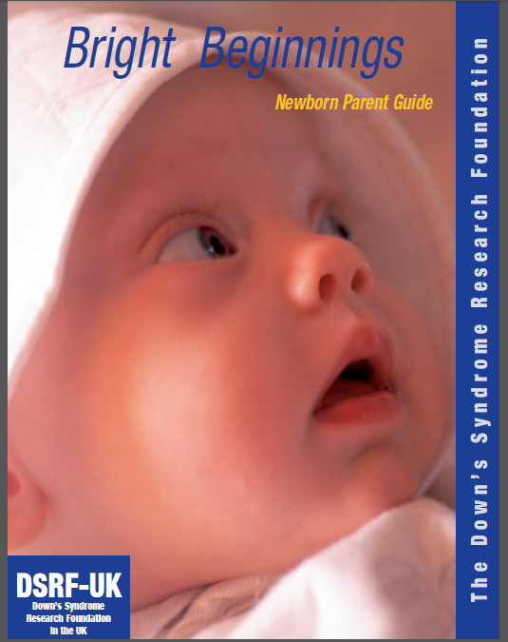
Information for Parents

Slide 7
Early ‘medical’ issues
Feeding
Poor suck
Frequent respiratory infections
Congenital heart disease
Aprox 40% of babies with T21 (vs. 1%)
L to R shunts – AVSD, ASD, VSD, PDA
PPHN *
Haematology

Slide 8
Rx considerations in first year
Feeding (& growth)
CHD
Early intervention
Specialist H.V.
Early MDT: OT, PT, SLT, playgroups
Early liaising with education

Slide 9
Screening in first year
Vision
Mypoia – up to 70%
Nystagmus – up to 35%
Strabismus – up to 45%
Hearing
Frequent ear infections – up to 80%
Vital for speech
Thyroid dx in 10%

Slide 10
Milestones
 | Down age range | Typical age range
Sits alone | 6 – 30 months | 5 – 9 months
Crawls | 8 – 22 months | 6 – 12 months
Stands | 1 – 3.5 years | 8 – 17 months
Walks alone | 1 – 4 years | 9 – 18 months
First word | 1 – 4 years | 8 – 23 months
Two-word phrases | 2 – 7.5 years | 15 – 32 months
Responsive smile | 1.5 – 5 months | 1 – 2 months
Finger feeds | 10 – 24 months | 7 – 14 months
Drinks from cup | 12 – 32 months | 9 – 17 months
Bowel control | 2 – 7 years | 16 – 42 months
Dresses self | 3.5 – 8.5 years | 3.5 – 5 years

Slide 12
Trisomy 18 Edward Sx

Slide 13
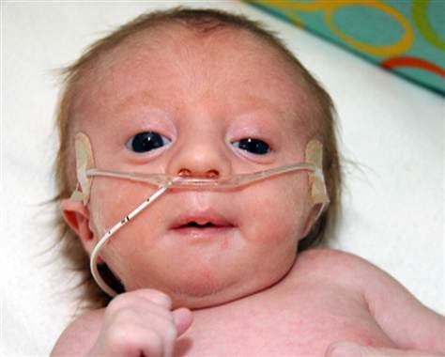
T 18
1: 6,000 live births
92% antenatal detection
F:M = 4:1
↑ incidence with ↑ maternal age
5 – 10% survive 1st yr
55% die within 1st week

Slide 14
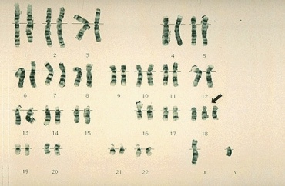
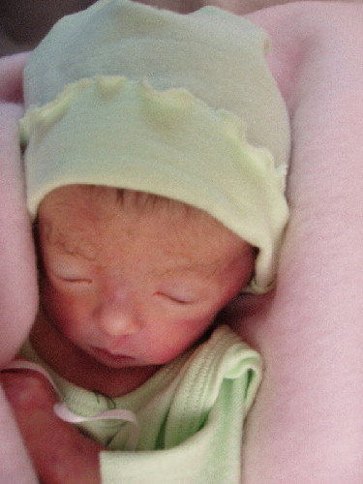
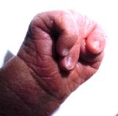
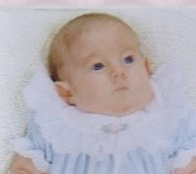
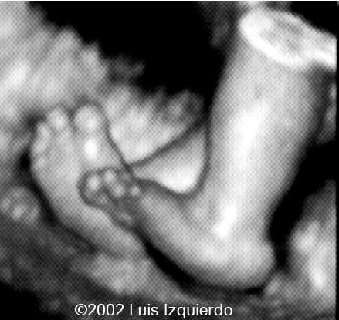

Slide 15
General
↓ fetal movements, often premature
Low bt wt, hypoplasia of skeletal muscle & subcut tissue
Hypertonic after neonatal period
Craniofacial
Wide fontanels, prominent occiput, microcephaly
Low-set, malformed ears, ptosis
Micrognathia, cleft lip/palate
Cardiac
VSD, ASD, PDA, Bicuspid AV, Coarct
Hands & Feet
Clenched hand, overlapping index finger over 3rd & 5th over 4th finger
‘Rocker bottom’ feet
Syndactyly 2nd & 3rd toes, 3rd & 4th fingers, palmar crease, dermatoglyphics
Torso
Short sternum, small widely-spaced nipples
Diastasis recti, umbilical / inguinal hernia
Skin
Redundant skin
Hirsutism of forehead & back
Genitourinary
Cryptorchidism, hypoplasia labia, with prominent clitoris
Horseshoe kidney, ectopic kidney, polycystic

Slide 17
Trisomy 13 Patau Sx

Slide 18
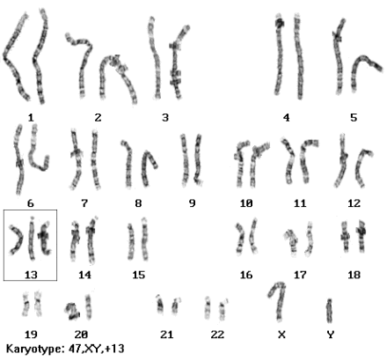
T 13
1st described in 1657 by Bartholin
Incidence 1:10,000 to 20,000 live births
Median survival 2 weeks

Slide 19
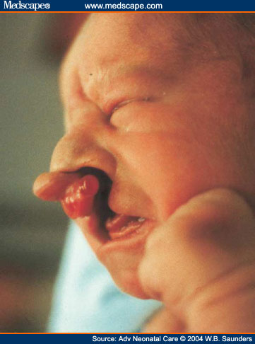
Central Nervous System
Holoprosencephaly type defects
Seizures, v severe learning disability, deafness
Craniofacial
Microcephaly, wide fontanels
Microphthalmia, coloboma of iris, retinal dysplasia
Cleft lip / palate, micrognathia, absent philtrum, low-set ears
Skin
Capillary haemangiomata, esp. forehead
Localised scalp defects in parieto-occipital area
Hands & Feet
Dermatoglyphics (distal palmar axial triradius)
Narrow, hyper convex nails & flexed, overlapping fingers
Polydactyly
Cardiac
In 80%
VSD, PDA, ASD, TAPVD

Slide 21
Trisomies
Very heterogeneous group
T 21 – bright beginnings
Inform & support parents
Screen & treat accordingly
Early intervention
T 18 & T 13
Inform & support parents
Consider early involvement of palliative care team

Slide 22


