Slide 1
Down Syndrome (DS) - Challenges
Dr Praveen Jauhari
Consultant Paediatrician
CARIS Lead – Wrexham Maelor Hospital
15th November 2018

Slide 2
Topics
Challenges in delivering the diagnosis to parents
SPIKES – A Six-Step Protocol
DS – Best practice guidance

Slide 3
Challenges in delivering the diagnosis to parents
Medical education places more value on technical proficiency than communication skills
Many clinicians unprepared for complex communications and emotional intensity of such communications

Slide 4
Challenges in delivering the diagnosis to parents
A difficult news delivered inadequately and insensitively can impair parent’s long term consequences of that news
Clinicians fear the upset it may cause, evoking a reaction, fear/ stress of not tackling the situation well, fear of not knowing all the answers

Slide 5
SPIKES – A Six-Step Protocol
Step 1 – SETTING UP the interview
Step 2 – Assessing the patient’s PERCEPTION
Step 3 – Obtaining the patient’s INVITATION
Step 4 – Giving KNOWLEDGE and Info
Step 5 – EMOTIONS and EMPATHY
Step 6 – STRATEGY and SUMMARY

Slide 6
Step 1 – SETTING UP the interview
Consultant Paediatrician and +/- Obstetrician
As soon as possible in post natal setting
Both parents together with baby in their arms
Quiet room, undisturbed, allow for emotion
Paediatrician to know the facts well – name of the child, antenatal results and examination

Slide 7
Step 2 – Assessing the patient’s PERCEPTION
Establish parents understanding about DS
How much they know and their experience
What have they been told so far –”before you tell, ask”
Parent’s comprehension and perception – tailor made information
How much they want to know?
Their emotional state, denial, unrealistic expectations

Slide 8
Step 3 – Obtaining the patient’s INVITATION
Most parents would ask for all necessary information explicitly
For some parents – shunning information is a psychological coping mechanism
Weigh how much to tell initially and how much later

Slide 9
Step 4 – Giving KNOWLEDGE and Info
Congratulate the parents on the birth of their child
Establish the reason of your visit – concerns of DS. Inform genetic results will take some time
Examine the baby - present the child in a positive but realistic light
Communicate in a manner respectful of parents feelings and in nonjudgmental fashion. Support parents decisions and work in partnership

Slide 10
Step 4 – Giving KNOWLEDGE and Info
Parents detest “I’m sorry” or “Unfortunately” or “Bad news”
Neutral and non directive language
Don’t use offensive and outdated terminology
Be honest and frank, if not certain about diagnosis. Inform what is being done

Slide 11
Step 4 – Giving KNOWLEDGE and Info
What is DS, what causes it?
Common and anticipated health conditions
Tests needed to confirm post-natally
Discuss need to perform investigations if diagnosis of DS is confirmed
Need for further arranged meetings
Info leaflet, info on support groups
Possible disability and other surveillance needed
Ensure understanding

Slide 12
Step 4 – Giving KNOWLEDGE and Info
Simplify your information. Avoid using medical jargon
Use short words and sentences
Tell them the most important things first
Tell them what they need to remember
Try to talk what applies to the child

Slide 13
Step 5 – EMOTIONS and EMPATHY
Prepared to deal with the parents’ emotional reactions, and be sensitive to them. These could be tearfulness, shock, sadness, silence, denial or anger
Convey warmth, insight and respect. Avoid negative predictions of the future
Good verbal and non verbal communication
Be prepared to spend time, being a good empathetic listener

Slide 14
Step 6 – STRATEGY and SUMMARY
There will be challenges but joys will soon outweigh them
Supportive, working in partnership
Best support will be parents for each other
Support from DSA
Summarise – addressing fears and concerns

Slide 15
DS – Best practice guidance
Dx antenatal – repeat postnatal karyotype
Examine thoroughly
Feeding assessment
DS – growth chart
Support parents
Counseling and genetics

Slide 16
DS – postnatal ward
Hypotonia (80%)
Hyper flexible joints (80%)
Extra skin on back of neck (80%)
Facial profile (90%)
Transverse crease (45%)
Short middle phalanx of 5th finger (60%)
Feeding difficulty/ GORD

Slide 17
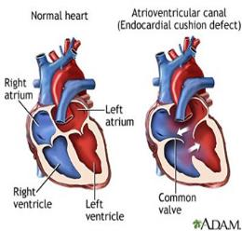
DS – Best practice guidance
Heart – 50% babies; 30-40% AVSD
ECG and ECHO, even if no murmur
Cardiologist assessment within 6 weeks
Possibility of earlier heart failure and PVD
Yearly assessment by Cardiologist

Slide 18
DS – Best practice guidance
Thyroid: Hypo in 1- 3.6%
Guthrie should detect most cases
If raised TSH – send lab TFT and start on thyroxine
Yearly TSH or 2 yearly TPO Ab and TFT

Slide 19
DS – Best practice guidance
Learning disability: Mild to moderate LD
Effects 15-20% of all LD population
Co-morbidities like ASD and ADHD
Behavioural issues to very placid children
Statementing, child development team
Physio, Occupational health, SALT

Slide 20
DS – Best practice guidance
Hearing: Universal hearing test
Glue ear – 35% - conductive loss
SN hearing loss – 4-6 times of general population
Initially : yearly then 2 yearly

Slide 21
DS – Best practice guidance
Vision: cataract 10 fold increase; refraction error
Nystagmus 10%
Initial detailed assessment by 4 years and then 2 yearly

Slide 22
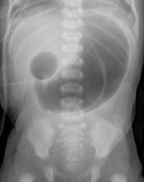
DS – Best practice guidance
GI tract: malformations in 7%
TOF 0.4%; pyloric stenosis 0.3%, duodenal atresia 3.9%; anal atresia 1%; Hirschprung 2.6%

Slide 23
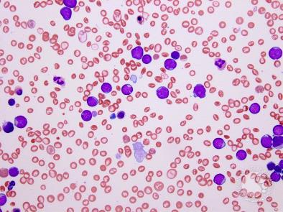
DS – Best practice guidance
Haematology: FBC → 10%
Transient myeloproliferative disorder
Transient Leukaemia

Slide 24
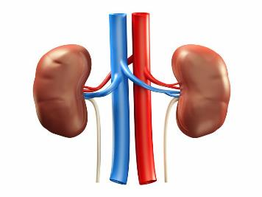
DS – Best practice guidance
Renal: no consensus on routine postnatal scan
Ensure descended testis

Slide 25
Initial Management of Down Syndrome
Ensure feeding established, bowels in 24 hours, passes urine
Hip examined, eyes for red reflex,
Support from Down Syndrome Support group, help and support for family
Genetic Test and FBC and Film, Guthrie
Plot growth chart, ECG, ECHO, Cardio referral 6 weeks
Chase TSH and act, Hearing screen, refer Ophthal
Info pack to family, inform GP, HV, community paeds, CDT

Slide 26
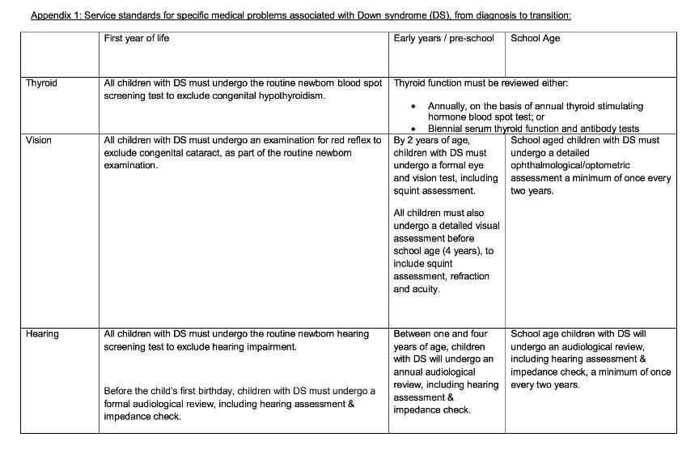
Surveillance for DS

Slide 27
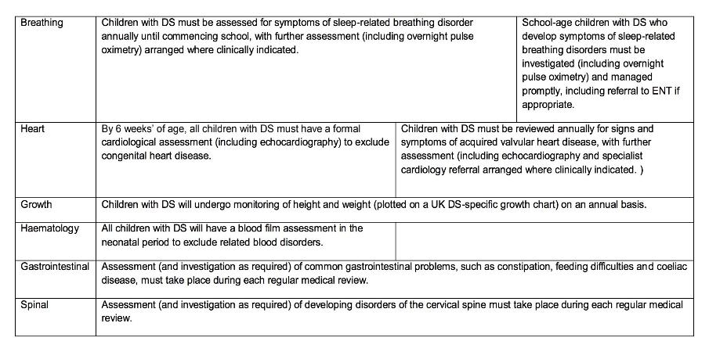
Surveillance for DS

Slide 28
Thank you

