Slide 1

CARIS Update
Fetal losses & trisomies

Slide 2
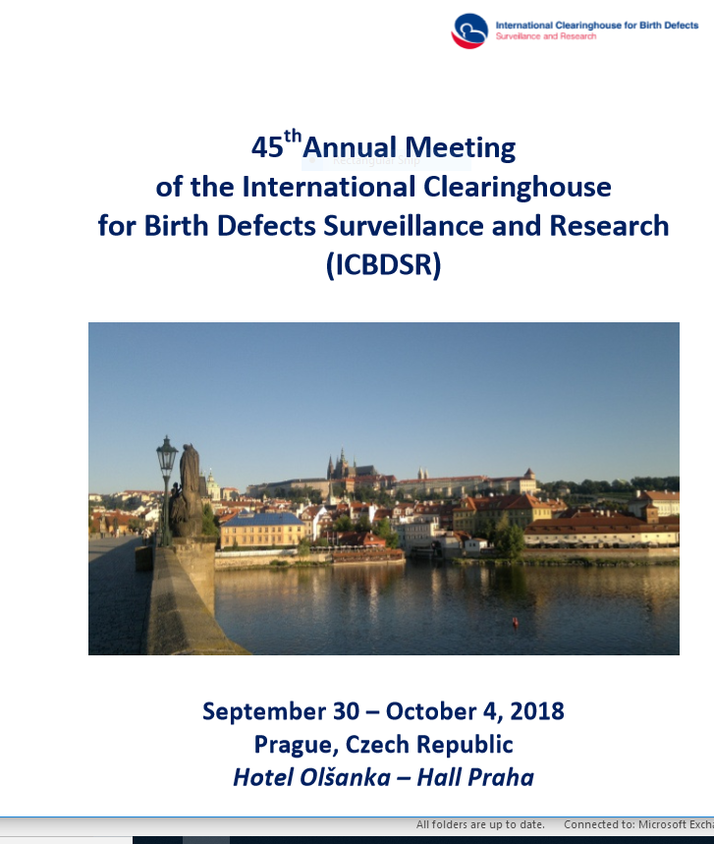
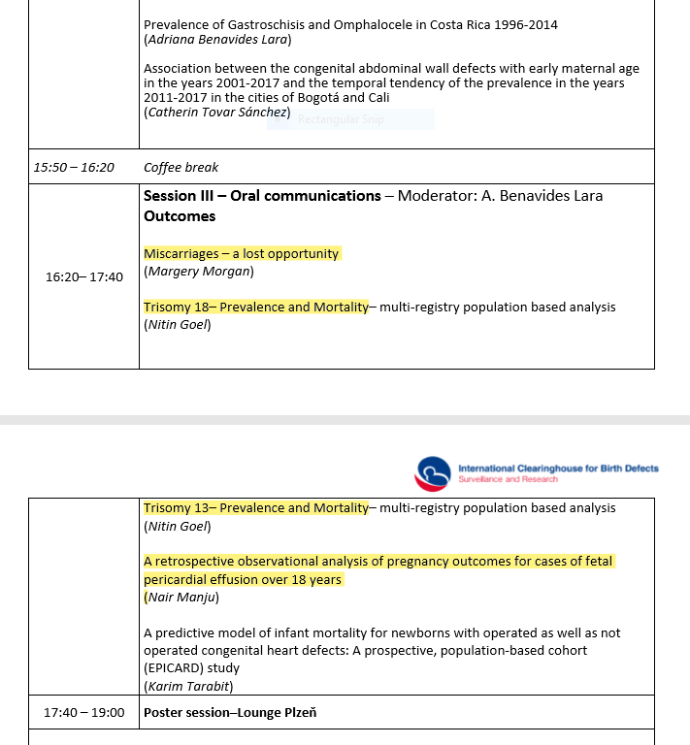

Slide 3
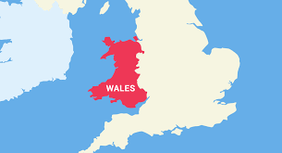
Miscarriages – a lost opportunity??
Khadija Janoowala, David Tucker, Margery Morgan
CARIS
Congenital Anomaly Register and Information Service for Wales

Slide 4
All cases of congenital anomaly – CARIS 1998-2016
n=29160 (excluding minor anomalies)

Slide 5
What do we know about miscarriages?
10-15% of all pregnancies end in spontaneous fetal loss
Causes include infection, uterine problems, maternal hormonal imbalance, immunological problems, fetal genetic/chromosomal abnormalities
Over 50% of miscarriages result from chromosomal abnormalities

Slide 6
Spontaneous fetal losses < 24 weeks n=858 CARIS 1998-2016

Slide 7
Miscarriages: chromosomal causes
Over 50% of miscarriages result from chromosomal abnormalities
More then 96% of these anomalies are aneuploidies
Trisomies 22, 15 and 16 most common (Coelho et al 2016)
Anomalies on chromosomes 13, 18, 21 and sex chromosome more common in late miscarriages (Menasha et al 2005)
Women with miscarriage due to aneuploidy are at increased risk of recurrence

Slide 8
Non chromosomal anomaly groups ending in fetal loss n=506 CARIS 1998-2016
Multiple
Cystic hygroma/hydrops
Musculo-skeletal

Slide 9
Gestational profile of miscarriage
chromosomal conditions 1998 - 2016
no. of cases
no. of cases

Slide 10
Amniocentesis and chorionic villus sampling – fetal losses CARIS 1998-2016
amniocentesis n=80
chorionic villus sampling n= 40
no. of cases

Slide 11
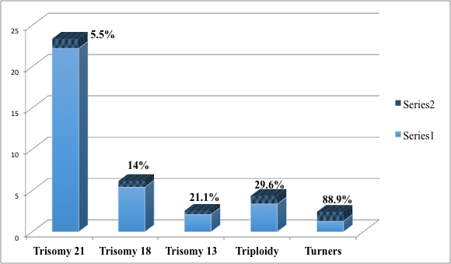
Change in prevalence (per 10,000 births) CARIS 1998-2016
Chromosomal Anomaly | Prevalence excluding spontaneous fetal loss | Prevalence including spontaneous fetal loss | % increase in cases
Trisomy 21 (n=74) | 22.2 | 23.36 | 5.5
Trisomy 18 (n=48) | 5.38 | 6.13 | 14
Trisomy 13 (n=28) | 2.09 | 2.53 | 21.1
Triploidy (n=72) | 3.35 | 4.34 | 29.6
Turners (n=63) | 1.27 | 2.41 | 88.9
% increase in cases
prevalence rate excluding spontaneous fetal losses

Slide 12
Comparison with EUROCAT
prevalence rates of chromosomal conditions 1998-2016 (per 10,000 births)

Slide 13
Outcome of trisomies (1998-2017)
In the prenatal setting, in addition to being nondirective, noncoercive, and unbiased, it is important to present the full spectrum of medical conditions prone to occur with Down syndrome
Toward better counseling for Down syndrome. Erawati V. Bawle MD, FACMG Genetics in Medicine volume 14, page 168 (2012)

Slide 14
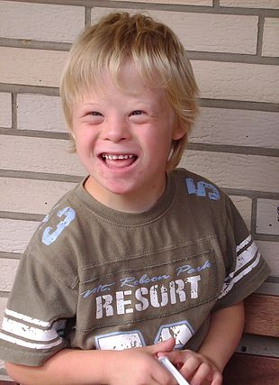
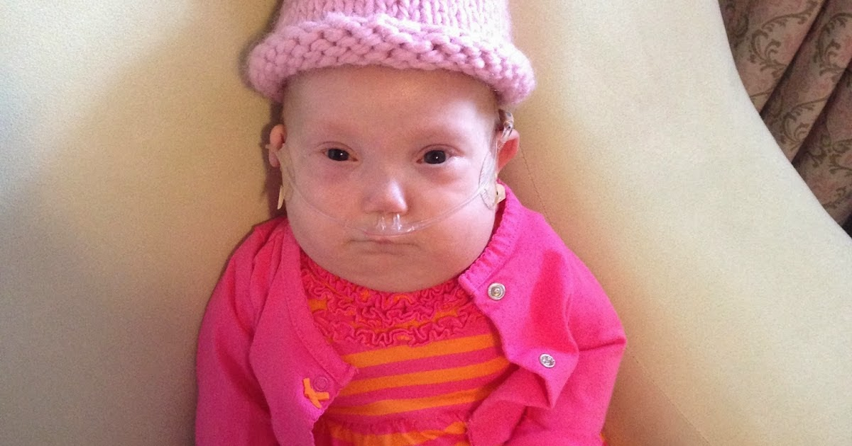
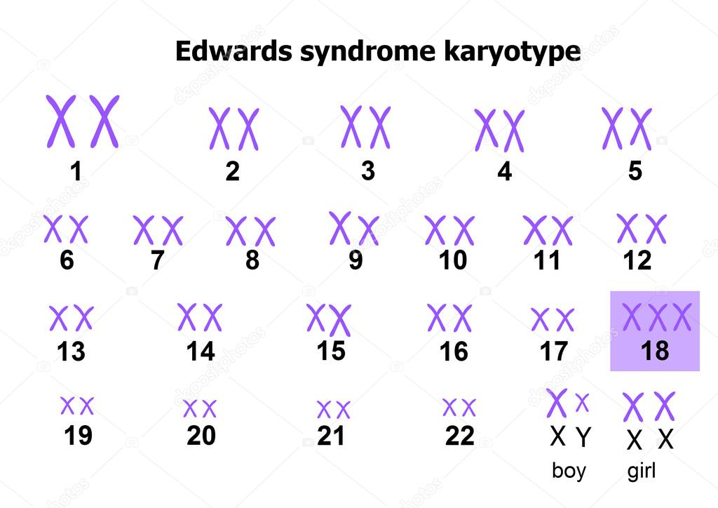
Down syndrome (DS or DNS), also known as trisomy 21, is a genetic disorder caused by the presence of all or part of a third copy of chromosome 21. It is typically associated with physical growth delays, characteristic facial features, and mild to moderate intellectual disability.
Patau syndrome is a syndrome caused by a chromosomal abnormality, in which some or all of the cells of the body contain extra genetic material from chromosome 13. The extra genetic material disrupts normal development, causing multiple and complex organ defects.
Edwards Syndrome (also known as Trisomy 18 (T18) or Trisomy E) is a genetic disorder caused by the presence of all or part of an extra 18th chromosome. The majority of people with the syndrome die during the fetal stage; infants who survive experience serious defects and commonly live for short periods of time.

Slide 18
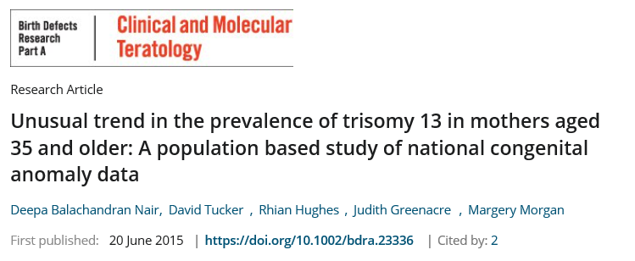

Slide 19

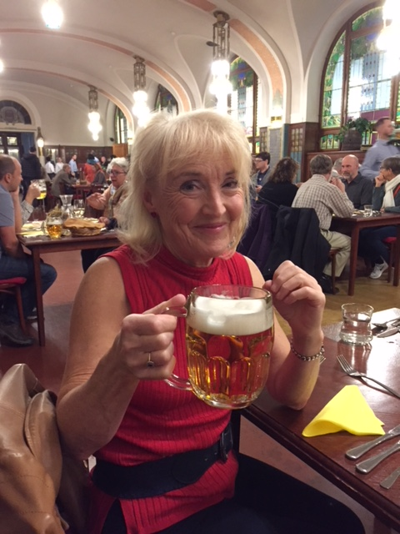
Trisomy 13 Prevalence and Mortality: multi-registry population based analysis
45TH ANNUAL MEETING (OCTOBER, 2018) PRAGUE, CZECH REPUBLIC
Nitin Goel
Joan K Morris
ICBDSR Group
Margery Morgan

Slide 20
Figure 2. Pregnancy outcomes in all registers
No Still births or TOPFA reported

Slide 21
Figure 5. Mortality in live births – one year follow-up data
No Still births or TOPFA reported
No TOPFA reported

Slide 22
Table 2. Survival in Live births from registries where complete 5-year follow up data was known
PROGRAM | Period |  | Number of cases | Number of Live Births | Survive 1 day |  | Survive 6 days |  | Survive 27 days |  | Survive 364 days |  | Survive 4 years |  | Alive at 5 years of age
 |  |  |  |  | Number | % | Number | % | Number | % | Number | % | Number | % | Number | %
ISRAEL | 2002 | 2014 | 14 | 14 | 11 | 78% | 4 | 28% | 1 | 7% | 0 | 0%
GERMANY | 1994 | 2014 | 35 | 5 | 5 | 100% | 1 | 20% | 0 | 0%
LOMB | 2003 | 2012 | 17 | 1 | 0 | 0% | 0 | 0%
MALTA | 2000 | 2013 | 6 | 4 | 4 | 100% | 3 | 75% | 1 | 25% | 0 | 0%
SWEDEN | 1974 | 2014 | 639 | 204 | 163 | 80% | 63 | 31% | 0 | 0%
ARKANSAS | 1998 | 2012 | 58 | 38 | 27 | 71% | 16 | 42% | 9 | 24% | 2 | 5% | 1 | 3% | 0 | 0%
TEXAS | 1999 | 2012 | 647 | 436 | 333 | 76% | 197 | 45% | 106 | 24% | 51 | 12% | 42 | 10% | 42 | 10%
UTAH | 1995 | 2012 | 150 | 87 | 50 | 57% | 29 | 33% | 12 | 14% | 5 | 6% | 4 | 4% | 4 | 4%
UKRAINE | 2001 | 2013 | 28 | 12 | 10 | 83% | 8 | 67% | 6 | 50% | 2 | 17% | 1 | 8% | 1 | 8%

Slide 23
Conclusions
This study provides an international perspective over the years on prevalence, pregnancy outcomes and survival in live births with T13
It highlights the variation in screening, data collection and reporting practices
Prevalence and outcomes varied by country and termination policy
Overall outcomes were poor with about half of live born infants not surviving the first week of life
However upto one-tenth survived the first year of life

Slide 24
Table 2. Survival in Live births from registries where complete 5-year follow up data was known
PROGRAM | Period |  | Number of cases | Number of Live Births | Survive 1 day |  | Survive 6 days |  | Survive 27 days |  | Survive 364 days |  | Survive 4 years |  | Alive at 5 years of age
 |  |  |  |  | Number | % | Number | % | Number | % | Number | % | Number | % | Number | %
ISRAEL | 2000 | 2014 | 11 | 11 | 7 | 64% | 3 | 27% | 2 | 18% | 0 | 0% |  | 0% |  | 0%
GERMANY | 1994 | 2014 | 125 | 24 | 20 | 83% | 16 | 67% | 13 | 54% | 4 | 17% | 4 | 17% | 4 | 17%
LOMB | 2003 | 2012 | 58 | 12 | 12 | 100% | 10 | 83% | 8 | 67% | 4 | 33% | 3 | 25% | 3 | 25%
MALTA | 2000 | 2013 | 29 | 21 | 18 | 86% | 14 | 67% | 9 | 43% | 2 | 10% | 1 | 5% | 1 | 5%
SWEDEN | 1974 | 2014 | 1335 | 232 | 167 | 72% | 62 | 27% | 0 | 0% |  | 0% |  | 0% |  | 0%
ARKANSAS | 1998 | 2012 | 167 | 90 | 73 | 81% | 52 | 58% | 34 | 38% | 10 | 11% | 9 | 10% | 9 | 10%
TEXAS | 1999 | 2012 | 1517 | 816 | 681 | 83% | 470 | 58% | 315 | 39% | 100 | 12% | 26 | 3% | 26 | 3%
UTAH | 1995 | 2012 | 316 | 138 | 90 | 65% | 61 | 44% | 37 | 27% | 11 | 8% | 6 | 4% | 6 | 4%
UKRAINE | 2001 | 2013 | 28 | 18 | 18 | 100% | 15 | 83% | 13 | 72% | 3 | 17% | 3 | 17% | 3 | 17%

Slide 25

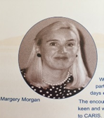
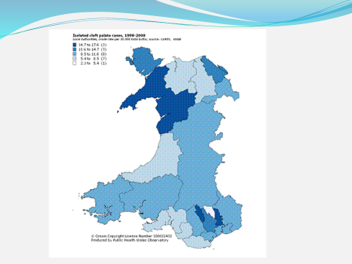
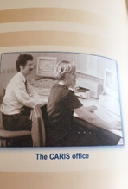
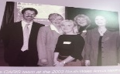
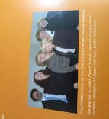
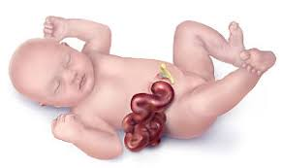
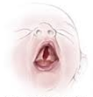
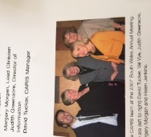
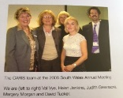
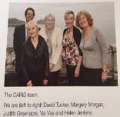
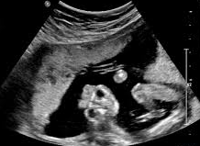

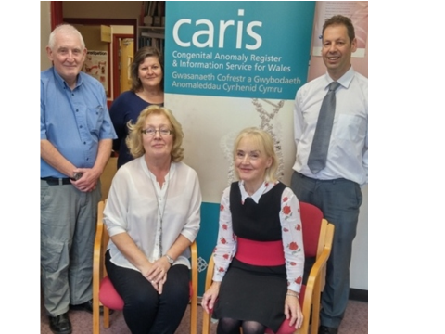



Improved cardiac anomaly detection by ultrasound over 20 years
High prevalence of isolated cleft palate in North Wales since 1998
Data sources
First reporting source to CARIS (2008-2012)
High prevalence rate of gastroschisis – cluster 2004
Overall congenital prevalence rate has fallen
First reporting source to CARIS (2013-2017)
Increase in genetic/chromosomal proportion
ultrasound anencephalic fetus
CARIS : 20 years in Wales
Khadija Janoowala, David Tucker, Margery Morgan
CARIS (Congenital Anomaly Register and Information Service for Wales, Swansea), United Kingdom
Data sources expanded to include ultrasound reporting at 20 weeks , inpatient data, child health and neonatal databases and molecular genetics.
The CARIS team: Vivian Morgan, Linda Bailey, Helen Jenkins, Margery Morgan, David Tucker
Annual reports are now shorter and bilingual
High rates of neural tube defects in Wales
BabySAFER campaign to highlight importance of preconception health 2013
-Data Protection Act (including GDPR)
-paper, web based/electronic reporting
Three conditions that have been causes for concern
-CARIS expanded to include Rare Diseases
-BabySAFER campaign
budget £100,000
EUROCAT joined
CARIS website created
International Clearing House joined
Incorporated into Public Health Wales
1998
2001
2004
2006
2011
2014
2018
1999
Exemption from patient consent by Patient Information Advisory Group
2003
Rationalising of soft chromosomal markers with reduction in reporting
2005
Health and Social Act – permission to collect data without consent
2009
EUROMEDICAT joined
2013
Case definition changed from up to 1 year to up to 18 years
budget £130,000 + research funds
-CARIS starts collecting data in Wales
-paper reporting system

Slide 26
Thank you for your support Diolch yn fawr iawn
Margery Morgan, CARIS, Wales

