Slide 1
PIMS-TS: Inflammatory complications in the time of COVID
Jennifer Evans
November 2021

Slide 2
Timeline of beginning of COVID pandemic
December 2019 – first patient in Wuhan China
January 7th 2020 – identification of new virus COVID-19
January 13th 2020 – first case outside China
January 31st 2020 – first 2 cases in the UK
5th March 2020 - first death in the UK
26th March 2020 – first lockdown
22nd April 2020 – peak of first wave in the UK

Slide 3
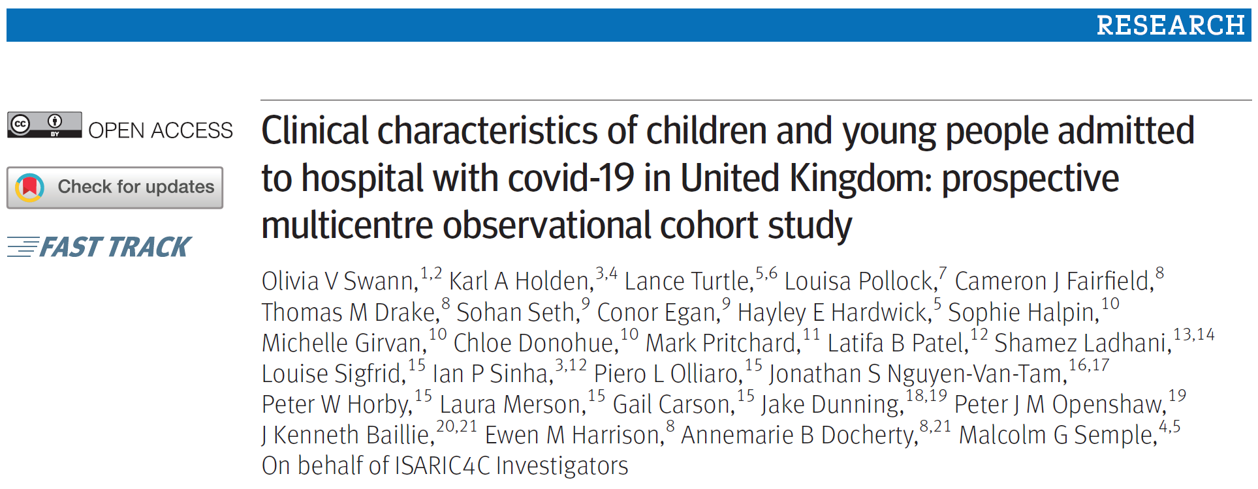
Between 17 January and 3 July 2020, 69 516 patients of all ages (range 0-106 years) were enrolled at 260 hospitals across England, Scotland, and Wales

Slide 4
Between 17 January and 3 July 2020, 69 516 patients of all ages (range 0-106 years) were enrolled at 260 hospitals across England, Scotland, and Wales

Slide 5
651 children, 138 hospitals
35% <12 months of age; median age 4.5years
42% at least one co-morbidity
18% critical care
Risk factors: <1month, adolescent, BAME, PIMS
6 deaths – all significant underlying co-morbidity

Slide 7
651 children, 138 hospitals
35% <12 months of age; median age 4.5years
42% at least one co-morbidity
18% critical care
Risk factors: <1month, adolescent, BAME, PIMS
6 deaths – all significant underlying co-morbidity
58 met PIMS criteria (pediatric inflammatory multisystem syndrome – temporally associated with SARS-cov2)

Slide 8
MIS-C timeline
Riphagen et al published
First case

Slide 9
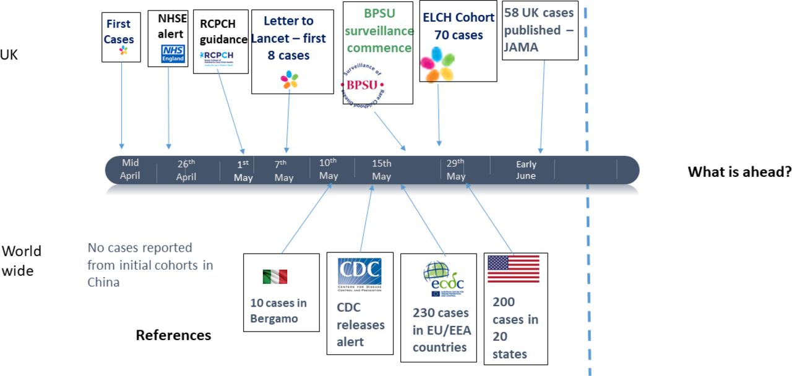

Timeline of paediatric inflammatory multisystem syndrome temporally associated with SARS-CoV-2 (PIMS-TS) development.1–4 6–9 NHSE, National Health Service England.
Marie White et al. Arch Dis Child 2020;105:1025-1027
Copyright © BMJ Publishing Group Ltd & Royal College of Paediatrics and Child Health. All rights reserved.
Notes:
Timeline of paediatric inflammatory multisystem syndrome temporally associated with SARS-CoV-2 (PIMS-TS) development.1–4 6–9 NHSE, National Health Service England.

Slide 10
Lancet Child and adolescent health 2020;4:669-77

Slide 11
Intensive care admissions
21/23 PICUs in the UK
78 patients
67% male
Median age 11 years (8-14)
Median observed to expected weight
ratio 1.22
78% no co-morbidities
47% afrocaribbean 28% Asian
22% PCR positive
Majority tested serology positive

Slide 12
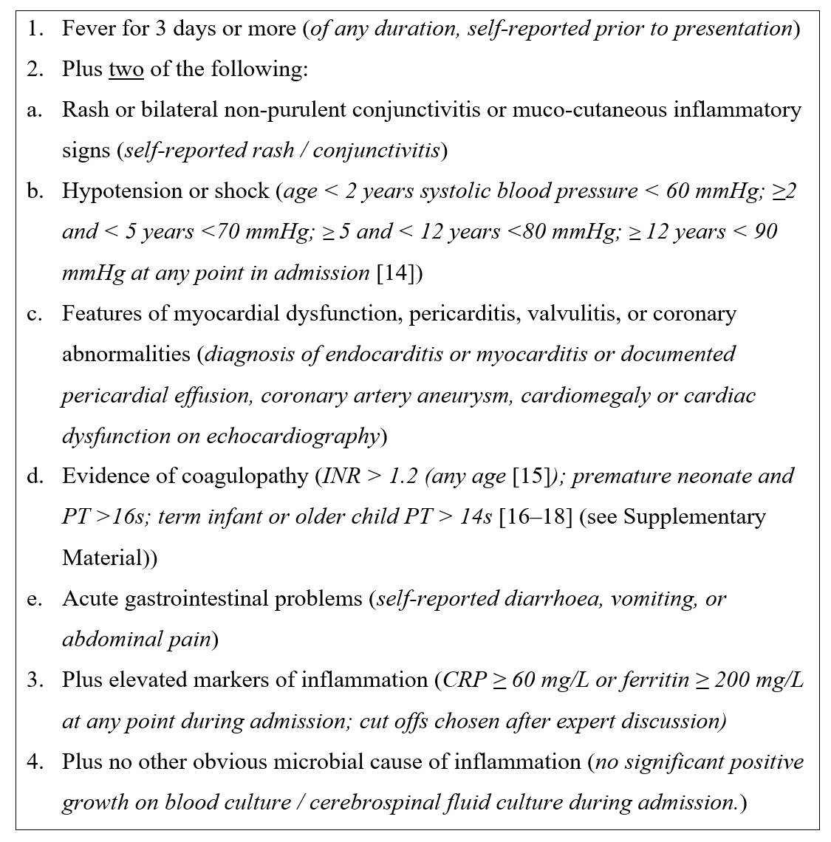

Modified who mis-c criteria
Multisystem inflammatory syndrome in Children

Slide 13
describes 3 phenotypes
Shocked Cohort n=29
Median age 10.5
Abdo pain diarrhoea +/- rash/erythema
Raised inflammatory markers
Raised cardiac enzymes
Echo- ventricular dysfunction and CA aneurysms
Frequently given 2 or more treatments
Some resolved without immune modulation
3 ECMO 1 Death
Kawasaki like disease n=13
Median age 8
Clinically meet AHA criteria 4/5 features
Raised inflammatory markers, milder increase cardiac markers
Echo – rare ventricular dysfunction +/- CAA
Managed as per KD guidelines – IVIG steroid and infliximab
No ECMO or death
Febrile and Inflammatory n=23
Median age 10
Range of features including abdominal pain, diarrhoea, mucocutaneous features, tachycardia common and mild hypotension
Raised inflammatory markers and cardiac enzymes
Echo +/- mild ventricular dysfunction +/- CAA
Variety of treatments including self resolution
No ECMO or death

Slide 14
How to define it ?
How to identify it ?
How to manage it ?

Slide 15
How to define it ?
How to identify it ?
How to manage it ?
What is the spectrum ?
Mild
Severe

Slide 16
Approach to management of PIMS-TS

Slide 17
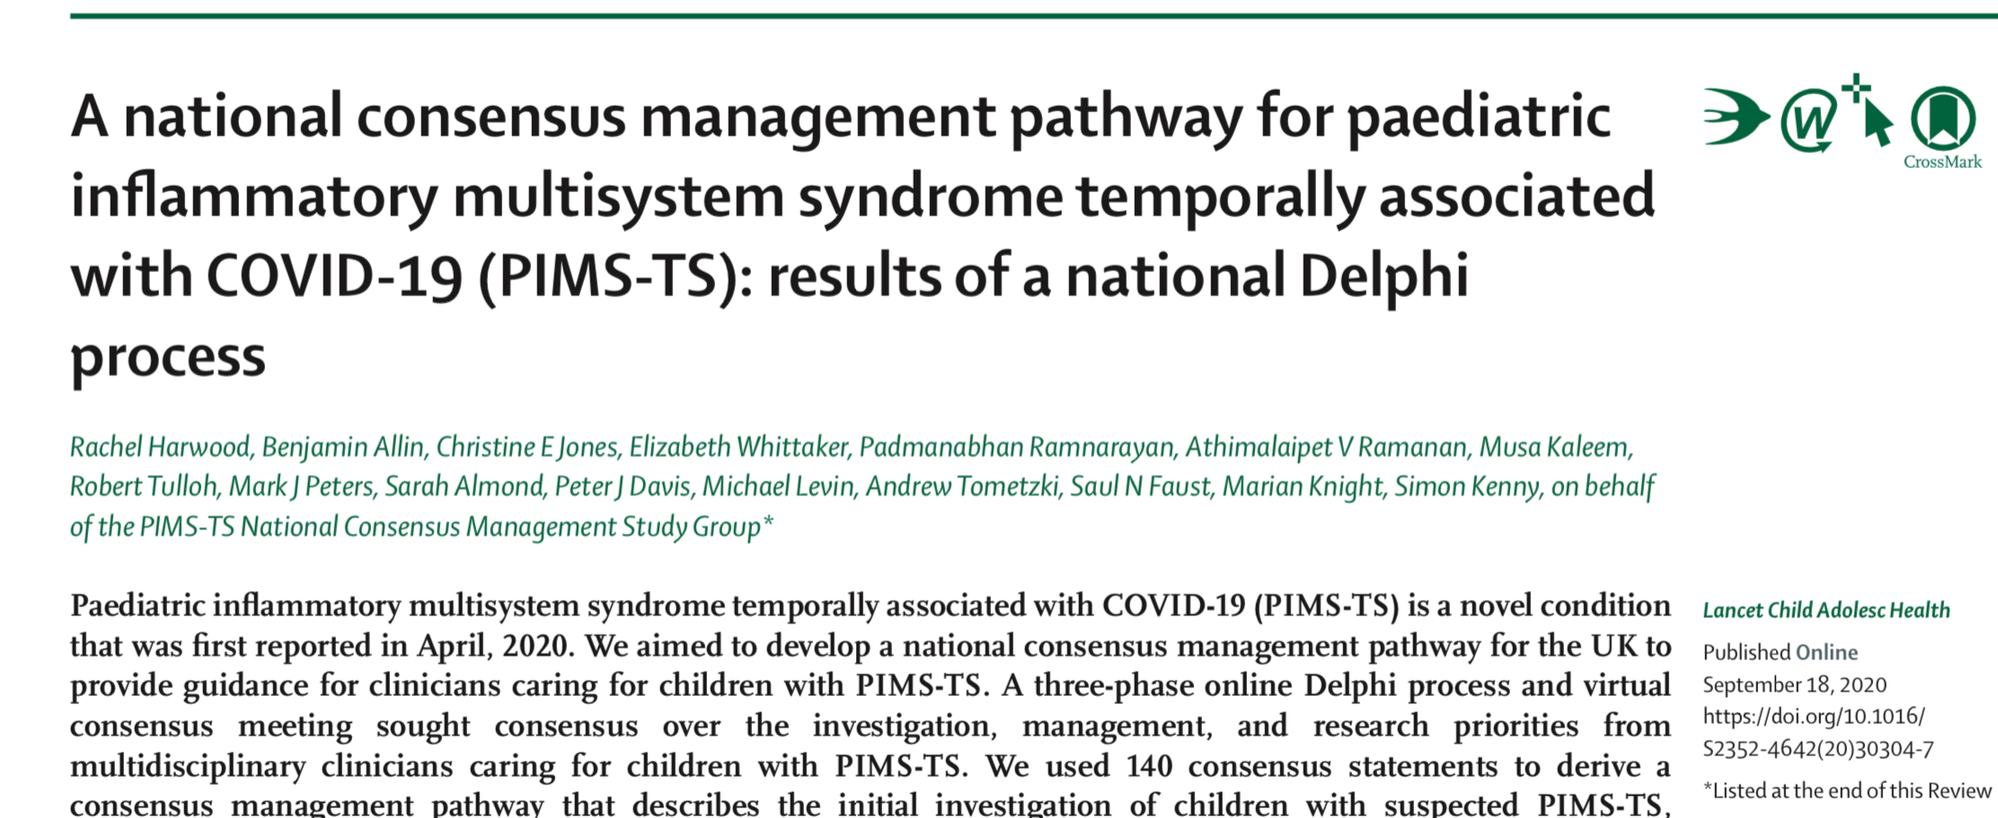

Slide 19
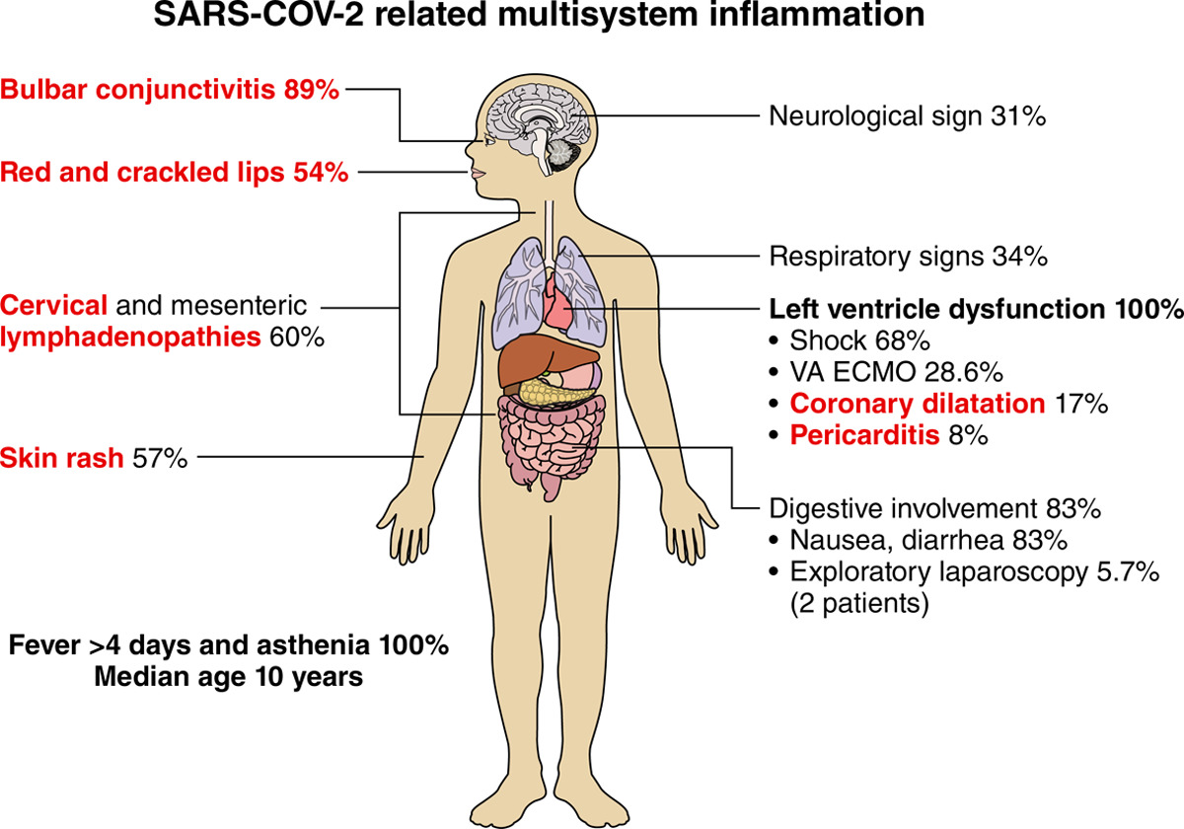
35 children from France & Switzerland Belhadjer Z et al Circulation May 2020
Schematic representation of the clinical signs in severe forms of SARS-CoV-2–related multisystem inflammation.
Red text indicates signs or symptoms consistent with Kawasaki disease
black text indicates signs that are rare in Kawasaki disease.

Slide 20
Gastrointestinal features in children with COVID 19: an observation of varied presentation in eight children
Tullie L et al The Lancet Child and Adolescent Health July 2020
8 children with atypical appendicitis then deteriorated
Imaging confirmed terminal ileitis & raised blood inflammatory markers
Highlights the need for abdominal imaging USS/ CT

Slide 21
Typical patient journey
7 year old boy – admitted to The Grange
After 2 days persistent fever despite antibiotics – developed widespread rash
Increasing markers of blood inflammation
Call to paeds ID UHW
Cardiac markers of inflammation increasing
Decision made to transfer to HDU UHW
Seen by PICU / cardiology / ID
Recruited into RECOVERY – IVIG
Deteriorated overnight
Needed O₂ and inotropes
Additional treatment with steroids

Slide 22
Typical patient journey 2
Remained on HDU for 3 days
Reviewed daily by ID, cardiology and PICU – together
Daily echocardiograms
Daily blood markers
Treated with steroids enoxaparin antibiotics
Transfer to the ward
Usual length of stay on the ward 5 days – ensure fever subsided and markers are down

Slide 23
Follow up
Patient remained on oral steroids and medication for reduced cardiac function
Outpatient review at 2 weeks – ID & cardiology including echo
Advice regarding recovery – patients extremely fatigued
Liason with local hospital – follow up there in 4 weeks

Slide 24
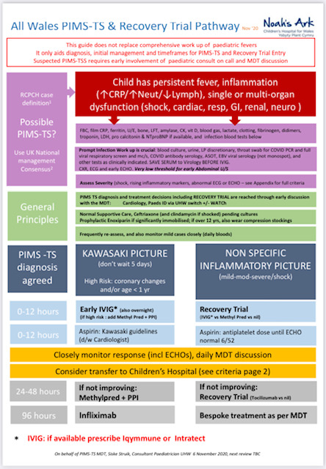
New presentations
Uncertain outcome
MDT based management
Flexible MDT content – led by ID
Local general paediatrician
Cardiology & local cardiology
PICU
Respiratory
Gastroenterology / surgery
Rheumatology

Slide 25
First wave – April to June 2020 – 13 cases
Continued to see cases of typical Kawasaki disease through the summer – significantly more than “normal”
First case of 2nd wave PIMS-TS seen November 3rd
Up to date – 22 PIMS-TS and 2 acute COVID requiring HDU

Slide 26
Second wave
November 2020 – June 2021
More cases of “classic PIMS”
End of October 2021v- entering 3rd wave

Slide 27
Cases of inflammatory disease related to COVID in South & West Wales April 2020 – November 2021

Slide 28
Cases of PIMS-TS / COVID second wave

Slide 29
Patients admitted to C & V n=14
7 patients received critical care
4 intubated and ventilated
3 non invasive ventilation / BP support

Slide 30
Treatment – 1st wave
IV antibiotics
If features of toxic shock should include clindamycin
Kawasakis – treat according to standard protocol

Slide 31
Treatment
IV antibiotics
If features of toxic shock should include clindamycin
Kawasakis – treat according to standard protocol
Some observations on the past few months
- we did what we thought made sense
Now we need to try and answer the questions on how best to treat

Slide 32
RECOVERY TRIAL Randomised Evaluation of COVID-19 Therapy:
Pragmatic trial
national clinical trial aims to identify treatments that may be beneficial for people hospitalised with suspected or confirmed COVID-19
Platform study for various treatments

Slide 33
RECOVERY TRIAL
Pragmatic trial
national clinical trial aims to identify treatments that may be beneficial for people hospitalised with suspected or confirmed COVID-19
Platform study for various treatments
Recovery
Acute respiratory COVID
Neonates with respiratory COVID
PIMS TS

Slide 34
RECOVERY for PIMS-TS – steroids IVIG or both?
Aim: compare steroids vs no additional treatment (in presence and absence of IVIg) and IVIg vs no additional (in presence and absence of steroids).
This design:
Allow investigators to use no treatment, IVIg or steroids or as standard care if deemed necessary
Allow effects of steroids and IVIg to be compared with no additional treatment separately (in presence and absence of other drug)
Allow wide spectrum of severity to be recruited because some treatment can be guaranteed but not absolutely required

Slide 35
All Welsh units had RECOVERY running for adults
Identified interested paediatricians in other health boards
Preliminary meeting explaining new pathway & RECOVERY
Business meeting to consolidate teams and process – paediatricians and local research teams – nurses & pharmacists
Grand round style teaching for whole department
All health boards joined and are ready to recruit

Slide 36
PATIENTS RECRUITED TO RECOVERY TRIAL n=10

Slide 37
Current situation
3rd wave started – last 2 weeks 8 cases
Results of RECOVERY awaited
Long term follow up reassuring

Slide 38
Resources
Tertiary centre – PICU / cardiology/
gastroenterology / rheumatology – not on call
No funded paediatric ID service in Wales
Transfer of patients into C & V secondary care beds from other health boards
Follow up – short term appointments – ID / cardiology

Slide 39
Thanks and acknowledgements
Siske Struik
Jo May
Julian Forton (UHW paediatric lead for RECOVERY)
Cardiology: Dirk Wilson Orhan Uzun Chris Gillett Alan Pateman Victor Ofoe
PICU Siva Oruganti Michelle Jardine
NICU Mali Chakraborty
Amar Wahid Ieuan Davies
Pharmacy: Neil Dawson Jess Girvin
Stephen Jolles
R&D Rhian Thomas-Turner Zoe Morrison Phil Connor
General paeds team at UHW

