Slide 1
Isolated Fetal Ascites
Dr. Odai Yaghi (ST3 O&G)
Dr. Margery Morgan (Consultant O&G)
Singleton Hospital

Slide 2
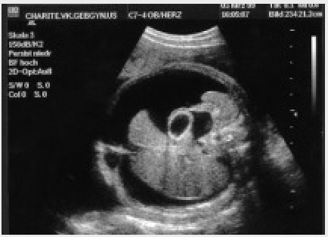
Background
Fetal ascites is an abnormal fluid collection in the fetal peritoneal cavity, and it is often the first finding in hydrops fetalis.
Hydrops fetalis (fetal hydrops) is defined as abnormal accumulation of fluid in two or more fetal compartments. This can include ascites, pleural effusion, pericardial effusion or skin oedema.
It may also be associated with polyhydramnios and placental oedema.

Slide 3
Causes of Fetal Ascites
  Abnormal lymphatic drainage
  Obstruction of venous return due to any space occupying lesion in the thorax
  Cardiac failure
  Decreased plasma oncotic pressure seen in fetal anemia, hepatic insufficiency (storage disease) or congenital nephrosis
  Increased capillary permeability
  Urinary tract obstruction
  Meconium peritonitis
  Chromosomal anomalies
  Intrauterine infection

Slide 4
Methodology
Retrospective review of CARIS data
Period of review: 22 years
Number of cases:
  Hydrops – 308 cases.
  Ascites – 241 cases.
Number of cases with isolated ascites – 67
Isolated = no other hydropic features

Slide 5
Fetal Ascites in Wales n = 67

Slide 6
n = 67

Slide 7
Maternal Factors n= 67
Known Cases | Medical History | Smoking | Alcohol | Drug Misuse
n=46 | 2 (DM) | 12 | 0 | 1

Slide 8
Outcome n = 67

Slide 9
Live Births: 6 Cases
Termination: 12 Cases
Live Births: 14 Cases
Termination: 12 Cases
IUD: 6 Cases
IUD: 3 Cases
IUD: 2 Cases
Live Births: 14 Cases
Notes:
Less than 20/40: Termination = 12, IUD = 6, Live births = 2.
20-27+6: Termination = 12, IUD = 3, Live births = 14.
28+: Termination = 0, IUD = 2, Live births = 14

Slide 10
Termination : Associated Anomalies n = 25

Slide 11
IUD : Associated Anomalies n = 11

Slide 12
Live Birth : Associated Anomalies n = 31

Slide 13
Fetal Ascites – Associated Anomalies n = 67

Slide 14
What This Study Adds
Large study.
Confirms early diagnosis is a poor prognostic feature.
Spontaneous resolution in 10% of cases only.
Widespread associated anomalies
  Preponderance of cardiac cases in live births.

Slide 15
Thank You

