Slide 1





HYDROPS
CARIS 2021
Dr Bryan Beattie MD FRCOG
Consultant in Fetal Medicine

Slide 2
Dr Bryan Beattie MD FRCOG
Medically qualified fetal medicine consultant who trained in Canada and the United Kingdom and Clinical Lead for NHS Fetal Medicine Service in Wales.
MD Thesis on Doppler Ultrasound in Obstetrics (Queens University Belfast).
Founder member of the British Maternal Fetal Medicine Society.
Executive Medical Director of Innermost Healthcare, a private women’s healthcare clinic in Cardiff, Wales.
Founder & Chairman of Innermost Learning-UK registered educational charity

Slide 3

HYDROPS
PREVALENCE 1:2000 births

Slide 4

HYDROPS
DIAGNOSIS

Slide 5
DIAGNOSIS
Abnormal accumulation of fluid in at least two places:
skin (oedema)
pericardial effusion
pleural effusion
ascites
Polyhydramnios
Placentomegaly (placental thickness >6 cm)

Slide 6
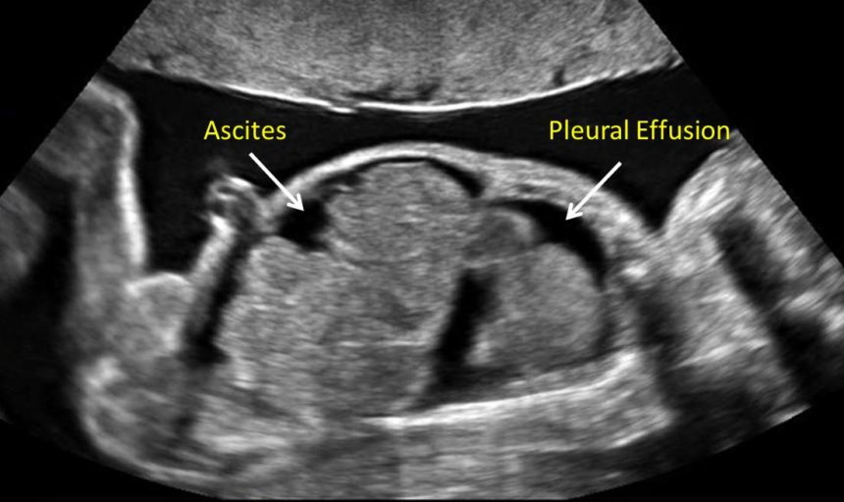
DIAGNOSIS
Oedema

Slide 7

HYDROPS
AETIOLOGY

Slide 8
AETIOLOGY
Non-specific finding in a wide variety of fetal and maternal disorders, including hematological, chromosomal, cardiovascular, renal, pulmonary, gastrointestinal, hepatic and metabolic abnormalities, congenital infection, neoplasms, malformations of the placenta or umbilical cord and genetic syndromes.
Classically divided into:
Immune: 10% of cases due to maternal haemolytic antibodies.
Non-immune: 90% of cases due to all other aetiologies.

Slide 9
AETIOLOGY
Anaemia: Red cell isoimmunization, Parvovirus B19, cytomegalovirus, α-thalassemia, fetomaternal hemorrhage, G6PD deficiency.
Infection: Cytomegalovirus, Parvovirus B19, toxoplasmosis, syphilis, herpes simplex, rubella, coxackievirus, varicella.
Chromosomal: Trisomies 21, 18 or 13, Turner syndrome, triploidy, tetraploidy.
Heart failure: Cardiac defects, dysrhythmias, myocarditis, cardiomyopathy, recipient in twin-to-transfusion syndrome.
Arteriovenous shunts: Fetal tumor, vein of Galen aneurysm, placental chorioangioma, acardiac twin.
Metabolic disorder: Mucopolysaccharidosis, Gaucher's disease, Hurler's syndrome, Gangliosidosis, Sialidosis.
Neuromuscular: Fetal akinesia deformation sequence.
Brain abnormality: Encephalocele, intracranial hemorrhage, porencephaly with absent corpus callosum.
Mediastinal compression: Skeletal dysplasias, diaphragmatic hernia, cystic adenomatoid malformation, pulmonary sequestration, laryngeal obstruction.
Hypoproteinemia: Renal defects, gastrointestinal defects.
Genetic syndrome: Arthrogryposis, Noonan syndrome, multiple pterygium syndrome, Pena-Shokeir syndrome, Cornelia de Lange syndrome, tuberous sclerosis.

Slide 10
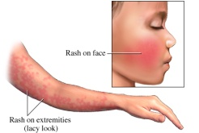

Parvovirus B19 and Pregnancy
“Fifth Disease”, “Slap Cheek”, “Erythema Infectiosum”
Infection Risk: up to 7 days before rash,
none if rash present
Spread: human to human only
(airborne respiratory droplet,
direct contact with contaminated surfaces or infected individuals)
Incubation: 4-20 days
Seroconversion: within 28 days
Adult Symptoms: usually none, mild rash, rarely arthralgia
Child Symptoms: rash on cheeks +/- lacy race on body especially after bath
Immunity: 60% adults
Maternal Fetal Transmission: 50%
Fetal Risks: usually none, fetal demise (9%),
rarely anaemia or hydrops (3%)
Rash
on face
Lacy rash
Rhodd gan Apel Martha Aur
A gift from Apel Martha Aur

Slide 11
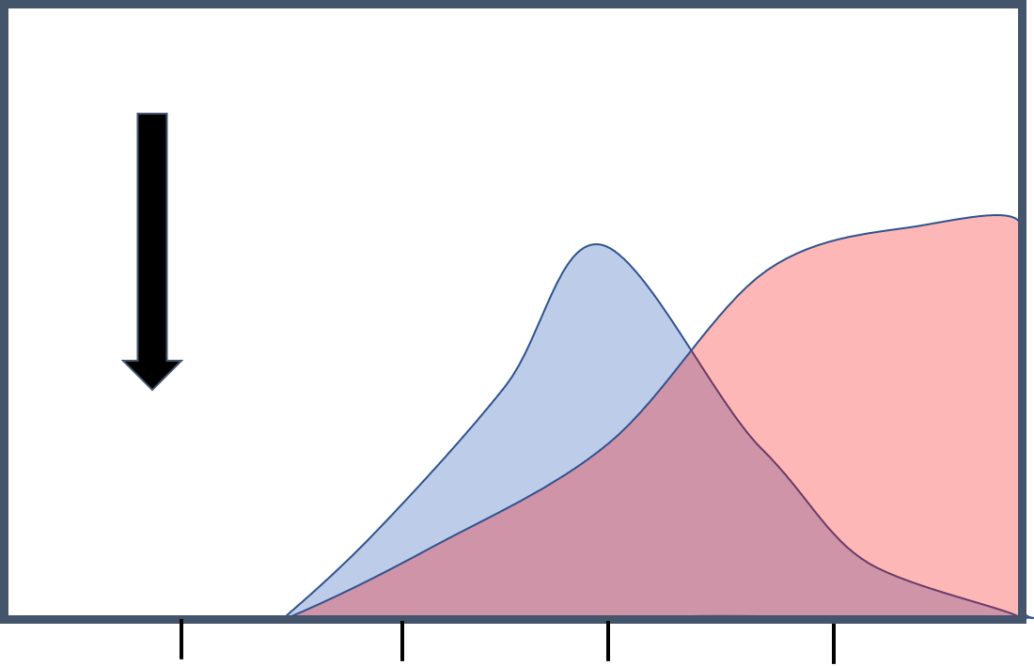

Exposure
Parvovirus B19 Management
Maternal Serology
Susceptible: IgM NEG, IgG NEG.
If recent exposure - repeat in 28 days
Recent Infection: IgM POS, IgG NEG or IgG POS
Compare with booking bloods for seroconversion
Past Infection: IgM NEG, IgG POS (ideally compare with booking bloods)
Management if IgM Positive
Ultrasound scans for 12 weeks after serology confirmation
under 18 weeks - scan 2-3 weekly for hydrops,
over 18 weeks - scan weekly for MCA Vmax
Refer to Fetal Medicine if abnormal scan
Tel: 02920 742279 fetal.med@wales.nhs.uk
IgG
IgM
Antibody
0 2 4 6
Weeks

Slide 12

Prenatal Diagnosis
DEBUG

Slide 13
PRENATAL DIAGNOSIS - D.E.B.U.G.
Demographics
age, ethnicity, carrier status, medical history, family history, obstetric history
External
drugs, radiation, toxins, viral infection (Rubella, CMV, Toxoplasmosis, Syphilis, VZ, Parvo)
Biomarkers
AFP, HCG,E2, Inhibin, PAPP-A (Quad Test, Combined Test)
Ultrasound and Imaging
Ultrasound (markers eg NT, anomalies, arrhythmia and cardiac function)
MRI
Fetoscopy
Genetics
invasive - amnio, CVS, FBS (PCR, karyotype, array CGH, exomes, SNP, FAGP)
non invasive prenatal testing – (Counting v Single Nucleotide Polymorphism)

Slide 14
INVESTIGATION
In many instances, the underlying cause may be determined by
Maternal:
red cell antibody screen and Kleihauer
infection screen (parvovirus, CMV, syphilis)
carrier screening (G6PD, Piruvate Kinase, a-thalassaemia)
Fetal:
ultrasound scan (anatomy and doppler studies)
echocardiography (structure, function, rate, rhythm)
amniocentesis (PCR, karyotyping and array)
fetal blood sampling (haemoglobin, red cell morphology)
Post Mortem:
hydrops often remains unexplained even after post mortem

Slide 15

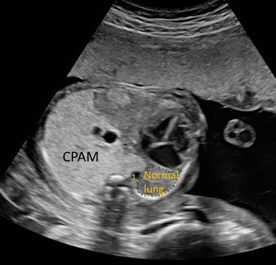
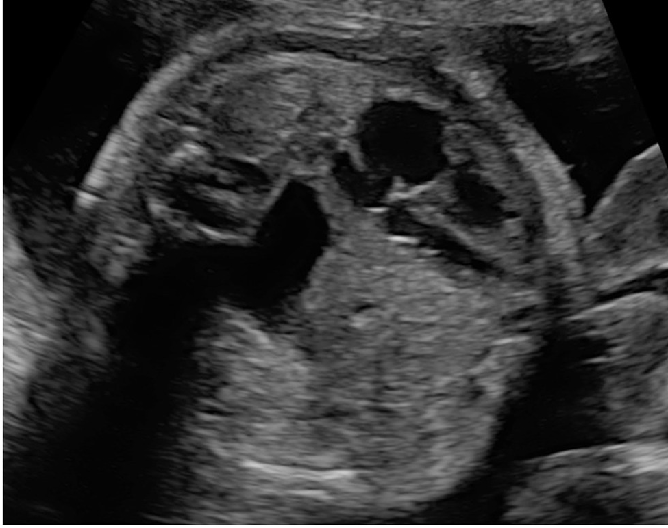
ULTRASOUND – LUNG MASS
Lung
Heart
Stomach
Lung
Bowel
Congenital
Diaphrgamatic Hernia
C.P.A.M.

Slide 16
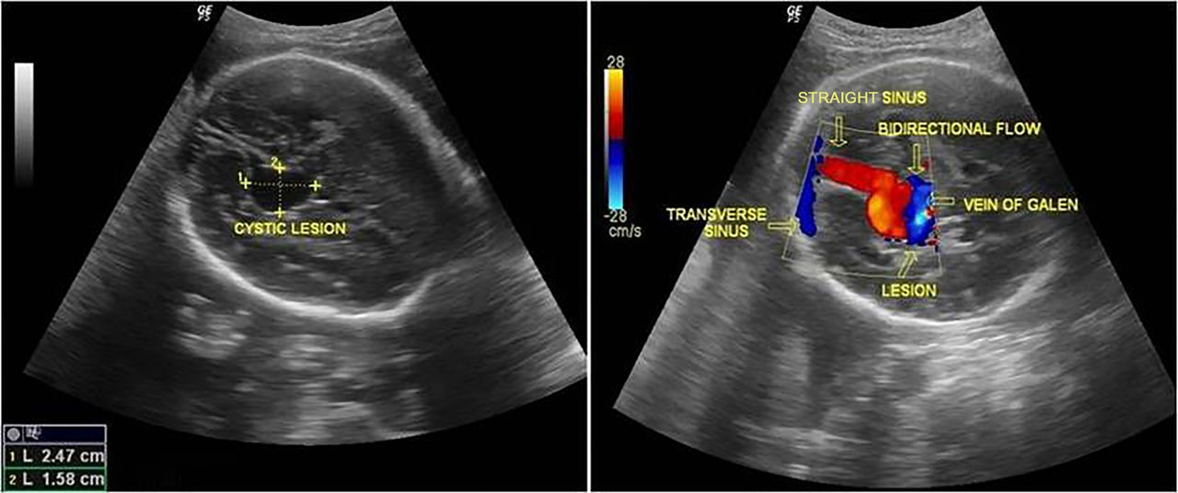
ULTRASOUND – AV SHUNT
Vein of Galen Aneurysm

Slide 17
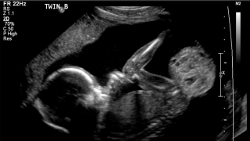
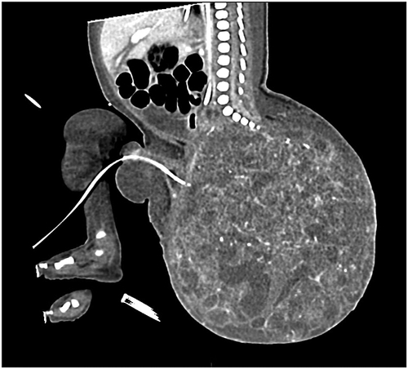
ULTRASOUND & MRI – Tumour
Sacrococcygeal Teratoma

Slide 18
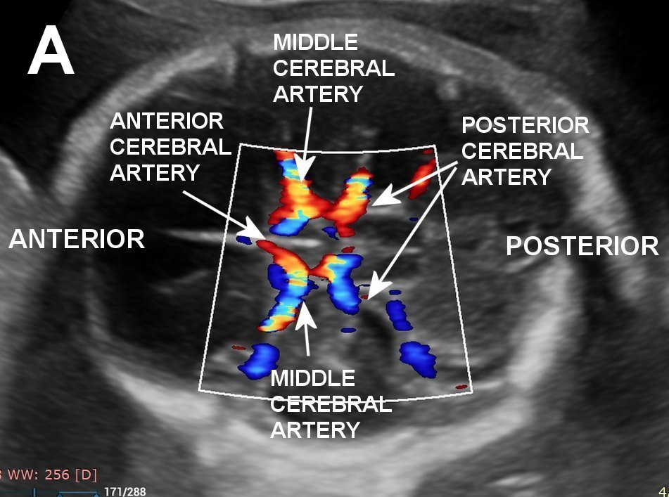
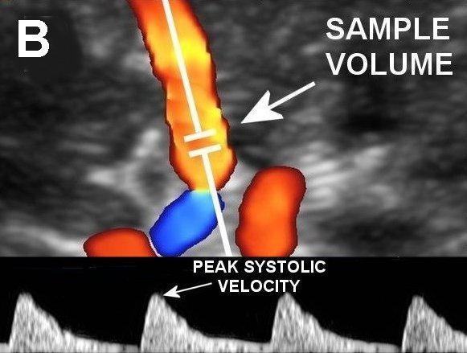
ULTRASOUND – Anaemia
MCA Vmax Measurement

Slide 19
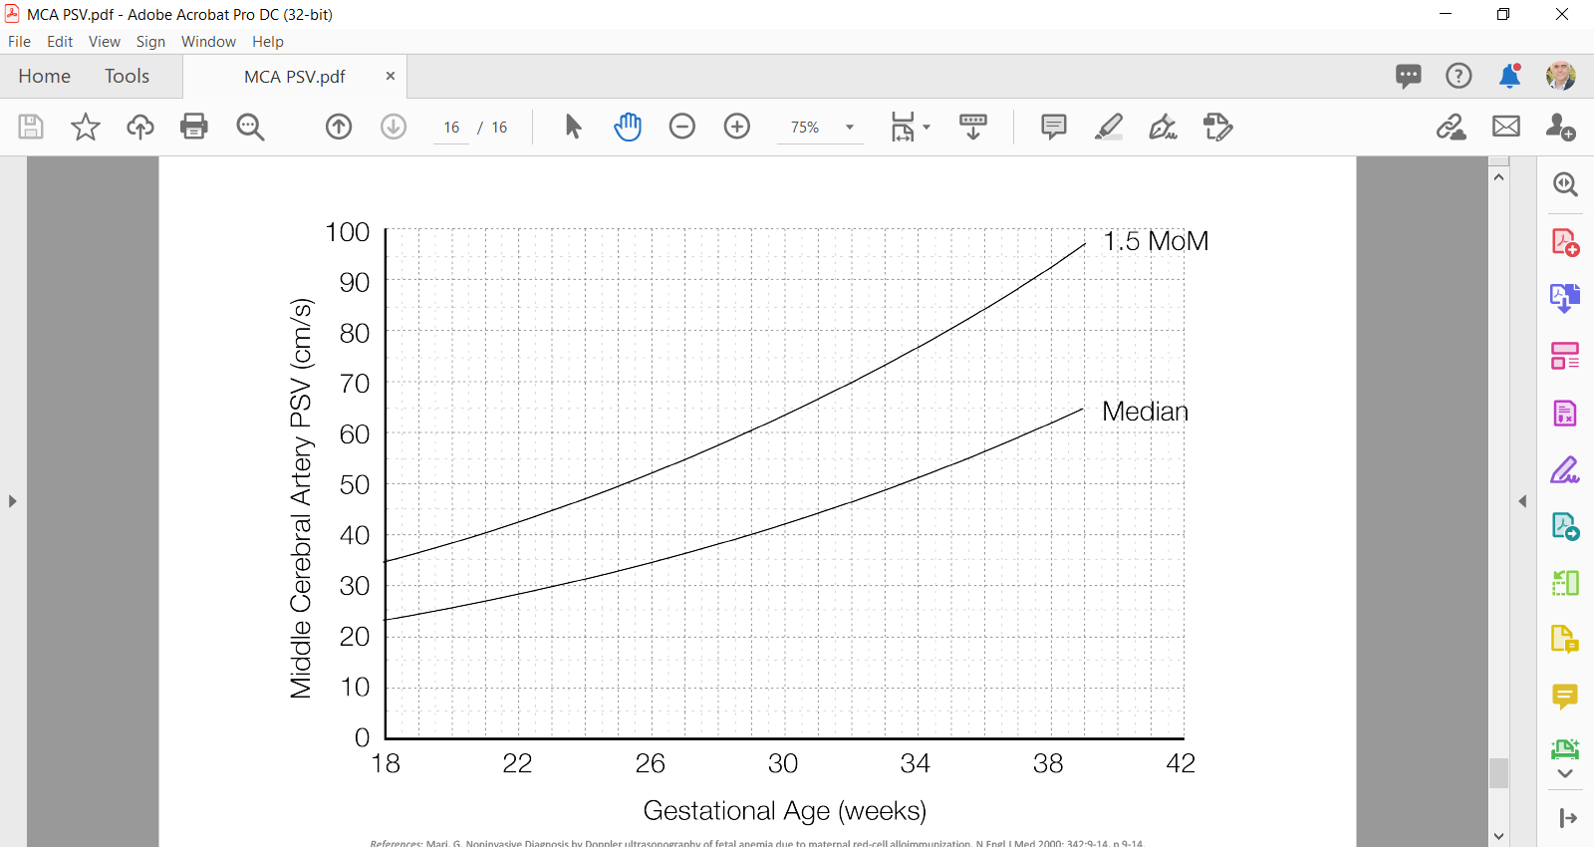
ULTRASOUND – MCA Vmax
ANAEMIA

Slide 20

HYDROPS
TREATMENT

Slide 21
FETAL THERAPY
Fetal anaemia: intrauterine blood transfusion/s
Pleural effusions or large pulmonary cyst: thoracoamniotic shunt
Fetal tachyarrhythmias: transplacental or direct fetal administration of antiarrhythmic drugs.
Teratomas, chorioangiomas, pulmonary sequestration: ultrasound-guided laser coagulation of feeding vessel.
Recipient fetus in twin-to-twin transfusion syndrome: endoscopic laser coagulation of the communicating placental vessels.

Slide 22

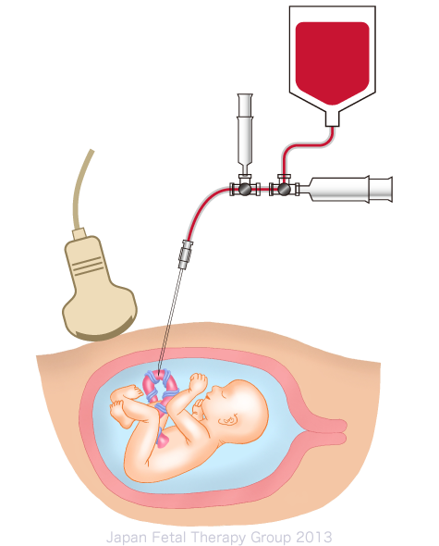
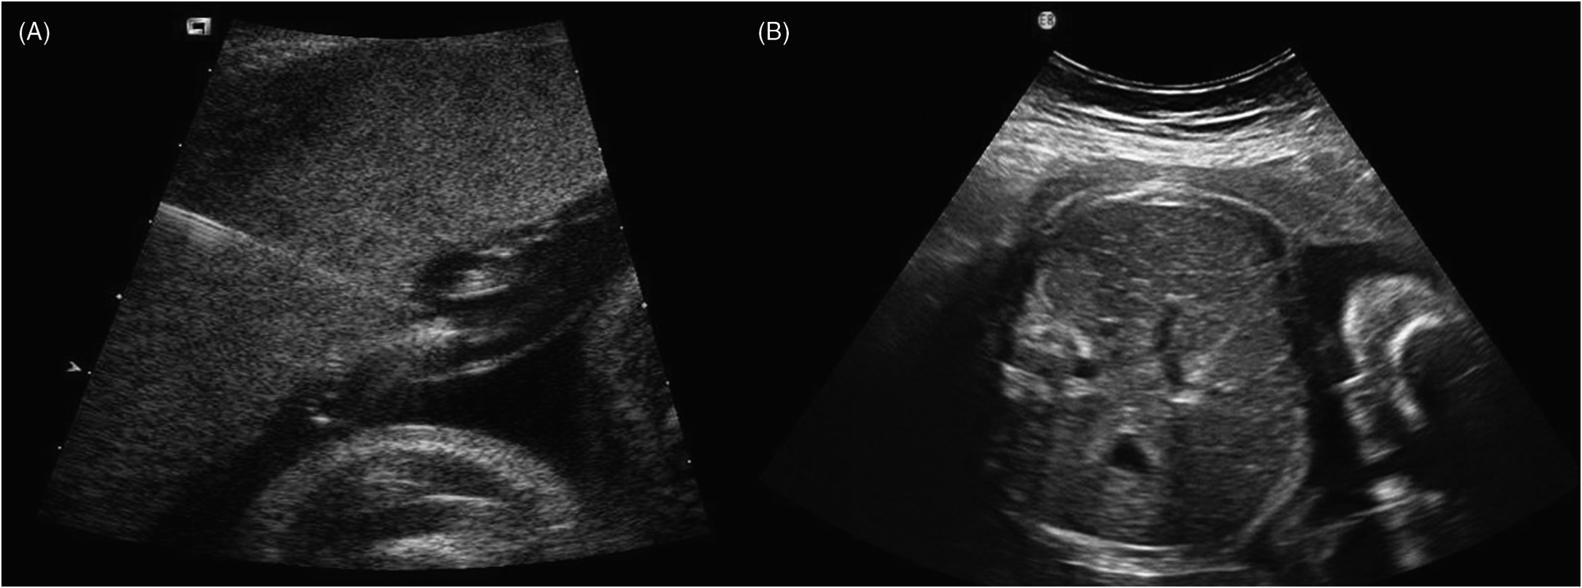
TREATMENT – Fetal Transfusion
Cord Vein
Heaptic Vein

Slide 23
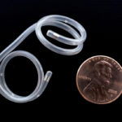
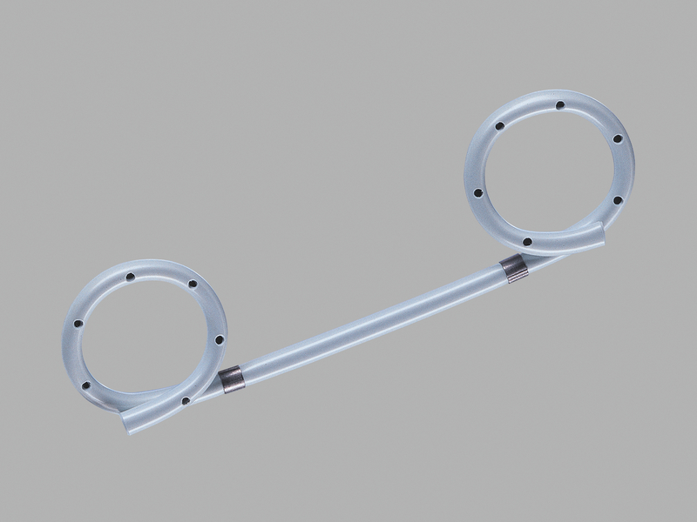
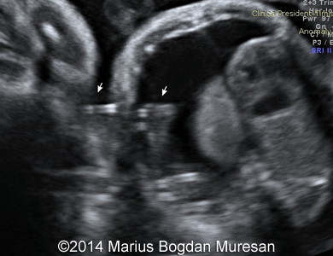
TREATMENT – Thoraco-Amniotic Shunt
Pigtail
Catheter
Thoraco-Amniotic Shunt

Slide 24


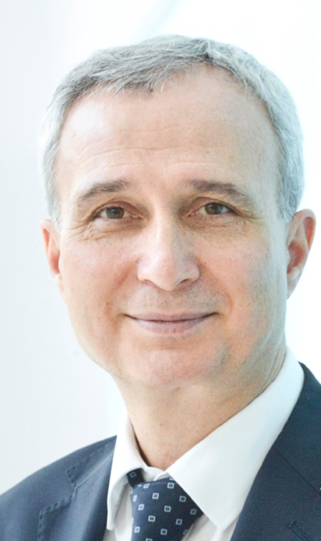
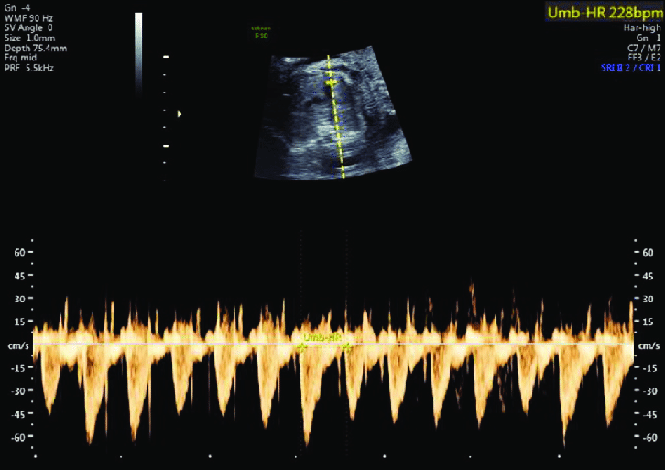
TREATMENT – Maternal Drug Therapy
Favourable outcome for hydrops or cardiac failure associated with fetal tachyarrhythmia: a 20-year review - Gulhan Tunca Sahin, Robert Bryan Beattie and, Orhan Uzun
20 fetuses with hydrops due to SVT - joint management FMU and Fetal Cardiology
Admit for baseline ECG, Echo, FBC, U+E, LFTs
High dose inpatient Digoxin and Flecainide
Weekly scan, ECG, Digoxin and Flecainide levels
Fetal SVT 220bpm
Overall tachycardia response rate 90% (18/20)
Restoration of sinus rhythm 85% (17/20) Median time to restore sinus rhythm or control arrhythmia 1.5 days (range 12 hours to 13 days)
Hydrops resolved in 85% (17/20) Median time of 12 days (range 3–21 days).

Slide 25

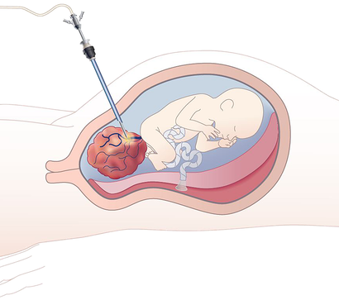
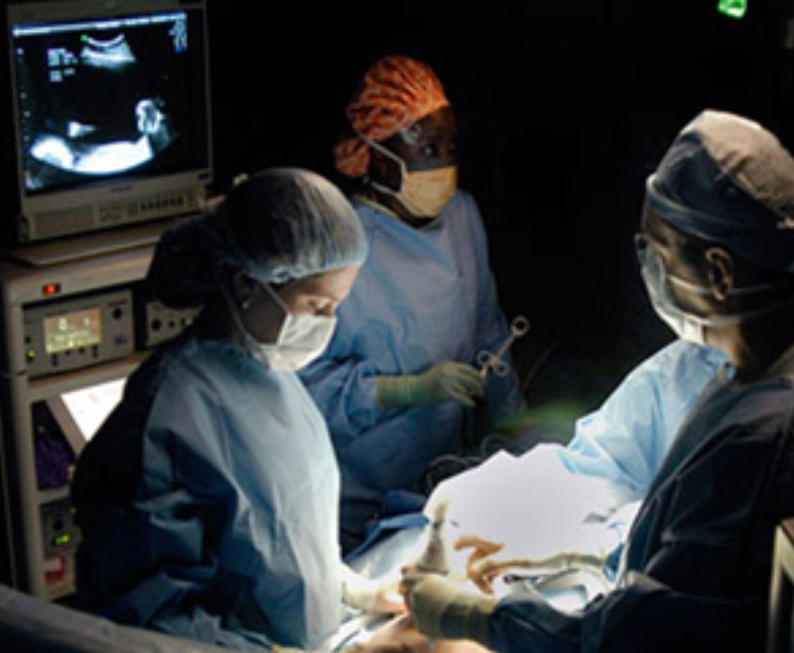
TREATMENT – Laser Ablation
Laser Ablation
Sacrococcygeal Teratoma
Laser Ablation
TTTS

Slide 26

HYDROPS
MONITORING

Slide 27
PRENATAL MONITORING
Fetal:
Scans every 2-3 weeks to monitor the evolution of hydrops.
Maternal:
Risk of maternal morbidity due to ‘mirror syndrome’
(fetal hydrops with generalized fluid overload and pre-eclampsia in the mother).

Slide 28

HYDROPS
DELIVERY

Slide 29
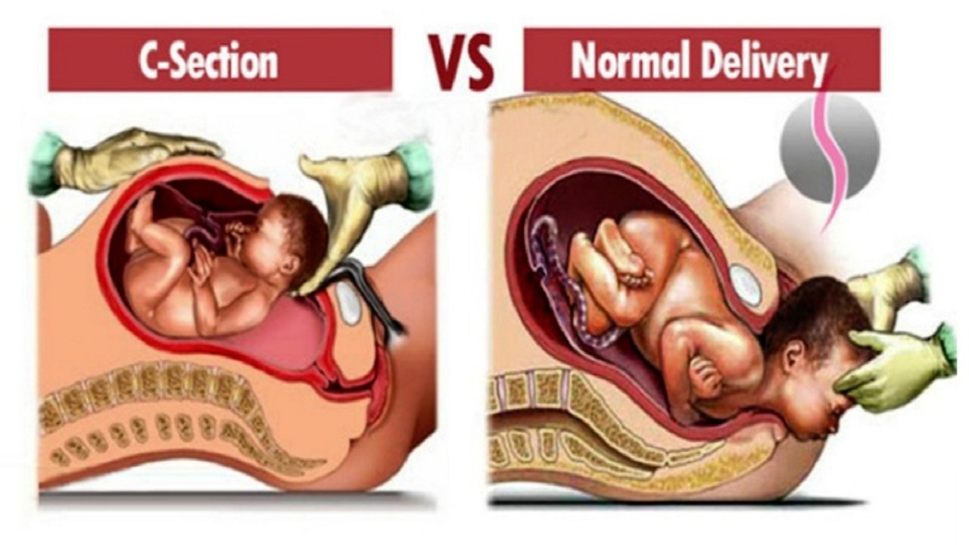
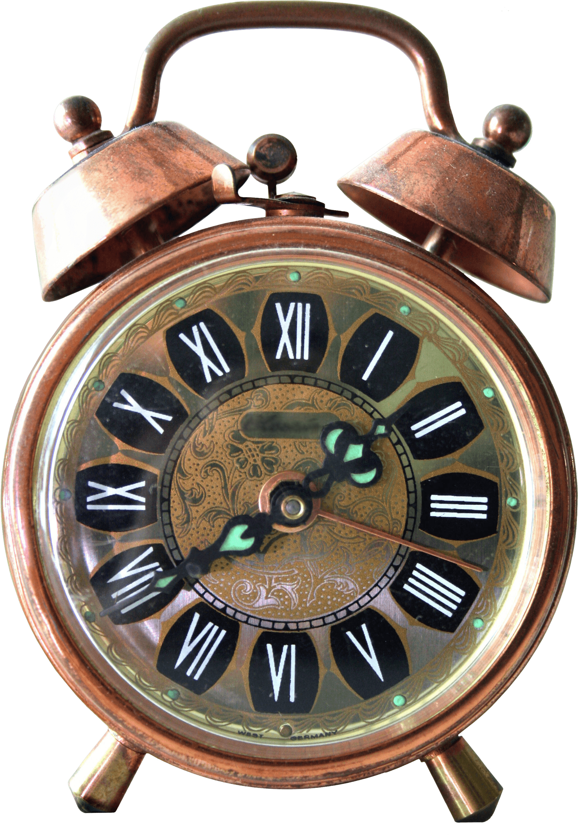
DELIVERY
Timing
Aetiology
Severity

Slide 30

DYSTOCIA
Risk of Abdominal Dystocia

Slide 31

HYDROPS
PROGNOSIS

Slide 32
PROGNOSIS
Depends on the cause of hydrops
Progressive unexplained hydrops is often lethal before or soon after birth

Slide 33

HYDROPS
RECURRENCE

Slide 34
RECURRENCE
Structural Anomalies: no increased risk of recurrence
Infection: no increased risk of recurrence.
Arrhythmia: recurrence risk low
Trisomy 21,18,13 & XO: recurrence risk usually 1%.
Metabolic disorders: recurrence risk (autosomal recessive) 25%.
Red blood cell isoimmunisation: recurrence risk high

Slide 35
HYDROPS
THANK YOU

