Slide 1
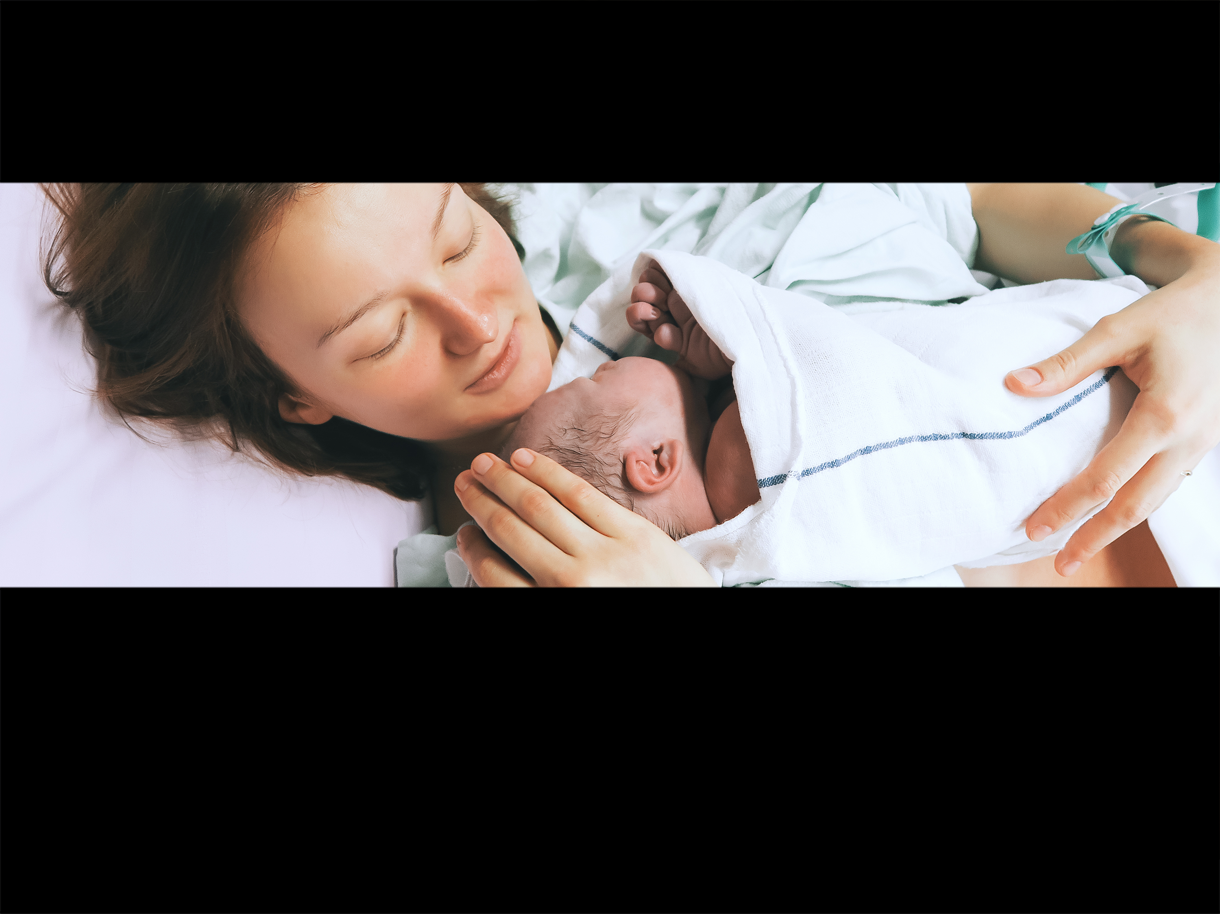


Cora Doherty
Characteristics and outcomes of neonatal SARS-CoV-2 infection in the United Kingdom
A prospective national cohort study using active surveillance

Slide 2
Co-investigator group
Chris Gale (Co-PI), Imperial College, London
Jenny Kurinczuk (Co-PI), NPEU, University of Oxford
Maria A Quigley, NPEU, University of Oxford
Anna Placzek, NPEU, University of Oxford
Marian Knight, NPEU, University of Oxford
Shamez Ladhani, Public Health England, Colindale
Elizabeth S Draper, University of Leicester
Don Sharkey, University of Nottingham
Cora Doherty, University Hospital of Wales, Cardiff
Helen Mactier, Princess Royal Maternity & University of Glasgow

Slide 3
Novel Corona Virus
Novel Corona virus SARS-CoV-2 identified late December 2019
Limited information for Neonates initially

Slide 4
Potential Neonatal Impact
Vertical - pregnancy, labour, birth
Horizontal – mother, family, neonatal unit
Maternal Covid – leading to impact on labour or birth eg preterm delivery – neonate may not have Covid

Slide 5
Clinical and Service impact - planning
March 2020 – reconfigurations at unit, network level and national guidance from eg BAPM released and updated
Important to determine how common impact
Inform prevention and control
Understand clinical course and look to potential treatment of infection

Slide 6
Other Impact
Indirect effects – eg preterm delivery
Delivery by CS to mothers – practice China
Separation of mothers and babies

Slide 7
Active population based surveillance
BPSU – pioneered pop based active surveillance since 1985
BPSU – emails all paediatricians in UK and Ireland every month requesting to report a condition under surveillance eg Rubella
90% response rate – 4,000 consultants
April 1st 2020 – active surveillance for neonatal complications of coronavirus – (back to March 1st)
Incidence
Clinical course
Management
Identified as Urgent Public Health Priority study by the NIHR Clinical Research Network

Slide 8
Initial Criteria
Any baby or infant:
That has a diagnosis of COVID-19 made on a sample taken before 29 days of age and receives inpatient care for COVID-19 (this includes postnatal ward, neonatal unit, paediatric inpatient wards, paediatric intensive care units)
OR
Where the mother had confirmed COVID-19 at the time of birth or suspected COVID-19 at the time of birth that has subsequently been confirmed, and the baby was admitted for neonatal care.
Limitations - secondary or tertiary care – not asymptomatic in community
Recent change September 2021 – only babies admitted that are positive on testing

Slide 9
Data collection
Data collection form – sent to notifiers
Follow-up emails x 3
Supported by CRN hospital-based research nurses (urgent public health priority study)
Possible vertically acquired infection
Consistent with UKOSS
Positive baby sample < 12 hours after birth

Slide 10
Severe disease (Dong et al.)
At least two of:
Hyperthermia (> 37·5ºC) OR apnoea OR cough OR tachypnoea OR respiratory distress/chest recession OR supplemental oxygen requirement OR poor feeding/vomiting OR diarrhoea
Low WBC OR low lymphocytes OR raised CRP
Abnormal chest X-ray
Dong Y, Mo X, Hu Y, Qi X, Jiang F, Jiang Z, et al. Epidemiology of COVID-19 Among Children in China. Pediatrics. 2020.

Slide 11
Ethics & Approvals
Urgent public health priority study
HRA 282127
REC 20/NE/0107
Data collected without parental consent
England and Wales (20/CAG/0058)
Scotland (PBPP 1920-0288)
Maternal consent required in Northern Ireland
ISRCTN60033461

Slide 12
Results
Study is on-going
This analysis is of babies with SARS-CoV-2 confirmed 1st March 2020 - 30th April 2020
Published Lancet Child and Adolescent Health - 9th November 2020

Slide 13
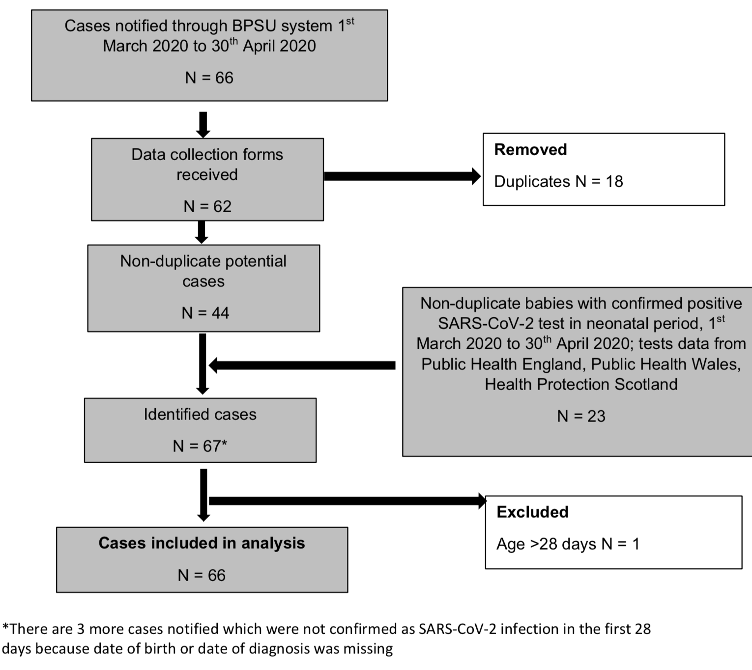
Results

Slide 14
Incidence
66 babies* - 28 with severe disease
5.6 (95%CI 4.3 – 7.1) per 10,000 live births (1 in 1,780)
England 6.4 (95%CI 4.9, 8.2) per 10,000 live births
Severe disease 2.4 (95% CI 1.6, 3.4) per 10,000 live births (1 in 4,200)
Median age at diagnosis 9.5 days (IQR 7.5 – 11)
45 (68%) diagnosed > 7 days
21 (32%) diagnosed 1-7 days; 14 to infected mothers

Slide 15
Results
45 dx > 7 days after delivery
18 (27%) preterm – mainly late preterm
17 (26%) – mother and baby positive

Slide 16
Date and Age of Diagnosis

Slide 17
Characteristics
44% Male
45% Black, Asian, Minority Ethnic group
11.1 (95%CI 7.4 - 15.9) per 10,000 live births (1 in 900)
55% White 4.6 (95%CI 3.2 - 6.4) per 10,000 live births (1 in 2,200)
25% Preterm (<37 weeks gestation)
32⁺⁰–36⁺⁶ 18.4 (95% CI 9.8, 31.4) per 10,000 live births (1 in 540)

Slide 18
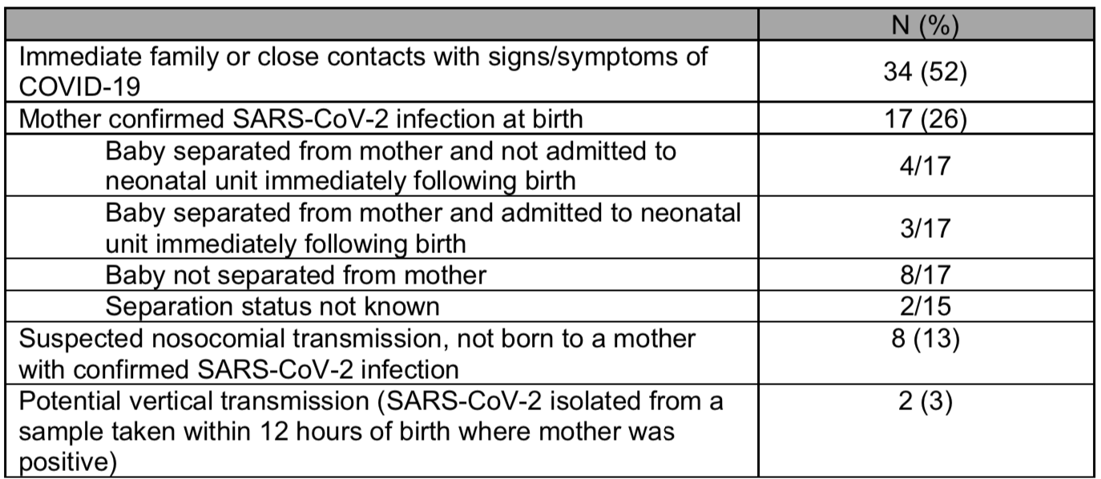
Transmission
17 infected babies with infected mothers – 1 in 7,000 live births
~300 infected mothers gave birth in the study period
5/6 false positive vertical transmissions from UKOSS data

Slide 19
Common signs at presentation
Most – hyperthermia, poor feeding, vomiting
Coryza, respiratory signs and lethargy also common
Symptoms more common > 7 days
Some babies in NICU – no sx – tested as Mum positive
25 babies CXR – 14 (56%) – abnormal – ground glass – 4 preterm

Slide 20
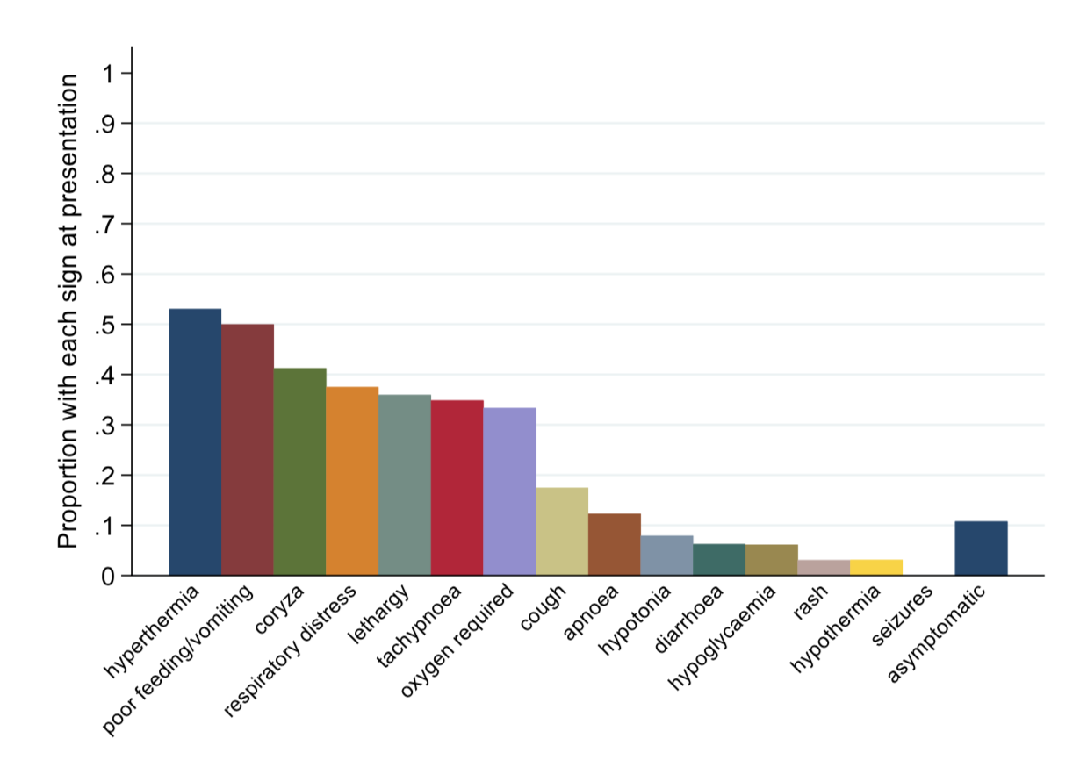
Clinical presentation
*
*
*
*
*
*

Slide 21
Laboratory
Lactate – 17/31 (55%) tested >2
CRP 14/49 (29%) >5
Lymphocytes low 5/54 (9%)

Slide 22
Location
NICU 20 (30%)
PICU 4 (6%)
Postnatal Ward and Paediatric Ward 42 (64%)
Most babies and mothers together

Slide 23
Respiratory support – 22/66 (33%)
Invasive ventilation 3
Noninvasive 10 (4 preterm)
Supplemental oxygen 22
Other treatment – 5 – steroids, antiviral, IgG

Slide 24
Interpretation
Inpatient care neonates with SARS-CoV-2 rare
Infection in first 7 days uncommon
Only 2 suspected vertical transmission
Respiratory – 33% - some related to prematurity
Unusual – but neonates sicker – 42% criteria for severe disease
Avoid separation of Mother and Baby

Slide 25
Looking ahead
BAME rates need further explanation
Preterm rates 26% at background 8% - needs further examination –
? Iatrogenic delivery
? Preterm labour
New variants – impact
Placenta – vascular malperfusion
Longer term effects of neonatal Covid

Slide 27
Thanks to members of:
British Paediatric Surveillance Unit Scientific Committee
Confidentiality Advisory Group, Health Research Authority
Health Protection Scotland
Health Research Authority
Information Governance team, Nuffield Department of Population Health, University of Oxford
Information Services Division, Scotland
Multicentre Research Ethics Committee
Northern Ireland Maternal and Child Health, Public Health Agency
Policy Research Programme, Department of Health and Social Care, England
Public Benefit and Privacy Panel for Health and Social Care, Scotland
Public Health England
Public Health Wales
Sponsors, Clinical Trials and Research Governance, Research Support, University of Oxford

Slide 28
Particular thanks to
British Paediatric Surveillance Unit, Royal College of Paediatrics and Child Health: Richard Lynn, Jacob Avis
Public, parent and patient involvement: Charlotte Bevan and Rachel Plachcinski, PPPI Leads Policy Research Unit in Maternal and Neonatal and the MBRRACE-UK third sector stakeholder group
NIHR Clinical Research Networks

Slide 29
Particular thanks to
Reporting clinicians
Barnet Hospital Dr Esther Freeman; Birmingham Women's Hospital Dr Gergely Toldi;
Breightmet Health Centre Dr Gabrielle Lipshen; Bristol Royal Hospital for Children Dr Stefania
Vergnano; Chelsea & Westminster Hospital Dr Catherine O'Sullivan; Countess of Chester
Hospital Dr Ravi Jayaram; Croydon University Hospital Dr John Chang; Derbyshire Children's
Hospital Dr Jennifer Evennett; Ealing Hospital Dr Ewa Lichtarowicz-Krynska; Evelina Children's
Hospital Dr Emma Parish; Hinchingbrooke Hospital Dr Hilary Dixon; Imperial College School of
Medicine Dr Simon Nadel; Joyce Green Hospital Dr Selwyn D'Costa; Kings College Hospital Dr
Theodoros Dassios; Leeds General Infirmary Dr Elizabeth Evans, Dr Kerry Jeavons, Dr Sian
Cooper; Leicester Royal Infirmary Dr Premkumar Sundaram; Luton & Dunstable Hospital Dr
Doris Iyamabo; Manor Hospital Dr Rayasandra Gireesh; Medway Maritime Hospital Dr Ghada
Ramadan; Newham University Hospital Dr Susan Liebeschuetz; Norfolk & Norwich Univ
Hospital Dr Catherine Thomas; Northwick Park Hospital Ms Anam Fayadh; Oxford University
Hospitals Dr Charles Roehr; Peterborough City Hospital Dr Katharine McDevitt; Queen Elizabeth
Hospital - Birmingham Dr Manobi Borooah; Queen Elizabeth Hospital - Lewisham and
Greenwich Dr Olutoyin Banjoko; Queen Mary's Hospital for Children Dr Daniel Langer; Queen's
Hospital - Romford Dr Ambalika Das, Ms Helen Smith; Queen's Medical Centre Dr Don Sharkey;
Royal Berkshire & Battle Hospitals Dr Chandan Yaliwal; Royal Devon & Exeter Hospital Dr Sian
Ludman; Royal Free Hospital Dr James Rosenberg; Royal Oldham Hospital Dr Anita Vayalakkad;
Royal United Hospital Dr Tobias Hunt; Russells Hall Hospital Dr Evans Chingwenje;
Southampton General Hospital Dr Mark Johnson; St George's Hospital Medical School Dr Sijo
Francis; St Mary's Hospital - London Dr Jayanta Banerjee; St Peter's Hospital Dr Vennila
Ponnusamy; Stoke Mandeville Hospital Dr Gopa Sarkar; The Royal London Hospital Dr Nicolene
Plaatjies; University College Hospital London Dr Sarah Eisen; University Hospital Wishaw Dr
Augusta Anenih; Victoria Hospital - Blackpool Dr Christopher John Rawlingson; Warrington
Hospital Dr Colin Wong, Dr Delyth Webb; Watford General Hospital Dr Nazakat Merchant;
Wexham Park Hospital Dr Kanaga Raj Sinnathuray; William Harvey Hospital Dr Amit Gupta

Slide 30
Funding
NIHR Policy Research Programme through the Policy Research Unit in Maternal and Neonatal Health and Care, National Perinatal Epidemiology Unit, University of Oxford (PR-PRU-1217-21202).

