Slide 1
Behçet’s Disease in Wales: An Epidemiological Description of an Adult Case Series
Annie Ashman, ST3 Registrar in Public Health
16 November 2021

Slide 2
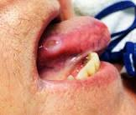
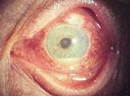
Background
Behçet’s is “a rare, chronic, relapsing, multisystemic vasculitis”
Ulcers, eye inflammation, joint pain
Unknown aetiology, incurable
Significant morbidity
Geographical variation
Behçet’s Disease in Wales – Annie Ashman

Slide 3
Aims of study
To identify population prevalence of Behçet’s disease in Wales
To provide an epidemiological profile of a case series of adult Behçet’s disease patients in Wales
Behçet’s Disease in Wales – Annie Ashman

Slide 4
Methods 1 – data abstraction
Adult Rare Disease Surveillance Registry for Wales
[Data sources: CARIS, PEDW, clinical portals]
Cases from 1995 – September 2020 identified in database, anonymised data pulled for analysis
Paediatric cases identified from CARIS database
Dataset exported to SPSS for analysis
Behçet’s Disease in Wales – Annie Ashman

Slide 5
Methods 2 – data handling
Manual deduplication of data
Suspected, unverified cases removed
Creation of new variables (WIMD, survival in months from diagnosis)
Behçet’s Disease in Wales – Annie Ashman

Slide 6
Methods 3 – statistical analysis
Continuous data summarised as median (range)
Non-parametric tests: Categorical and continuous data compared with Chi-square and Mann-Whitney U-tests.
Spearman’s Rho to investigate correlation between date of diagnosis and age at diagnosis
Univariable and multivariable survival analyses conducted using Kaplan-Meier and Cox regression respectively
Behçet’s Disease in Wales – Annie Ashman

Slide 7
Results 1
347 adult cases, 5 paediatric cases
Prevalence: 11.1 per 100,000 population
267 females (76.9%), 80 males (23.1%)
23 cases deceased by end of study (6.6%)
Median age at diagnosis = 42.0 years (range 10-78 years)
Highest proportion of cases in most deprived WIMD quintile
Behçet’s Disease in Wales – Annie Ashman

Slide 8
Results 2: Gender cohorting
Factor | Male | Female | p-value
Age at diagnosis in years – median (range) | 38.0 (13-76) | 42.0 (10-78) | 0.326¹
Deaths – n (%) | 8 (10.0) | 15 (5.6) | 0.167²
WIMD 2019 quintile – n (%) 1 2 3 4 5 Missing data | 14 (17.5) 11 (13.7) 15 (18.7) 17 (21.3) 21 (26.3) 2 (2.5) | 73 (27.3) 54 (20.2) 51 (19.1) 48 (18.0) 36 (13.5) 5 (1.9) | 0.36²
^{1 –} Mann-Whitney U-test, ^{2 –} Chi-square test
Spearman’s Rho coefficient = 0.063, p = 0.257
Behçet’s Disease in Wales – Annie Ashman

Slide 9
Results 3: Survival analyses
Univariable analysis:
Factor | Survival (months) | p-value (Mantel-Cox Log Rank)
Gender (median, (range)): Male Female | 104.5 (4-311) 99.5 (1-315) | 0.15
WIMD 2019 quintile | - | 0.473
Age at diagnosis in years | - | <0.001*
* Cox regression: age significantly and independently associated with poorer durations of survival (p <0.001)
Behçet’s Disease in Wales – Annie Ashman

Slide 10
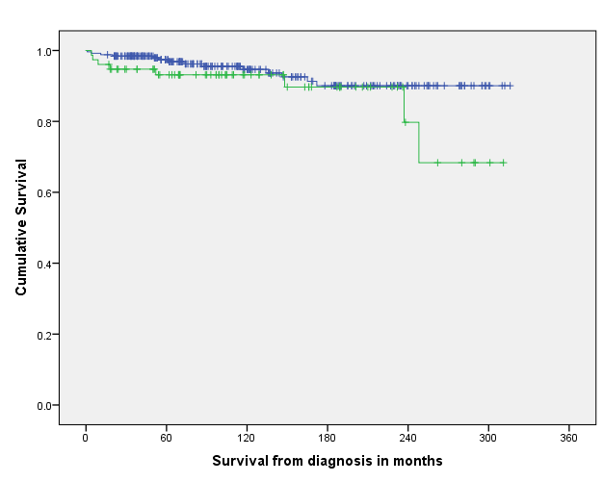
Results 3: Univariable survival analysis
Gender
------- Female
------ Male
Behçet’s Disease in Wales – Annie Ashman

Slide 11
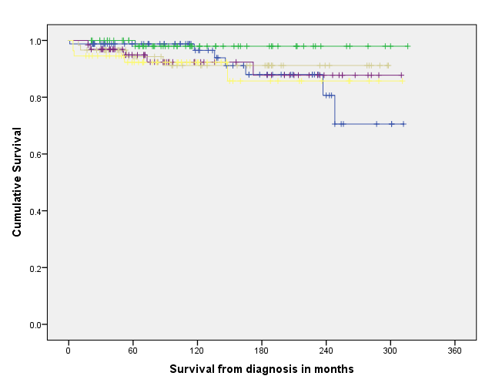
Results 3: Univariable survival analysis
WIMD 2019 Quintile
----- 1
----- 2
----- 3
----- 4
----- 5
Behçet’s Disease in Wales – Annie Ashman

Slide 12
Strengths
National, population-level registry data
Data identification using well-established surveillance registry practices
Triangulation using multiple databases
Behçet’s Disease in Wales – Annie Ashman

Slide 13
Limitations
Unvalidated cases not included
Variables not routinely collected, e.g. comorbidity
Missing data on small number of cases
Cause of death not recorded
Behçet’s Disease in Wales – Annie Ashman

Slide 14
Conclusions
Estimated prevalence = 11.1 per 100,000 population
Greater proportion of female than male patients
Older age at diagnosis than reported elsewhere
Age at diagnosis was associated with poorer durations of survival
No statistically significant difference in survival according to WIMD 2019 or gender
Behçet’s Disease in Wales – Annie Ashman

Slide 15
Acknowledgements
Ceri Williams, David Tucker and all of the CARIS team
Llion Davies
Dr Lisa Hurt
Behçet’s Disease in Wales – Annie Ashman

