Slide 1

10 Years on.....

Slide 2
In the beginning.....
In 2001, average age of identification in Wales was reported to be 21 months
Expected incidence in Wales: 40 children a year (1-2 per 1000 births)

Slide 3
In the beginning.....
In 2002, moves to develop an all Wales Newborn Hearing Screening Programme
Managed by Velindre NHS Trust
  Breast Test Wales and Cervical Screening Wales
  Antenatal Screening Wales
  Benefit from experience in other programmes
  Sharing expertise and support with other programmes
Managed Clinical Network
  Clear accountability
  Crosses organisational boundaries
  Based on partnerships with all Trusts in Wales and other bodies

Slide 4
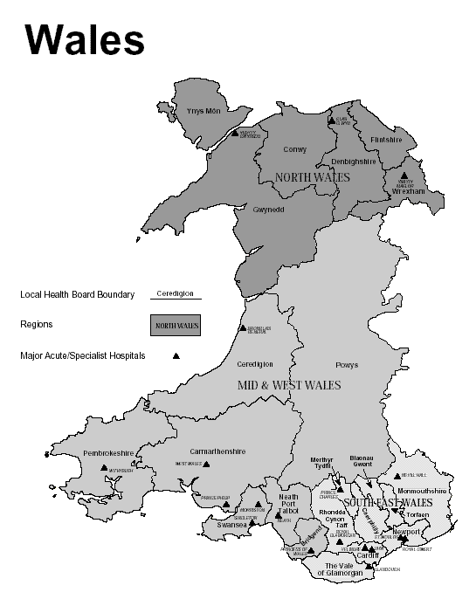
Newborn Hearing Screening Wales
Implementation Date | Trust
March 2003 | North East Wales Conwy and Denbighshire
July 2003 | North West Wales
October 2003 | Swansea Bro Morgannwg
December 2003 | Cardiff and Vale North Glamorgan Pontypridd and Rhondda
March 2004 | Powys
May 2004 | Gwent
October 2004 | Carmarthenshire Ceredigion Pembrokeshire

Slide 5
Aim of Programme
To identify babies with significant hearing impairment which is of sufficient severity to cause or potentially cause a disability without the introduction of habilitation in infancy

Slide 6
Objectives of Programme
Offered to all babies whose mother resident in Wales
Offered to most babies in first week of life
To identify significant bilateral permanent hearing loss >40dBnHL in better ear
To ensure that adequate services are available up to the age of 2 years

Slide 7
Newborn Hearing Screening in Wales
Programme ends at completion of assessment process or at 3 months
Importance of continued surveillance
Targeted behavioural test for eligible babies

Slide 8
Management Arrangements

Slide 9
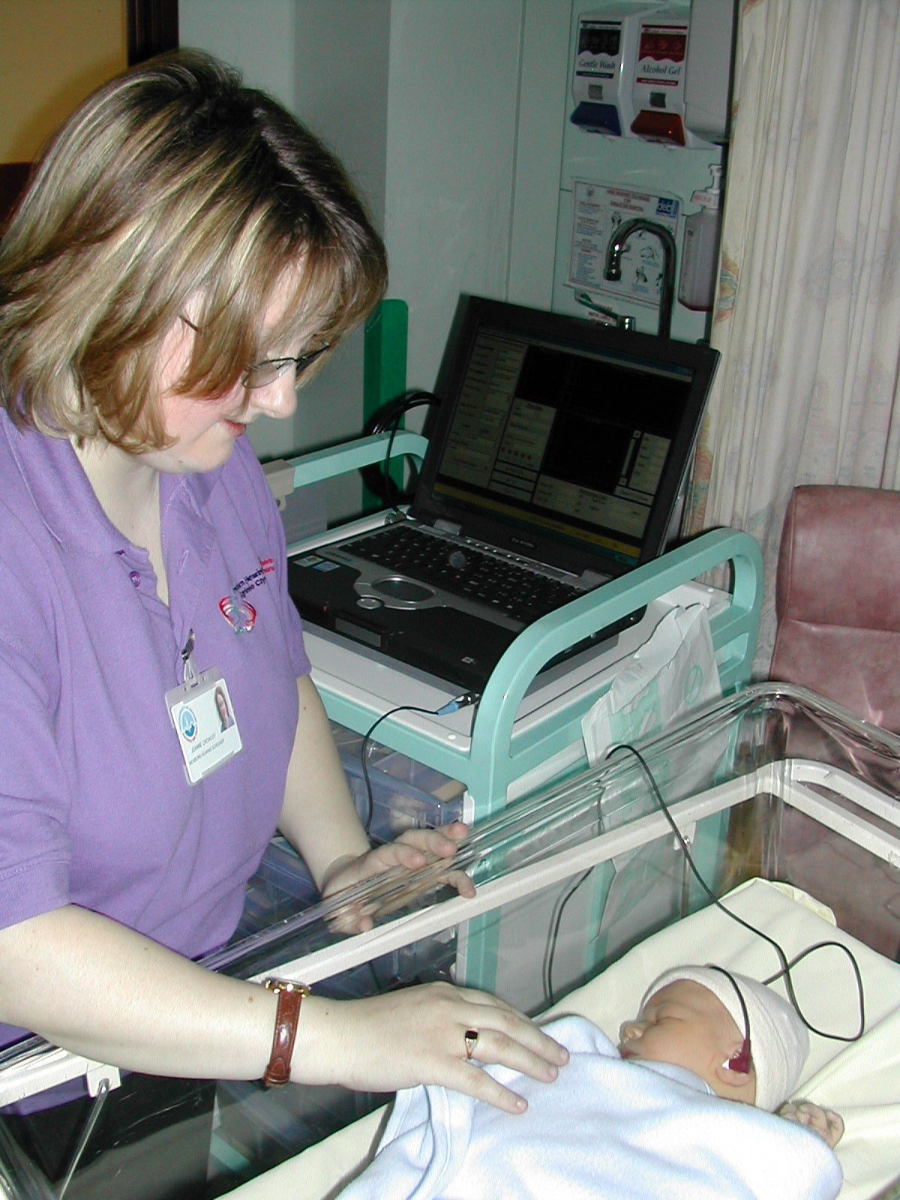

Slide 10
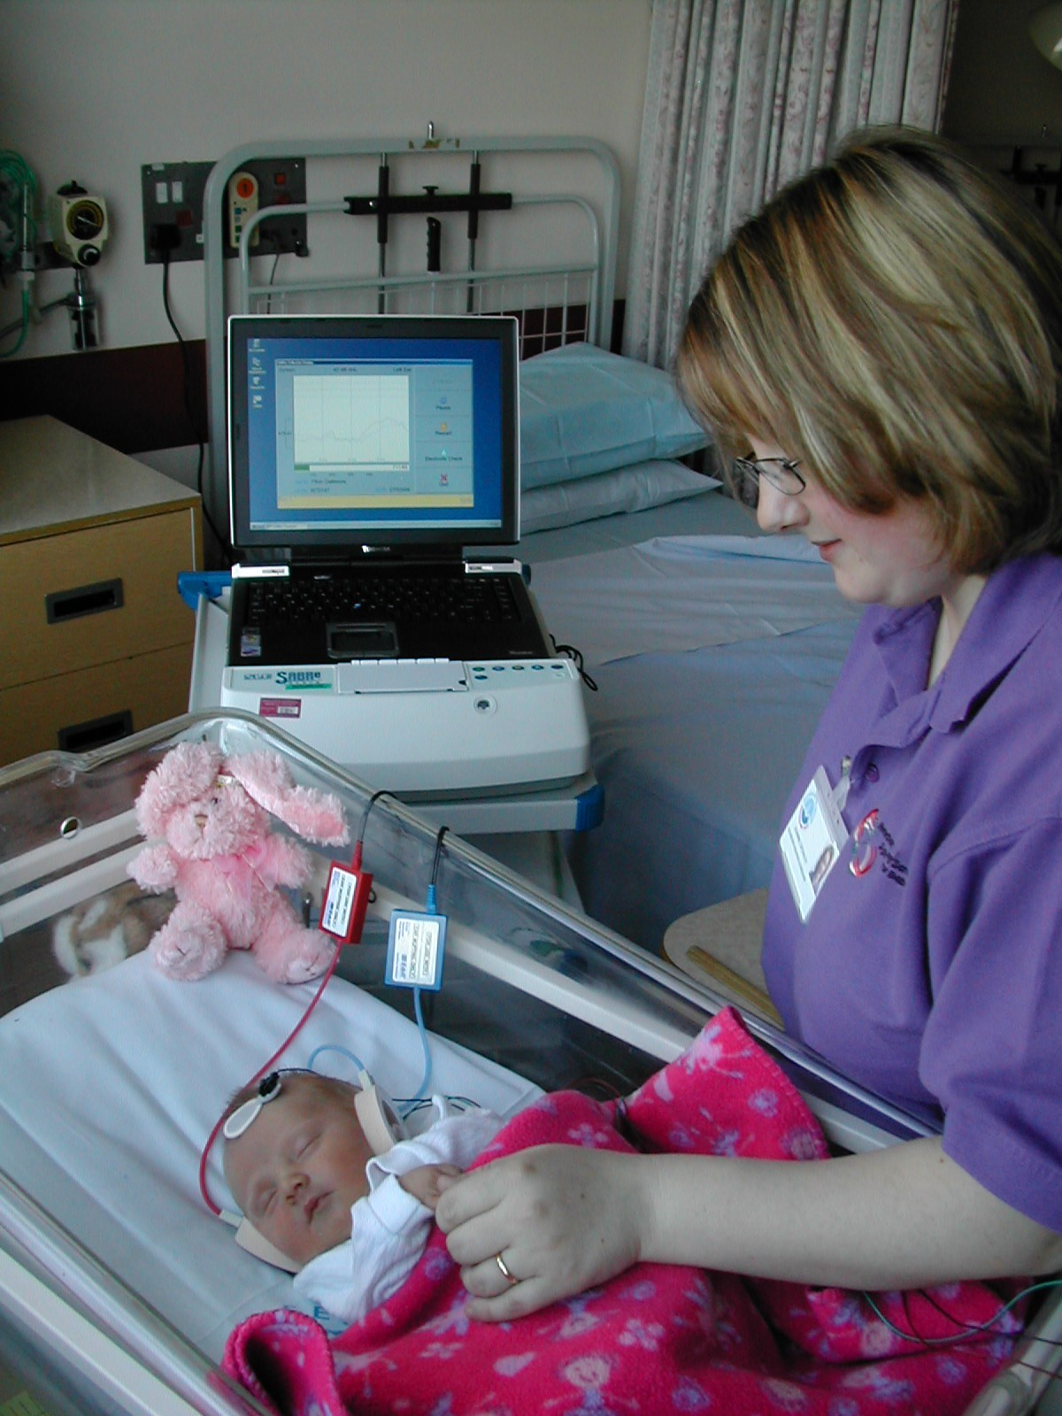

Slide 11
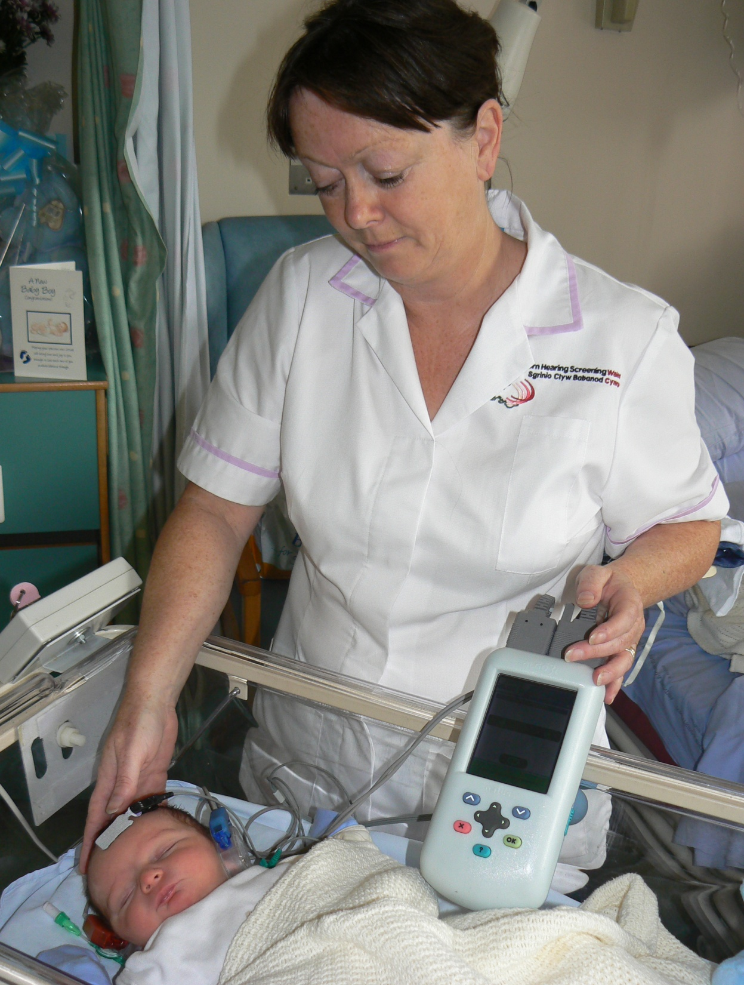

Slide 12
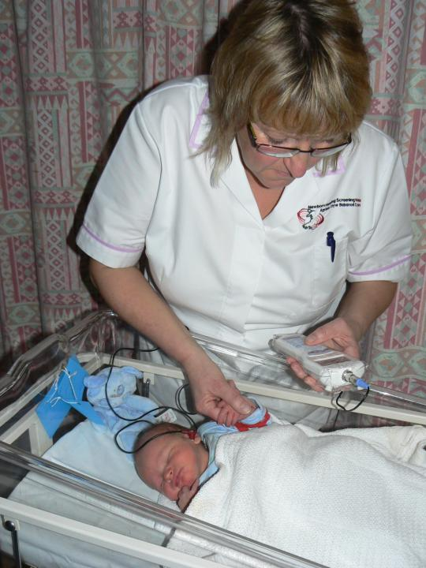
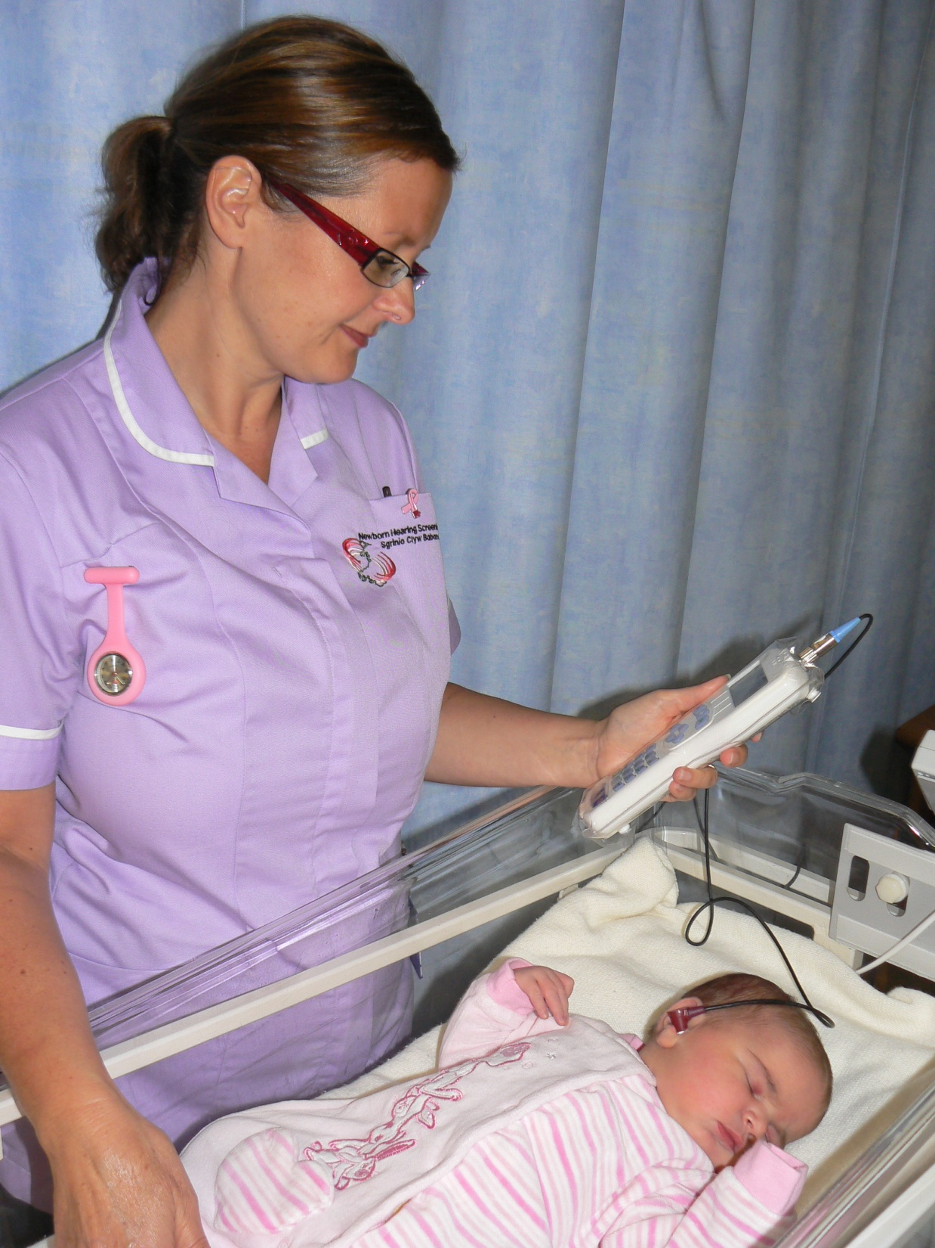

Slide 14
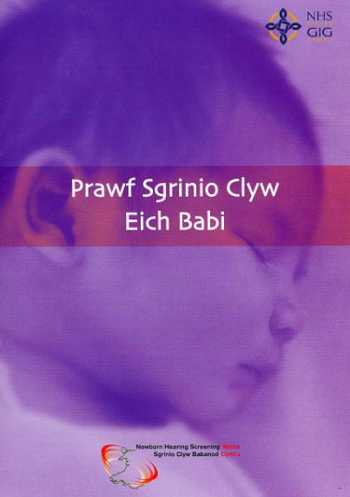
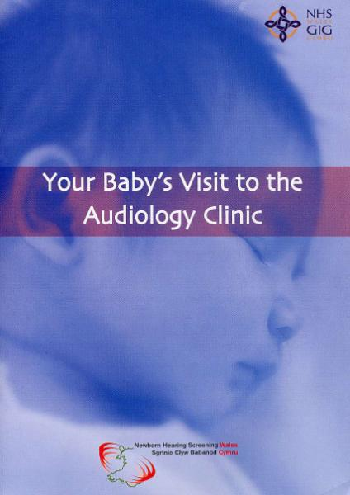
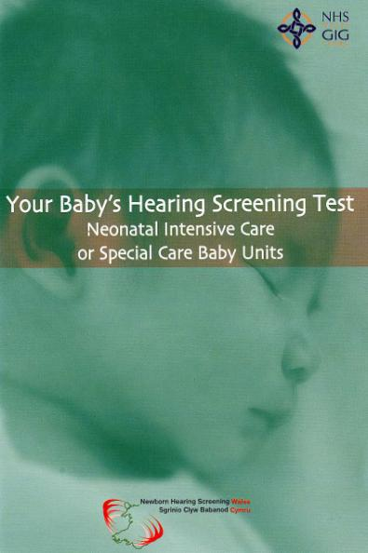

Slide 15
Targeted Behavioural Test
Eligible babies are those:
Who miss/do not complete screening or assessment
Who move into area between 6 weeks and 6 months of age
Whose parents request follow-up of one ear clear response
At risk of persistent conductive loss – Down’s, Cleft Palate, significant craniofacial abnormality
At risk of known progressive loss – proven CMV, Rubella infection
Babies with a significant family history of early onset hearing loss

Slide 16
All Wales: Screening
01.04.12 – 31.03.13
Coverage – 99.9% offered, 99.5% tested
75.7% babies tested within 7 days
100% high risk babies complete screening
98.2% well babies complete screening within 4 weeks
0.1% screening declined (well babies)

Slide 17
All Wales: Screening
01.04.12 – 31.03.13
Screen sensitivity = 92.9%
Screen specificity = 98.8%

Slide 18
All Wales: Assessment
01.04.12 – 31.03.13
1.3% screened babies referred for assessment
90.3% of babies referred complete assessment process within 3 months of referral
5.7% babies referred for assessment and not seen
0.6% discharged from assessment with normal hearing, as proportion of babies screened

Slide 19
All Wales: Habilitation
01.04.12 – 31.03.13
Mean age of identification 12.7 weeks (median 8.1 weeks)
Hearing aids fitted at mean age 16.3 weeks (median 11.3 weeks)
90% fitted within 4 weeks of audiological confirmation
Audiological confirmation achieved in 90.9% of babies by 6 months

Slide 20
All Wales Prevalence
In babies born 1.4.12 – 31.3.13, prevalence of permanent bilateral hearing loss > 40dBHL in better ear is 1.0 per 1000
Prevalence since start of screening is 1.3 per 1000 (408 babies)
Prevalence of permanent bilateral hearing loss under 5 years of age is 1.5 per 1000

Slide 21
The story so far....
Trusts merged and became Health Boards
Screening Division of Public Health Wales
- Bowel Screening, Aortic Aneurysm Screening, Newborn Bloodspot, Diabetic Retinopathy Screening
Change of Programme Lead
Formation of “MAC”
Changes in England – PHE, Clinical Group

Slide 22
Achievements
Impact on age of identification
Driver for improving standards in paediatric audiology services
Establishing audiology network across Wales
Peer review
Encouraging and supporting multidisciplinary Early Years HI services across Wales
Outcome measures with colleagues in education
BTEC in newborn hearing screening
CHSWG in every area

Slide 23
Challenges ahead
Medical paediatric audiology workforce:
- UK wide issue
- Impact on NBHSW – DC and PL retirements
Changes in education services
Provision of Specialist S&LT
Shifting focus in England
Quality Assurance

Slide 24
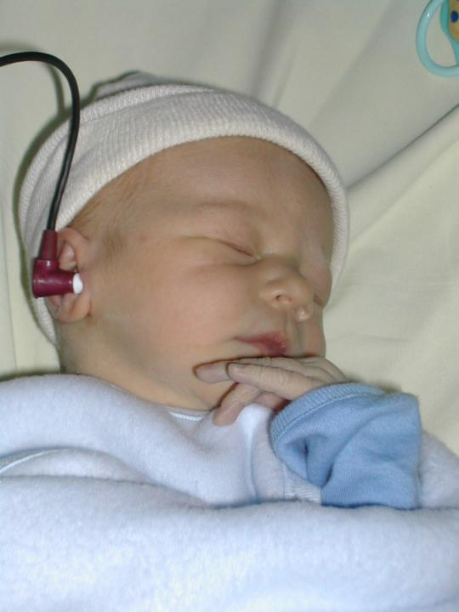
www.newbornhearingscreening.wales.nhs.uk

