Slide 1







Oral health of 12-year-old children in Wales in 2023/24
Iechyd y geg ymhlith plant 12 oed yng Nghymru yn 2023/24
Oral Health Intelligence function, Dental Public Health Team, Public Health Wales
January 2025

Slide 2
Ein cenhadaeth
Our Mission
Ni yw Iechyd Cyhoeddus Cymru. Ni yw sefydliad iechyd cyhoeddus cenedlaethol Cymru. Rydym yn bodoli i helpu pawb yng Nghymru i fyw bywydau hirach, iachach
Gyda'n partneriaid, ein nod yw cynyddu disgwyliad oes iach, gwella iechyd a llesiant, a lleihau anghydraddoldebau i bawb yng Nghymru, nawr ac ar gyfer cenedlaethau'r dyfodol
Gyda'i gilydd, mae ein timau'n gweithio i atal clefyd, diogelu iechyd, darparu arweinyddiaeth systemau, gwasanaethau arbenigol ac arbenigedd iechyd cyhoeddus
Ni yw'r brif ffynhonnell o wybodaeth, ymchwil ac arloesedd iechyd cyhoeddus, i helpu pawb yng Nghymru i fyw bywydau iachach
Gweithio gyda'n gilydd ar gyfer Cymru iachach
We are Public Health Wales. We are the national public health organisation for Wales. We exist to help all people in Wales live longer, healthier lives
With our partners, we aim to increase healthy life expectancy, improve health and wellbeing, and reduce inequalities for everyone in Wales, now and for future generations
Together, our teams work to prevent disease, protect health, provide system leadership, specialist services and public health expertise
We are the primary source of public health information, research and innovation, to help everyone in Wales live healthier lives
Working together for a healthier Wales
Public Health Wales

Slide 3
Ein gweledigaeth
Our Vision
Erbyn 2035, byddwn wedi cyflawni dyfodol iachach i Gymru. Rydym yn gweithio tuag at Gymru lle mae pobl yn byw bywydau hirach, iachach a lle mae gan bawb yng Nghymru fynediad teg a chyfartal at y pethau sy'n arwain at iechyd a llesiant da
By 2035, we will have achieved a healthier future for Wales. We are working towards a Wales where people live longer, healthier lives and where all people in Wales have fair and equal access to the things that lead to good health and well-being
Public Health Wales

Slide 4
Cyflwyniad
Introduction
Dyma grynodeb o arolygiad Rhaglen Epidemiolegol Deintyddol GIG Cymru o blant blwyddyn ysgol saith (12 oed) a gynhaliwyd ledled Cymru yn 2023-24
Casglwyd data gan dimau Gwasanaeth Deintyddol Cymunedol y GIG ym mhob Bwrdd Iechyd Lleol a'u dadansoddi gan Uned Gwybodaeth Iechyd y Geg Cymru ym Mhrifysgol Caerdydd ar y cyd â Gwybodaeth Iechyd y Geg yn Iechyd Cyhoeddus Cymru
Ceir rhagor o wybodaeth yn Adroddiad Technegol 'Darlun o Iechyd y Geg 2024', a gyhoeddwyd gan Uned Gwybodaeth Iechyd y Geg Cymru, Prifysgol Caerdydd
Mae arolygon o blant 12 oed (blwyddyn ysgol saith) yn darparu data manwl ar anghenion iechyd y geg ar gyfer gwyliadwriaeth, cynllunio gwasanaethau a gwerthuso
This is a summary of the NHS Wales Dental Epidemiological Programme’s inspection of school year seven (12-year-old) children undertaken across Wales in 2023-24
Data was collected by the NHS Community Dental Service teams within each Local Health Board and analysed by the Welsh Oral Health Information Unit at Cardiff University in conjunction with Oral Health Intelligence at Public Health Wales
Further information can be found in the Technical Report ‘Picture of Oral Health 2024’, published by the Welsh Oral Health Information Unit, Cardiff University
Surveys of 12-year-old (school year seven) children provide detailed data on oral health need for surveillance, service planning and evaluation
Public Health Wales

Slide 5
Methodoleg
Methodology
Yn debyg i’r blynyddoedd blaenorol, mae'r arolwg yn dilyn canllawiau’r Gymdeithas Brydeinig ar gyfer Astudio Deintyddiaeth Gymunedol
Amcanion arolygiad Rhaglen Epidemioleg Ddeintyddol GIG Cymru o blant blwyddyn ysgol saith (12 oed):
1-Cofnodi data, o sampl o blant blwyddyn ysgol saith yng Nghymru yn y tymhorau ysgol, Gaeaf 2023/2024 a Gwanwyn 2024;
2-Cael amcangyfrifon dilys o gyffredinrwydd a difrifoldeb pydredd dannedd plant blwyddyn ysgol saith i’w cymharu â’r arolygon blaenorol
Cydnabyddiaethau: Hoffai Iechyd Cyhoeddus Cymru a Phrifysgol Caerdydd ddiolch i’r holl ysgolion a gytunodd i gymryd rhan a hwyluso’r arolwg. Yn yr un modd, hoffem ddiolch hefyd i’r timau Gwasanaethau Deintyddol Cymunedol ym mhob Bwrdd Iechyd am eu holl waith caled yn cysylltu â’r ysgolion a chasglu’r data
As in previous years, the survey follows the guidance from the British Association for the Study of Community Dentistry
The objectives of the NHS Dental Epidemiology Programme for Wales inspection of school year seven (12-year-old) children:
1-Record data, from a sample of school year seven children in Wales in the school terms, Winter 2023/2024 and Spring 2024;
2-Obtain valid estimates of caries prevalence and severity in school year seven children to compare to previous surveys
Acknowledgements: Public Health Wales and Cardiff University would like to extend our gratitude to all the schools that agreed to participate and facilitate the survey. Equally, we would also like to thank the Community Dental Service teams in each Health Board for all their hard work in contacting the schools and collecting the data
Public Health Wales

Slide 6
Crynodeb
Summary
Archwiliwyd 6,329 o blant o 203 o ysgolion gwladol prif ffrwd, sy’n cynrychioli 18.4% o gyfanswm poblogaeth blwyddyn ysgol saith mewn ysgolion gwladol prif ffrwd
Mesurwyd dau fesur o brofiad pydredd dannedd: cyffredinrwydd a difrifoldeb
Mae cyffredinrwydd yn cofnodi faint o blant oedd â dannedd wedi’u pydru, ar goll neu wedi’u llenwi. Mae difrifoldeb yn disgrifio nifer cyfartalog y dannedd yr effeithiwyd arnynt gan bydredd dannedd fesul plentyn
Cwblhawyd cwestiynau Ansawdd Bywyd yn ymwneud ag Iechyd y Geg gan 6,322 o blant
Dylid trin data o Fae Abertawe a Chwm Taf Morgannwg yn ofalus oherwydd y newidiadau a wnaed i ffiniau’r byrddau iechyd hyn yn 2019
6,329 children from 203 state-maintained mainstream schools were examined, which represents 18.4% of the total school year seven population in mainstream state-maintained schools
Two measures of dental caries experience were measured: prevalence and severity
Prevalence records how many children had decayed, missing or filled teeth, whilst severity describes the average number of teeth affected by tooth decay per child
Oral Health related Quality of Life questions were completed by 6,322 children
Data from Swansea Bay and Cwm Taf Morgannwg should be treated with caution due to the repatriation of Bridgend County Council
Public Health Wales

Slide 7
Crynodeb
Summary
Yn 2016/17, roedd bron i un o bob tri phlentyn wedi cael profiad o bydredd a byddai dau ddant yn cael eu heffeithio arnynt. Yn 2023/24, roedd hyn wedi gostwng i un o bob pedwar plentyn â dau ddannedd wedi pydru
Yn gyffredinol, bu gostyngiad ystadegol arwyddocaol yng nghyffredinrwydd a difrifoldeb pydredd dannedd rhwng 2016/17 a 2023/24, ond ymhlith plant â chlefyd, ni fu newid o ran difrifoldeb
Effeithiodd iechyd y geg ar un o bob tri phlentyn a samplwyd
Mae anghydraddoldebau iechyd y geg yn parhau (h.y. mae’r rhai o gefndiroedd tlotach yn profi mwy o afiechyd), ond mae’r mynegai llethr o anghydraddoldeb wedi gostwng rhwng 2008/09 a 2023/24
Gwelir amrywiad ar draws y Byrddau Iechyd o ran cyffredinrwydd a difrifoldeb pydredd dannedd
In 2016/17, approaching one in three children had decay experience and two teeth would be affected. In 2023/24, this has reduced to one in four children with two carious teeth
Overall, there was a statistically significant reduction in the prevalence and severity of dental caries across from 2016/17 to 2023/24, but amongst children with disease, there has been no change in severity
Oral health impacted on one in every three children sampled
Oral health inequalities remain (i.e. those from poorer backgrounds experience more disease), but the slope index of inequality has decreased between 2008/09 and 2023/24
Variation is seen across the Health Boards in both prevalence and severity of dental caries
Public Health Wales

Slide 8
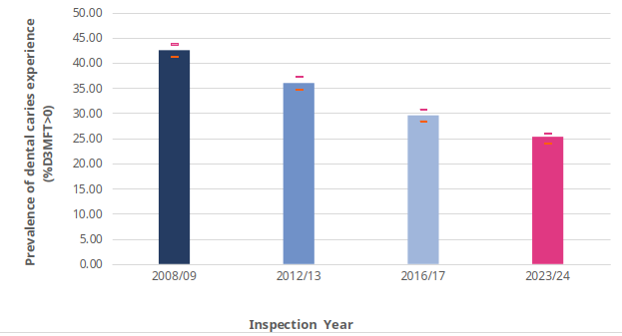
Cyffredinrwydd pydredd dannedd Prevalence of dental caries
Y brif neges yw bod cyffredinrwydd pydredd dannedd wedi lleihau yng Nghymru
Y cyffredinrwydd cymedrig yw 25.3% [24.0-26.0]
Mae ffin isaf y cyfwng hyder ar gyfer 2016/17 uwchlaw’r ffin uchaf ar gyfer 2023/24, sy’n golygu bod y gostyngiad hwn yn ystadegol arwyddocaol
The headline message is that the prevalence of dental caries has reduced in Wales
The mean prevalence is 25.3% [24.0-26.0]
The lower boundary of the confidence interval for 2016/17 is above the upper boundary for the 2023/24, meaning this reduction is statistically significant
Public Health Wales

Slide 9
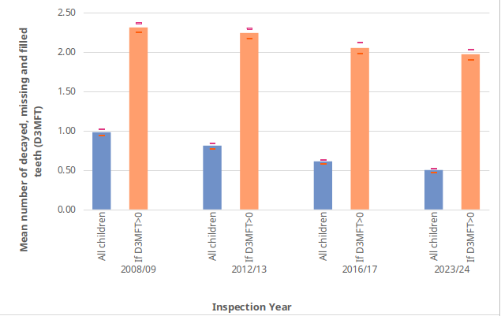
Difrifoldeb pydredd dannedd Severity of dental caries
Y brif neges yw bod difrifoldeb pydredd dannedd wedi lleihau (pob plentyn). Nifer cymedrig y dannedd â phydredd yw 0.5 [0.47-0.52] (pob plentyn). Mae ffin isaf y cyfwng hyder ar gyfer 2016/17 uwchlaw’r ffin uchaf ar gyfer 2023/24, sy’n golygu bod y gostyngiad hwn yn ystadegol arwyddocaol
Ymhlith y plant â phydredd, y difrifoldeb yw 1.97 [1.90-2.03] ac ni fu newid ers 2016/17
The headline message is that the severity of dental caries has reduced (all children). The mean number of teeth with decay experience is 0.5 [0.47-0.52] (all children). The lower boundary of the confidence interval for 2016/17 is above the upper boundary for the 2023/24, meaning this reduction is statistically significant
In children with decay, the severity is 1.97 [1.90-2.03] and there has been no change since 2016/17
Public Health Wales

Slide 10
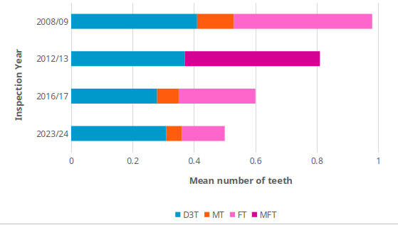
Cyfansoddiad D3MFT Composition of D3MFT
Yr elfen fwyaf o brofiad pydredd dannedd yn 2023/24 yw pydredd dannedd heb ei drin (D3T). Mae hyn wedi cynyddu o 15.5% [14.6-16.4] yn 2016/17 i 16.9% [15.9-17.8] yn 2023/24
Er nad yw hyn yn ystadegol arwyddocaol, mae’n awgrymu bod baich pydredd dannedd heb ei drin yn gwaethygu ymhlith plant yr effeithir arnynt.
[Cyfunwyd MT ac FT yn 2012/3]
The largest component of dental caries experience in 2023/24 is for untreated dental caries (D3T). This has increased from 15.5% [14.6-16.4] in 2016/17 to 16.9% [15.9-17.8] in 2023/24
Although this isn't statistically significant, it suggests that the burden of untreated dental caries is worsening in affected children
[MT and FT were combined in 2012/3]
Public Health Wales

Slide 11
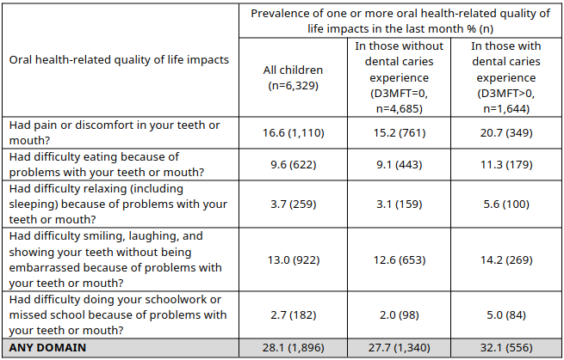
Ansawdd bywyd Quality of Life
Dywedodd bron i draean o blant (28.1%) fod iechyd y geg wedi effeithio ar ansawdd eu bywydau. Ymhlith plant â phrofiad o bydredd dannedd (D3MFT>0), nododd dros draean (32.1%) effaith.
Yr effaith fwyaf cyffredin ar ansawdd bywyd y geg yn ymwneud ag iechyd oedd poen (16.6% o'r holl blant a 20.7% o'r rhai â phrofiad o bydredd dannedd)
Almost a third of children (28.1%) reported that their oral health had impacted on their quality-of-life. In children with dental caries experience (D3MFT>0), over a third (32.1%) reported an impact.
The most common oral health-related quality of life impact was pain (16.6% of all children and 20.7% of those with dental caries experience)
Public Health Wales

Slide 12
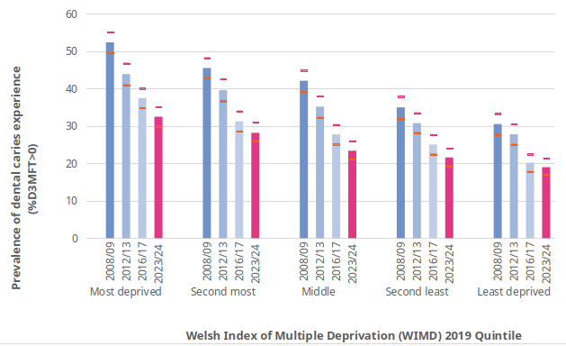
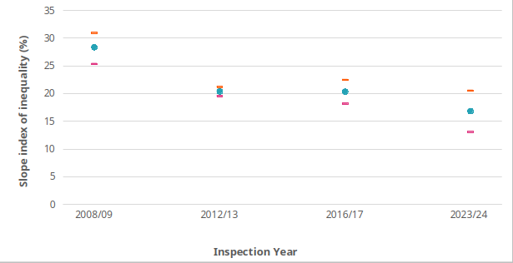
Anghydraddoldeb Inequality
Mae graddiant cymdeithasol clir o ran cyffredinrwydd a difrifoldeb y profiad o bydredd dannedd ymhlith plant yng Nghymru. Mae unigolion o'r cymunedau mwyaf difreintiedig yn fwy tebygol o brofi pydredd dannedd ac fe fydd mwy o ddannedd wedi'u heffeithio arnynt.
Mae mynegai llethrau anghydraddoldeb o ran cyffredinrwydd pydredd dannedd wedi gostwng rhwng 2008/09 a 2023/24
There is a clear social gradient in both the prevalence and severity of dental caries experience amongst children in Wales. Individuals from the most deprived communities are more likely to experience dental caries and have more teeth affected.
The slope index of inequality of dental caries prevalence has decreased between 2008/09 and 2023/24
Public Health Wales

Slide 13
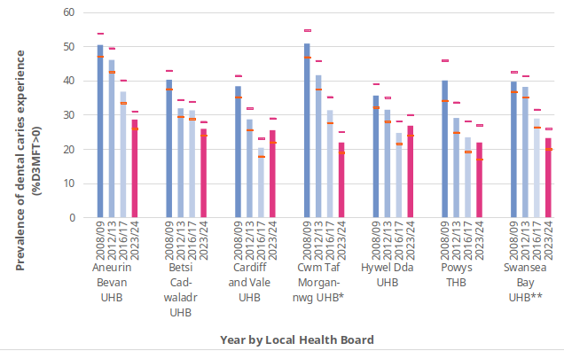
Byrddau Iechyd Health Boards
Mae cyffredinrwydd pydredd dannedd yn amrywio o 21.9% yn BIPCT [19.0-24.8] a BIAP [16.6-27.2] i 28.6% [26.3-31.0] yn BIPAB. Ers 2016/17 bu:
Gostyngiad yn BIPAB a BIPBC
Dim newid yn BIPCF, BIPHDd na BIAP
Oherwydd y bu newid i ardal Cyngor Bwrdeistref Sirol Pen-y-bont ar Ogwr, nid yw’n bosibl dehongli newidiadau o ran cyffredinrwydd clefydau yn BIPCTM na BIPBA
Prevalence of dental caries experience ranges from 21.9% in both CTUHB [19.0-24.8] and PTHB [16.6-27.2] to 28.6% [26.3-31.0] in ABUHB. Since 2016/17 there has been:
Reduction in ABUHB & BCUHB
No change in C&VUHB, HDUHB & PTHB
Due to the Bridgend County Borough Council area change, it is not possible to interpret changes in disease prevalence in CTMUHB and SBUHB
Public Health Wales

Slide 14
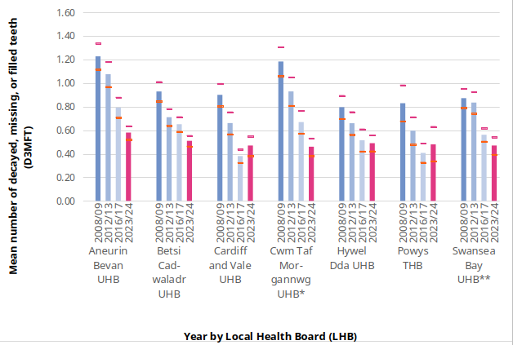
Byrddau Iechyd Health Boards
Mae difrifoldeb pydredd dannedd yn amrywio o 0.46 [0.38-0.53] yn BIPCTM i 0.58 [0.52-0.64] yn BIPAB. Ers 2016/17 bu:
Gostyngiad yn BIPAB a BIPBC
Dim newid yn BIAP, BIPHDd na BIPCF
Oherwydd y bu newid i ardal Cyngor Bwrdeistref Sirol Pen-y-bont ar Ogwr, nid yw’n bosibl dehongli'r newidiadau o ran difrifoldeb y clefyd yn BIPCTM na BIPBA
Severity of dental caries ranges from 0.46 [0.38-0.53] CTMUHB to 0.58 [0.52-0.64] in ABUHB. Since 2016/17 there has been:
Reduction in ABUHB and BCUHB
No change in PTHB, HDUHB & C&VUHB
Due to the Bridgend County Borough Council area change, it is not possible to interpret changes in disease severity in CTMUHB and SBUHB
Public Health Wales

Slide 15
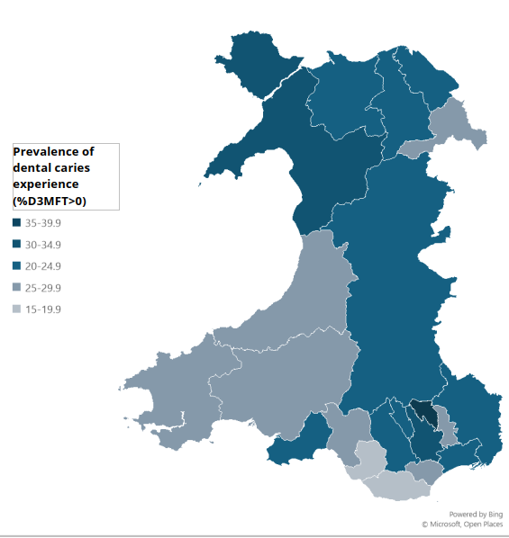
Awdurdodau Unedol Unitary Authorities
Ar lefel Awdurdod Unedol, mae cyffredinrwydd pydredd dannedd yn amrywio o 16.8% [12.4-21.2] ym Mhen-y-bont ar Ogwr i 36.4% [32.0-40.9] ym Mlaenau Gwent
At a Unitary Authority-level, dental caries prevalence ranges from 16.8% [12.4-21.2] in Bridgend to 36.4% [32.0-40.9] in Blaenau Gwent
Public Health Wales

Slide 16
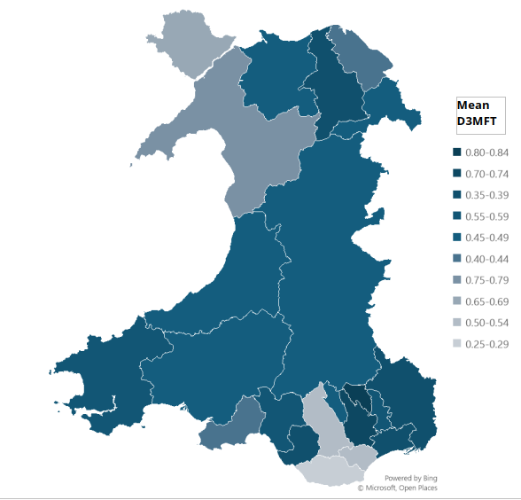
Awdurdodau Unedol Unitary Authorities
Ar lefel Awdurdod Unedol mae difrifoldeb y clefyd yn amrywio o 0.29 [0.20 i 0.38] ym Mro Morgannwg i 0.81 [0.68-0.94] ym Mlaenau Gwent
At a Unitary Authority-level disease severity ranges from 0.29 [0.20 to 0.38] in the Vale of Glamorgan to 0.81 [0.68-0.94] in Blaenau Gwent
Public Health Wales

Slide 17
Gweithio gyda'n gilydd i greu Cymru iachach Working together for a healthier Wales

