Slide 1
HIV and STI trends in Wales: 2017
Communicable Disease Surveillance Centre,
Health Protection, Public Health Wales,
Cardiff, UK
September 2018, v1

Slide 2
HIV and STI Trends in Wales: 201
Summary of HIV and STI trends, Wales 2016-17
* Visits to sexual health clinics increased by 5% in the same period (5% in females, 6% in males)
Source: Welsh sexual health clinics (via SWS)
Notes:
i) Diagnoses and tests of STIs were reported from sexual health clinics across Wales via SWS
ii) New HIV diagnoses from SHCs across Wales via SWS – a change from other reports which have PHE data, not comparable
iii) Diagnoses made in clinics in Carmarthenshire and Pembrokeshire, reported on paper SHHAPT forms, have also been included
iv) The following KC60/SHHAPT codes were used: primary, secondary and early latent syphilis (A1, A2, A3), gonorrhoea (B, B1, B2), chlamydia (C4, C4A, C4C), first episode of genital herpes (C10A), first episode of genital warts (C11A) and new diagnosis of HIV (E1A, E2A, E3A1, H1, H1A, H1B)
v) Laboratory data were extracted via SWS from Datastore, which collects data from all laboratories across Wales. Duplicates, resulting from samples moving between labs, may be included.

Slide 3
Summary of HIV and STI trends, Wales 2011-17
* Visits to sexual health clinics increased by 118% in the same period (154% in females, 50% in males)
Source: Welsh sexual health clinics (via SWS)
Notes:
i) Diagnoses and tests of STIs were reported from sexual health clinics across Wales via SWS
ii) New HIV diagnoses from SHCs across Wales via SWS – a change from other reports which have PHE data, not comparable
iii) Diagnoses made in clinics in Carmarthenshire and Pembrokeshire, reported on paper SHHAPT forms, have also been included
iv) The following KC60/SHHAPT codes were used: primary, secondary and early latent syphilis (A1, A2, A3), gonorrhoea (B, B1, B2), chlamydia (C4, C4A, C4C), first episode of genital herpes (C10A), first episode of genital warts (C11A) and new diagnosis of HIV (E1A, E2A, E3A1, H1, H1A, H1B)
v) Laboratory data were extracted via SWS from Datastore, which collects data from all laboratories across Wales. Duplicates, resulting from samples moving between labs, may be included. This duplication became less likely with the new, common Laboratory Information Management System (LIMS). For this reason, comparing data from 2011 (old system) to data from 2017 (new system) may be slightly underestimated.

Slide 4
New HIV diagnoses from sexual health clinics across Wales, by gender
Source: Welsh sexual health clinics (via SWS)
Notes:
i) New HIV diagnoses from SHCs across Wales via SWS – a change from other reports which have PHE data, not comparable
ii) Incidences were calculated per 100,000 gender-specific populations, using mid-year estimates provided by StatsWales
iii) Diagnoses made in clinics in Carmarthenshire and Pembrokeshire, reported on paper SHHAPT forms, have also been included
iv) The following KC60/SHHAPT codes were used: primary, secondary and early latent syphilis (A1, A2, A3), gonorrhoea (B, B1, B2), chlamydia (C4, C4A, C4C), first episode of genital herpes (C10A), first episode of genital warts (C11A) and new diagnosis of HIV (E1A, E2A, E3A1, H1, H1A, H1B)

Slide 5
Chlamydia diagnoses made in sexual health clinics in Wales, by gender
Source: Welsh sexual health clinics (via SWS)
Notes:
i) Diagnoses reported from Sexual Health clinics across Wales via SWS
ii) Incidences were calculated per 100,000 gender-specific populations, using mid-year estimates provided by StatsWales
iii) Diagnoses made in clinics in Carmarthenshire and Pembrokeshire, reported on paper SHHAPT forms, have also been included
iv) The following KC60/SHHAPT codes were used: primary, secondary and early latent syphilis (A1, A2, A3), gonorrhoea (B, B1, B2), chlamydia (C4, C4A, C4C), first episode of genital herpes (C10A), first episode of genital warts (C11A) and new diagnosis of HIV (E1A, E2A, E3A1, H1, H1A, H1B)

Slide 6
Gonorrhoea diagnoses made in sexual health clinics in Wales, by gender
Source: Welsh sexual health clinics (via SWS)
Notes:
i) Diagnoses reported from Sexual Health clinics across Wales via SWS
ii) Incidences were calculated per 100,000 gender-specific populations, using mid-year estimates provided by StatsWales
iii) Diagnoses made in clinics in Carmarthenshire and Pembrokeshire, reported on paper SHHAPT forms, have also been included
iv) The following KC60/SHHAPT codes were used: primary, secondary and early latent syphilis (A1, A2, A3), gonorrhoea (B, B1, B2), chlamydia (C4, C4A, C4C), first episode of genital herpes (C10A), first episode of genital warts (C11A) and new diagnosis of HIV (E1A, E2A, E3A1, H1, H1A, H1B)

Slide 7
Syphilis diagnoses made in sexual health clinics in Wales, by gender
Source: Welsh sexual health clinics (via SWS)
Notes:
i) Diagnoses reported from Sexual Health clinics across Wales via SWS
ii) Incidences were calculated per 100,000 gender-specific populations, using mid-year estimates provided by StatsWales
iii) Diagnoses made in clinics in Carmarthenshire and Pembrokeshire, reported on paper SHHAPT forms, have also been included
iv) The following KC60/SHHAPT codes were used: primary, secondary and early latent syphilis (A1, A2, A3), gonorrhoea (B, B1, B2), chlamydia (C4, C4A, C4C), first episode of genital herpes (C10A), first episode of genital warts (C11A) and new diagnosis of HIV (E1A, E2A, E3A1, H1, H1A, H1B)

Slide 8
Genital herpes diagnoses made in sexual health clinics in Wales, by gender
Source: Welsh sexual health clinics (via SWS)
Notes:
i) Diagnoses reported from Sexual Health clinics across Wales via SWS
ii) Incidences were calculated per 100,000 gender-specific populations, using mid-year estimates provided by StatsWales
iii) Diagnoses made in clinics in Carmarthenshire and Pembrokeshire, reported on paper SHHAPT forms, have also been included
iv) The following KC60/SHHAPT codes were used: primary, secondary and early latent syphilis (A1, A2, A3), gonorrhoea (B, B1, B2), chlamydia (C4, C4A, C4C), first episode of genital herpes (C10A), first episode of genital warts (C11A) and new diagnosis of HIV (E1A, E2A, E3A1, H1, H1A, H1B)

Slide 9
Genital warts diagnoses made in sexual health clinics in Wales, by gender
Source: Welsh sexual health clinics (via SWS)
Notes:
i) Diagnoses reported from Sexual Health clinics across Wales via SWS
ii) Incidences were calculated per 100,000 gender-specific populations, using mid-year estimates provided by StatsWales
iii) Diagnoses made in clinics in Carmarthenshire and Pembrokeshire, reported on paper SHHAPT forms, have also been included
iv) The following KC60/SHHAPT codes were used: primary, secondary and early latent syphilis (A1, A2, A3), gonorrhoea (B, B1, B2), chlamydia (C4, C4A, C4C), first episode of genital herpes (C10A), first episode of genital warts (C11A) and new diagnosis of HIV (E1A, E2A, E3A1, H1, H1A, H1B)

Slide 10
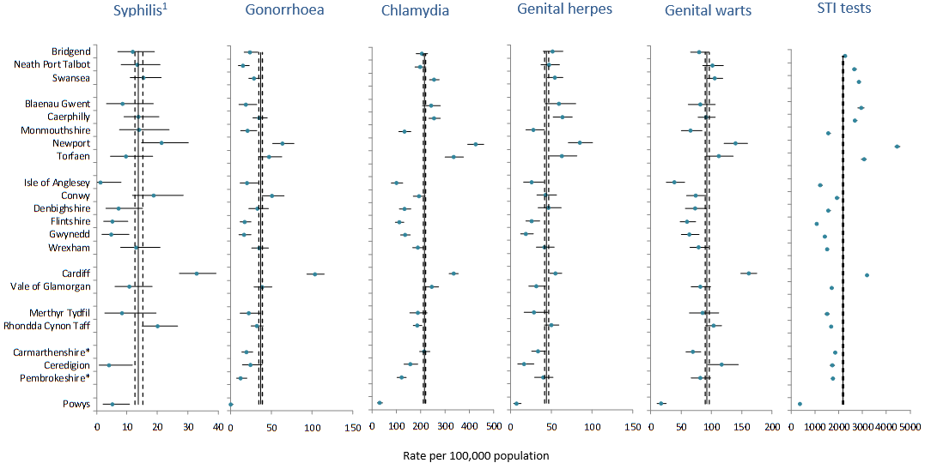
Rates of STI diagnoses made in sexual health clinics in Wales, by local authority of residence: 2017
Source: Welsh sexual health clinics (via SWS)
Notes:
¹Syphilis diagnoses from 2015 to 2017 were combined for this analysis *diagnoses made in clinics in Carmarthenshire or Pembrokeshire up to March 2016 were not included in these analyses, although individuals living in these LAs that have visited clinics elsewhere are included. i) Diagnoses of STIs were reported from sexual health clinics across Wales via SWS. ii) These data have not been imputed and may be partially representative of completeness of reporting. In addition, only individuals for whom a residence LA was provided were included. iii) The following KC60/SHHAPT codes were used: gonorrhoea (B, B1, B2), chlamydia (C4, C4A, C4C), first episode of genital herpes (C10A), first episode of genital warts (C11A) and STI tests (S1, S2, T1, T2, T3, T4). Syphilis rates are not depicted, due to low numbers of cases. iv) LA-specific rates were calculated using mid-year estimates provided by StatsWales.

Slide 11
Age distribution of STI diagnoses amongst females: Wales, 2017
Source: Welsh sexual health clinics (via SWS)
Notes:
i) Diagnoses of STIs were reported from sexual health clinics across Wales via SWS
ii) These data do not include diagnoses made in clinics in Carmarthenshire or Pembrokeshire up to March 2016, as single year age breakdown was not available
iii) The following KC60/SHHAPT codes were used: primary, secondary and early latent syphilis (A1, A2, A3), gonorrhoea (B, B1, B2), chlamydia (C4, C4A, C4C), first episode of genital herpes (C10A) and first episode of genital warts (C11A)
iv) Age- and gender-specific incidence was calculated using mid-year estimates provided by StatsWales

Slide 12
Age distribution of STI diagnoses amongst males: Wales, 2017
Source: Welsh sexual health clinics (via SWS)
Notes:
i) Diagnoses of STIs were reported from sexual health clinics across Wales via SWS
ii) These data do not include diagnoses made in clinics in Carmarthenshire or Pembrokeshire up to March 2016, as single year age breakdown was not available
iii) The following KC60/SHHAPT codes were used: primary, secondary and early latent syphilis (A1, A2, A3), gonorrhoea (B, B1, B2), chlamydia (C4, C4A, C4C), first episode of genital herpes (C10A) and first episode of genital warts (C11A)
iv) Age- and gender-specific incidence was calculated using mid-year estimates provided by StatsWales

Slide 13
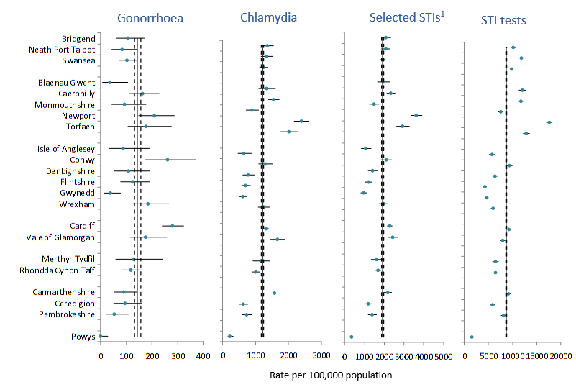
Rates of STI diagnoses amongst 15-24 year olds made in sexual health clinics in Wales, by local authority of residence: 2017
Source: Welsh sexual health clinics (via SWS)
Notes:
¹ Selected STIs: gonorrhoea, chlamydia, genital warts, genital herpes, and primary, secondary and early latent syphilis. i) Diagnoses of STIs were reported from sexual health clinics across Wales via SWS. ii) The following KC60/SHHAPT codes were used: gonorrhoea (B, B1, B2), chlamydia (C4, C4A, C4C), selected STIs (A1, A2, A3, B, B1, B2, C4, C4A, C4C, C10A, C11A) and STI screens (S1, S2, T1-4). iii) These data have not been imputed and may be partially representative of completeness of reporting. In addition, only individuals for whom a residence LA was provided were included. iv) LA-specific rates were calculated using mid-year estimates of 15-24 year olds provided by StatsWales.

Slide 14
Proportion of STI and new HIV diagnoses which are among MSM in Wales
Source: Welsh sexual health clinics (via SWS)
Notes:
i) Diagnoses of STIs were reported from sexual health clinics across Wales via SWS, including diagnoses in males and females
ii) New HIV diagnoses from SHCs across Wales via SWS – a change from other reports which have PHE data, not comparable
iii) Diagnoses made in clinics in Carmarthenshire and Pembrokeshire, reported on paper SHHAPT forms, have also been included
iv) The following KC60/SHHAPT codes were used: primary, secondary and early latent syphilis (A1, A2, A3), gonorrhoea (B, B1, B2), chlamydia (C4, C4A, C4C), first episode of genital herpes (C10A), first episode of genital warts (C11A) and new diagnosis of HIV (E1A, E2A, E3A1, H1, H1A, H1B)

Slide 15
New HIV diagnoses from sexual health clinics across Wales by gender and sexuality
Source: Welsh sexual health clinics (via SWS)
Notes:
i) New HIV diagnoses from SHCs across Wales via SWS – a change from other reports which have PHE data, not comparable
ii) Diagnoses made in clinics in Carmarthenshire and Pembrokeshire, reported on paper SHHAPT forms, have also been included
iii) The following KC60/SHHAPT codes were used: primary, secondary and early latent syphilis (A1, A2, A3), gonorrhoea (B, B1, B2), chlamydia (C4, C4A, C4C), first episode of genital herpes (C10A), first episode of genital warts (C11A) and new diagnosis of HIV (E1A, E2A, E3A1, H1, H1A, H1B)

Slide 16
Chlamydia diagnoses made in sexual health clinics in Wales, by gender and sexuality
Source: Welsh sexual health clinics (via SWS)
Notes:
i) Diagnoses reported from Sexual Health clinics across Wales via SWS
ii) Diagnoses made in clinics in Carmarthenshire and Pembrokeshire, reported on paper SHHAPT forms, have also been included
iii) The following KC60/SHHAPT codes were used: primary, secondary and early latent syphilis (A1, A2, A3), gonorrhoea (B, B1, B2), chlamydia (C4, C4A, C4C), first episode of genital herpes (C10A), first episode of genital warts (C11A) and new diagnosis of HIV (E1A, E2A, E3A1, H1, H1A, H1B)

Slide 17
Gonorrhoea diagnoses made in sexual health clinics in Wales, by gender and sexuality
Source: Welsh sexual health clinics (via SWS)
Notes:
i) Diagnoses reported from Sexual Health clinics across Wales via SWS
ii) Diagnoses made in clinics in Carmarthenshire and Pembrokeshire, reported on paper SHHAPT forms, have also been included
iii) The following KC60/SHHAPT codes were used: primary, secondary and early latent syphilis (A1, A2, A3), gonorrhoea (B, B1, B2), chlamydia (C4, C4A, C4C), first episode of genital herpes (C10A), first episode of genital warts (C11A) and new diagnosis of HIV (E1A, E2A, E3A1, H1, H1A, H1B)

Slide 18
Syphilis diagnoses made in sexual health clinics in Wales, by gender and sexuality
Source: Welsh sexual health clinics (via SWS)
Notes:
i) Diagnoses reported from Sexual Health clinics across Wales via SWS
ii) Diagnoses made in clinics in Carmarthenshire and Pembrokeshire, reported on paper SHHAPT forms, have also been included
iii) The following KC60/SHHAPT codes were used: primary, secondary and early latent syphilis (A1, A2, A3), gonorrhoea (B, B1, B2), chlamydia (C4, C4A, C4C), first episode of genital herpes (C10A), first episode of genital warts (C11A) and new diagnosis of HIV (E1A, E2A, E3A1, H1, H1A, H1B)

Slide 19
Genital herpes diagnoses made in sexual health clinics in Wales, by gender and sexuality
Source: Welsh sexual health clinics (via SWS)
Notes:
i) Diagnoses reported from Sexual Health clinics across Wales via SWS
ii) Diagnoses made in clinics in Carmarthenshire and Pembrokeshire, reported on paper SHHAPT forms, have also been included
iii) The following KC60/SHHAPT codes were used: primary, secondary and early latent syphilis (A1, A2, A3), gonorrhoea (B, B1, B2), chlamydia (C4, C4A, C4C), first episode of genital herpes (C10A), first episode of genital warts (C11A) and new diagnosis of HIV (E1A, E2A, E3A1, H1, H1A, H1B)

Slide 20
Genital warts diagnoses made in sexual health clinics in Wales, by gender and sexuality
Source: Welsh sexual health clinics (via SWS)
Notes:
i) Diagnoses reported from Sexual Health clinics across Wales via SWS
ii) Diagnoses made in clinics in Carmarthenshire and Pembrokeshire, reported on paper SHHAPT forms, have also been included
iii) The following KC60/SHHAPT codes were used: primary, secondary and early latent syphilis (A1, A2, A3), gonorrhoea (B, B1, B2), chlamydia (C4, C4A, C4C), first episode of genital herpes (C10A), first episode of genital warts (C11A) and new diagnosis of HIV (E1A, E2A, E3A1, H1, H1A, H1B)

Slide 21
Average annual rate of STI and new HIV diagnoses by ethnic group, Wales 2013-2017
Source: Welsh sexual health clinics (via SWS)
Notes:
i) Diagnoses of STIs were reported from sexual health clinics across Wales via SWS
ii) New HIV diagnoses from SHCs across Wales via SWS – a change from other reports which have PHE data, not comparable
iii) Rates are per 100,000 ethnicity-specific population, using 2011 population estimates from ONS
iv) Diagnoses made in clinics in Carmarthenshire or Pembrokeshire up to March 2016 were not included
v) The following KC60/SHHAPT codes were used: primary, secondary and early latent syphilis (A1, A2, A3), gonorrhoea (B, B1, B2), chlamydia (C4, C4A, C4C), first episode of genital herpes (C10A), first episode of genital warts (C11A) and new diagnosis of HIV (E1A, E2A, E3A1, H1, H1A, H1B)

Slide 22
Number of attendances at sexual health clinics across Wales
Source: Welsh sexual health clinics (via SWS)
Notes:
i) All patient attendances reported to SWS deduplicated by patient, individual clinic, and date.
ii) Attendances to clinics in Carmarthenshire and Pembrokeshire, reported on paper SHHAPT forms, have also been included

Slide 23
HIV and STI Trends in Wales: 201
Definitions of STI diagnoses and tests made in sexual health clinics

