Slide 1
Selective varicella (chickenpox) catchup vaccination programme training slides
Vaccine Preventable Disease Programme
Public Health Wales
Version 1
October 2026
Notes:
Material contained in this document may be reproduced without prior permission provided it is done so accurately and is not used in a misleading context.​
​
Acknowledgement to Public Health Wales NHS Trust to be stated.​
​
© 2026 Public Health Wales NHS Trust.​

Slide 2
Acknowledgements
Vaccine Preventable Disease Programme
Vaccine Programme Wales
Welsh Government
UK Health Security Agency
Health Boards

Slide 3
Contents
Section | Slide number
Aims & learning outcomes | 4
Selective varicella (chickenpox) catchup vaccination programme overview | 10
MMRV vaccines for the selective catch-up programme | 19
Epidemiology & surveillance | 37
Resources to support the selective varicella (chickenpox) catchup vaccination programme | 43

Slide 4
Aims & learning outcomes

Slide 5
Aims of resource
The purpose of this training resource is to:
develop the knowledge base of healthcare practitioners regarding the selective varicella (chickenpox) catchup vaccination programme
support healthcare practitioners involved in delivering vaccination or messages around vaccination for the selective varicella (chickenpox) catchup vaccination programme, by providing evidence-based information
promote high uptake of MMRV vaccination in all eligible groups by increasing the knowledge of those involved in supporting and delivering the vaccination programme

Slide 6
Learning outcomes
On completion of this resource, healthcare practitioners will be able to:
explain the eligibility criteria for the selective varicella (chickenpox) catchup vaccination programme
understand the rationale for the selective varicella (chickenpox) catchup vaccination programme
be aware of UK epidemiology and uptake of MMR-containing vaccines
explain which vaccines should be used and the precautions and contraindications to the administration of these
understand the importance of their role in promoting and providing evidence-based information about MMRV vaccination to patients
identify relevant resources and additional information in relation to the MMRV vaccine selective catch-up programme

Slide 7
Pre-requisites to administering MMRV vaccine
Before administering the MMRV vaccine, it is recommended that:
those new to immunisation should receive comprehensive foundation immunisation training*. Both knowledge and clinical competence should be assessed before new immunisers start to give and/or advise about the MMRV vaccine National Minimum Standards and Core Curriculum for Vaccination Training. An advisory document for Wales is available for use alongside this document that addresses specific issues relating to NHS Wales that are not reflected or may differ to England. The advisory document is available from Immunisation training resources and events - Public Health Wales.
undertake training in the management of anaphylaxis and Basic Life Support (BLS) (adult) as specified by the policy for your local area and are familiar with Resuscitation Council UK (RCUK) guidance on Management of Anaphylaxis in the Vaccination Setting
undertake any additional statutory and mandatory training as required by your employer
undertake theoretical and practical vaccination training and been assessed as competent
undertake specific training on the MMRV vaccination programme and familiarised yourself with the process for preparation of Priorix-Tetra® and ProQuad®
have an appropriate legal framework to supply and administer the MMRV vaccine in place for example a patient specific prescription, Patient Specific Direction (PSD) or Patient Group Direction (PGD). Further information will be available here: Patient Group Directions (PGD) - Welsh Medicines Advice Service (wales.nhs.uk)
those involved in immunisation and vaccination understand the process of consent and how this applies when giving vaccines. Information on consent can be viewed here: Consent: the green book - GOV.UK
Immunisers and those giving immunisation advice, access and familiarise themselves with the following key documents: Specific Green Book Chapters : Measles: the green book chapter - GOV.UK; Mumps: the green book chapter - GOV.UK; Rubella: the green book chapter - GOV.UK; Varicella: the green book chapter - GOV.UK; MMRV vaccination: information for healthcare professionals - GOV.UK The vaccine product information in the Summary of Product Characteristics: Electronic Medicines Compendium website
Notes:
*This should be either through a face to face taught course or a blended approach of both e-learning and a face to face taught course. New immunisers should also have a period of supervised practice and support with a registered healthcare practitioner who is experienced, up to date and competent in immunisation.
Practitioners should always ensure they are accessing the most up to date information and guidance.

Slide 8
Notes to users
this slide set contains a collection of core slides for both individual use and for use or adaptation during the delivery of selective varicella (chickenpox) catchup vaccination programme training
trainers should select the slides required depending on the background and experience of the healthcare practitioners they are training and according to the role they will have in delivering the selective varicella (chickenpox) catchup vaccination programme
the information in this slide set (version 1) was correct at time of publication
updates to the slide set may be required in the future, for example in response to changing epidemiology or vaccination recommendations - please check online to ensure you are using the latest version of these slides Immunisation training resources and events - Public Health Wales
This training slide set provides an overview of the selective varicella (chickenpox) catchup vaccination programme and should be used alongside the more detailed disease-specific slide sets available on the Immunisation training resources and events - Public Health Wales
The following slides and recordings provide further information on the MMRV vaccine and the diseases it protects against:
Vaccination against chickenpox (varicella) and other changes to the routine childhood immunisation schedule in January 2026 webinar slide set
Varicella (chickenpox) the disease,​ complications and vaccination slide set and recording (SharePoint, NHS employees only)
Measles The disease, complications and vaccination slide set and recording (SharePoint, NHS employees only)

Slide 9
Key messages
• MMRV vaccination is key to protect children against measles, mumps, rubella and varicella (chickenpox), reducing illness and complications
• the introduction of the MMRV vaccination programme, and selective varicella (chickenpox) catchup vaccination programme, is expected to reduce chickenpox cases and associated complications in children
• although chickenpox is often mild, it can cause serious complications including bacterial infections, pneumonia, encephalitis, hospitalisation and, rarely, death
• the selective catch-up programme provides protection for eligible children who remain susceptible to chickenpox and helps prevent gaps in immunity
• achieving high vaccine uptake is important to maximise individual protection and reduce the burden of chickenpox on families, communities and healthcare services
• healthcare professionals play a key role in identifying eligible children, promoting vaccine confidence and supporting informed parental decisions
• every contact is an opportunity to identify under-vaccinated children and offer protection against measles, mumps, rubella and chickenpox where appropriate

Slide 10
Selective varicella (chickenpox) catchup vaccination programme

Slide 11
Background to the selective varicella (chickenpox) catchup vaccination programme: JCVI statement
In November 2023 the Joint Committee on Vaccination and Immunisation (JCVI)* recommended a universal varicella (chickenpox) vaccine programme be introduced as part of the routine childhood schedule. They recommended a:
2-dose programme
at 12 and 18 months
using the combined MMRV (measles, mumps, rubella and varicella) vaccine
The aim of the programme is to prevent severe cases of varicella and other serious outcomes of varicella
They also recommended a catch-up programme should also be initiated to prevent a gap in immunity
For more information, see: JCVI statement on a childhood varicella (chickenpox) vaccination programme - GOV.UK
Notes:
*The JCVI is an expert scientific advisory committee which advises the UK government on vaccination and immunisation matters

Slide 12
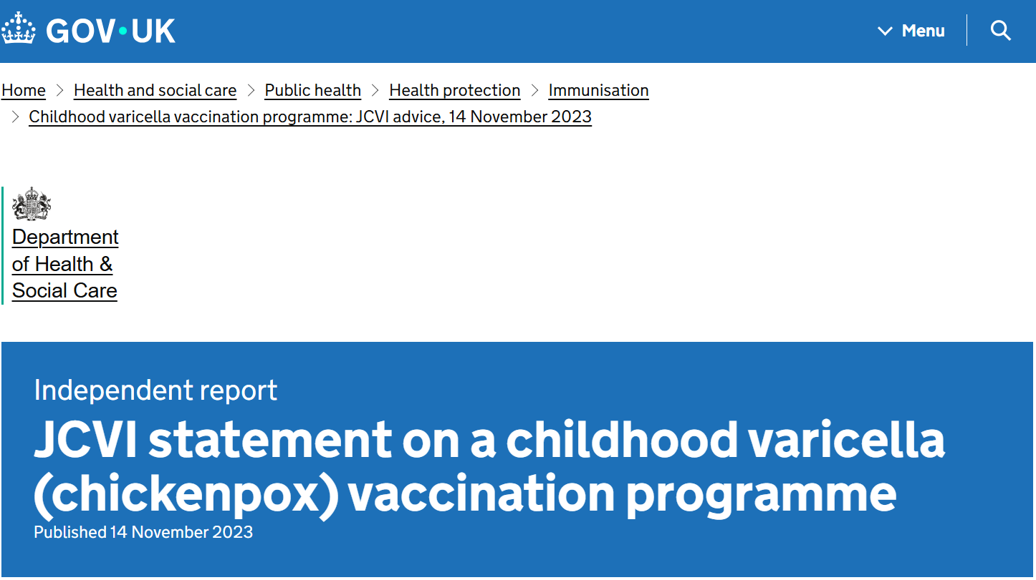
What does a gap in immunity mean?
data from other countries show that when chickenpox vaccination is offered routinely to children, it leads to a “significant and dramatic decrease in the number of cases”
fewer children were exposed to chickenpox during the COVID-19 pandemic, and the introduction of MMRV is predicted to significantly decrease circulation of varicella, therefore some people may remain at risk of catching chickenpox later in life
for this reason, the JCVI considered a catch-up programme would be beneficial to help prevent a gap in immunity
JCVI statement on a childhood varicella (chickenpox) vaccination programme - GOV.UK

Slide 13
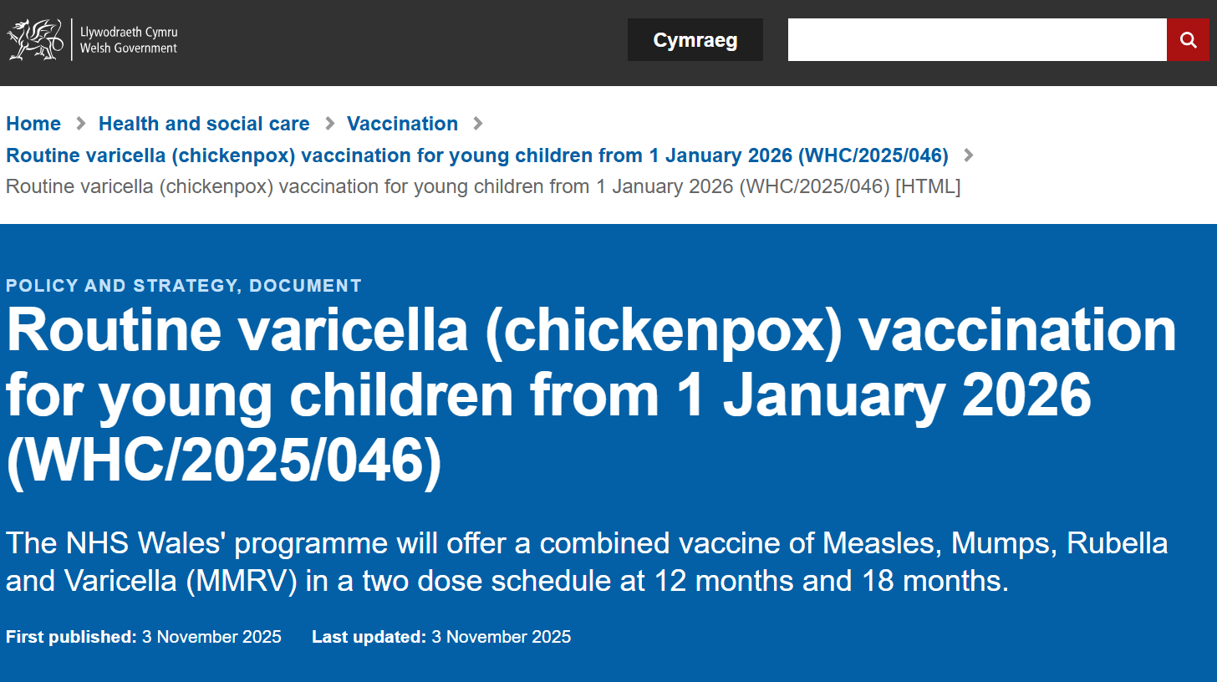
Background to the selective varicella (chickenpox) catchup vaccination programme: Welsh Health Circular (WHC), November 2025
in November 2025, the Welsh Government published policy about the introduction of a routine NHS varicella (chickenpox) vaccination programme for children from 1 January 2026 based on the advice from the JCVI
this WHC also outlines details for the varicella selective catch-up programme
the aim of the selective catch-up programme is to help accelerate control and further reduce transmission in the population
https://www.gov.wales/routine-varicella-chickenpox-vaccination-young-children-1-january-2026-whc2025046-html

Slide 14
Further information about the previous changes to the routine childhood schedule (July 2025 and January 2026)
PHW webpages:
Healthcare professionals: Changes to the childhood immunisation schedule for health professionals - Public Health Wales
Public: About the changes to the childhood immunisation schedule - Public Health Wales
Routine immunisation schedule for Wales: Routine immunisation schedules for Wales - Public Health Wales
PHW vaccine specific training slide sets:
Vaccination against chickenpox (varicella) and other changes to the routine childhood immunisation schedule in January 2026 - Public Health Wales (12 December 2025)
Changes to the routine childhood immunisation programme in 2025 and 2026 – slide set - Public Health Wales (June 2025)
Disease specific recorded slide sets:
Varicella (chickenpox) the disease,​ complications and vaccination recording (SharePoint, NHS employees only) and slide set (10 September 2025)
Measles The disease, complications and vaccination recording (SharePoint, NHS employees only) and slide set (19 November 2025)
External information: Childhood schedule changes 2025 and 2026: information for healthcare practitioners - GOV.UK

Slide 15
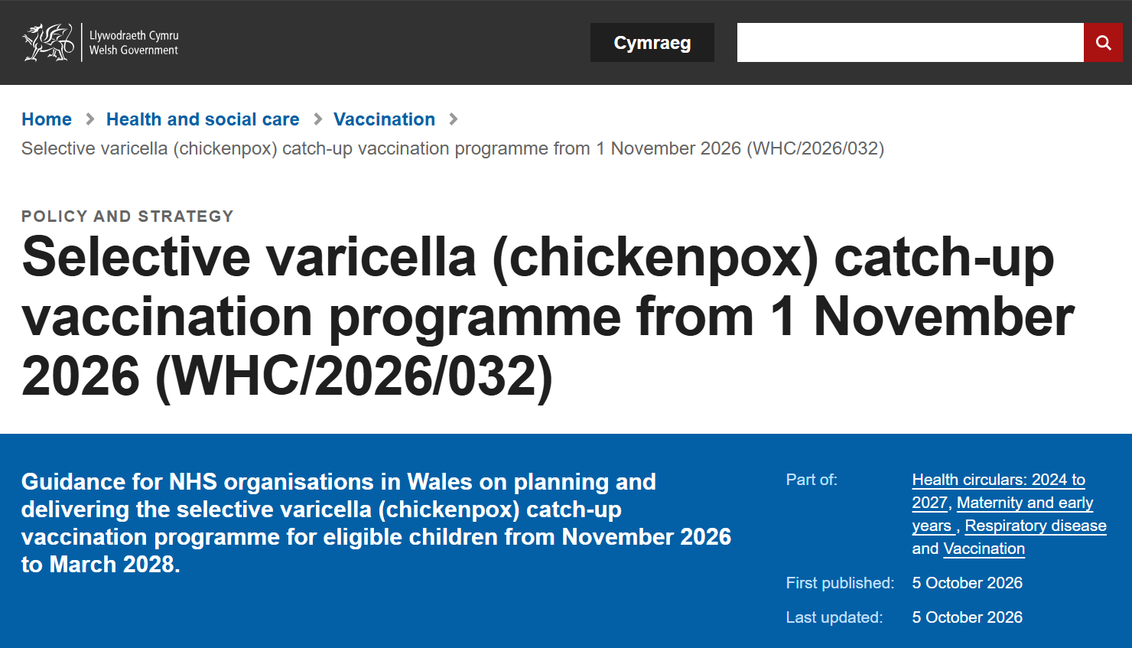
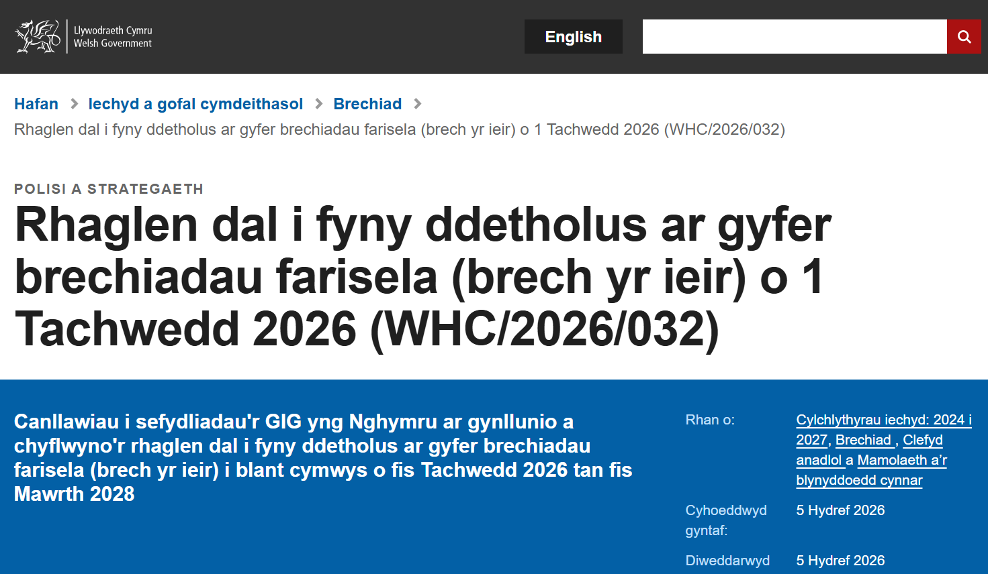
Background to the selective varicella (chickenpox) catchup vaccination programme: Welsh Health Circular (WHC), published October 2026
on 5 October 2026, the Welsh Government published policy about the selective varicella (chickenpox) catch-up vaccination programme
Selective varicella (chickenpox) catch-up vaccination programme from 1 November 2026 (WHC/2026/032) | GOV.WALES

Slide 16
The selective varicella (chickenpox) catchup vaccination programme as outlined in the WHC:
a one-dose MMRV programme offered to:
children whose date of birth is between 1 January 2020 to 31 August 2022 (those aged over 3 years and 4 months to under 6 years on 1 January 2026)
who have not had:
    a chickenpox infection, or
    2 doses of varicella vaccination
there is no requirement for practices to check the history of chickenpox infection, for those who respond to the offer, by undertaking serology testing
if any children in this cohort have missed routine doses of MMR should be brought up to date using the Vaccination of individuals with uncertain or incomplete immunisation - GOV.UK
this selective varicella (chickenpox) catchup programme will be between 1 November 2026 and 31 March 2028. Notification of eligibility should be issued to parents and guardians by 31 March 2027 at the latest (for example, within 5 months of the start of the programme)
Selective varicella (chickenpox) catch-up vaccination programme from 1 November 2026 (WHC/2026/032) | GOV.WALES

Slide 17
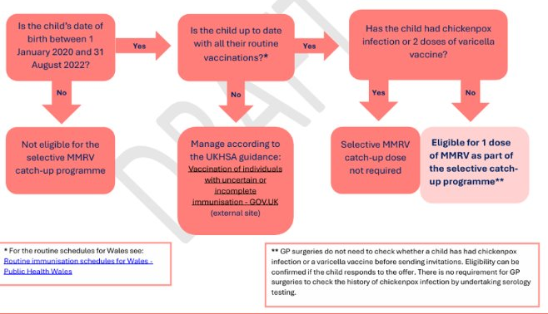
Selective varicella (chickenpox) catchup vaccination programme between 1 November 2026 and 31 March 2028 eligibility algorithm draft
17

Slide 18
Additional information:
a child's eligibility is defined by their date of birth (1 January 2020 to 31 August 2022), and not their age
the child should have had two previous MMR vaccinations at 12 months and 3 years 4 months but won’t have been offered MMRV at a routine appointment. There are no safety concerns with having 3 MMR-containing vaccines
there are no safety concerns with giving the vaccine to a child who has already had chickenpox infection or previous varicella vaccination. If there is uncertainty as to whether the child has had chickenpox infection before, parents can be advised that it is safe for their child to have the MMRV vaccine as part of the varicella (chickenpox) catchup vaccination programme
one dose of MMRV is more than 90% effective at protecting against chickenpox infection. It is about 99% effective in protecting against severe chickenpox infection
it is important to review the child’s vaccination record and offer any outstanding vaccines. Any missed vaccinations should be caught up using the Vaccination of people with uncertain or incomplete immunisation - GOV.UK (external site)

Slide 19
MMRV vaccines for the selective varicella (chickenpox) catch-up programme

Slide 20
The vaccines
the selective varicella (chickenpox) catchup vaccination programme will use 2 combined vaccines:
  Priorix-Tetra® (GSK): (does not contain pork gelatine)
    Patient information leaflet: Priorix Tetra Powder and solvent for solution for injection in pre-filled syringe - Summary of Product Characteristics (SmPC) - (emc) | 101321
    Information for healthcare professionals (SmPC): Priorix Tetra Powder and solvent for solution for injection in pre-filled syringe - Summary of Product Characteristics (SmPC) - (emc) | 101321
  ProQuad® (MSD): (contains pork gelatine)
    Patient information leaflet: ProQuad powder and solvent for suspension for injection in a pre-filled syringe - Patient Information Leaflet (PIL) - (emc) | 101444
    Information for healthcare professionals (SmPC):ProQuad powder and solvent for suspension for injection in a pre-filled syringe - Summary of Product Characteristics (SmPC) - (emc) | 101444
ProQuad® and Priorix-Tetra® are live attenuated vaccines. As the vaccine contains weakened forms of the viruses, it does not cause the diseases
the vaccines are considered clinically equivalent and interchangeable, although Priorix-Tetra® should be offered to children whose parents/guardians do not wish them to receive a vaccine containing pork gelatine
guidance in the Green Book supersedes the summary of product characteristics (SmPC) Varicella: the green book, chapter 34 - GOV.UK
a downloadable resource which describes how and why pork gelatine is used in vaccines can be found here: Vaccines and pork gelatine - Public Health Wales

Slide 21
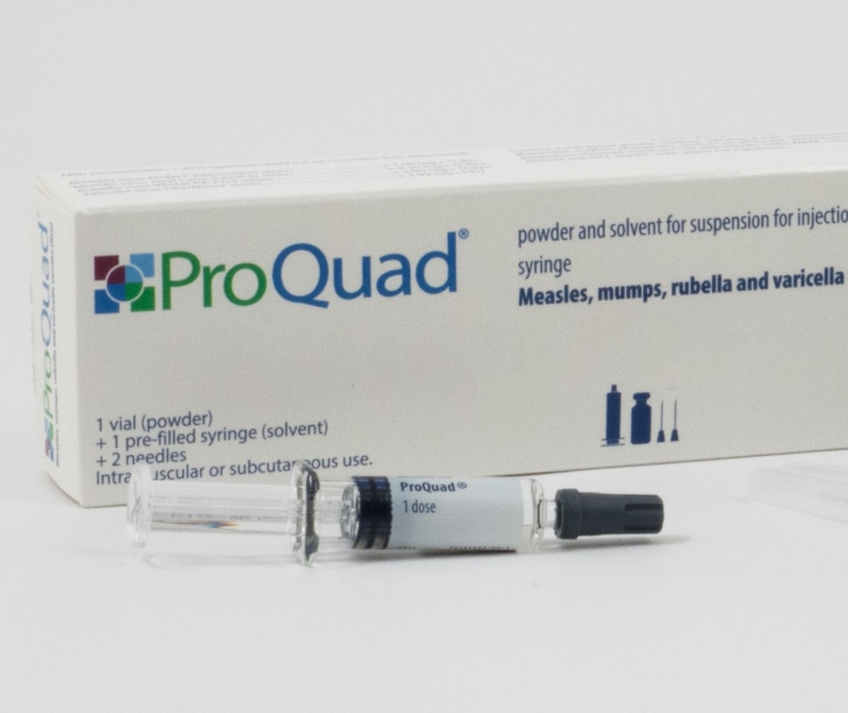
ProQuad®
pack size: Single dose packs. 1 x pre-filled syringe containing solvent + 1 vial of powder + 2 unattached needles. One reconstituted dose is 0.5ml
pack dimension: 150 (H) x 47 (W) x 28 mm (D)
in addition to the live attenuated viruses, ProQuad® contains:
  Sucrose Sodium bicarbonate Neomycin
  Hydrolysed gelatin Potassium phosphate Phenol red
  Sodium chloride Potassium chloride Hydrochloric acid (to adjust pH)
  Sorbitol (E420) Medium 199 with Hanks’ Salts Sodium hydroxide (to adjust pH)
  Monosodium glutamate Minimum Essential Medium, Eagle
  Sodium phosphate
the solvent is water for injections
ProQuad® contains pork gelatine
Priorix-Tetra® should be offered to children whose parents or guardians do not wish them to receive a vaccine containing pork gelatine
Image source: MSD
Notes:
ProQuad powder and solvent for suspension for injection in a pre-filled syringe - Summary of Product Characteristics (SmPC) - (emc) | 101444

Slide 22
Preparation and administration of ProQuad®
powder in a vial, with a solvent for solution in a pre-filled syringe
before reconstitution: powder is a before reconstitution the lyophilised powder (or “compact crystalline cake / plug”) is described as white to pale yellow (or “white to pale yellow compact crystalline plug/cake”)
solvent: clear, colourless liquid
reconstitute vaccine:
  by adding entire contents of pre-filled syringe of solvent to the vial containing the powder
  inspect the reconstituted vaccine. Its colour should become a clear pale yellow to light pink liquid
  it may contain translucent product-related particulates, which is normal for this vaccine, but if the vaccine presents with other colouration or contains other particulate matter, do not administer
Notes:
ProQuad powder and solvent for suspension for injection in a pre-filled syringe - Summary of Product Characteristics (SmPC) - (emc) | 101444

Slide 23
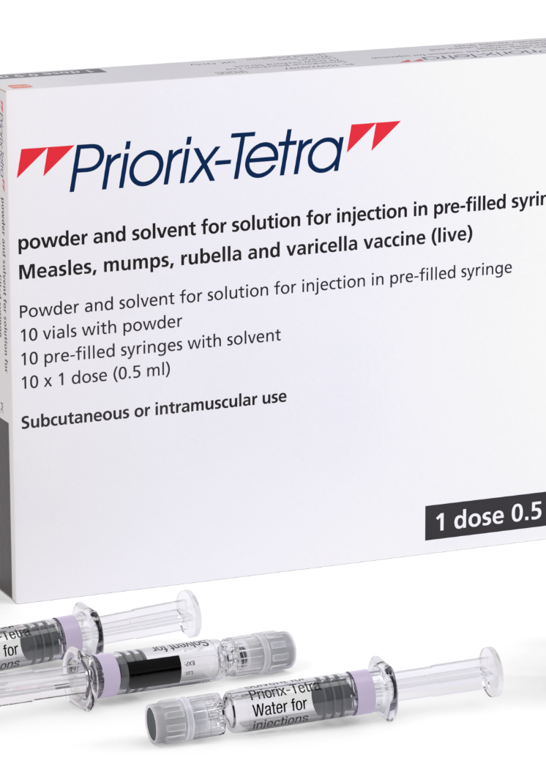
Priorix-Tetra®
pack size: 10 dose pack. 10 x single dose powder in a vial and 10 x single dose diluent (solvent) in a pre-filled syringe. One reconstituted dose = 0.5ml
pack dimension: 142 (H) x 178 (W) x 29 mm (D)
in addition to the live attenuated viruses, Priorix-Tetra® contains:
  Amino acids (containing phenylalanine)
  Lactose anhydrous
  Mannitol (E 421)
  Sorbitol (E420)
  Medium 199 (containing phenylalanine, para-aminobenzoic acid, sodium and potassium)
  Contains a trace amount of neomycin
the solvent is water for injections
Priorix-Tetra® does not contain pork gelatine
this MMRV vaccine should be offered to children whose parents or carers do not wish them to receive a vaccine containing pork gelatine
Image source: GSK
Notes:
Priorix Tetra Powder and solvent for solution for injection in pre-filled syringe - Summary of Product Characteristics (SmPC) - (emc) | 101321

Slide 24
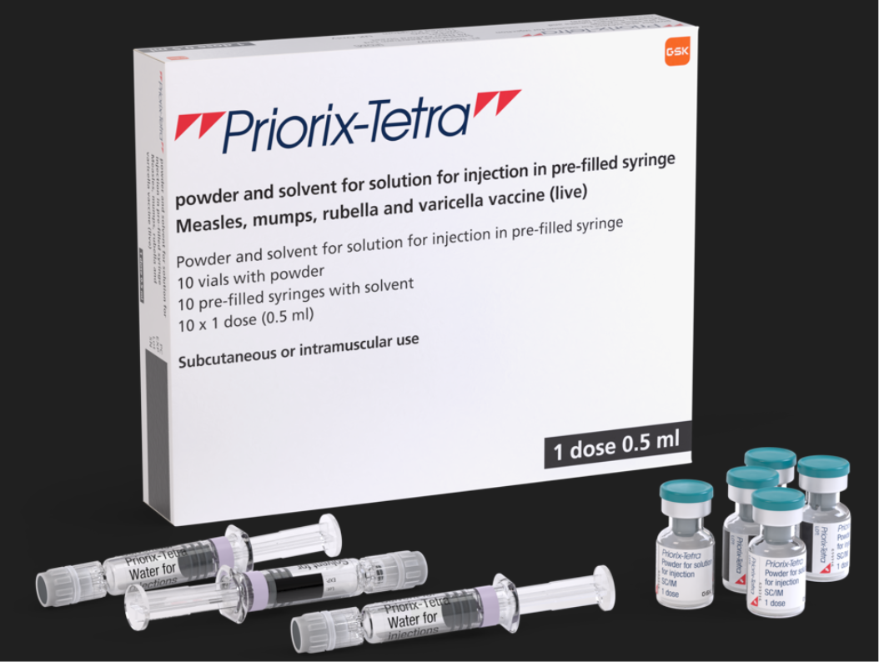
Priorix-Tetra®
please note that whilst it states: ‘1 dose 0.5ml’ in the bottom right corner of the box and on the side of the box, this refers to the volume of vaccine (0.5ml) which should be given per dose
the box itself contains 10 doses of MMRV vaccine
Notes:
Priorix Tetra Powder and solvent for solution for injection in pre-filled syringe - Summary of Product Characteristics (SmPC) - (emc) | 101321

Slide 25
Preparation and administration of Priorix-Tetra®
powder in a vial, with a solvent for solution in a pre-filled syringe
before reconstitution: powder is a whitish to slightly pink coloured cake, a portion of which may be yellowish
solvent: clear, colourless liquid
reconstitute vaccine:
  by adding entire contents of pre-filled syringe of solvent to the vial containing the powder
  inspect the reconstituted vaccine. Its colour may vary from clear peach to fuchsia pink due to minor variations of its pH
  it may contain translucent product-related particulates, which is normal for this vaccine, but if the vaccine presents with other colouration or contains other particulate matter, do not administer
one reconstituted dose is 0.5ml
Notes:
Priorix Tetra Powder and solvent for solution for injection in pre-filled syringe - Summary of Product Characteristics (SmPC) - (emc) | 101321

Slide 26
MMRV vaccine administration and storage
both vaccines should be stored in a vaccine refrigerator between +2ºC and +8ºC
store them in their original packaging. This is important to ensure that they are protected from light, that their component parts are kept together and for retention of the batch numbers and expiry dates for the entire product, which is printed on the vaccine cartons
once reconstituted, the vaccines should be administered immediately
for the national programme it is recommended that ProQuad® and Priorix-Tetra® be administered intramuscularly
they can be administered into the deltoid area of the upper arm, or the anterolateral aspect of the thigh

Slide 27
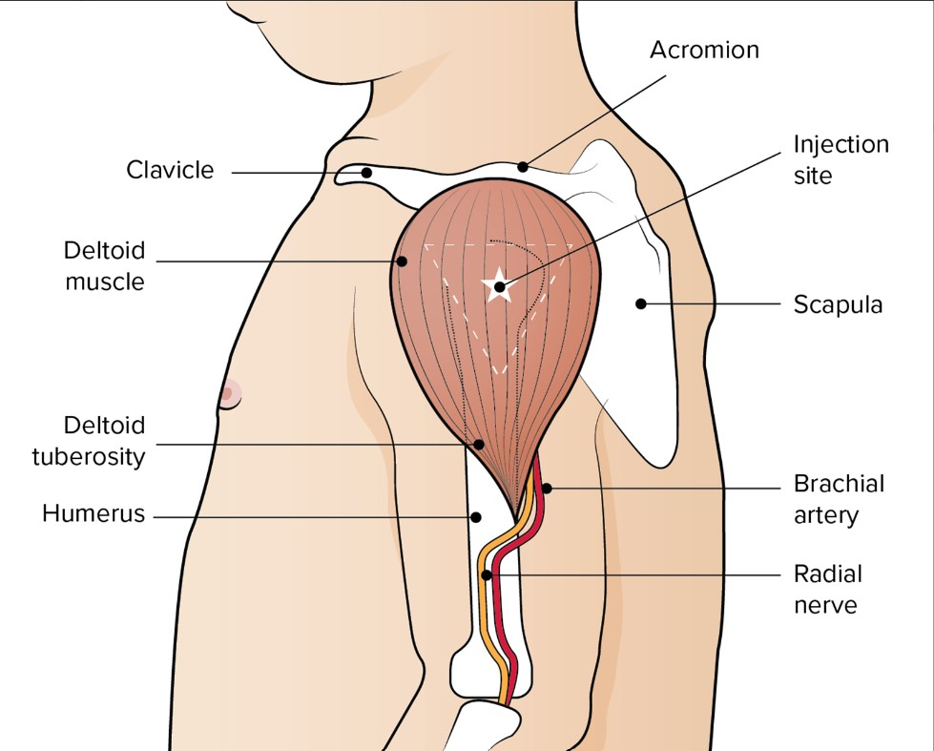
Administering vaccine into the deltoid muscle
The preferred site for intramuscular vaccine administration in individuals aged 1 year and over is generally the deltoid area of the upper arm
it is essential that the correct site and injection technique is used to administer vaccines
injecting too high into the upper arm might result in a shoulder injury or a frozen shoulder. This leads to pain, weakness and a limited range of motion that can last for months
injecting too low or too far to the side of the arm risks injecting into the axillary nerve or the radial nerve
to avoid shoulder injury, always assess the limb before administering the vaccine to identify the correct site for injection
Image from the Australian Immunisation Handbook
Notes:
Giving vaccine into the muscle:
leads to a better immune response to the vaccine (as the muscle contains the appropriate cells necessary to initiate the immune response)
is less likely to cause local reactions than if the vaccine is given under the skin (subcutaneously)
The needle needs to be long enough to ensure vaccine is injected into the muscle. For this reason, a 25mm needle is recommended.

Slide 28
Contraindications and precautions
The MMRV vaccine should not be given to:
pregnant women. Pregnancy should be avoided for 1 month after the last dose of a varicella containing vaccine
those who are immunosuppressed. See Contraindications and special considerations: the green book, chapter 6 - GOV.UK and Varicella: the green book, chapter 34 - GOV.UK for more detail
anyone who has had:
  a confirmed anaphylactic reaction to a previous dose of the same vaccine
  a confirmed anaphylactic reaction to any ingredient in the vaccine ( including neomycin or gelatine)
varicella vaccines are not recommended for infants under 9 months of age
vaccination should be postponed if a child is acutely unwell with a high fever, and they should wait until they have fully recovered. This avoids confusing symptoms of an illness with adverse effects of the vaccine.
a cold or a minor illness is not a reason to delay the vaccine
very few people are contraindicated for MMRV. If unsure, obtain guidance from the child’s specialist rather than withholding the vaccine

Slide 29
Possible adverse reactions
Global studies have found that varicella-containing vaccines are well tolerated and rarely linked to serious adverse events
adverse events after MMRV vaccination (excluding allergic reactions) are usually due to effective replication of the vaccine viruses, which can cause mild illness. These events typically occur:
  6-11 days post vaccination (measles component)
  2-3 weeks post-vaccination (mumps and rubella components)
  3-4 weeks post-vaccination (varicella component)
overall, adverse reaction rates are similar or lower for second and subsequent MMR-containing vaccine doses compared to the first dose
common reactions to the MMRV vaccine include:
  injection site reactions (pain, tenderness, redness, swelling)
  fever
  irritability
  rash (including measles-like or varicella-like rash)
Notes:
Source: Measles: the green book chapter - GOV.UK

Slide 30
Post-vaccination rash
some children may develop a varicella vaccine-associated rash at the injection site
they can attend childcare or school, but any vesicles should be kept covered as a precaution
very rarely, a varicella-like rash may appear elsewhere on the body within one month of vaccination (either disseminated or localised)
a widespread rash is more likely due to natural chickenpox than the vaccine virus; these children should be assessed by a clinician and recent exposure considered
Transmission
transmission of the varicella-containing vaccine virus from immunocompetent individuals to susceptible close contacts is possible but very rare
transmission of vaccine virus in absence of a post-vaccination rash has not been documented
if a localised vaccine-related rash appears away from the injection site, cover the lesions to reduce risk
if the rash is widespread, the risk is higher; immunosuppressed contacts with significant exposure should receive post-exposure prophylaxis as per guidance*
pregnant contacts who are otherwise healthy can be reassured that the risk of infection is very low
Notes:
*Post-exposure prophylaxis for chickenpox and shingles - GOV.UK
Sources:
Varicella: the green book chapter - GOV.UK
MMRV programme: information for healthcare practitioners - GOV.UK

Slide 31
Febrile convulsions
febrile convulsions are common in children
  1 in 25 children by the age of 5 have febrile convulsions
  these are generally short lived and are generally considered benign
there is a small increase in the risk of febrile convulsions 5 to 10 days following the first dose of the MMRV vaccine. This is not observed with the second dose
the absolute risk is very low. To put this in context:
  the number of extra children who may have a febrile convulsion per 100,000
    after 1st dose of MMR: 24
    after 1st dose of MMRV: 35
    after measles infection: 2,300
parents should be advised of the low risk, but also advised to seek medical attention if their child does have a febrile convulsion
as fever after the MMRV vaccine can happen anytime within 2 weeks, there is no need to give prophylactic paracetamol before the vaccine. If the child develops symptoms afterwards, paracetamol can be given
MMRV programme: information for healthcare practitioners - GOV.UK UKHSA have published the following guidance: MMRV and febrile convulsions - GOV.UK

Slide 32
Encephalitis and the MMRV vaccine
encephalitis is a known complication of wild-type varicella and measles infections, occurring in about 2–3 cases per 100,000 varicella infections and 100 cases per 100,000 measles infections
post-marketing surveillance of varicella-containing vaccines has reported a small number of encephalitis cases after vaccination, but no clear link has been established
over 15 years of monitoring in the USA, 22 cases of encephalitis were reported following MMRV vaccination—about 0.06 cases per 100,000 doses
varicella zoster virus was detected in 3 of these cases, of which 1 was confirmed as vaccine virus
the risk of encephalitis from natural varicella or measles infection is far higher than the risk after vaccination
Notes:
Source: Varicella: the green book chapter - GOV.UK

Slide 33
Idiopathic thrombocytopenic purpura (ITP)
ITP is a blood disorder where the immune system destroys platelets, which are needed for blood clotting
ITP can occur after MMRV vaccination, most likely due to the rubella component
it usually happens within six weeks and resolves on its own
the risk is about 1 in 22,300 after the first MMR dose in the second year of life and is likely similar for MMRV
the risk after vaccination is much lower than the risk after natural measles or rubella infection.
children with a previous ITP diagnosis do not have an increased risk after MMR-containing vaccines.
there is no evidence linking ITP to the second MMR dose, but data are limited for children who had ITP after the first dose
if ITP occurs within 6 weeks after the first dose of MMRV, *test for measles antibodies before giving a second dose
if the child is not protected against measles, a second MMRV dose is recommended
serological testing for mumps, rubella or varicella antibodies is not recommended
Notes:
*Speak to the on-call microbiologist who will help to arrange serological testing at either the local microbiology laboratory, or onward transport to the UKHSA Virus Reference Department, which offers free, specialised serological testing for such children
Source: Varicella: the green book chapter - GOV.UK

Slide 34
Prescription only medication (POM)
MMRV should only be administered using a:
prescription written manually or electronically by a registered medical practitioner or other authorised prescriber
patient specific direction (PSD)
patient group direction (PGD)
UK Health Security Agency (UKHSA) provide updated PGD templates (Patient Group Directions) which are available here: Welsh Medicines Advice Service (WMAS). These are template PGD’s that can be amended locally by health boards
NB: Local authorisation is required before PGD templates can be used.

Slide 35
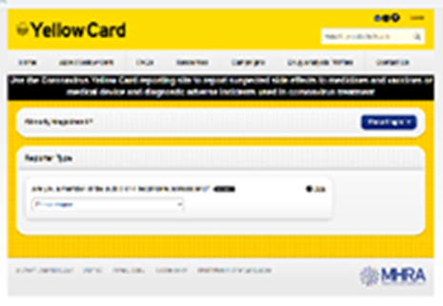

Reporting suspected adverse reactions
vaccinators should be advised that they can report any adverse reactions or suspected side effects to the MHRA through the online yellow card scheme website or the Yellow Card app
any suspected side effects following vaccine administration should be reported to the MHRA Yellow Card Scheme
anyone can report even if uncertain about whether vaccine caused condition:
  www.mhra.gov.uk/yellowcard or call 0800 731 6789 (9am to 5pm Monday to Friday)
  Green Book Chapter 9 for detailed guidance on reporting vaccine reactions
Notes:
Healthcare professionals and patients are encouraged to report suspected adverse reactions to the Medicines and Healthcare Products Regulatory Agency (MHRA) using the yellow card reporting scheme
Green Book chapter 9: https://www.gov.uk/government/publications/surveillance-and-monitoring-for-vaccine-safety-the-green-book-chapter-9

Slide 36
Sources of further information
Green Book:
  Measles: the green book chapter - GOV.UK
  Mumps: the green book chapter - GOV.UK
  Rubella: the green book chapter - GOV.UK
  Varicella: the green book chapter - GOV.UK
PGD:
  Patient Group Directions (PGD) - Welsh Medicines Advice Service
The complete routine immunisation schedule for Wales
  Routine immunisation schedules for Wales - Public Health Wales
If any MMR-containing doses have been missed, they can be caught up using the Vaccination of individuals with uncertain or incomplete immunisation - GOV.UK (UKHSA- external resource)

Slide 37
Epidemiology & surveillance

Slide 38
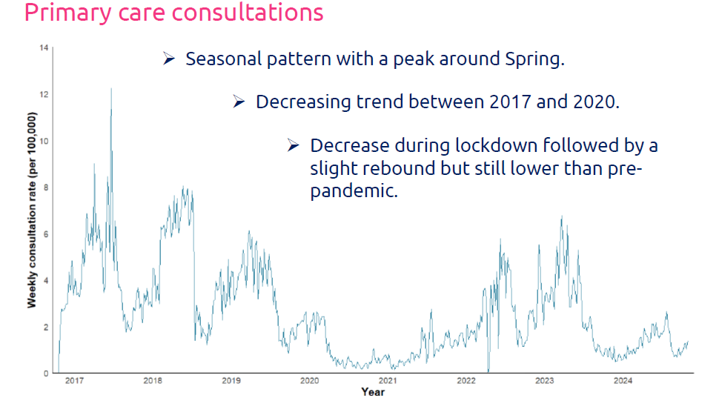
Varicella burden of disease in Wales
MPH Dissertation Project by Louis Whelan
Primary Care Consultations
Seasonal pattern with a peak around Spring.
Decreasing trend between 2017 and 2020.
Decrease during lockdown followed by a slight rebound but still lower than pre-pandemic.
By age-groups:
  The highest rate of consultations in children aged 1-4 years old.
  Lowest rate of consultations in adults particularly the oldest age groups.
  Seasonality not visible in cases above 15 years old.

Slide 39
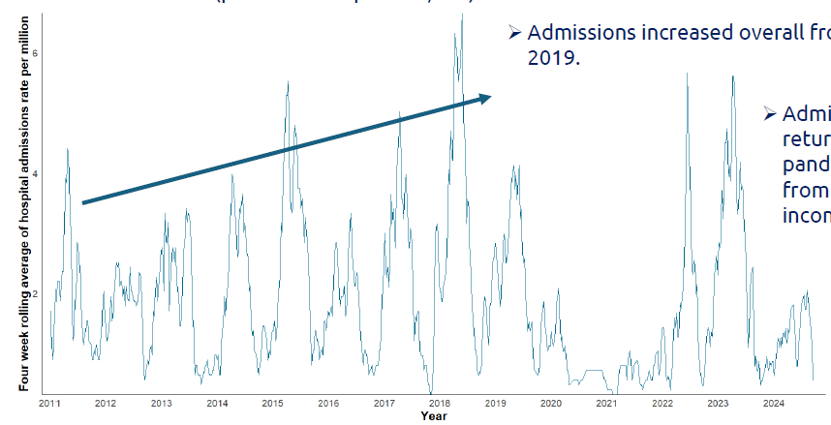
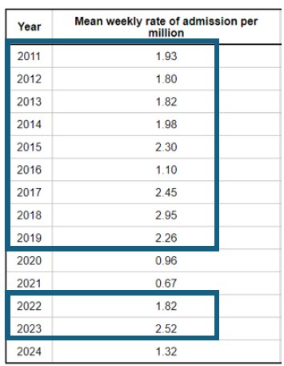
Varicella burden of disease in Wales
MPH Dissertation Project by Louis Whelan
Hospital Admissions
Much lower rates of hospital admissions than primary care consultations (per million vs per 100,000).
Admissions increased overall from 2011 to 2019.
Admission rates returned to pre-pandemic levels from 2022 (2024 incomplete).
By age-group:
  Highest rate of admission in under 1 year olds by far (almost 3x higher than 1-4 year olds).
  Very low rates in adult age groups.
  Age-specific admission rates for adults aged 50-69 and over 70 are higher than primary care consultation rates.

Slide 40
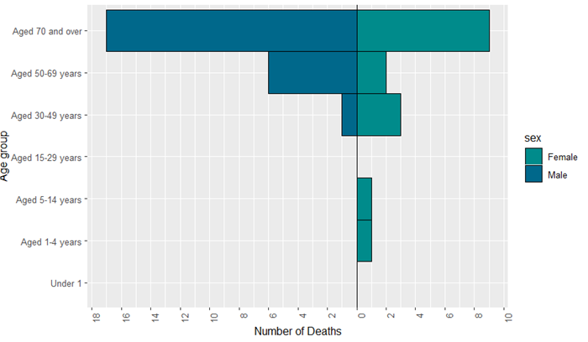
Varicella burden of disease in Wales
MPH Dissertation Project by Louis Whelan
Mortality
Forty deaths related to chickenpox between 2011 and 2024 (average three deaths per year) giving a crude mortality rate of 0.09 deaths per 100,000.
Overall, 95% of deaths in adults over 30 years old.
Chickenpox presents a substantial and measurable burden across Wales with a considerable number of cases resulting in severe disease and complications requiring hospitalisation.

Slide 41
Varicella burden of disease
Burden of varicella complications in secondary care, England, 2004 to 2017, Burnal et al. 2019
Results
There were over 60,000 admissions with varicella between 2004 and 2017. 38.1% had a recognised varicella complication.
The most common complications were bacterial skin infections (11.25%), pneumonia (4.82%), febrile convulsions (3.39%) and encephalitis (2.44%).
In older age groups, complication rates were higher and the complication types were more severe.
Length of hospital stay for complicated varicella was 3.1 times longer than for uncomplicated varicella.
Complicated varicella has a substantial health and economic burden.
Burden of varicella complications in secondary care, England, 2004 to 2017 - PMC

Slide 42
Surveillance of Vaccines, Vaccine Preventable Diseases and Respiratory Infections
For more information and links to our reports and internal data dashboards, please visit:
https://nhswales365.sharepoint.com/sites/PHW_VPDPComms/SitePages/Surveillance.aspx

Slide 43
Resources to support the selective varicella (chickenpox) catchup vaccination programme

Slide 44
Public Health Wales webpages
For the public:
Measles, mumps, rubella and varicella (MMRV and MMR) containing vaccines - Public Health Wales
Changes to the childhood immunisation schedule - Public Health Wales
For healthcare professionals:
Measles, mumps, rubella and varicella (MMRV and MMR) containing vaccines for healthcare professionals
Changes to the childhood immunisation schedule for health professionals
Health information resources (for ordering free resources)
Routine immunisation schedules for Wales
Vaccine Preventable Disease Programme (VPDP) – Home (SharePoint, access for NHS employees only)

Slide 45
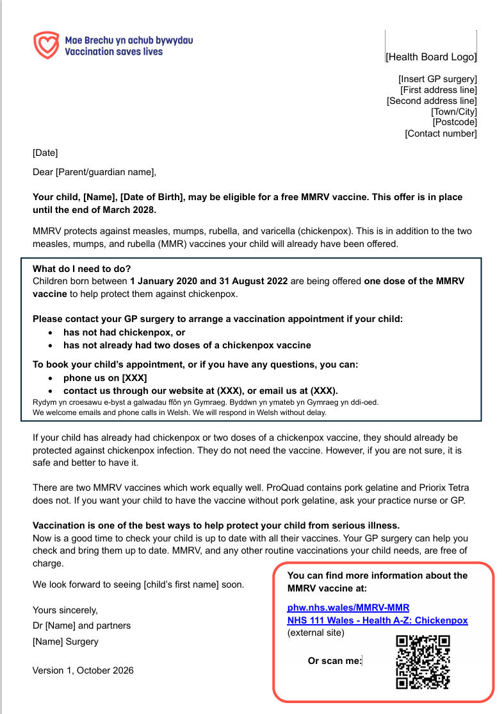
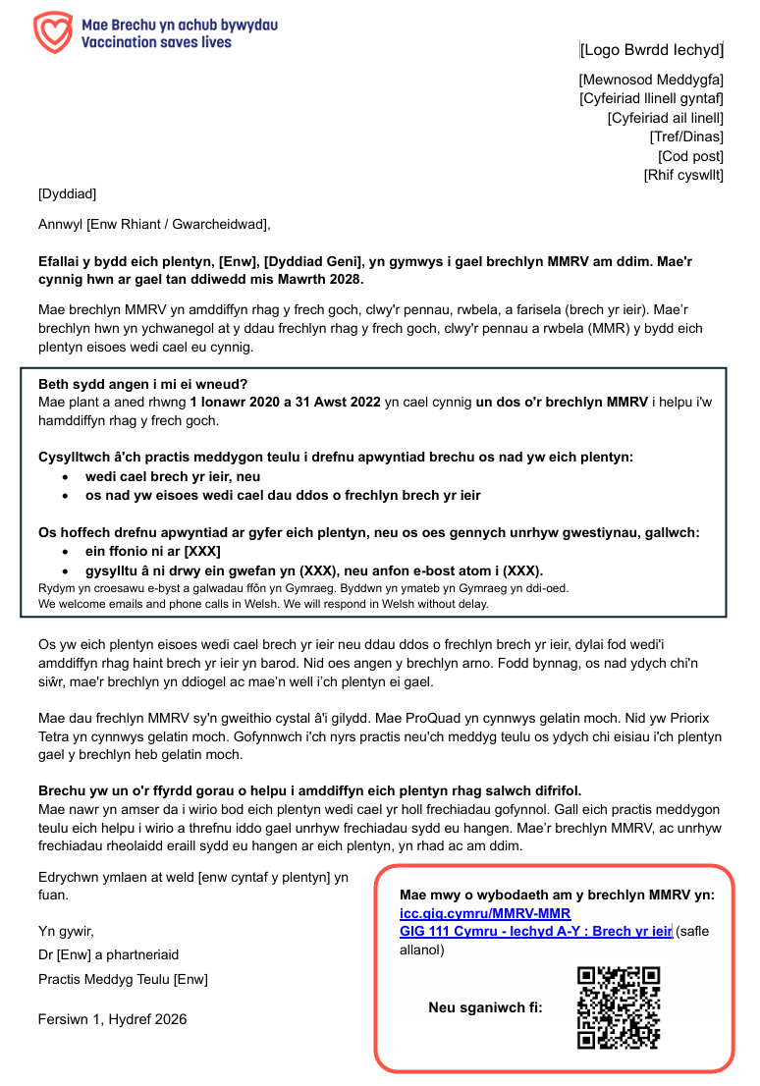
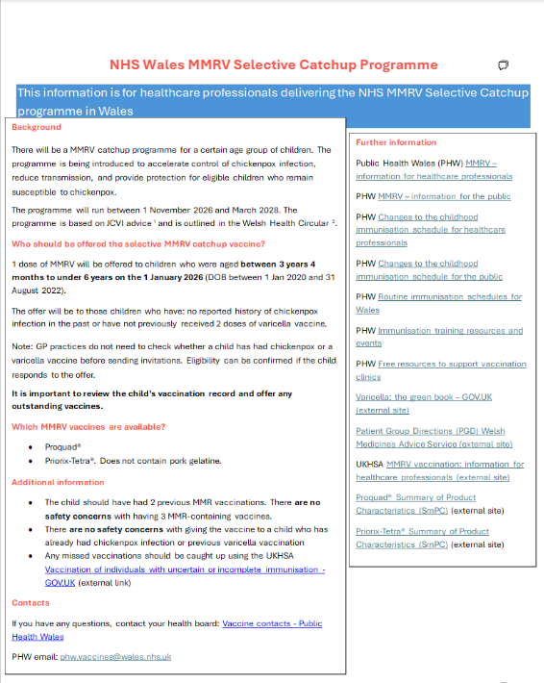
Resources for healthcare professionals
Selective Varicella (chickenpox) catchup vaccination programme GP template letters can be found on the MMRV and MMR vaccine information for Health professionals webpage. GP surgeries can download and use this bilingual notification letter to notify parents or guardians of children who may be eligible for one dose of MMRV vaccine
Further resources will be available on the MMRV and MMR vaccine information for Health professionals webpage soon, including:
Selective varicella (chickenpox) catchup vaccination programme visual aid and eligibility algorithm. The visual aid and algorithm is designed for healthcare professionals and outlines the programme background, recommendations and eligibility criteria, and provides all the key information to support the programme
Selective varicella (chickenpox) catchup vaccination programme template text. GP surgeries can use these suggested text messages to notify parents or guardians of children who may be eligible for one dose of MMRV vaccine
Draft

Slide 46


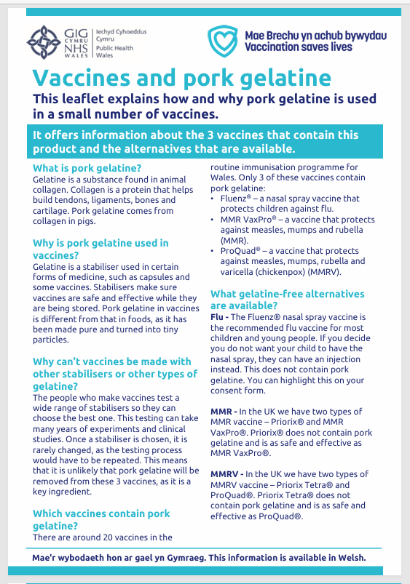
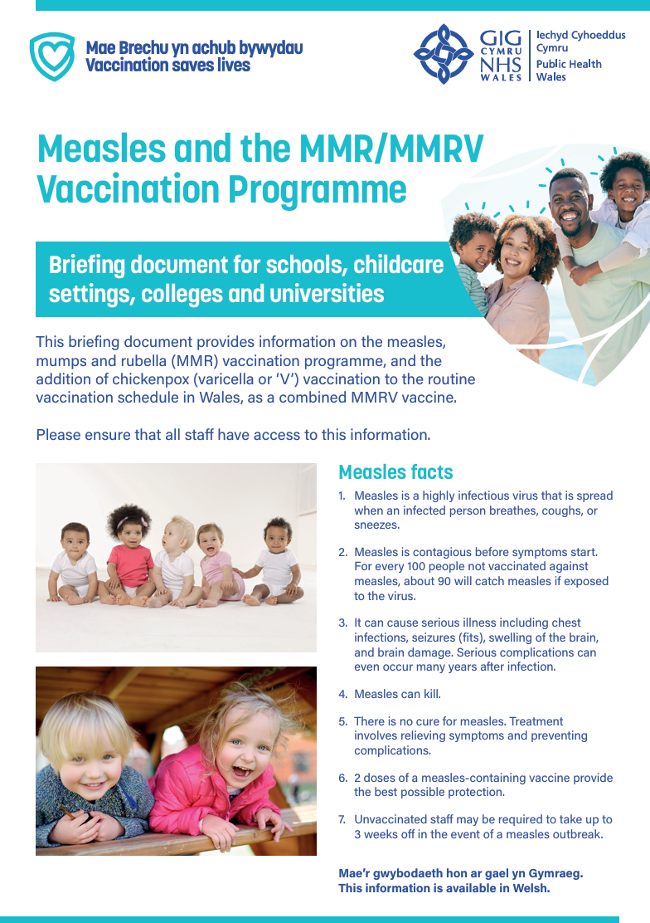
Resources for the public
Resources include:
Protection against measles, mumps, rubella and chickenpox MMRV/MMR leaflet
What to expect after vaccination leaflet
Vaccines and pork gelatine leaflet
MMRV-MMR briefing document for schools, childcare settings, colleges and universities
all resources are available to order or download for free at Health information resources
a ‘selective varicella (chickenpox) catchup vaccination programme printable leaflet’ will be available for download soon.

Slide 47

Confident vaccine conversations - Behavioural science and motivational interviewing approach
The approach and style of a vaccine conversation can make a real difference in understanding individual hesitancy, addressing barriers, and influencing vaccine uptake. There is an eLearning module available called: Confident vaccine conversations - Behavioural science and motivational interviewing approach, which aims to support staff with having positive conversations about immunisations.
This eLearning module supports staff to feel more confident starting conversations about vaccination, particularly where there may be hesitancy or concern.
Using practical Motivational Interviewing (MI) techniques, it helps staff navigate sensitive discussions i.e., vaccine misinformation, reduce resistance, and build trust in a respectful, non-judgmental way.
The skills developed are designed for real-world settings and are transferable to a wide range of conversations across healthcare roles.
The eLearning module is available for free on ESR and Learning@Wales. Information and registration support will be available here: Immunisation eLearning - Public Health Wales

Slide 48
Contacts for queries
In the first instance, please contact your local vaccine health board contact. They should be able to help you.
Vaccine contacts - Public Health Wales
Contact the Vaccine Preventable Disease Programme at phw.vaccines@wales.nhs.uk
39

