Slide 1

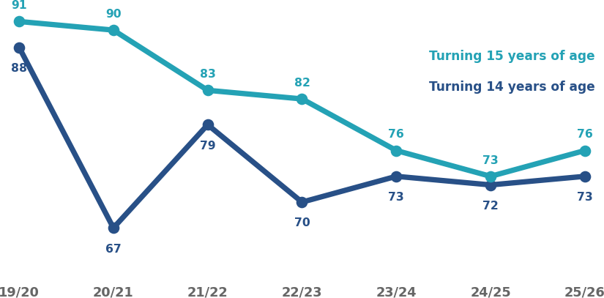
Mouth Cancer Action Month
1st November to 30th November
Mouth cancer is twice as common in men
Mouth cancer is more common in deprived areas of Wales
Adolescent HPV vaccination rates are variable
Mouth cancer is more common in people over 50
Each year there are over 350 new cases of mouth cancer
<29
0.6%
30 - 49
10.3%
#MouthCancerActionMonth
50 - 69
54.9%
70 - 89
32.2%
>90
2.1%
0%
20%
40%
60%

Slide 2
Mouth Cancer Action Month
1st November to 30th November
Early diagnosis is key to improve survival
Actions for Health Boards and health professionals:
Improve public and healthcare professional awareness of mouth cancer
Advise people to see a dentist for regular check-ups even if they do not have any teeth
Ensure urgent referral pathways exist and promote programmes to address inequalities in mouth cancer
Provide effective brief interventions to people at risk

