Slide 1
A Smoke-free Generation: What Does It Mean for You?
This activity links to the following Knowledge Banks:
Health effects and risks of tobacco and nicotine – the physical, mental and long-term health impacts
How tobacco and nicotine use affects your emotional and mental well-being
How tobacco and nicotine use affects your physical well-being
Behaviour, choice and influence
Laws, regulation and industry influence
Possible Health and Well-being descriptions of learning: Developing physical health and well-being has lifelong benefits
Progression step 1 I am beginning to recognise some of the behaviours, conditions and situations that affect my physical health and well-being and I am beginning to know how to respond and get help. | Progression step 2 I can recognise some of the behaviours, conditions and situations that affect my physical health and well-being, and I know how to respond and get help in a safe way. | Progression step 3 I can describe the behaviours, conditions and situations that affect my physical health and well-being, and I know how to respond to and/or manage these in order to actively reduce the risk of harm to myself. | Progression step 4 I can explain the behaviours, conditions and situations that affect my physical health and well-being and, through my actions, I can respond to and/or manage these in order to actively reduce the risk of harm to myself and to others. | Progression step 5 I can apply my knowledge of the behaviours, conditions and situations that affect my physical health and well-being, to keep myself and others safe. I can safely intervene, using learnt techniques, when others’ physical health is at risk.

Slide 2
Introduction
The Smoke-free Generation policy is a landmark public health measure designed to protect future generations from the harms of tobacco. By gradually raising the legal age of sale for tobacco products, the policy aims to create a generation that will never legally be able to buy tobacco products.
These activities encourage learners to explore what the Smoke-free Generation policy means for them, understand what the policy is and consider how it affects them personally. They also support learners to explore attitudes towards smoking and vaping and to think critically about the potential real-life impacts on individuals and wider society, including issues related to health and personal choice.
Target Group
Ages: 11–16

Slide 3
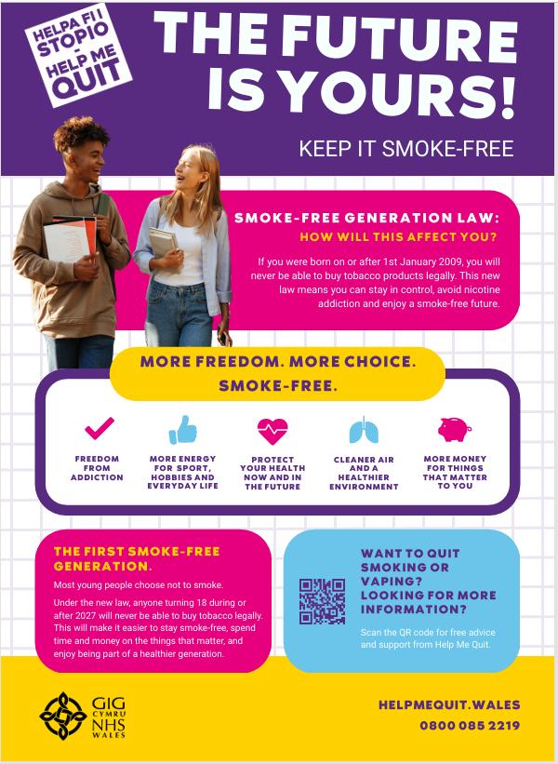
A Smoke-free Generation:
What Does It Mean for You?
Look at this infographic.
What is the main message?
What surprised you?
How might this affect people your age?
Do you think this law will reduce smoking among young people? Why/why not?
Is it fair that some people can buy tobacco products and others never can?
What might young people choose to do instead of smoking?
How might these changes affect what people choose to do?

Slide 4
Myth Busters
Let's see what you know about smoking, vaping and the Smoke-free Generation law.
Read each statement and decide if you think it is a FACT or a MYTH. Be ready to explain your answer.
The Law introduces new rules on vapes, including limits on advertising, flavours, packaging and sales to reduce appeal to young people.
The new law will create a “smoke-free generation” – anyone born on or after 1 January 2009 will never legally be able to buy tobacco products.
More checks are being carried out to tackle the illegal sale of tobacco and vape products, helping to protect young people and make it harder for them to get these products.
Vaping is more common than smoking among young people - around 1 in 8 Year 11 students in Wales regularly vape.
Smoking is still one of the main causes of illness and early death in Wales, and tobacco kills up to two-thirds of long-term users.
Vaping is less harmful than smoking for adult smokers, but it is not risk-free and so children and non-smokers should not vape.
Vaping is completely safe because it is regulated, widely available, and recommended as an alternative to smoking.
Smoking is no longer a major issue in Wales because new laws are phasing it out and fewer people smoke each year.
Age restrictions mean that smoking and vaping is not a real concern among young people, as most under 18s do not use these products regularly.
Second-hand smoke or vapour does not have any real impact on others, even outside or in places with lots of fresh air.

Slide 5
Fact
Myth
The new law will create a “smoke-free generation” – anyone born on or after 1 January 2009 will never legally be able to buy tobacco products.
Smoking is no longer a major issue in Wales because new laws are phasing it out and fewer people smoke each year.
Smoking is still one of the main causes of illness and early death in Wales, and tobacco kills up to two-thirds of long-term users.
Vaping is completely safe because it is regulated, widely available, and recommended as an alternative to smoking.
Vaping is more common than smoking among young people - around 1 in 8 Year 11 students in Wales regularly vape.
Age restrictions mean that smoking and vaping is not a real concern among young people, as most under 18s do not use these products regularly.
More checks are being carried out to tackle the illegal sale of tobacco and vape products, helping to protect young people and make it harder for them to get these products.
Second-hand smoke or vapour does not have any real impact on others, even outside or in places with lots of fresh air.
Vaping is less harmful than smoking for adult smokers, but it is not risk-free and so children and non-smokers should not vape.
The Law introduces new rules on vapes, including limits on advertising, flavours, packaging and sales to reduce appeal to young people.

Slide 6
"What Does It Mean for Me?”
Agree or Disagree?
Smoking will be much less common when I am an adult.
Making tobacco harder to buy will reduce smoking in the future.
Seeing what other people do can affect our choices.

Slide 7
Statement | Agree | Disagree
Smoking will be much less common when I am an adult. | Fewer people smoke now than in the past. The Smoke-free Generation law aims to prevent future generations from legally buying tobacco. More people know about the health risks of smoking. | Some people may still find ways to get tobacco. Smoking may continue in some communities and social groups. Not everyone will choose to stop smoking.
Making tobacco harder to buy will reduce smoking in the future. | If tobacco is harder to get, fewer young people may start smoking. Laws can help reduce access to harmful products. Many people are less likely to try something that is difficult to buy. | Some people may still get tobacco from other people. Access is only one reason people start smoking. Education and support may be just as important as laws.
Seeing what other people do can affect our choices | Friends and family can influence choices and behaviour. Social media can affect what people think is normal or acceptable. Seeing others smoke or vape may make some young people more likely to try it. | Many young people make their own decisions regardless of what others do. People can understand the risks and choose not to smoke. Different people are influenced by different things.

Slide 8

Smoke-free Generation scenarios
You’re 18 in the future and none of your friends smoke
You see people vaping/smoking on social media
Smoking is banned for your age group but older people still smoke
Public places (parks, beaches) are completely smokefree
Task:
What might be different about everyday life?
What are the positives?
Are there any challenges?
How might it influence your choices?
Would people still find ways to get cigarettes?
Does the law still make a difference?
Groups feed back to the class

Slide 9
Further possible learning suggestions
Explore how smoking has changed in Wales over time
Research smoking rates over the last 20 years and discuss why fewer people smoke today. Consider the impact of health campaigns, laws and changes in attitudes.
Investigate the impacts of smoking and vaping
Explore the physical, mental, social and environmental effects of tobacco and vape products. Consider how these products can affect individuals, families and communities.
Design a Smoke-free Generation campaign
Create a poster, video, social media post or assembly presentation that encourages young people to make informed choices about smoking and vaping.

Slide 10
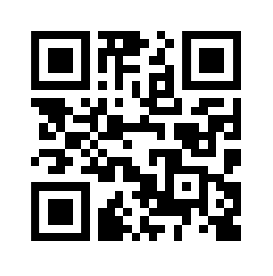
Advice and Support can be sought here:
School Nursing Service: Where there are drop-ins available at your school, school nurses are able to provide advice and support to learners.
Help Me Quit: Smokers and vapers who would like to quit can access free specialist bilingual NHS advice. Call 0800 085 2219, Text HMQ to 80818 or visit www.helpmequit.wales
DAN 24/7: A free and bilingual telephone helpline available to anyone in Wales wanting further information and/or help relating to drugs and/or alcohol. Call 0808 808 2234, text DAN to 81066 or visit www.dan247.org.uk

