Slide 1
The True Cost of Tobacco: From Field to Filter
This activity links to the following Knowledge Banks:
Understanding tobacco and nicotine – what these substances are and how they work
The social and environmental impact
Laws, regulation and industry influence
Quitting, support and health promotion
This activity supports learners to become familiar with the facts about the tobacco industry and how it impacts on the environment, producers, the public and the NHS.
Possible Health and Well-being descriptions of learning: Our decision-making impacts on the quality of our lives and the lives of others
Progression step 1 I have developed an awareness that my decisions can affect me and others. | Progression step 2 I can recognise that my decisions can impact on me and others, both now and in the future. | Progression step 3 I can recognise that some decisions I make will have a long-term impact on my life and the lives of others. | Progression step 4 I can consider relevant factors and implications when making decisions individually and collectively. | Progression step 5 I can critically evaluate factors and implications, including risks, when making decisions individually and collectively.

Slide 2
Introduction
This activity looks beyond smoking as a personal choice and explores the wider impact of tobacco from how it is grown to what happens after it is used.
You’ll examine how tobacco affects people, communities, the environment and public services, both in Wales and around the world.
By discussing different facts and statements, you’ll be encouraged to think critically about the social, environmental and economic costs of tobacco use and who pays the price.

Slide 3
The True Cost of Tobacco: From Field to Filter
Tobacco use doesn’t just harm individual smokers - it has wide-reaching effects on families, communities, the environment and the economy.​
​
The impact begins with how tobacco is grown, often involving deforestation, pesticide use and poor labour conditions overseas, and continues with the waste left behind, including cigarette butts that pollute streets, rivers and coastal areas.​
In Wales, reducing tobacco use contributes to cleaner air, healthier communities, reduced health inequalities and a more sustainable environment, supporting national goals under the Well-being of Future Generations (Wales) Act 2015.

Slide 4

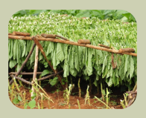
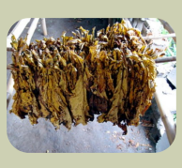
Agriculture and Farming
10-20 million people could be fed by food crops grown instead of tobacco plants
Around 600 million trees are cut down each year to produce tobacco
Children as young as 10 are sent to work on tobacco farms
Children and workers on tobacco farms can become ill with green tobacco sickness due to nicotine being absorbed through their hands
One field the size of a large football pitch grows enough tobacco to make a million cigarettes

Slide 5
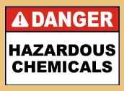
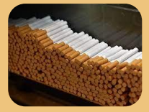
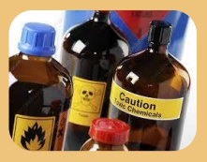
Cigarette Production
Plastic in the filters of cigarettes takes 12-15 years to decompose
One tobacco company produces 700 billion cigarettes worldwide every year
Machines used to make cigarettes use four miles of paper in one hour
There are more than 7,000 chemicals in cigarette smoke
There are over 70 cancer causing chemicals in a cigarette

Slide 6


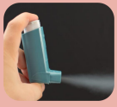
Smokers
A 20-a-day smoker spends over £5,000 a year on cigarettes
Smoking kills 210 people a day in the UK, the same as a small plane crashing
Within 20 minutes of quitting, blood pressure and heart rate return to normal
The lungs of a
20-a-day smoker collect about a mug full of tar every year
11.4% of adults in Wales smoke (2024)
Non-smokers are less likely to develop asthma and suffer from asthma attacks
Some children in Wales try their first cigarette as young as 12 years old.

Slide 7



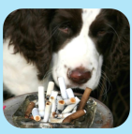
Smoking Facts
3% of young people in Wales aged 11-16 smoke at least weekly
Around 3,800 people die in Wales every year from a smoking related illness
Help Me Quit is a free NHS service that can help smokers to quit
Doctors, pharmacies, school nurses, friends and family can all help people to quit smoking
You are 3 times more likely to smoke if your parents do
Smoking rollies is just as harmful as cigarettes - they both contain the same chemicals
Pets who live with smokers are twice as likely to develop cancer

Slide 8
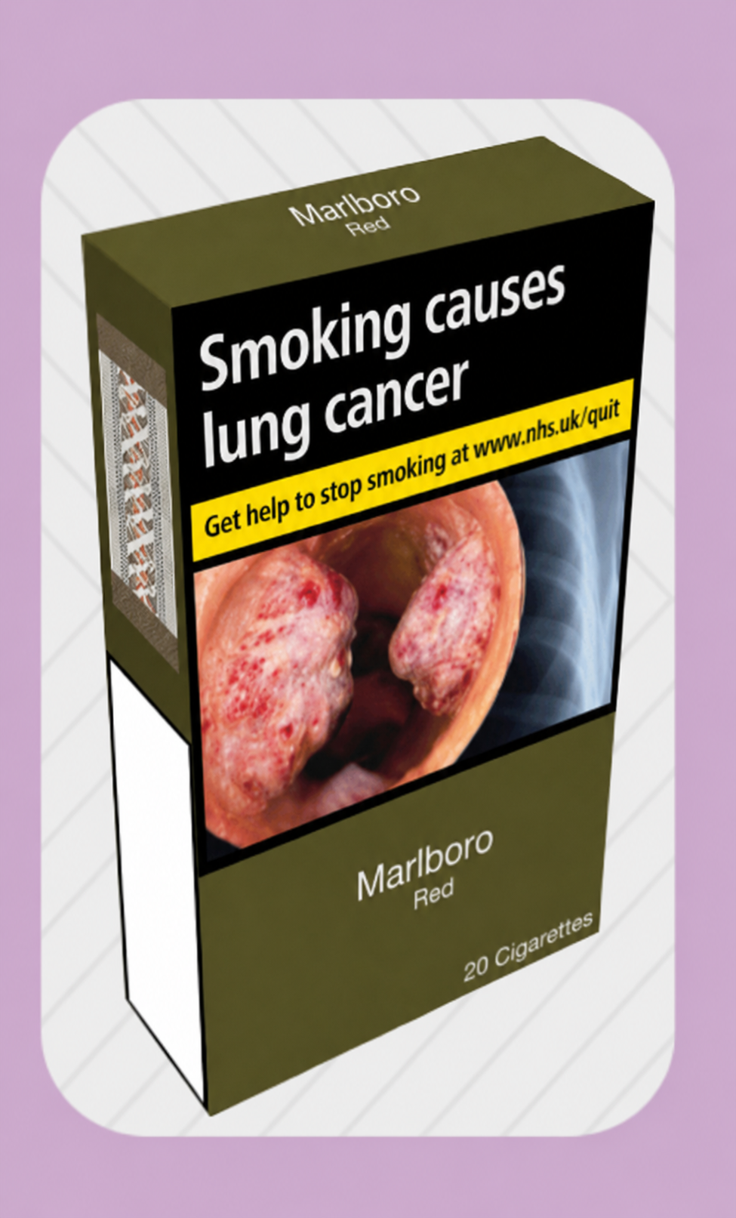
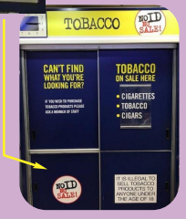
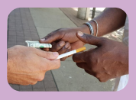

Retailer
Seeing tobacco products on display in shops has been shown to encourage young people to smoke
Every shop selling cigarettes must display a notice stating the legal age to buy tobacco products
Since 2015, shops must ensure that tobacco products including cigarettesare not on display
Anyone who sells cigarettes to under-18s can be fined £2,500
Cigarettes must be sold in their original packaging - selling single cigarettes is illegal

Slide 9
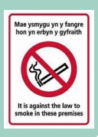

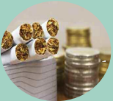
Tax and the Law
The government collects around £12 billion a year in tax from the sale of tobacco products
In 2021 smoking was banned in some outdoor spaces such as around hospitals, schools and playgrounds
Since 2015 it has been illegal to smoke in a car carrying anyone under the age of 18
The UK government spends around £87 million every year to help people quit smoking
In Wales smokers cost the NHS £386 million a year to treat disease
Smoking in enclosed or semi-enclosed public places was banned in Wales in 2007

Slide 10
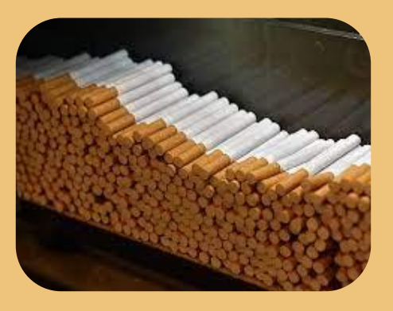
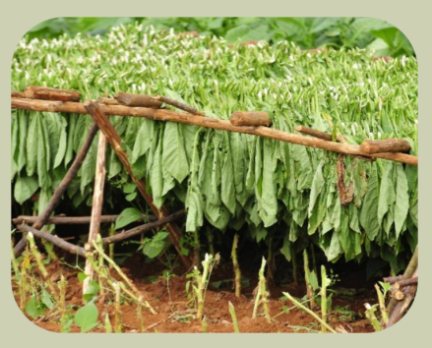
Supply
1 million illegal cigarettes are smoked in Wales every day
Brazil is the biggest exporter of tobacco leaf used to make cigarettes
1.6 million illegal cigarettes were found in just one raid by the North Wales police
Some of the people involved in the sale of illegal tobacco may also commit other more serious crimes
The USA is the biggest exporter of manufactured cigarettes
Illegal tobacco is often sold at car boot sales, from people's homes, ice cream vans and in some corner shops
Two of the largest tobacco companies in the world are based in the UK

Slide 11
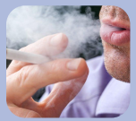
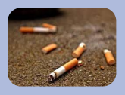
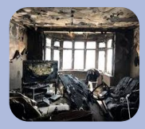
Community
Breathing in others' smoke can be harmful to our health - this is called second hand smoking or passive smoking
Smoke from one cigarette can linger in a room for up to 5 hours
A 20 a day smoker creates 7,300 cigarette butts a year
Cigarette butts make up 70%-90% of street litter and are the most littered item in the world
Smoking is one of the main causes of fires in the home
Almost half the world’s children live in a home with a smoker

Slide 12
Further possible learning suggestions
Environmental Impact Investigation (Wales Focus): Use Keep Wales Tidy & Natural Resources Wales data
Learners research:
Cigarette litter in Welsh communities
Welsh coastal pollution from cigarette butts
How smoking links to climate change (deforestation, manufacturing, waste)
Field to Filter Supply Chain Activity
Learners map the journey of tobacco:
Farm → Factory → Transport → Retail → Consumer → Waste
And identify:
Environmental harm
Worker rights issues
Economic impacts
Health consequences
Ethical Trade Debate
Should the UK ban imports of tobacco grown using child labour?
Are tobacco companies responsible for environmental damage?
Should cigarette filters be banned due to plastic waste?

Slide 13
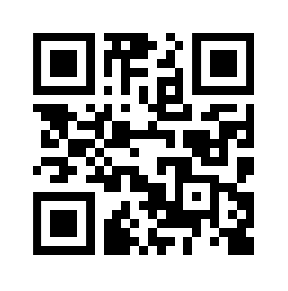
Advice and Support can be sought here:
School Nursing Service: Where there are drop-ins available at your school, school nurses are able to provide advice and support to learners.
Help Me Quit: Smokers and vapers who would like to quit can access free specialist bilingual NHS advice. Call 0800 085 2219, Text HMQ to 80818 or visit Help Me Quit
DAN 24/7: A free and bilingual telephone helpline available to anyone in Wales wanting further information and/or help relating to drugs and/or alcohol. Call 0808 808 2234, text DAN to 81066 or visit www.dan247.org.uk

