Slide 1
The Big Debate
This activity links to the following Knowledge Banks:
The social and environmental impact
Behaviour, choice and influence
Laws, regulation and industry influence
Smoking data and statistics
This activity provides statements to promote critical thinking and discussion about smoking and nicotine use in young people.
Possible Health and Well-being descriptions of learning: Our decision-making impacts on the quality of our lives and the lives of others
Progression step 1 I have developed an awareness that my decisions can affect me and others. | Progression step 2 I can recognise that my decisions can impact on me and others, both now and in the future. | Progression step 3 I can recognise that some decisions I make will have a long-term impact on my life and the lives of others. | Progression step 4 I can consider relevant factors and implications when making decisions individually and collectively. | Progression step 5 I can critically evaluate factors and implications, including risks, when making decisions individually and collectively.

Slide 2
Introduction
This activity invites you to explore different viewpoints about smoking and nicotine use and how these behaviours are influenced by society, the media and everyday environments.
You’ll be presented with a series of statements and asked to decide whether you agree or disagree, explaining your reasoning.
You will need to think critically, listen to others and consider how decisions around smoking can affect individuals, communities and wider health and well-being.

Slide 3

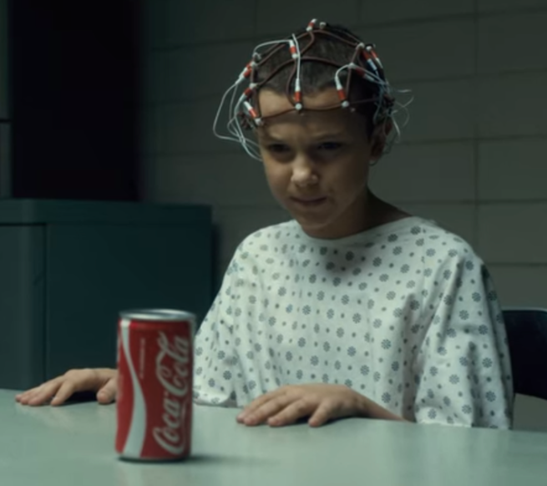
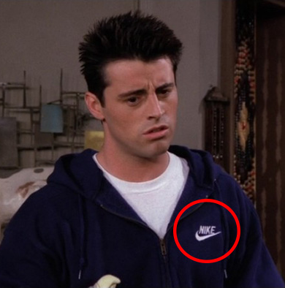
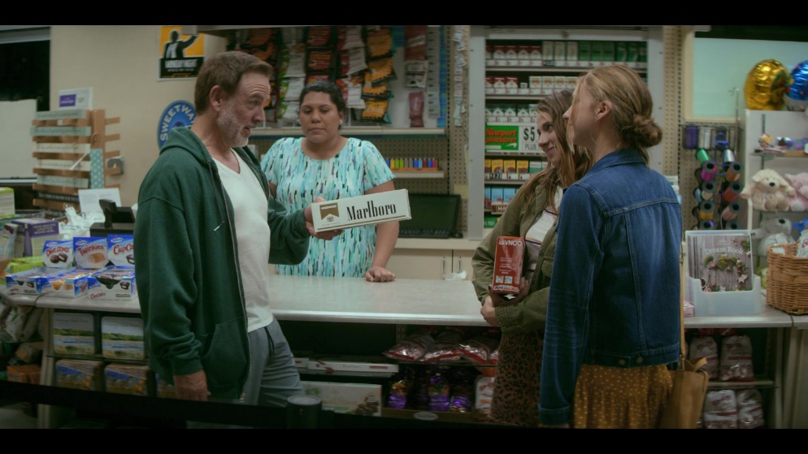
Product Placement
Product placement is when a company pays for their products to be featured in films and television programmes to gain exposure.
Companies pay celebrities and influencers to advertise products on their social media
#AD #Gifted

Slide 4

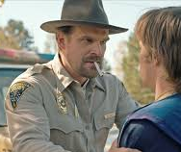
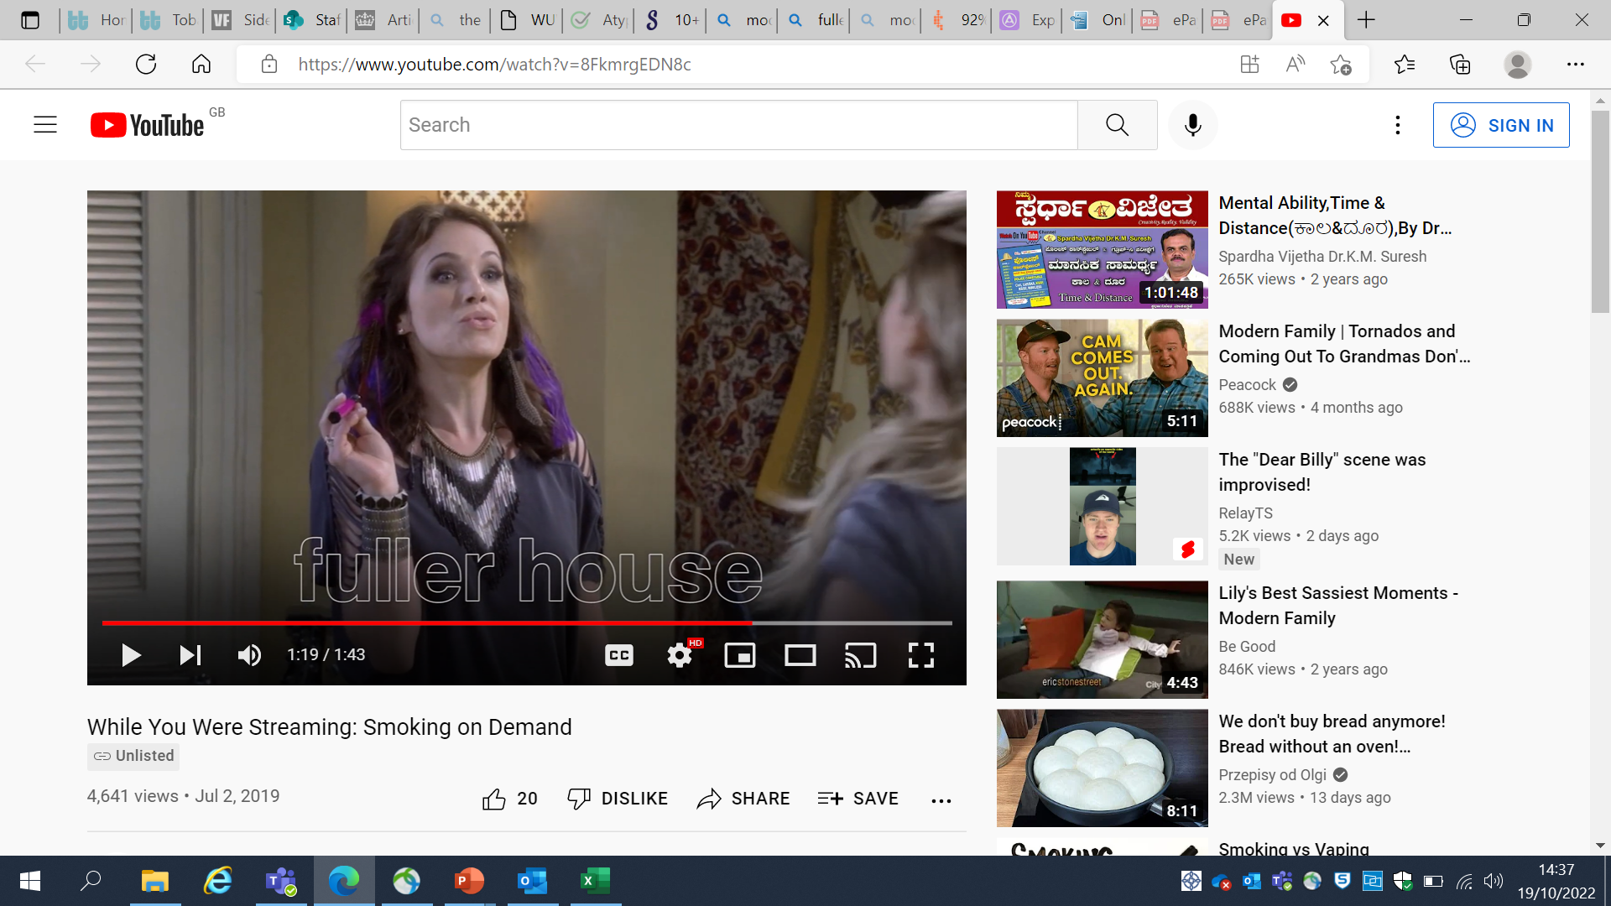
For or Against?
Product placement encourages non-smokers to smoke

Slide 5
The debate
For
Against
Financial necessity: Product placement, especially for big movies and TV shows, can be a way to help pay for the cost of production.
Focusing on other factors: Peer pressure, family smoking habits and personal stress are much more significant in a person's decision to start smoking than seeing a character smoke on screen.
Normalise the behaviour: When a popular actor or a character smokes on TV or in a movie, it can make smoking seem like a normal and cool part of life.
Product placement often pairs smoking with positive things, like being attractive, rebellious, successful, or part of an exciting story. They rarely show the real-life consequences of smoking.
Many studies show a strong link between young people seeing smoking in media and them being more likely to start smoking.

Slide 6
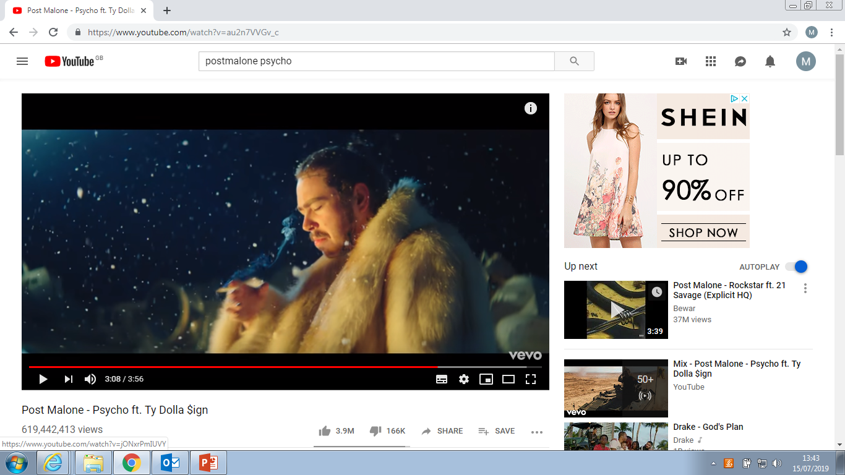

For or Against?
Smoking should be allowed in video games and music videos

Slide 7
The debate
For
Against
Allows creators the freedom to portray characters and scenes authentically.
Depictions can reflect historical contexts or the reality of certain personalities.
Audiences can tell the difference between a fictional story and real life and won't be swayed to smoke just by seeing it.
It is up to parents to monitor what their children watch and play, and to teach them about the dangers of smoking, rather than banning the content entirely.
It normalises a deadly habit.
Often, smoking in media presents an incomplete and misleading picture of its real-world consequences.
It influences young people: Studies have shown that the more young people see smoking in media, the more likely they are to try smoking themselves.
Even without a brand name, showing smoking a lot keeps the habit visible and suggests it's an acceptable part of life.

Slide 8
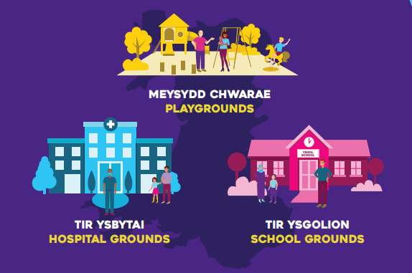
For or Against?
Smoking in open spaces encourages others to take up smoking

Slide 9
The debate
For
Against
People should have the freedom to be in open spaces and to smoke wherever they want – it’s their choice.
The decision to start smoking is a personal one. Someone seeing a stranger smoke in an open space is not going to make them start.
Many people think that factors like whether your parents or close friends smoke, have a much bigger impact than seeing it in open spaces.
Public health campaigns, school lessons, and doctors talking to young people about the dangers of smoking are far more effective than trying to hide the behaviour entirely.
It normalises the behaviour. When people see others smoking in their daily lives, it makes smoking seem like a common and acceptable activity.
If you grow up seeing adults or older teenagers smoking in public, it can create a social norm where smoking is "just what people do“.
Smoking can be used to project a certain image, like being rebellious, tough, or independent.
If you're a non-smoker but see a group of friends smoking at a park, it's easy for you to try it because the cigarettes are right there.

Slide 10
Further possible learning suggestions
Analysing Media Influence
Learners explore examples from films, TV, gaming and social media where smoking or vaping appears.
Task: Identify techniques used to make behaviours look appealing or normal.
Hidden Messages in Advertising
Review historical cigarette adverts vs. modern influencer-style marketing.
Discuss: What rules exist today? Why did they change?
Peer Pressure Role-Play Scenarios
Learners practice saying no, supporting others, or asking questions to challenge peer influence.
Investigating Local Smoking/Vaping Data
Use Welsh local authority or Public Health Wales data to explore trends.

Slide 11
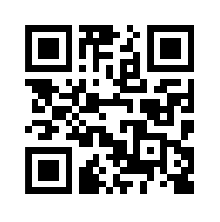
Advice and Support can be sought here:
School Nursing Service: Where there are drop-ins available at your school, school nurses are able to provide advice and support to learners.
Help Me Quit: Smokers and vapers who would like to quit can access free specialist bilingual NHS advice. Call 0800 085 2219, Text HMQ to 80818 or visit Help Me Quit
DAN 24/7: A free and bilingual telephone helpline available to anyone in Wales wanting further information and/or help relating to drugs and/or alcohol. Call 0808 808 2234, text DAN to 81066 or visit www.dan247.org.uk

