Slide 1
Smoker’s Body
This activity links to the following Knowledge Banks:
Health effects and risks of tobacco and nicotine – the physical, mental and long-term health impacts
Quitting, support and health promotion
Smoking data and statistics
This activity develops understanding of how smoking can affect different parts of the body (short and long term).
Possible Health and Well-being descriptions of learning: Developing physical health and well-being has lifelong benefits
Progression step 1 I am beginning to recognise some of the behaviours, conditions and situations that affect my physical health and well-being and I am beginning to know how to respond and get help. | Progression step 2 I can recognise some of the behaviours, conditions and situations that affect my physical health and well-being, and I know how to respond and get help in a safe way. | Progression step 3 I can describe the behaviours, conditions and situations that affect my physical health and well-being, and I know how to respond to and/or manage these in order to actively reduce the risk of harm to myself. | Progression step 4 I can explain the behaviours, conditions and situations that affect my physical health and well-being and, through my actions, I can respond to and/or manage these in order to actively reduce the risk of harm to myself and to others. | Progression step 5 I can apply my knowledge of the behaviours, conditions and situations that affect my physical health and well-being, to keep myself and others safe. I can safely intervene, using learnt techniques, when others’ physical health is at risk.

Slide 2
Introduction
In this activity, you’ll explore how smoking affects the body, both in the short term and over time.
Tobacco and nicotine don’t just affect the lungs – they can harm many different organs and systems, sometimes in ways that aren’t immediately obvious.
You’ll look at different examples of these effects and decide whether they happen quickly or develop after long‑term smoking.
This will help you understand why smoking can have serious impacts on health and why making informed choices matters.

Slide 3
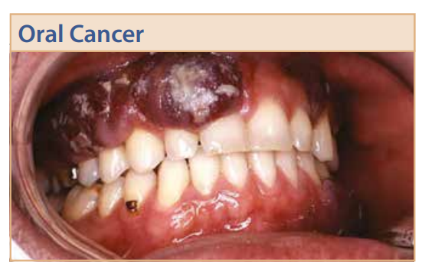
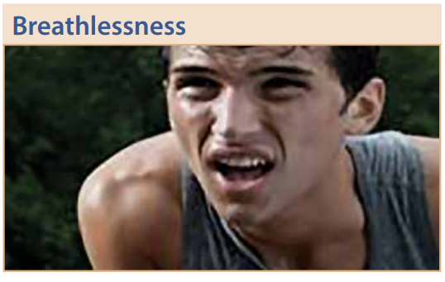
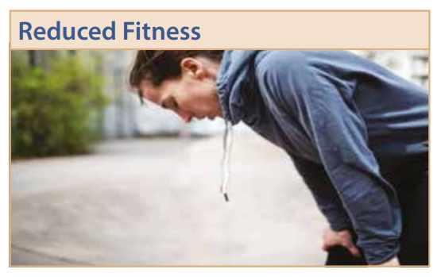
Nearly 2000 people die in the UK every year due to oral cancer. Most cases of mouth cancer are linked to tobacco and alcohol. Chewing tobacco is particularly dangerous. Oral cancer can affect the lips, tongue, cheeks and neck.
Smoking causes a build up of tar in the lungs. Air sacs (called alveoli) inside the lungs become blocked making it harder for you to breathe. Long-term smokers are at high risk of developing COPD (chronic obstructive pulmonary disease) and emphysema.
Smoking decreases oxygen in the body and reduces physical endurance. Your heart, lungs and muscles need oxygen rich blood to achieve peak performance.

Slide 4
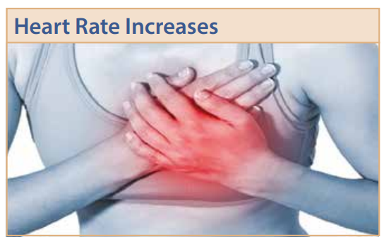
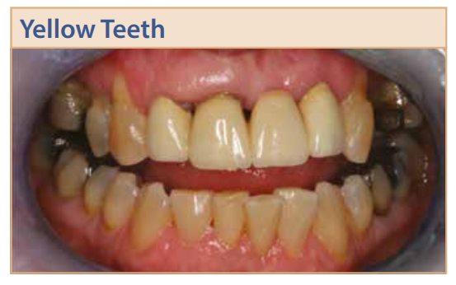
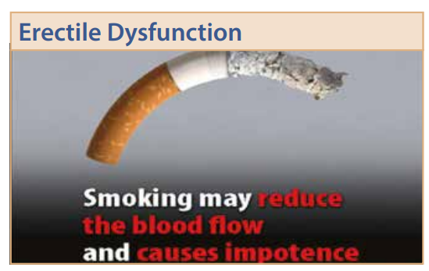
Nicotine is a stimulant. Stimulants increase the heart rate making the heart work harder. This puts extra pressure on the heart and raises blood pressure.
One of the effects of smoking is yellow staining on the teeth due to the nicotine and tar in the tobacco.
Erectile dysfunction is the medical term for difficulty getting an erection. The 7,000 chemicals in a cigarette cause damage to the blood vessels within the body. They cause narrowing of the arteries and fatty deposits to build up, meaning it is much harder for blood to flow into the penis, to help it to expand in the normal way. Nicotine has a direct effect on the blood vessels which carry blood to the penis.

Slide 5
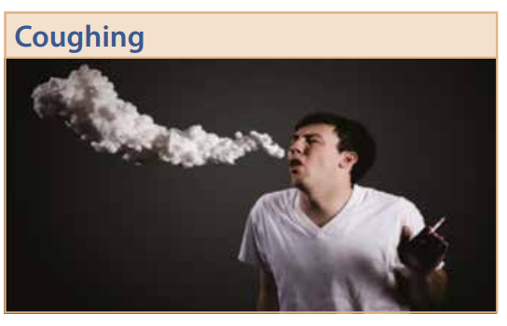
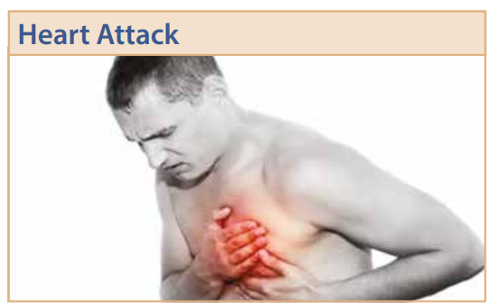
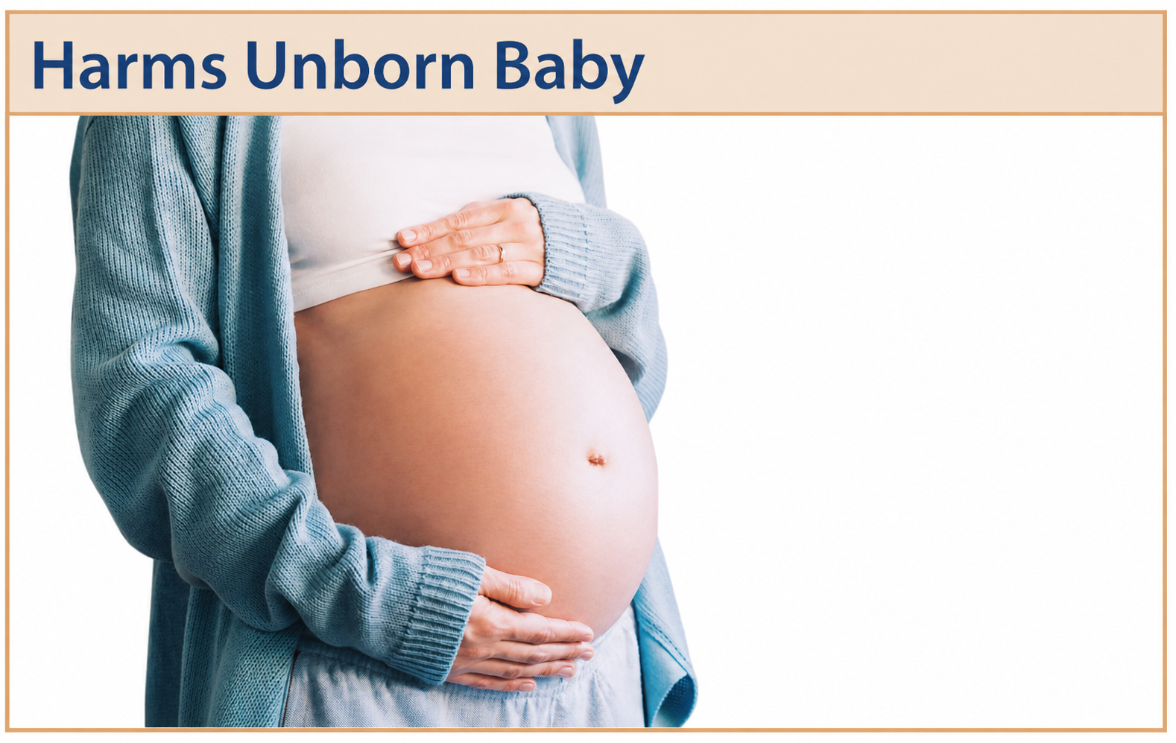
Smokers cough due to the toxins in cigarette smoke. Smoking causes damage and destruction to the protective cilia in the windpipe. Cilia sweep harmful substances out of the lungs.
Smoking damages the lining of your arteries, leading to a build-up of fatty material which narrows the arteries. This can cause a heart attack or stroke. The carbon monoxide in tobacco smoke reduces the amount of oxygen in the blood. This means the heart has to pump harder to supply the body with the oxygen it needs.
The nicotine and other chemicals in a cigarette is passed to the baby through the umbilical cord. Smoking during pregnancy increases the chance of miscarriage, low birth weight and other pregnancy complications.

Slide 6
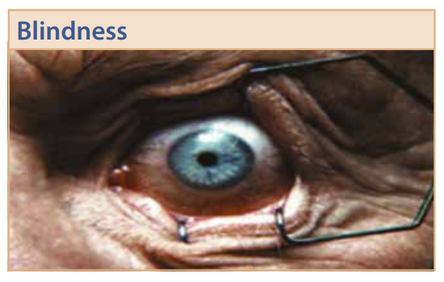
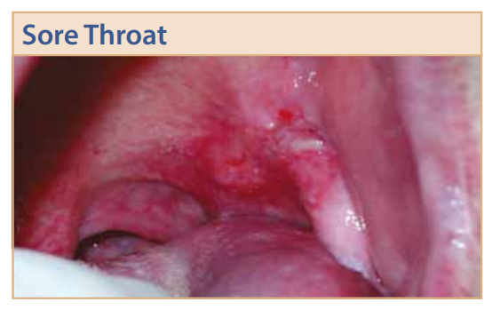
The condition macular degeneration is a leading cause of vision loss and is 4 times more likely to affect long term smokers than those who do not smoke. Smokers are also at higher risk of developing cataracts.
Smoking causes a sore throat because it irritates, inflames, and dries out the delicate lining of your throat.

Slide 7
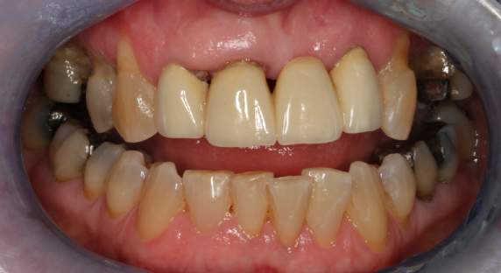
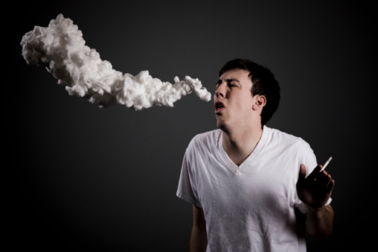
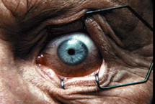

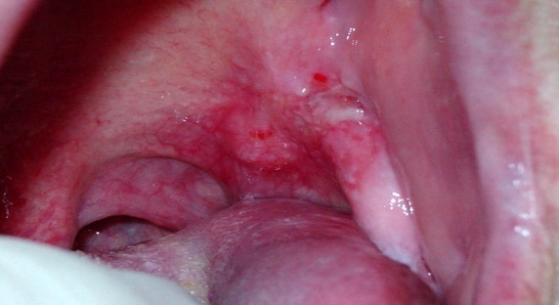
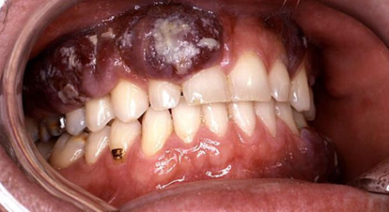
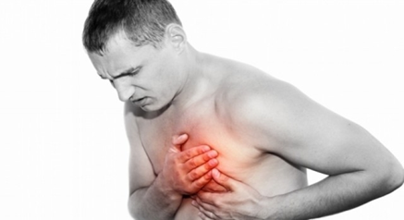
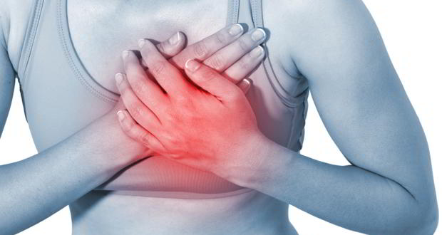

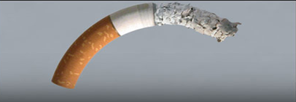
Short term effects
Long term effects
Yellow Teeth
Coughing
Blindness
Reduced Fitness
Sore Throat
Harms unborn baby
Oral Cancer
Heart Attack
Heart Rate Increases
Breathlessness
Erectile Dysfunction

Slide 8
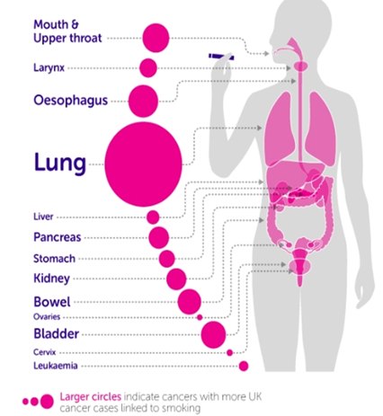
Cancer of the organs
Smoking causes 1 in 4 UK cancer deaths, and nearly a fifth of all cancer cases overall. 4 out of 5 lung cancer patients are smokers.
Tobacco was responsible for 100 million deaths worldwide in the 20th Century. There are very few organs in the body that are not affected by smoking-related cancers.

Slide 9
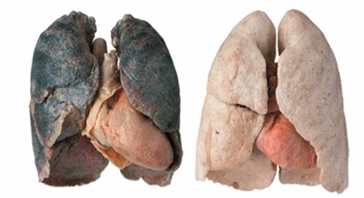
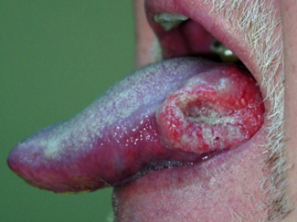
Lung cancer has one of the lowest survival rates of all cancers and is the most common cause of cancer death in the UK.
Smoking also increases the risk of other cancers including cancers of the larynx (voice box), tongue and mouth, nose, bladder, pancreas, kidney, liver, stomach, bowel, cervix, ovary, penis and some types of leukaemia.
There is also some evidence that smoking could increase the risk of certain types of breast cancer.

Slide 10
Further possible learning suggestions - use PHW, NHS and Cancer Research UK pages as sources
Body System Detective Task
Learners choose an organ system (lungs, heart, circulation, mouth, reproductive system, eyesight) and investigate:
What smoking does short-term
What smoking does long-term
Why young bodies are especially vulnerable
Create a Public Health Poster
Learners design a poster for other young people explaining:
One harm of smoking
How the body is affected
One way to get support
Athlete vs. Smoker Scenario Comparison Helps link smoking directly to their lived experience (PE, sport).
Give learners profiles of two teens - one who smokes, one who doesn’t - and compare:
Lung capacity
Fitness
Heart rate
Stamina

Slide 11

Advice and Support can be sought here:
School Nursing Service: Where there are drop-ins available at your school, school nurses are able to provide advice and support to learners.
Help Me Quit: Smokers and vapers who would like to quit can access free specialist bilingual NHS advice. Call 0800 085 2219, Text HMQ to 80818 or visit Help Me Quit
DAN 24/7: A free and bilingual telephone helpline available to anyone in Wales wanting further information and/or help relating to drugs and/or alcohol. Call 0808 808 2234, text DAN to 81066 or visit www.dan247.org.uk

