Slide 1
How we are influenced
This activity links to the following Knowledge Banks:
Laws, regulation and industry influence
The social and environmental impact
Behaviour, choice and influence
This activity informs learners of the techniques used by advertisers to sell products and services (product placement and celebrity endorsements.)
Possible Health and Well-being descriptions of learning: Our decision-making impacts on the quality of our lives and the lives of others
Progression step 1 I have developed an awareness that my decisions can affect me and others. | Progression step 2 I can recognise that my decisions can impact on me and others, both now and in the future. | Progression step 3 I can recognise that some decisions I make will have a long-term impact on my life and the lives of others. | Progression step 4 I can consider relevant factors and implications when making decisions individually and collectively. | Progression step 5 I can critically evaluate factors and implications, including risks, when making decisions individually and collectively.

Slide 2
Introduction
This activity helps you explore how advertising, media and influencers can shape the choices people make. You will learn about the techniques companies use - such as product placement, celebrity endorsements and social media advertising - and how these can affect behaviour, especially around harmful products.
What you will do:
Learn what “influence” means and think about who and what influences you in daily life.
Explore how the tobacco industry has used advertising, social media and entertainment to target young people.
Look at examples of smoking in films, music videos, video games and streaming platforms, and discuss why it appears there.
Examine influencer posts and identify whether they are adverts (#Ad, #Gifted).
Discuss why it’s important to recognise advertising tactics and how they affect decision‑making.
Your task: Use the information in the slides to think critically about how companies try to influence you, why they do it and how being aware of these tactics can help you make informed choices.

Slide 3
The definition of influence:
'The capacity to have an effect on the character, development or behaviour of someone or something, or the effect itself'
Just about anything can influence your decision making, behaviour and values but the more we are exposed to something, the more normal it can seem. For example, you may be influenced to wear certain types of clothes, listen to certain music or even to drink certain drinks.
Consider how you are influenced by your friends, family, social media and music as well as the reels and adverts you see.

Slide 4
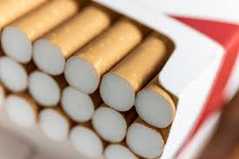
Marketing and Industry Influence
The tobacco industry has a long history of targeting young people.
In the past, marketing linked smoking to fun, independence and social status.
Today, companies use social media, influencer marketing and packaging design to appeal to adolescents and young adults.
Marketing exploits, peer pressure, curiosity and brand loyalty, increasing the likelihood that young people will start using – and then keep using - tobacco or vaping products.
Awareness of these tactics shows that addiction is not only a personal choice - commercial interests actively shape behaviour.
Why is it important to be aware of the advertising tactics used by tobacco companies?

Slide 5
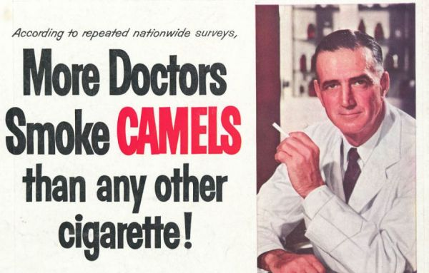
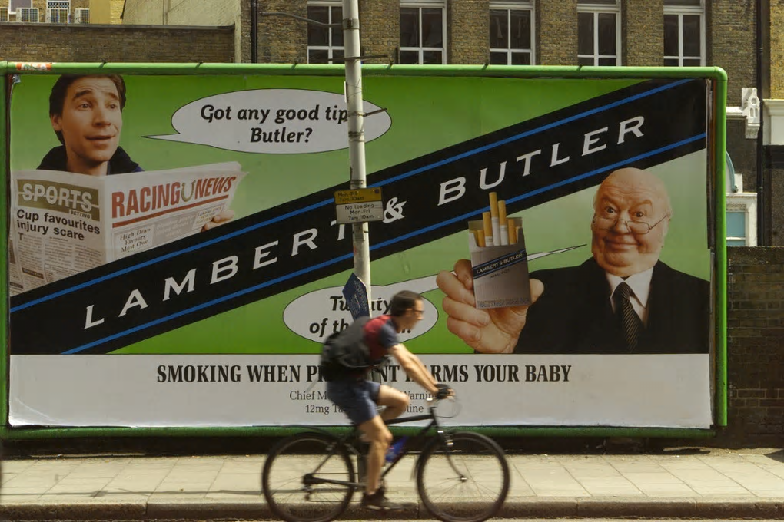
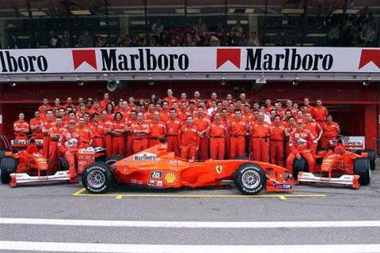
History of tobacco advertising
Smoking was historically advertised as ‘healthy’
Billboard adverts were banned in Feb 2003
Tobacco sponsorship of global sports was banned in 2005
Why ban advertising on billboards and at sports events?

Slide 6

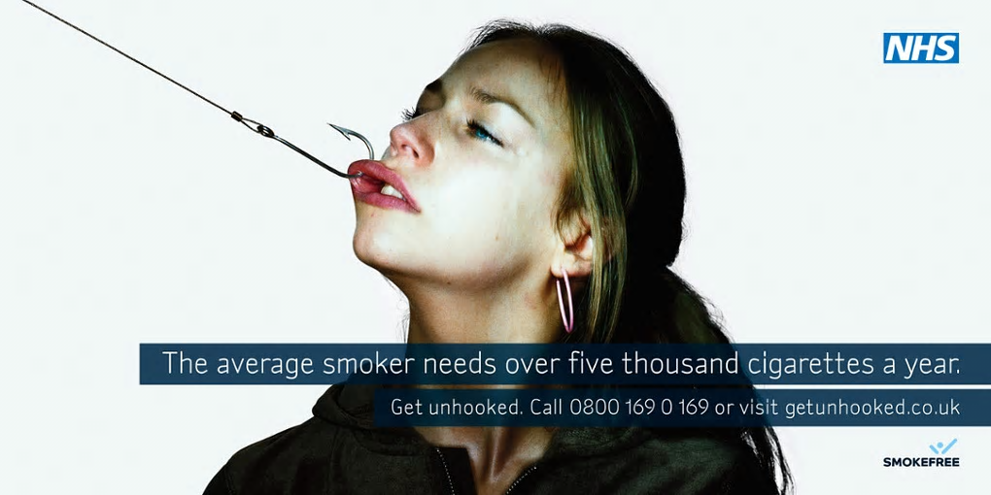
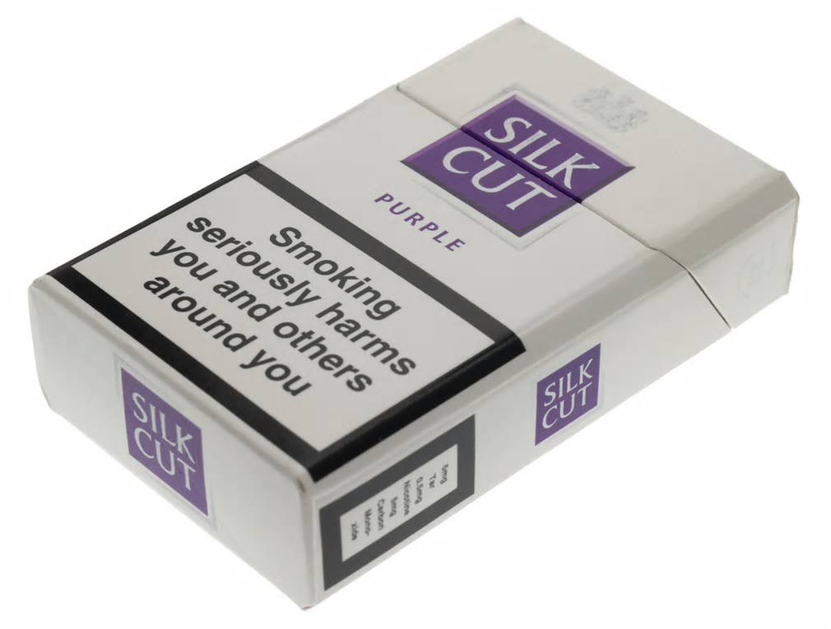
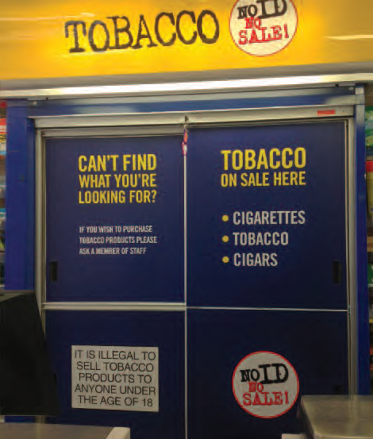
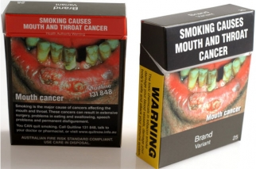
Preventing tobacco advertising
2006
NHS campaign
2015
Shutters
2008
Health warnings
2016
Plain packaging

Slide 7

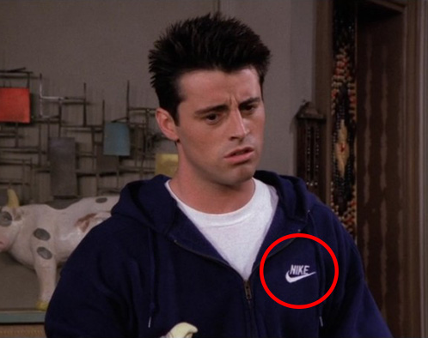
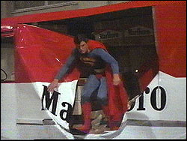


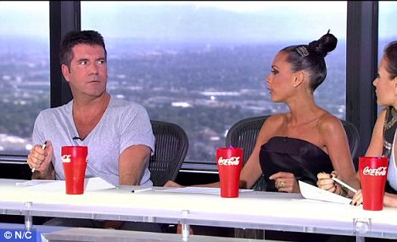
How companies
advertise their products
Product placement
When companies pay for their products to be shown in:
TV shows
Movies
Music videos
Used by celebrities

Slide 8

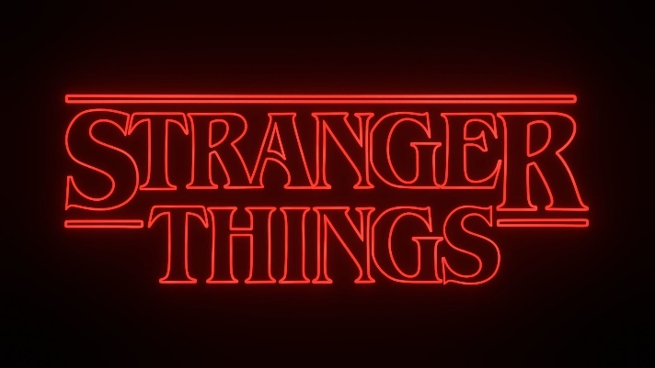


Smoking on screen
Young people who are repeatedly exposed to tobacco content on screen are more likely to start smoking
Smoking is not currently banned on screen
It is illegal in the UK for tobacco companies to pay celebrities to include tobacco content in their music videos

Slide 9
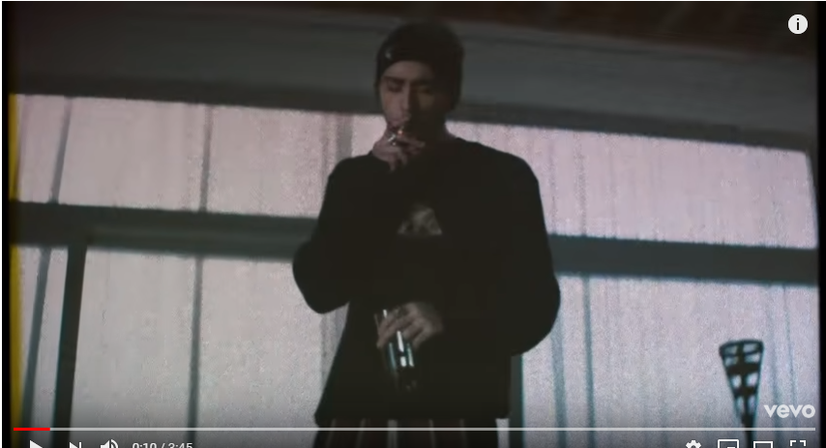
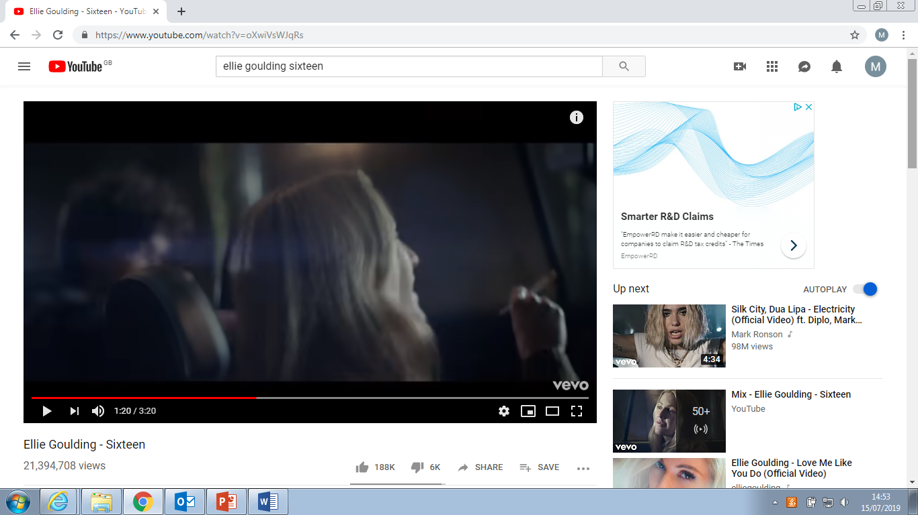
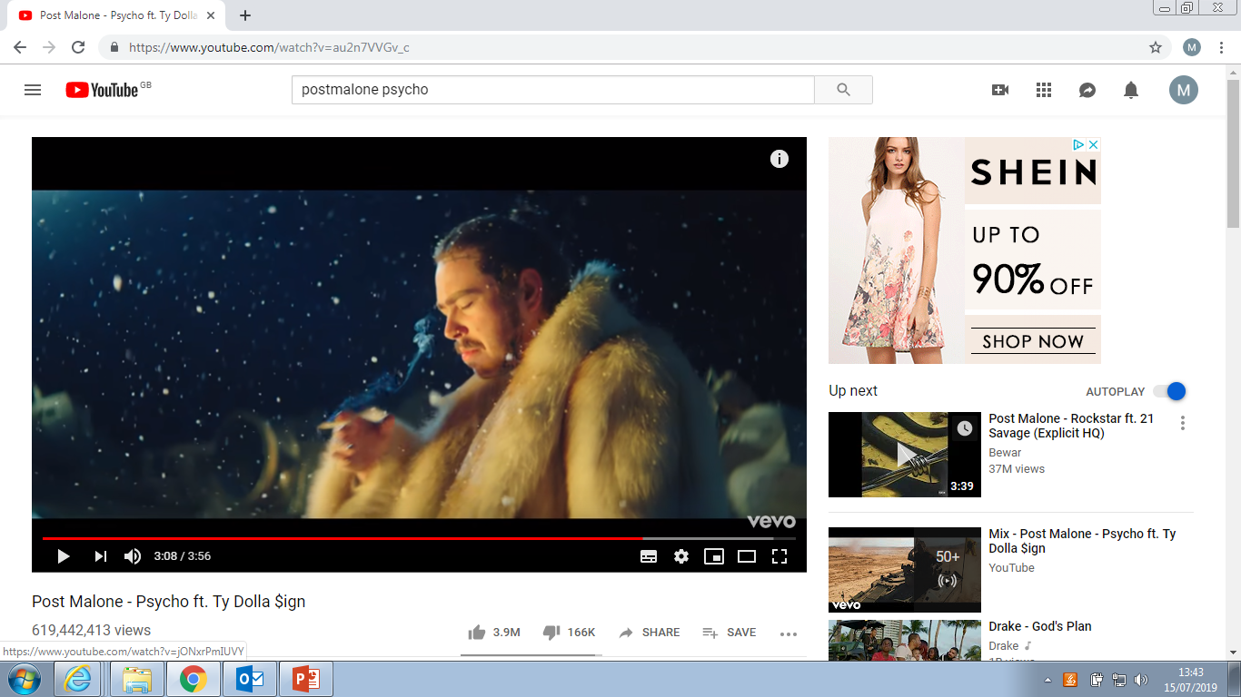
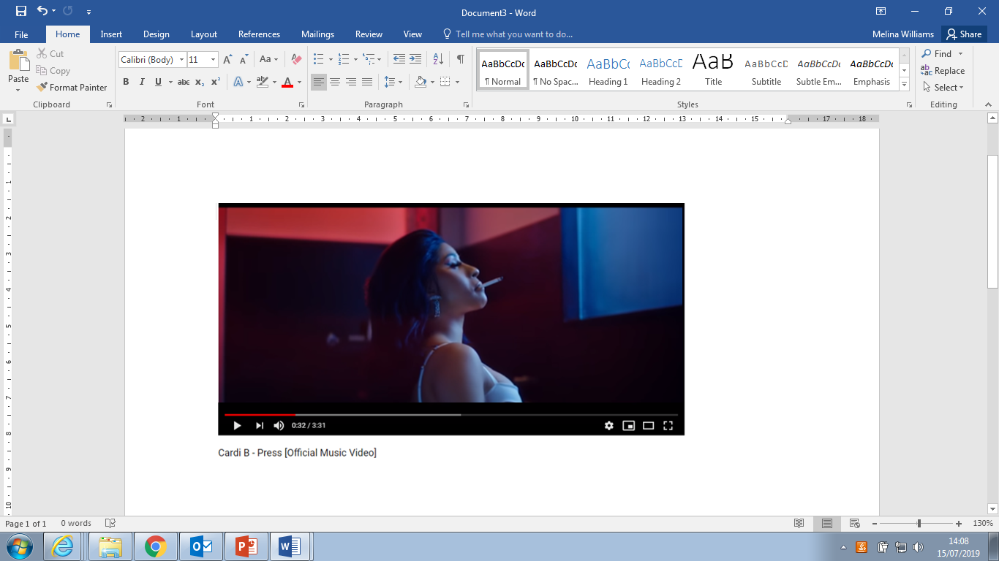
Smoking in music videos
Who watches these music videos?
Zayn Malik – Still got time
Ellie Goulding - Sixteen
Is there a need to have smoking in them?
Post Malone - Psycho
Cardi B - Press

Slide 10

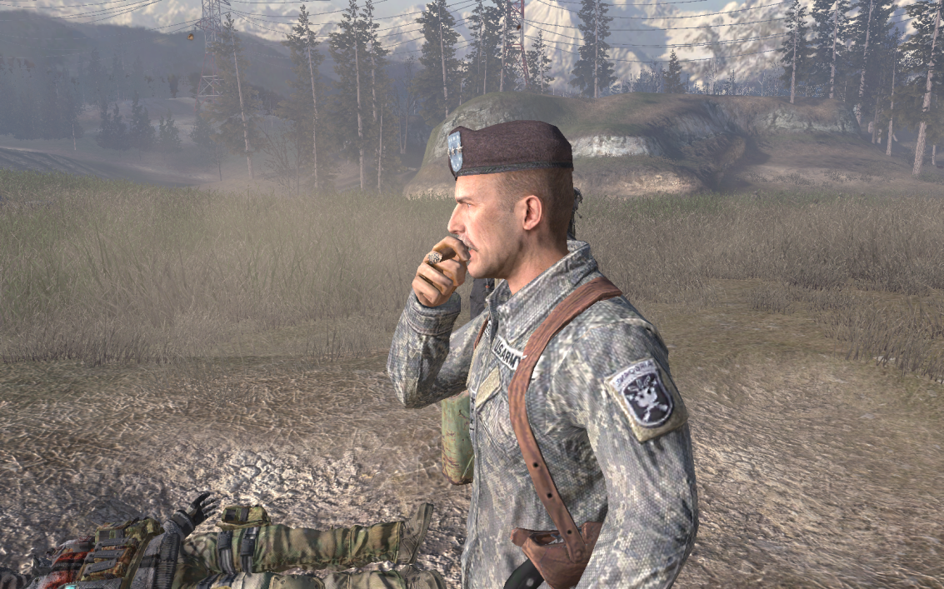



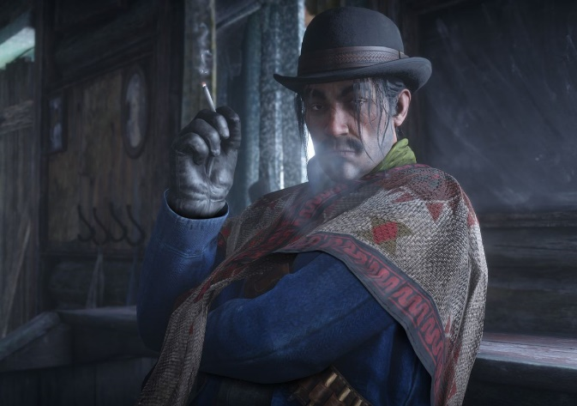


Smoking in video games
Who plays these games?
Does smoking make a difference to the game?

Slide 11
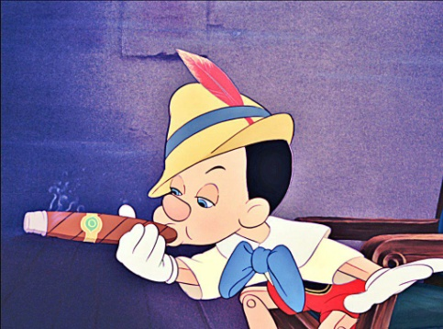
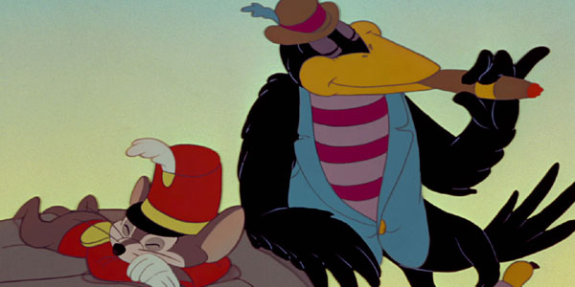
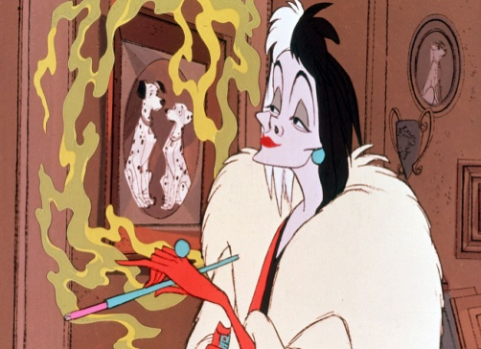
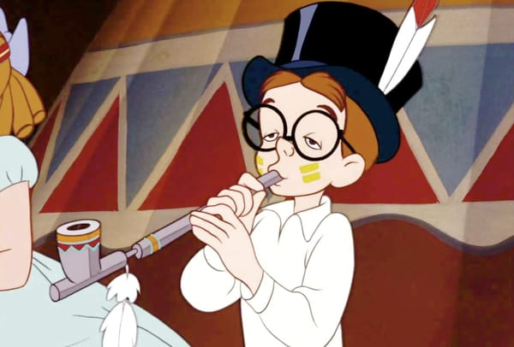

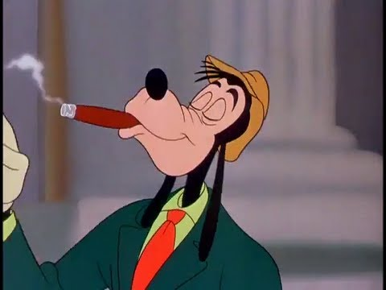
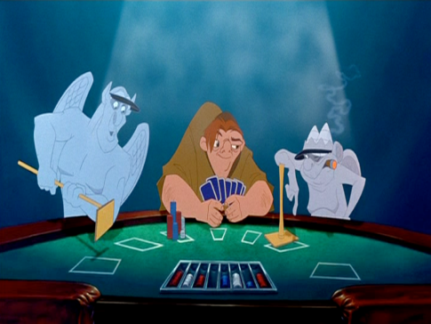
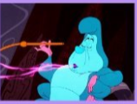
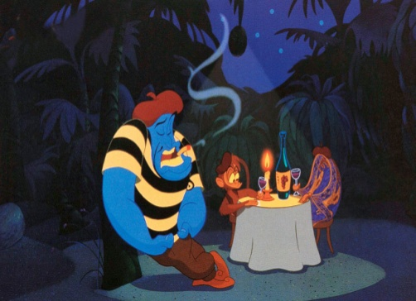
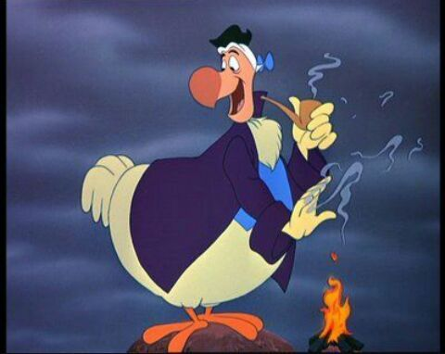
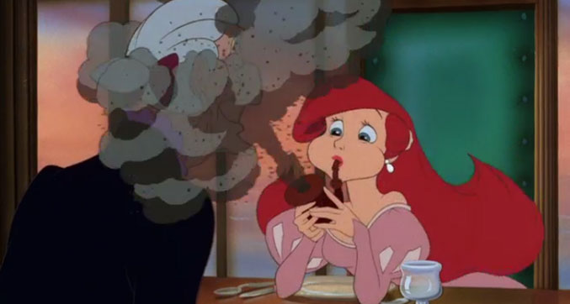
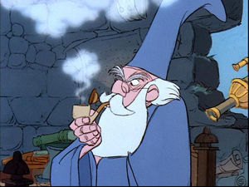
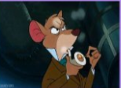
Smoking in Disney
Disney has now banned smoking in all of its future PG films to stop smoking appear as normal.

Slide 12
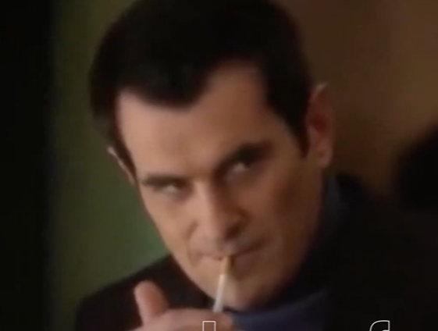

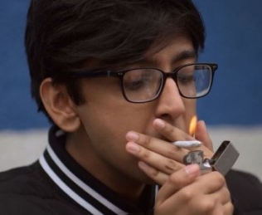
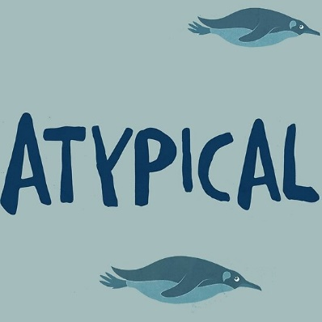
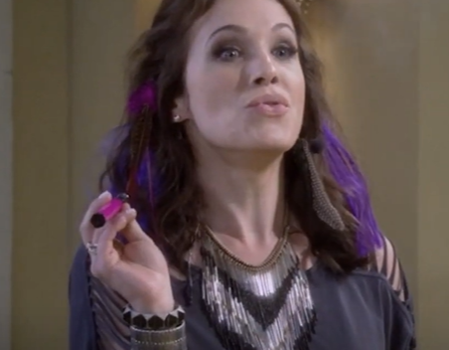

Smoking On Demand (Netflix, Prime, Disney etc)
Streaming platforms and non-broadcast media often feature a higher prevalence of smoking content compared to traditional broadcast television.
A significant amount of smoking content is present in programming specifically targeted at children and young people.
Age verification systems and content categories implemented by streaming services can be circumvented by users with ease.
Netflix has adopted a policy to exclude depictions of smoking in programmes rated for younger audiences (e.g., 12 or lower), with exceptions made only for content demonstrating verifiable historical or factual accuracy.

Slide 13
Advertising on Social Media: What Are the Rules?
#AD
#Gifted
Social media influencers often promote products to their followers. To protect consumers, there are rules about being open and honest about advertising.
Key rules for influencers:
If a post is paid advertising, it must be clearly labelled with tags such as #Ad, #Advert or Paid Partnership.
If an influencer receives free products, gifts or other rewards, they may use labels like #Gifted.
The label must be clear and easy for viewers to notice.
These rules help ensure people know when they are seeing advertising rather than personal recommendations.
Why does this matter?
It helps people understand when they are being marketed to.
It allows audiences to make informed choices about products.
It prevents hidden advertising.
Discussion
Look at the next slide showing examples of influencer posts.
Think about:
Can you easily see if the post is an advert?
Where is the #Ad or #Gifted label placed?
Why might companies use influencers to promote products?
​

Slide 14
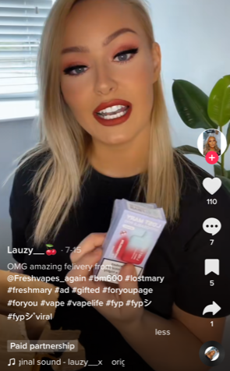
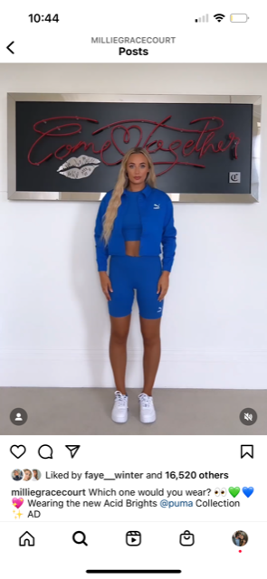
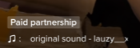
Social media
Celebrities and influencers with thousands of followers are gifted free items and paid to promote products.
#AD
#Gifted
What product placement techniques do the tobacco industry use to promote their products, for example, social media and influencers?​
​
What does their approach tell you about their target audiences?​
​

Slide 15
Further possible learning suggestions
Creative Learning Tasks
Design your own anti-smoking campaign, including posters, videos or social media posts.
Create a “myth-busting” infographic for younger learners using facts from Help Me Quit (HMQ). Help Me Quit
Role-play: advertising agency vs public health campaign - learners create competing campaigns.
Digital & Social Media Influence
Analyse influencer content and discuss how #Ad and #Gifted rules protect consumers.
Explore how algorithms amplify certain behaviours and trends.
Create a guide for young people on How to spot manipulative marketing online.

Slide 16
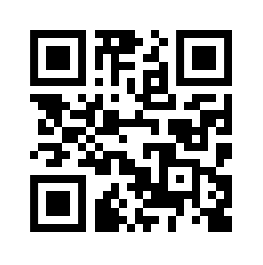
Advice and Support can be sought here:
School Nursing Service: Where there are drop-ins available at your school, school nurses are able to provide advice and support to learners.
Help Me Quit: Smokers and vapers who would like to quit can access free specialist bilingual NHS advice. Call 0800 085 2219, Text HMQ to 80818 or visit Help Me Quit
DAN 24/7: A free and bilingual telephone helpline available to anyone in Wales wanting further information and/or help relating to drugs and/or alcohol. Call 0808 808 2234, text DAN to 81066 or visit www.dan247.org.uk

