Slide 1
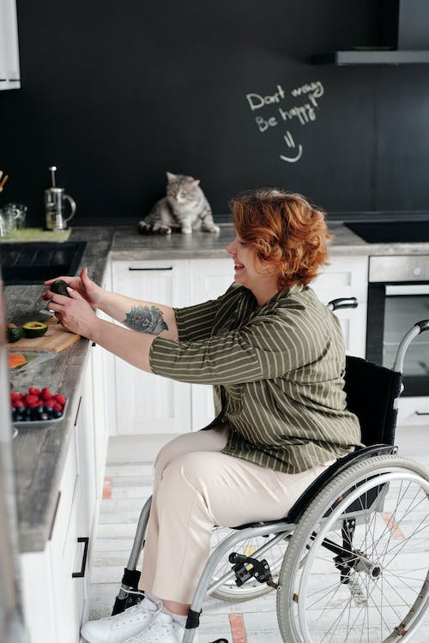



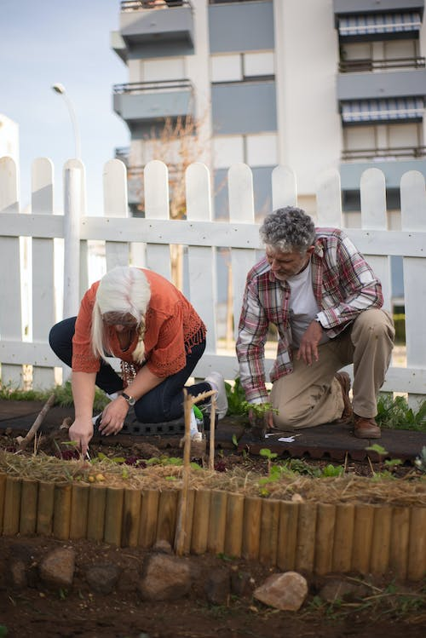

Supporting Healthy
Behaviours:
A Guide for Community Pharmacy

Slide 2
Supporting Healthy Behaviours: A Guide for Community Pharmacy
2
Contents
Supporting Healthy Behaviours | 3
Community Pharmacy Workforce Wellbeing | 4
Making Every Contact Count (MECC) | 5
Social Prescribing | 7
Smoking | 9
Vaping | 11
Alcohol | 12
Substance Use | 13
Healthy Weight | 15
Physical Activity | 17
References | 19

Slide 3

Supporting Healthy Behaviours
A Healthier Wales highlighted the need for a shift towards greater prevention and early intervention, to improve people’s health and wellbeing, and support the sustainability of our health and care system.
Opportunities to initiate behaviour change conversations, and empower people to make healthier
choices, are plentiful through the high number of contacts between the public and community pharmacy services.
Wellbeing of Wales (2025) reported around two thirds of avoidable deaths were attributed to preventable conditions
Areas for quality improvement in community pharmacy:
Improve the identification of people who require support with adopting healthy behaviours
Optimise signposting or referrals for people who require support with healthy behaviours, where available and appropriate
Review skills/service gaps to support people to adopt healthy behaviours and take action to address gaps.

Slide 4

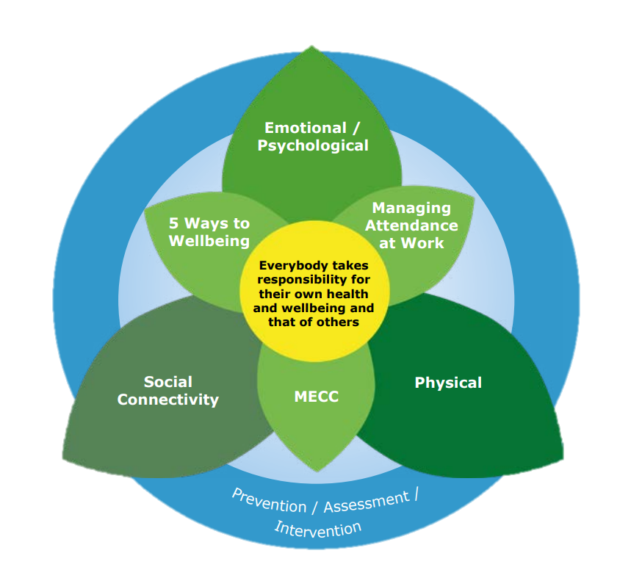

Community Pharmacy Workforce Wellbeing
The need to adopt and/or maintain healthy behaviours is relevant to us all and we can all consider how best to incorporate healthy behaviours into our lives.
The health and wellbeing of community pharmacy staff is also a key factor that underpins performance at work, engagement within the workplace, recruitment and retention and sickness absence levels.
For yourself and colleagues, it may be beneficial to be aware of, and take up relevant resources, outlined in this document, to support your own health and wellbeing.
Our Wellbeing Matters, HEIW
HEIW’s Our Wellbeing Matters links together a range of resources the workforce can use to support their wellbeing, and Healthy Working Wales aims to support and encourage employers to create healthy working environments and take action to improve the health and wellbeing of their staff.

Slide 5


Making Every Contact Count
Making Every Contact Count (MECC) is an approach to behaviour change that utilises the millions of day-to-day interactions between people to support individuals in making positive changes to their health and wellbeing.
What is MECC?
MECC aims to empower all staff interacting with people, to recognise the opportunities they have to promote healthy behaviours, support behaviour change and contribute to reducing the risk of developing a long term condition.
MECC is about:
Identifying opportunities to raise the issue of health behaviours
Communicating in a supportive, non directive manner to help motivate individuals to think about making a behaviour change
Signposting/referring individuals to further information and support
MECC is not about:
adding another job to already busy working days
becoming a specialist or expert in certain health-related areas
becoming a counsellor or providing ongoing support to particular individuals
telling somebody what to do and how to live their life.

Slide 6

Adopting this approach, as a part of what we all do, will allow us to move to a position where discussion of health-related behaviours and their impact on health and wellbeing is routine, non-judgemental and integral to everyone's professional and social responsibility.
MECC eLearning
It is not easy for everyone to raise questions about health-related behaviours. MECC requires a range of skills and knowledge in order for staff to gain confidence to support and direct people.
Training resources for staff are a key element of a MECC programme.
The Making Every Contact Count website provides access to training on the
skills and knowledge needed to have effective health behaviour change conversations.
MECC training is available to community pharmacy staff through their usual Continuing Professional Development platform, Y Ty Dysgu.

Slide 7
Social Prescribing
  What is social prescribing?
  Social prescribing describes a person-centred approach to connecting people to local community assets.
It can help empower individuals to recognise their own needs, strengths, and personal assets, and to connect with their communities for support with their health and wellbeing.
Social prescribing may provide a continuum of support, play a preventative role, or form part of a ‘step-down’ model of support.
Social prescribing can be delivered by a dedicated social prescribing practitioner, or someone who performs social prescribing as part of their role.
  Social prescribing has grown organically within Wales, producing a range of different delivery models, across health and care, third sector, and statutory organisations.
  Often developed from the grass roots, services are delivered to meet local population needs.
  The Welsh Government ‘National Framework for Social Prescribing’ aims to support consistency in approach and help to provide reassurance on quality of delivery, without dictating how services are delivered in different communities.
  The Social Prescribing Pathway
Referral
Made by:
- Self
- Healthcare
- Community and
Voluntary sector
organisations
- Statutory
services
Social Prescribing
Includes:
- What matters
conversation
- Action
planning
- Signposting /
referral
Community Assets
For example:
- Welfare
support
- Exercise on
referral
- Social Cafes
- Nature based
interventions

Slide 8
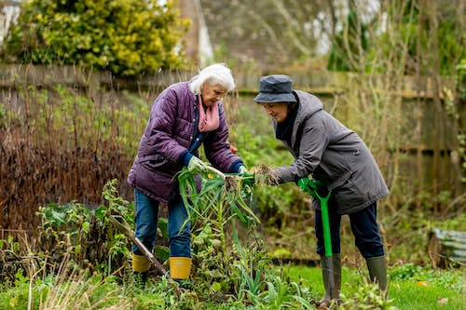


  What does a Social Prescribing Practitioner do?
  A social prescribing practitioner may be known by a variety of terms, including ‘community connector’, ‘link worker’, ‘social prescriber’ or ‘local area coordinator’.
  They will:
  Have a what matters conversation with an individual to identify their non-medical needs
  Co-produce an action plan tailored to their preferences and needs
  Help to access local community assets such as groups, interventions or services
  Explore barriers and challenges to attending assets and activities, and encourage ongoing participation
  If a potential medical need is identified they may also refer to a GP or pharmacist
The benefits of social prescribing are wide-ranging, recognising its holistic role in improving physical, mental and social wellbeing
Signpost or refer to your local social prescribing service, people who need help to connect to community support to better manage their health and wellbeing.

Slide 9

Smoking
Smoking is still the largest cause of avoidable death in Wales, with 10% of the adult population reported to smoke¹.
We know that 6 in 10 smokers in Wales want to give up³
Smokers want and expect health care professionals to engage with them and give them options.
Smoking remains a major cause of morbidity and mortality in Wales
More than 3,845 deaths every year (10% of all deaths amongst those over 35) and over 17,000 hospital admissions annually are attributable to smoking².
Areas for quality improvement activity in community pharmacy
You and your colleagues can help people who smoke by undertaking a quick 30 second evidence-based conversation – Very Brief Advice:
Asking: about smoking status
Advising: about the best way to quit (using NHS support is x3 more effective)
Acting: refer to Help Me Quit

Slide 10



Help Me Quit is Wales’s national stop smoking brand
Encouraging a person to quit is one of the most impactful interventions you can make for their long-term health.
HMQ provides free evidence-based cessation support to help quit smoking for good
HMQ gives access to expert advisors, licensed stop-smoking medications, and tailored behavioural support
People using HMQ are up to three times more likely to quit than those who try alone.
Help Me Quit makes it as easy as possible for smokers to engage
People can get a call back at a time that suits them via the HMQ website
HMQ services offer support in a range of settings - HMQ Community Pharmacy; HMQ Community; HMQ Hospital, HMQ telephone support. Local service locations can be viewed on this map.
Further information including self-help resources can be found at www.helpmequit.wales
How to refer to Help Me Quit
If your pharmacy offers HMQ Community Pharmacy support, clients can receive help right there in store. Otherwise, refer them using one of the following options:
Refer directly via online Health Professional Referral Form: https://www.helpmequit.wales/professional-referral-form/
Call Help Me Quit: 0800 085 2219
Encourage the Smoker to Self-Refer
Visit: www.helpmequit.wales
Text: HMQ to 80818 Call: 0800 085 2219
Download: Help Me Quit App - Search 'HelpMeQuit'

Slide 11

Vaping
Help to Quit
Vaping Now
Available in Wales
Support to stop vaping is now available through HMQ, with a range of options to suit individual needs. However, the vaping support offer does differ from that for smoking.
1 Start with Self-Help
Direct people first to the HMQ website to access self-help materials and build their personalised quit plan using ‘Your Quit Plan’: www.helpmequit.wales
2 Need More Support?
If someone needs further help to quit vaping, they can speak with a trained advisor at the national HMQ Hub for a behavioural support session:
Call 0800 085 2219
Rates of vaping have risen in recent years in Wales, amongst adults and children and young people⁴.
We know that 6 in 10 smokers in Wales want to give up³
Smokers want and expect health care professionals to engage with them and give them options
Vaping is less harmful than smoking, but it is not risk free.
Most vapes contain nicotine, which is addictive. Nicotine use typically leads rapidly to dependence, with experiences of withdrawal and cravings experienced as unpleasant by most people.
For further information on vaping see:
Briefing for Community Pharmacy Teams - Help Me Quit

Slide 12
Alcohol
17% of adults (16+ years) in Wales are drinking above the recommended guidelines¹.
There is no completely safe limit for drinking alcohol and drinking even low amounts of alcohol increases the risk of diseases like cancer.
The risk of developing a range of health problems increases the more a person drinks.
Areas for quality improvement activity in community pharmacy
You and your colleagues can help people with their alcohol use by:
Being aware of alcohol-related harms and NICE guidance on prevention interventions
Asking about their drinking behaviour when it might be relevant
Assessing drinking behaviour using AUDIT C
Providing advice based on AUDIT C score and signposting to the DAN 24/7 helpline.
Alcohol Use Disorders Identification Test - Consumption scoring AUDIT C [abridged]
AUDIT-C Score | Risk
0-4 | Low risk drinking
5-7 | Increasing risk drinking
8-10 | Higher risk drinking
11-12 | Possibly dependant
AUDIT C consists of the consumption questions from the full AUDIT, an alcohol use screening test to assess a person’s risk to alcohol harm.
Alcohol Brief Intervention (ABI) Level 2 e-learning is available to support you to have conversations about making positive changes to alcohol consumption.

Slide 13

Substance Use
Harms from substance use are not evenly distributed; they disproportionately impact the most vulnerable, deepening health inequities and placing additional strain on health and social care systems.
Deaths from drug misuse registered in 2024 rose substantially to 288 deaths, an increase of 13.8 per cent from the previous year and the highest number of drug misuse deaths on record⁵.
There is no completely safe limit for drinking alcohol and drinking even low amounts of alcohol increases the risk of diseases like cancer.
Areas for quality improvement activity in community pharmacy
You and your colleagues can help people with their substance use by:
Being alert to early risk signs e.g. stress, difficult personal circumstances, low mood
Taking a non-judgemental approach. Stigma can be a barrier to people accessing support
Advising on drug related risks and encouraging positive coping strategies in line with NICE guidance
Signposting to substance use services for additional help
Substance use contributes to a range of negative outcomes including premature mortality and morbidity, exacerbation of social inequalities and the disruption to families and communities.

Slide 14


People wanting support can be signposted to the Wales Drug & Alcohol Helpline DAN 24/7.
DAN 24/7 is a free, confidential and bilingual telephone helpline providing a single point of contact for anyone in Wales wanting further information and/or help relating to drugs and/or
alcohol. Talking to somebody about a drug or alcohol problem can be the first step for a person in resolving their problems. People can self-refer for support.
The service is available 24 hours a day, 7 days a week.
Freephone: 0808 808 2234 or text DAN to: 81066

Slide 15
Healthy Weight
Areas for quality improvement activity in community pharmacy
You and your colleagues can help people who are, at risk of or experiencing obesity, by:
Asking – seek permission to talk about and explore weight when opportunities arise
Assessing – discuss the persons health status and weight management journey
Advising on the benefits of achieving and maintaining a healthier weight
Signposting/referring the person to the Healthy Weight Healthy You website, their GP or your local health board’s weight management service.
Getting to and maintaining a healthier weight can be challenging, and influenced by the conditions in which we are born, grow, live and work.
61% of adults in Wales were classified as experiencing overweight or obesity; including
35% overweight
26% obese¹.
A healthier weight reduces the risk of developing several chronic conditions including cardiovascular disease, Type 2 Diabetes, and cancer.
Compassionate conversations and access to support, can help people to have a healthier weight.
It is important to understand a person’s weight journey from their perspective, free from judgement and bias.

Slide 16



Having Healthy Weight Conversations (MECC Level 1&2) e-learning provides practical techniques and approaches to help you confidently support discussions about healthy weight.
The Healthy Weight Healthy
You website offers content and resources including:
Goal setting and self-monitoring
Understanding weight and your weight management journey
Interactive, downloadable resources such as meal planners
Signposting information for ways to get active and further weight loss options.
Information for health professionals webpage.
Individuals can be signposted to Healthy Weight Healthy You, a web-based NHS resource for adults in Wales with overweight and obesity.
It is a free, evidence-based, resource offering tailored information and self-directed support.

Slide 17

Areas for quality improvement activity in community pharmacy
You and your colleagues can help people to be more physically active by:
Asking people about movement and being active when opportunities arise
Advising on the benefits of physical activity – any amount of physical activity is better than none.
Signposting/referring to further information, activities and support.
Physical Activity
Physical activity is anything that gets the body moving - activities like walking, wheeling, dancing, playing and gardening all count.
Being active provides a range of short and long term physical and mental health benefits; helps develop and maintain bone and muscle strength plus improves balance. Being physically inactive is harmful to health.
Around 31% of adults in Wales are inactive, defined as undertaking less than 30 minutes of physical activity per week¹
Physical activity can both prevent and treat more long term conditions than any other single intervention⁶
See also:
UK Chief Medical Officer Physical Activity guidelines for information on all age groups; activity during pregnancy and post-birth, and for those with disabilities.
The Moving Medicine resource for healthcare professionals includes guides on how to integrate physical activity conversations into everyday care.

Slide 18
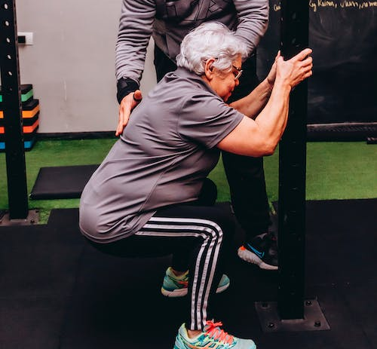
You can signpost people to:
NHS Exercise webpage for information
We Are Undefeatable webpage for advice on being more active whilst living with a health condition
Living Streets Walkbook: Recipes for walking and wellbeing for inspiration
Hapus website for movement and wellbeing ideas
Your local authority’s website to find leisure centres, green spaces, disability-friendly walks and other activities, including information on the 60+ Active Leisure scheme offering access to free or discounted sports and fitness sessions, and details of free swimming for certain groups
People aged 16+ who are inactive and have, or are at risk of developing, a chronic condition can be referred to the Wales National Exercise Referral Scheme (NERS).
Individuals can be referred by health professionals, such as a GP, practice nurse, or physiotherapist.
Available across Wales, NERS provides a 16-week programme with an initial assessment and supervised, tailored exercise plan.
Key Messages:
Every movement counts - break up long periods of inactivity
Connect movement to feeling better and short-term gains such as improving sleep, lifting mood, improving social connections
Encourage people to find what feels fun for them

Slide 19
References
1 Welsh Government. National Survey for Wales 2024-25.
2 Public Health Wales (2024) Smoking attributable mortality and hospital admissions for Wales, 2020 – 22
3 Public Health Wales (2016) Increasing uptake of NHS Smoking Cessation Support
4 Public Health Wales (2026). Vapes (e-cigarettes) Position Statement.
5 Public Health Wales Health Protection Division (2025). Data mining Wales: The annual profile for substance misuse 2024/25. Cardiff, Public Health Wales.
6 BMJ Learning. The Importance of Physical Activity Learning Module 1. Available from: http://learning.bmj.com/learning/info/getting-started.html [Accessed 8/6/2018].

Slide 20
Published: August 2026

