Slide 1


2026-2027 Influenza vaccination
Information and Resources for Schools
Vaccine Preventable Disease Programme
Public Health Wales
August 2026
Version 1

Slide 2

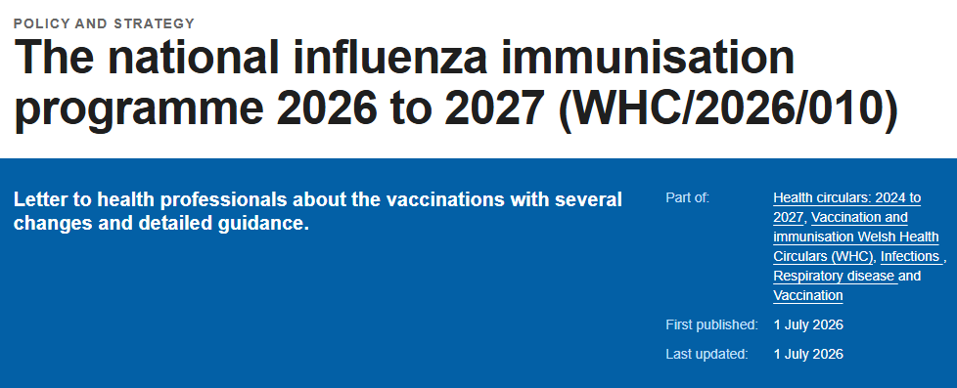
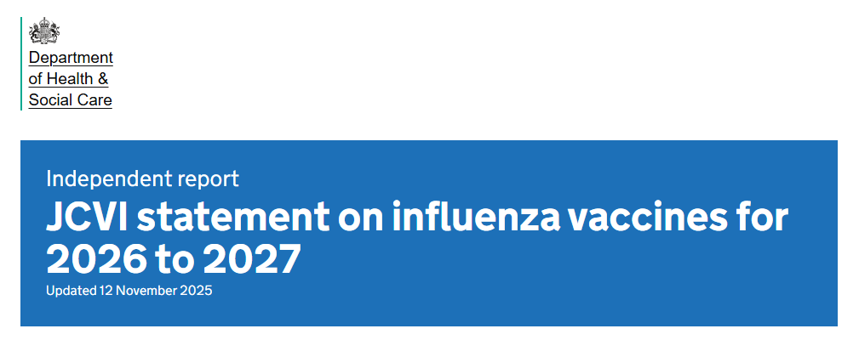
Guidance and Policy
The national influenza immunisation programme 2026 to 2027 (WHC/2026/010) | GOV.WALES
JCVI statement on influenza vaccines for 2026 to 2027 - GOV.UK

Slide 3
Healthcare Professional Information
PGD and VGD templates: Patient Group Directions (PGD) - Welsh Medicines Advice Service
Influenza: the green book, chapter 19 - GOV.UK​
​
Overview | Flu vaccination: increasing uptake | Guidance | NICE​
Influenza vaccines marketed in the UK - GOV.UK
Vaccine Preventable Disease Programme resources:
Frequently asked questions
Information for health and social care workers eligible for the flu vaccine - Public Health Wales
Flu resources for health and social care professionals - Public Health Wales
Vaccine resources for health and social care professionals
Childhood influenza vaccination programme - Public Health Wales
​

Slide 4
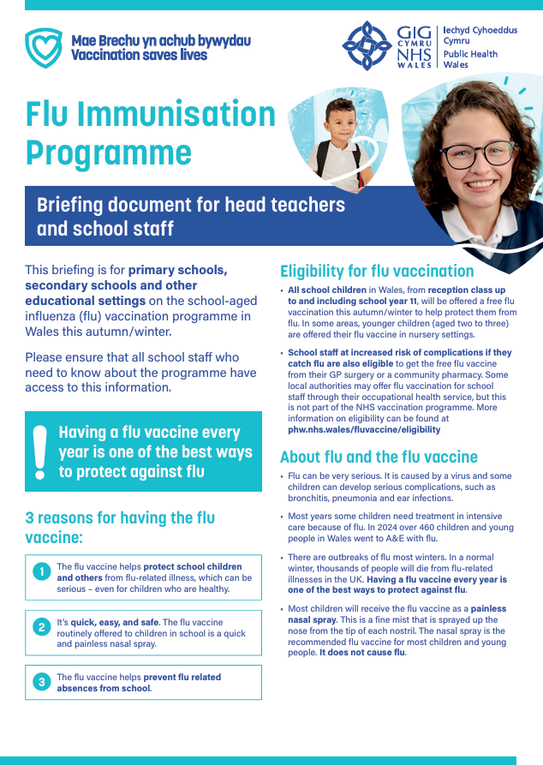
Information about the school aged flu vaccination programme for school staff
Flu vaccination programme – Briefing document for headteachers and staff at all educational settings.
**currently being updated**

Slide 5
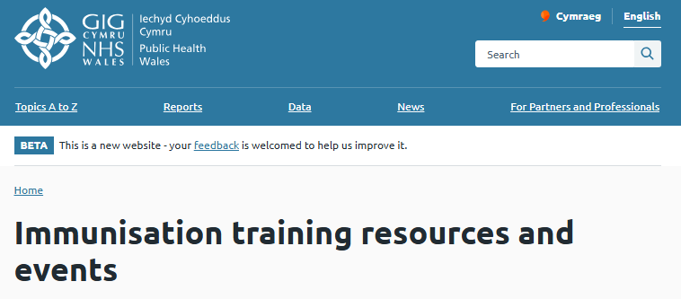
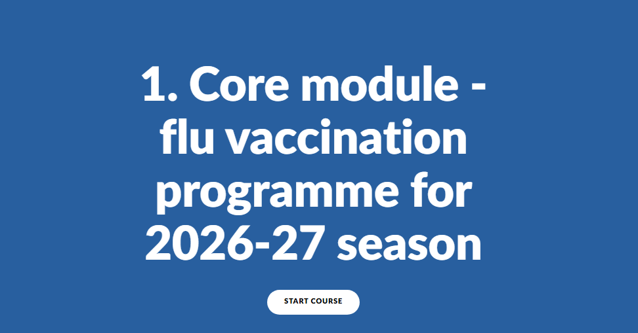
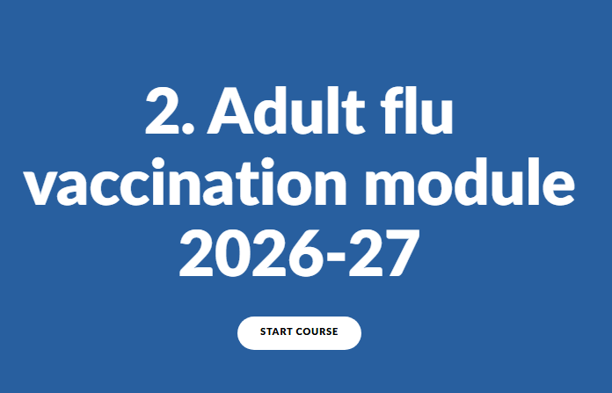
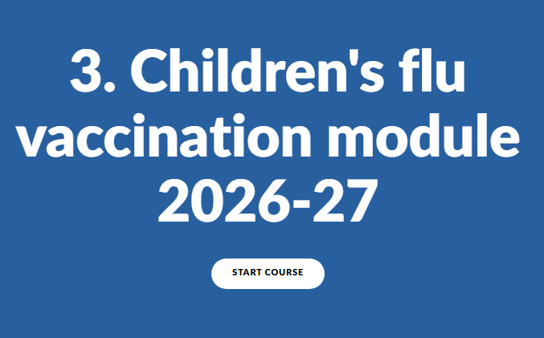
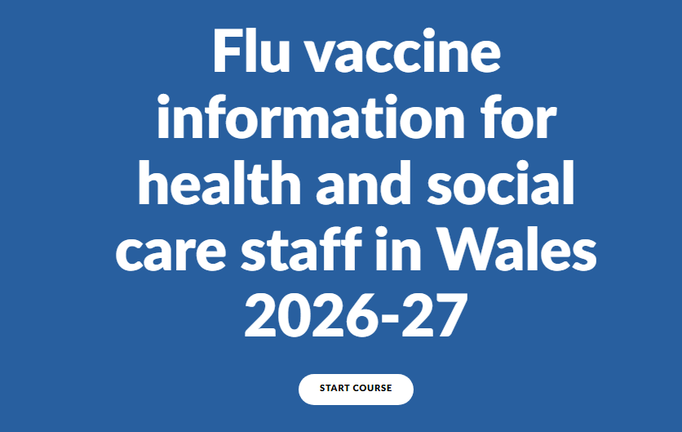
Training (1)
Immunisation training resources and events - Public Health Wales
Flu training recommendations for Wales 2026 to 2027 - Public Health Wales
Flu Clinical Update for Wales e-learning course - Public Health Wales
Module 1: Core module – flu vaccination programme for 2026-27 season
Module 2: Adults flu vaccination module
Module 3: Children’s flu vaccination module
Flu vaccine information for health and social care staff in Wales 2026-27

Slide 6

Training (2)
Immunisation training resources and events - Public Health Wales
Flu training recommendations for Wales 2026 to 2027 - Public Health Wales
The national flu immunisation programme – slide set - Public Health Wales

Slide 7
Frequently Asked Questions (FAQs)
Available on the VPDP SharePoint page (Access for NHS email only) at:
Frequently asked questions
**currently being updated**

Slide 8
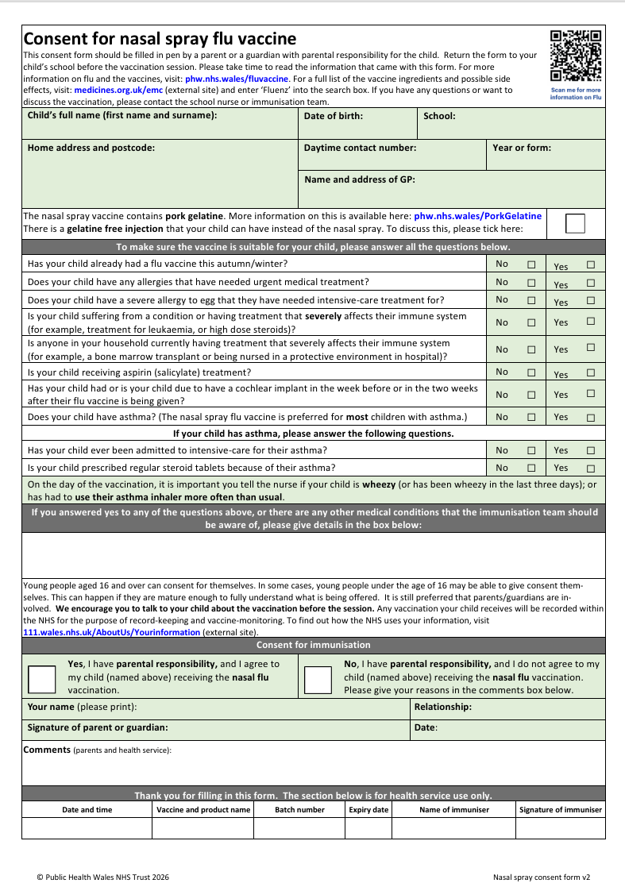
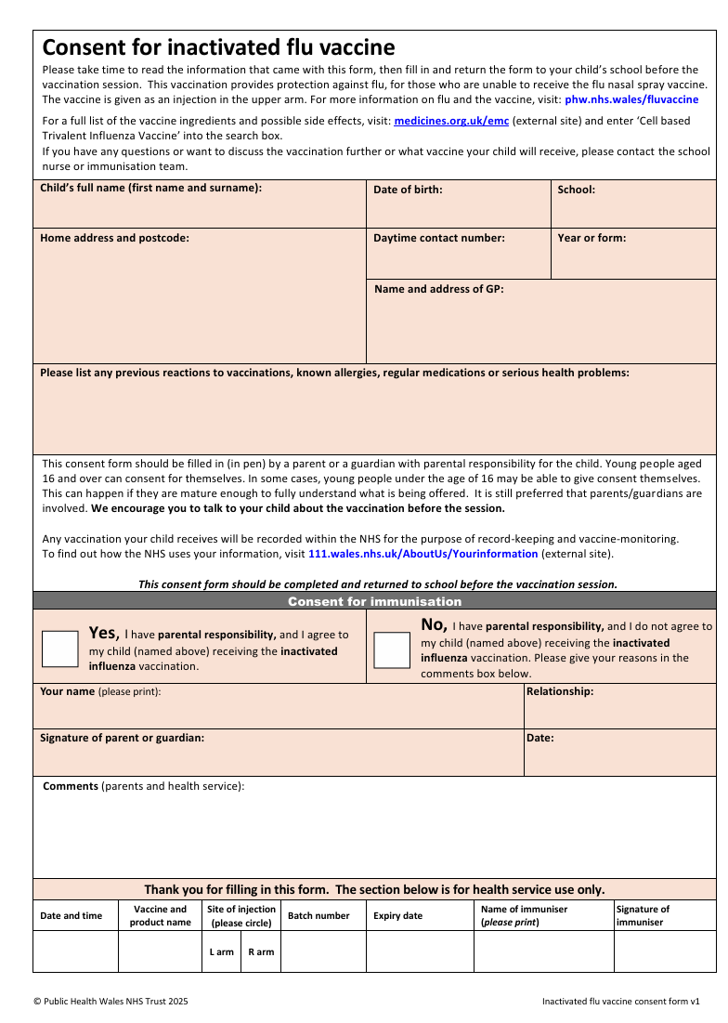
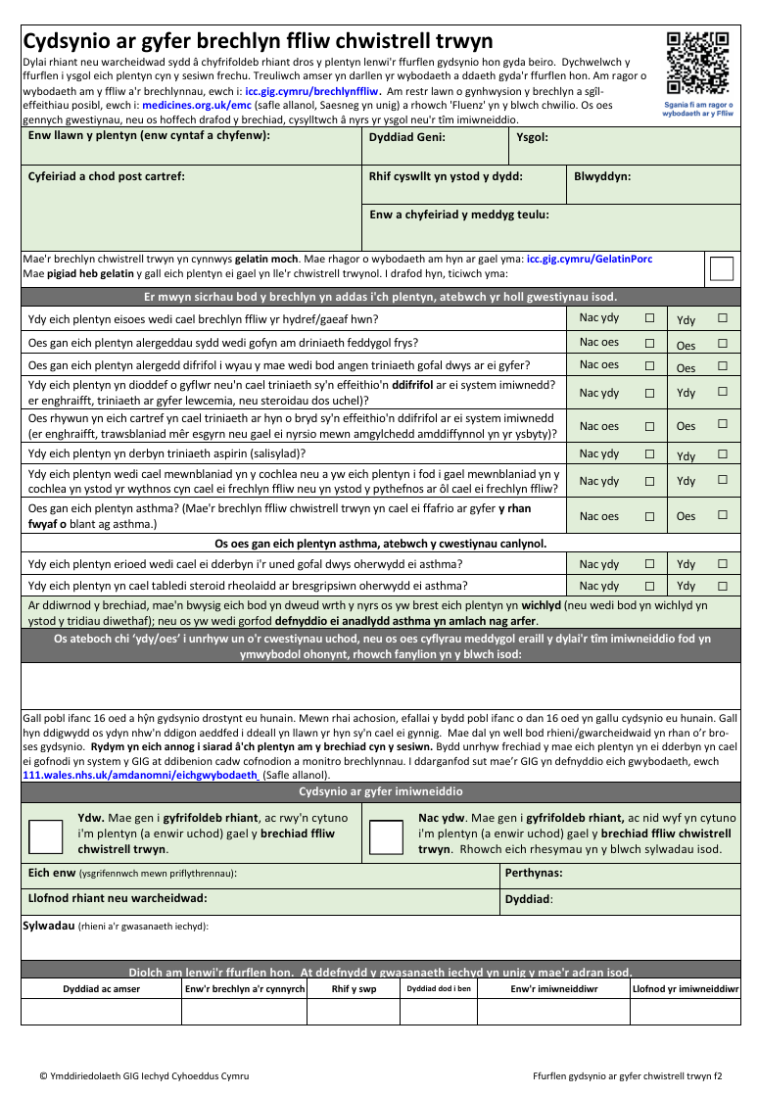
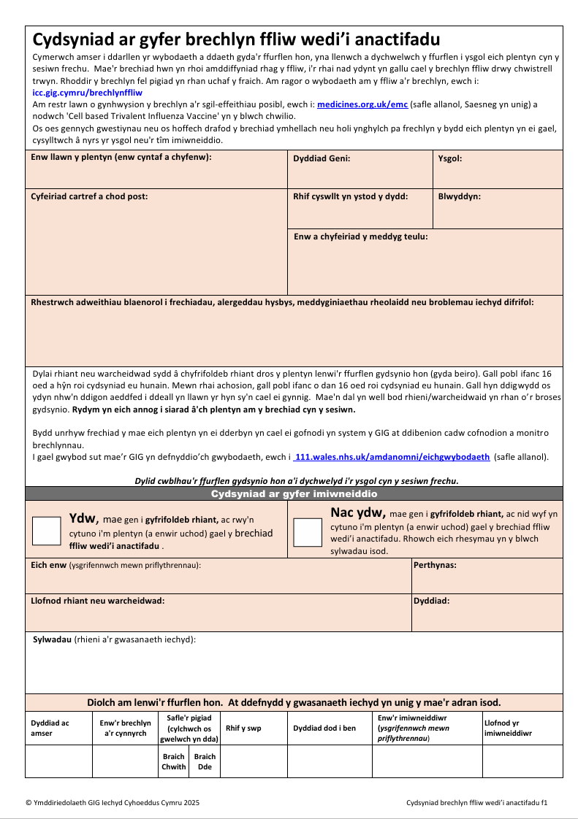
Template Consent Forms for Schools
Consent for nasal spray flu vaccine - Public Health Wales
Consent for inactivated flu vaccine - Public Health Wales

Slide 9
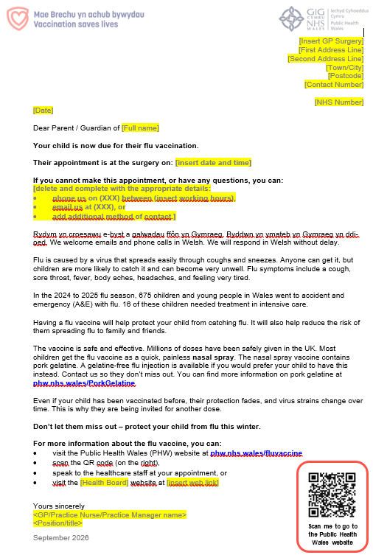
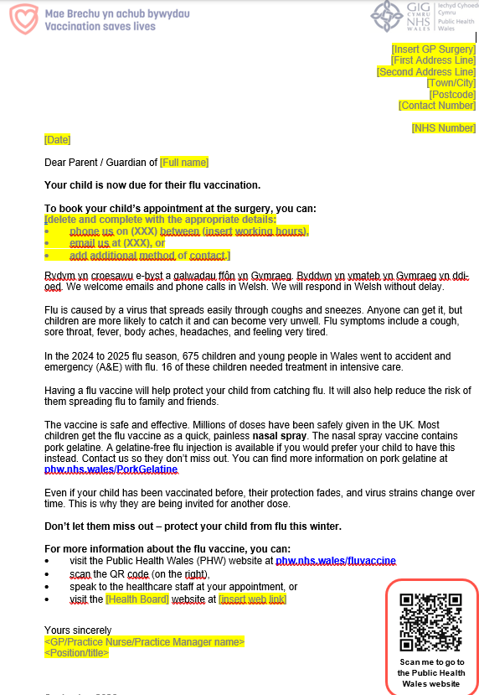
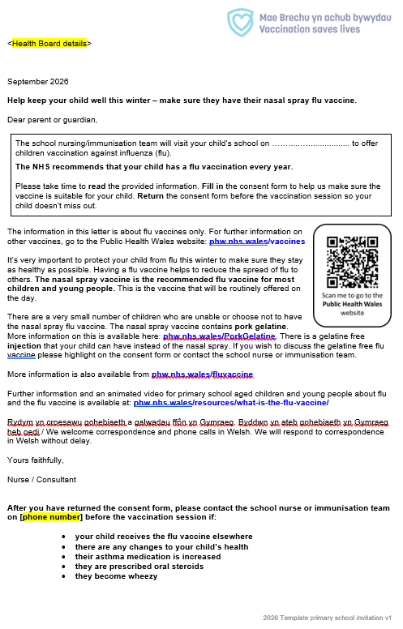
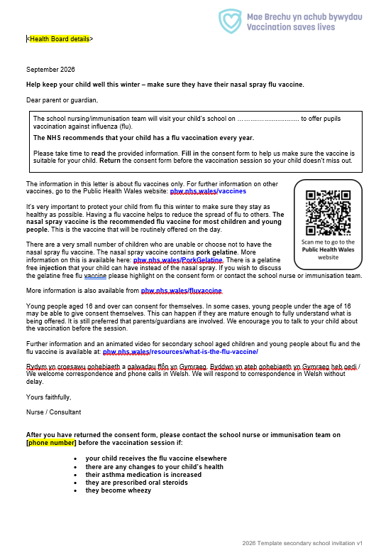
School Flu template invitation letters
A range of bilingual template letters are available for download and printing at: Flu vaccination invitation letter templates - Public Health Wales
These include:
2 and 3 year old letter Option 1
2 and 3 year old letter Option 2
Primary school letters​
Secondary school letters​

Slide 10
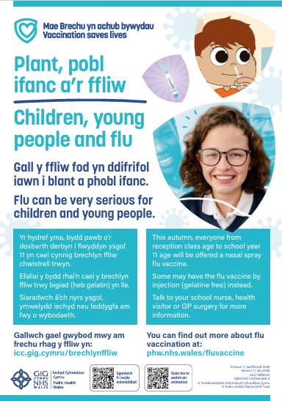


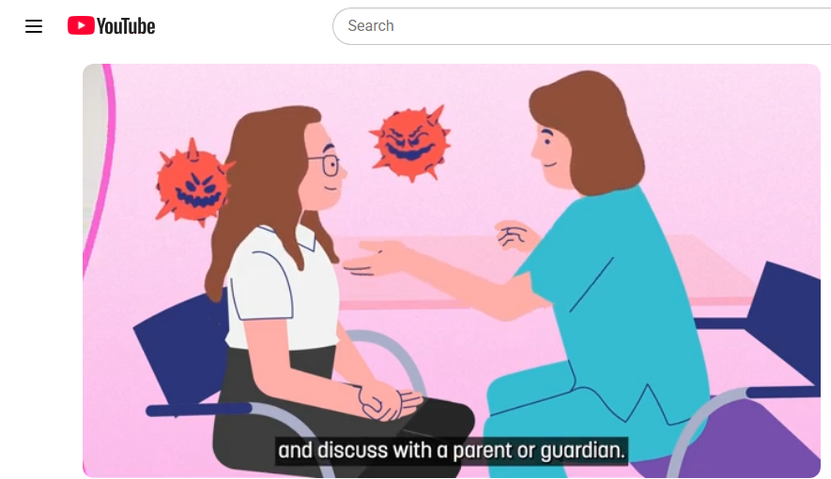
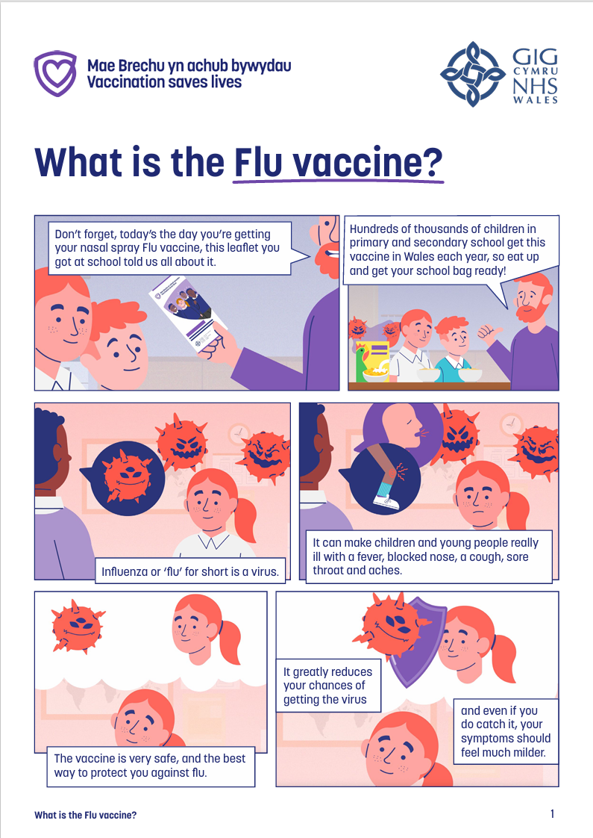
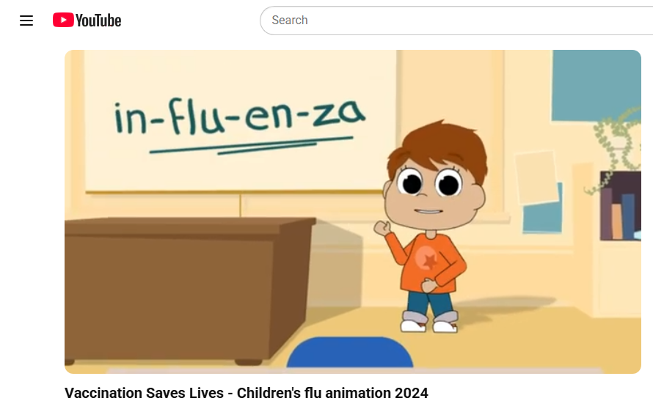
Information for Parents, Children and Young People
Poster
Leaflet
Children’s flu animations and comic
Children, young people and flu poster - Public Health Wales
Protecting children and young people with a nasal spray flu vaccine - Public Health Wales
What is the flu vaccine?

Slide 11
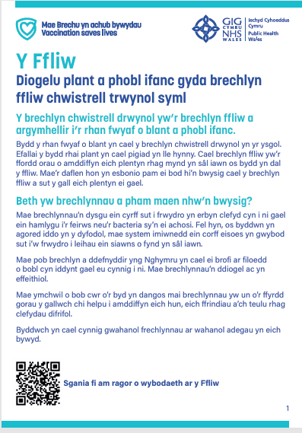

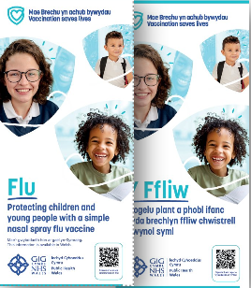
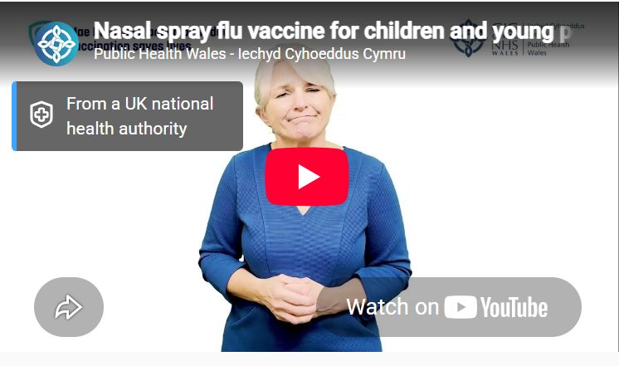
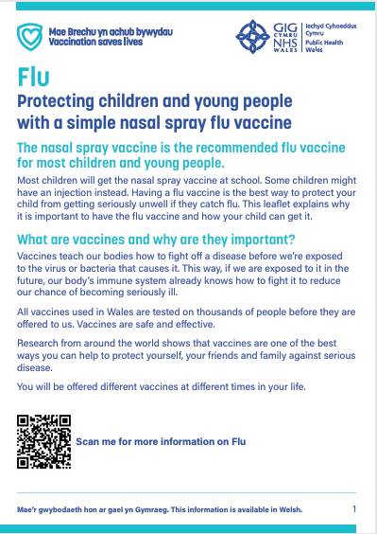

Accessible resources
BSL
Large Print
Easy Read
Audio
Nasal Flu Vaccine
phw.nhs.wales/app/uploads/sites/2/2025/09/Protecting-children-and-young-people-with-a-simple-nasal-spray-flu-vaccine-Audio-File.mp3
Protecting-children-and-young-people-with-a-simple-nasal-spray-flu-vaccine-Large-Print.pdf
Protecting children and young people with a nasal spray flu vaccine - Public Health Wales

Slide 12
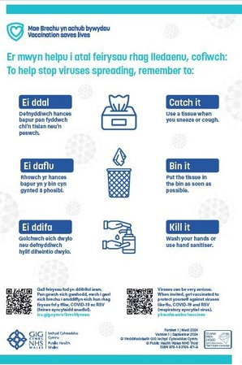
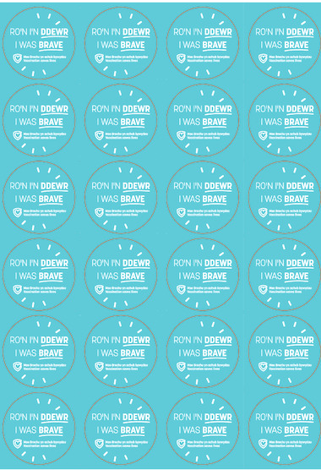
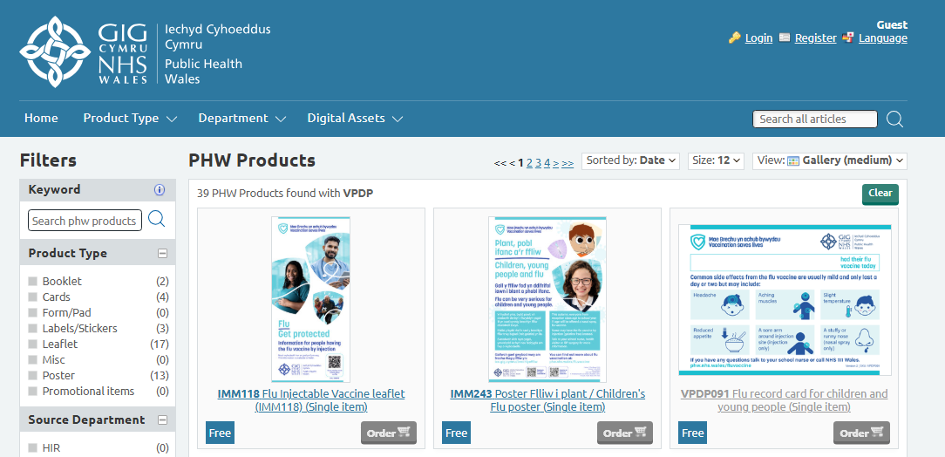
Information for Parents, Children and Young People
Resources available to order for free from PHW Products - Public Health Wales

Slide 13
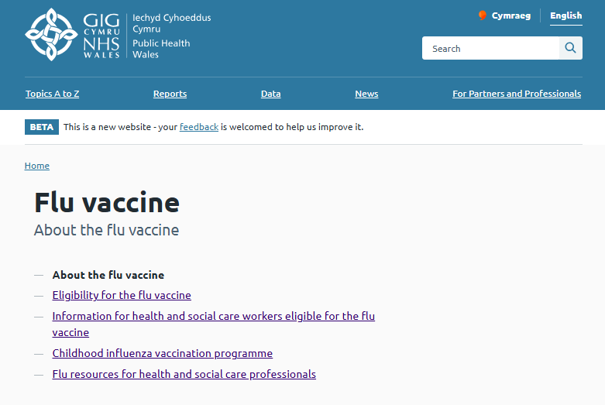
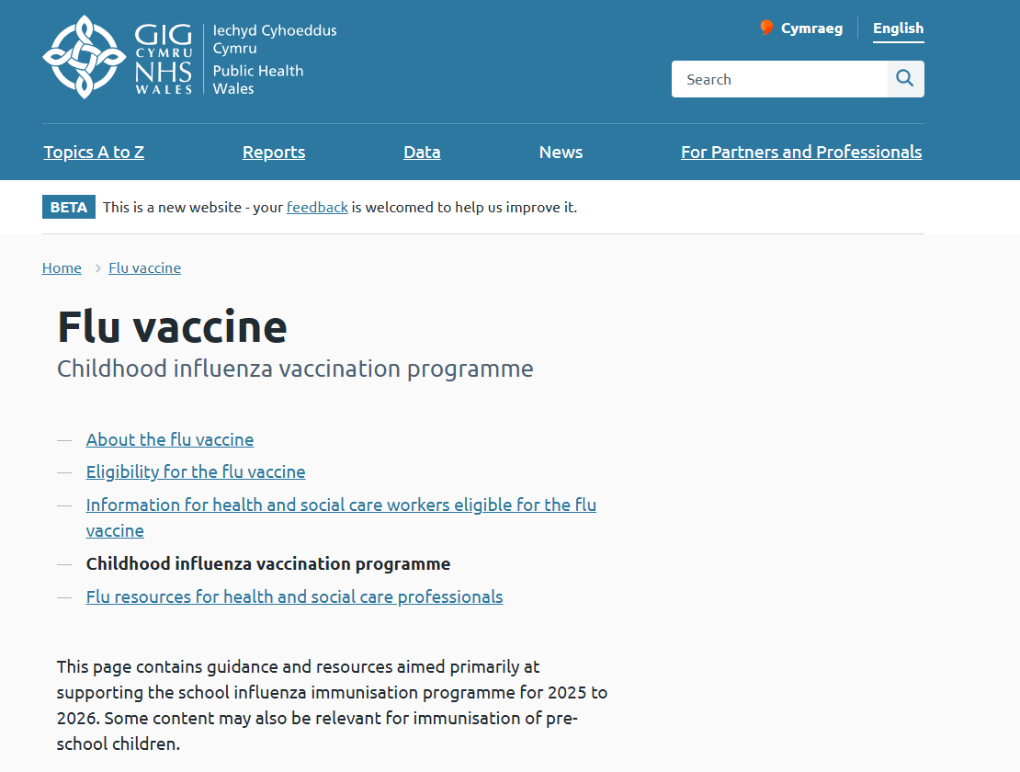
Webpage Information for Parents, Children and Young People
Flu vaccine - Public Health Wales
Childhood influenza vaccination programme - Public Health Wales

Slide 14
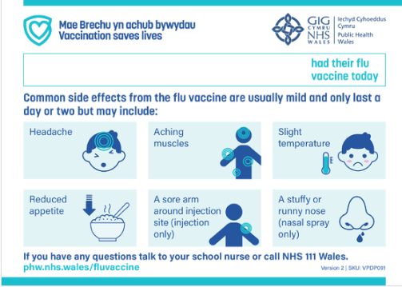
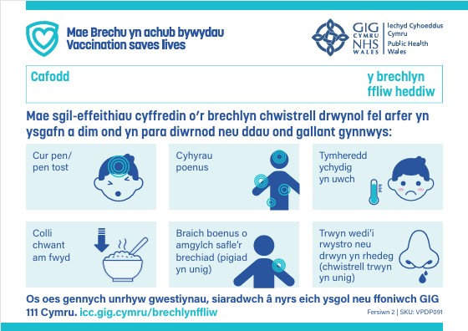
Vaccination Record Card
Flu record card for children and young people - Public Health Wales

Slide 15
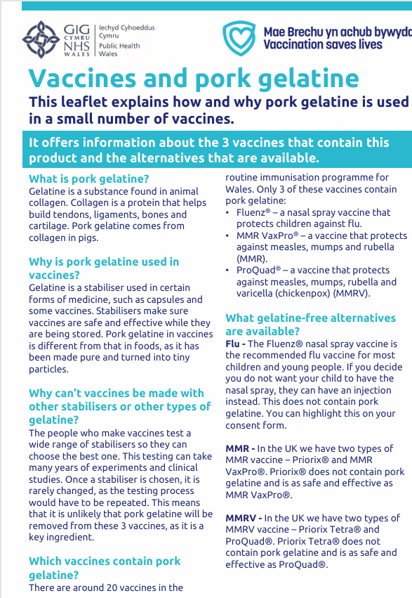
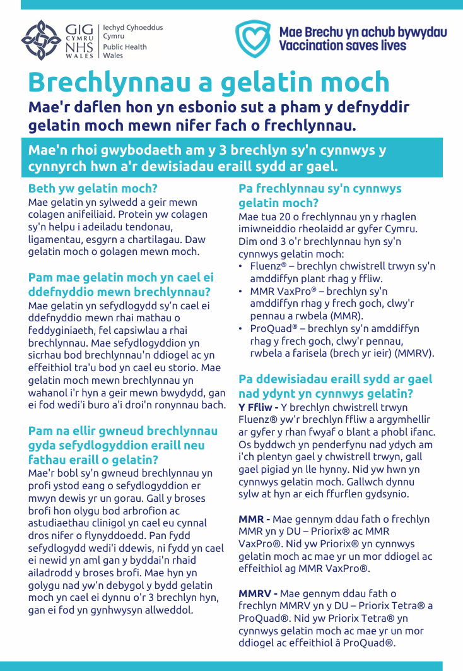
Vaccines and Pork Gelatine
Resources - Public Health Wales
Adnoddau - Iechyd Cyhoeddus Cymru

Slide 16





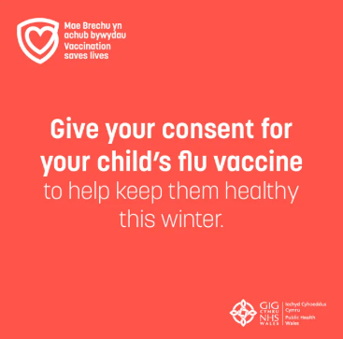
Communications
School- aged children - social media assets - Eng & Cym
School-aged children - Stakeholder toolkits - Eng & Cym
School-aged children - Mp4 videos Eng & Cym

Slide 17
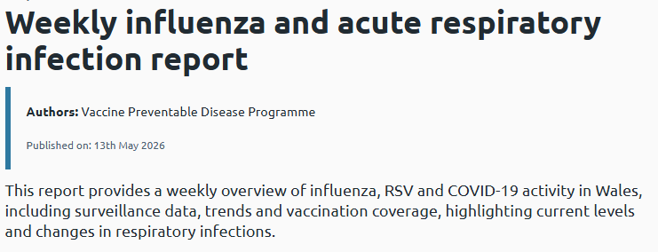
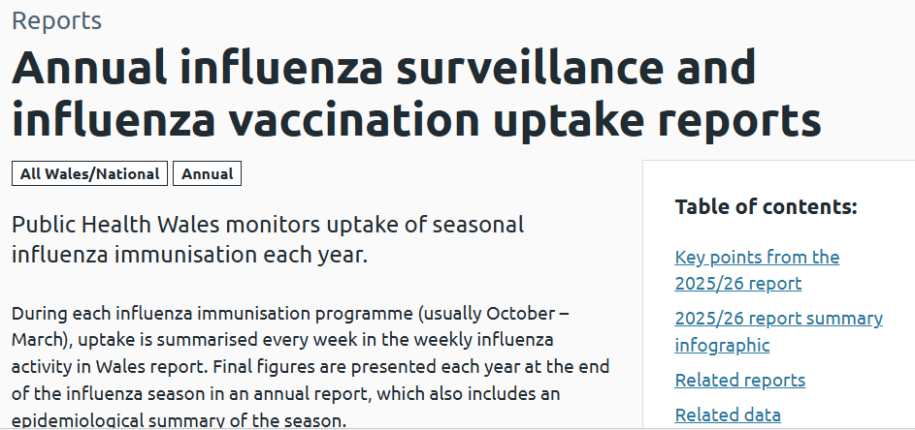
Surveillance
Weekly influenza and acute respiratory infection report - Public Health Wales
Annual influenza surveillance and influenza vaccination uptake reports - Public Health Wales
The following can be accessed by anyone with an NHS email address:
Surveillance of Vaccines, Vaccine Preventable Diseases and Respiratory Infections
Influenza Vaccine Online Reporting (IVOR)

Slide 18
Contacts for queries
In the first instance, please contact your local vaccine health board contact. They should be able to help you.
Vaccine contacts - Public Health Wales
Contact the Vaccine Preventable Disease Programme at phw.vaccines@wales.nhs.uk

