Slide 1
MenB vaccine for young people resources
July 2026
Vaccine Preventable Disease Programme
Public Health Wales

Slide 2
Webpages
MenB vaccine for young people - Public Health Wales
MenB vaccine for young people – information for health professionals - Public Health Wales
Vaccination for students - Public Health Wales

Slide 3
Training
You can view the training slide set here: Meningococcal B (MenB) vaccination programme: urgent time-limited response to recent outbreaks – Training slide set - Public Health Wales
There was a Q&A webinar on the Meningococcal B (MenB) vaccination programme: urgent time-limited response to recent outbreaks
  You can view the slide set from the webinar here: Webinar Q&A - Meningococcal B (MenB) vaccination programme urgent time-limited response to recent outbreaks - slide set [24 June 2026].pptx
  You can view a recording of the webinar here (NHS employees only): Webinar Q&A - Meningococcal B (MenB) vaccination programme - urgent time-limited response to recent outbreaks - recording.mp4

Slide 4
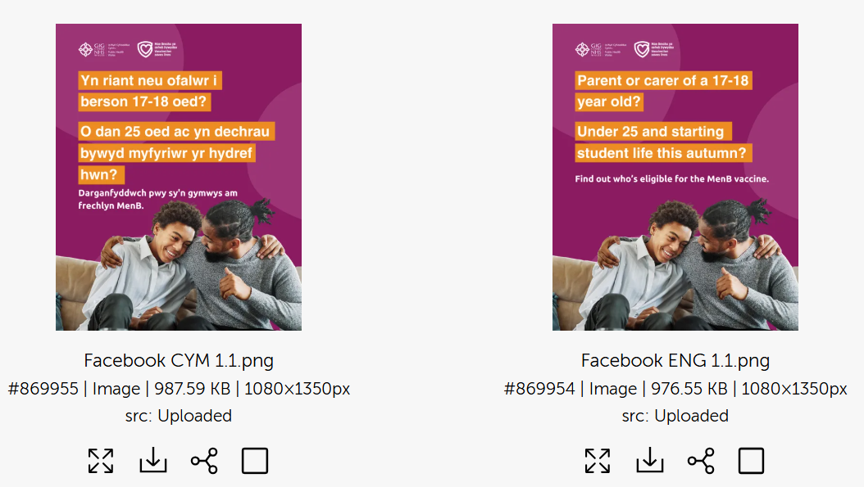
Brandkit
Public health Wales Asset Library – MenB Vaccination Programme -Digital resources (registration is required)
Public Health Wales Asset Library Log In

Slide 5
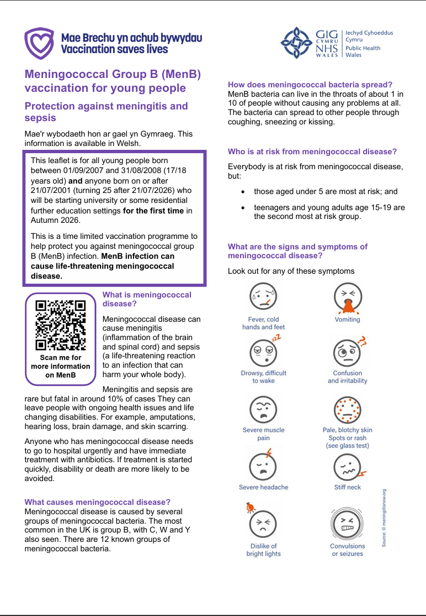
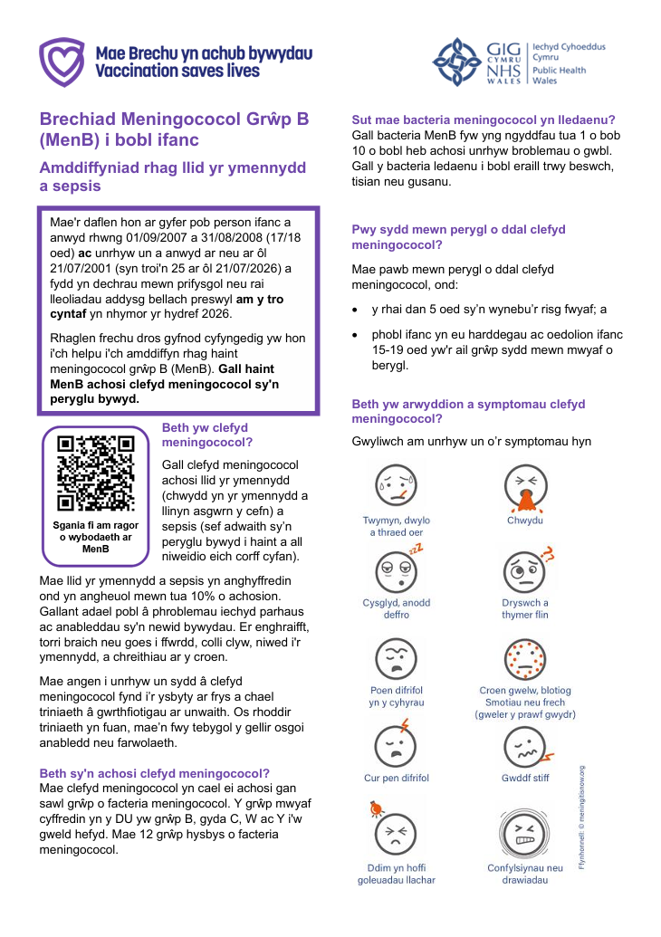
Leaflet
The leaflet has been created in a plain text version to allow for local printing. It is available bilingually.
It is available for viewing on the website here: Meningococcal Group B (MenB) vaccination for young people - Public Health Wales
You can also download the digital version from our web shop here: Taflen Plaen MenB i bobl ifanc | MenB for young people Plain Leaflet - Public Health Wales

Slide 6

Poster
Shortly available to order from our web shop here: MenB Vaccine / Brechlyn MenB poster - Public Health Wales

Slide 7
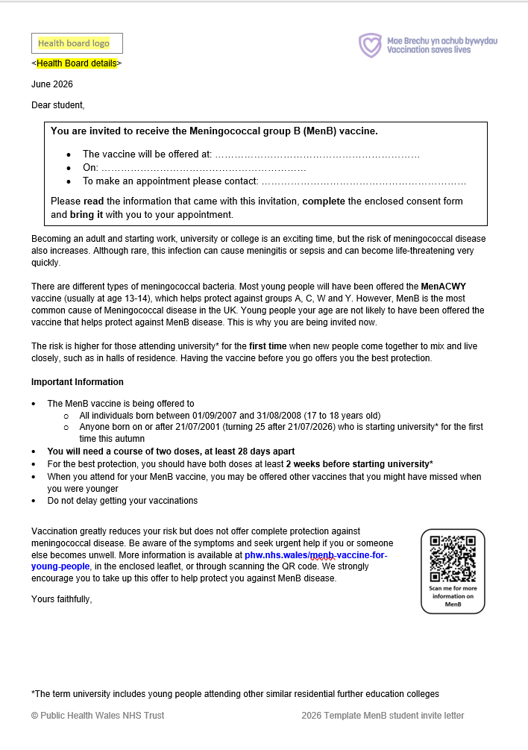
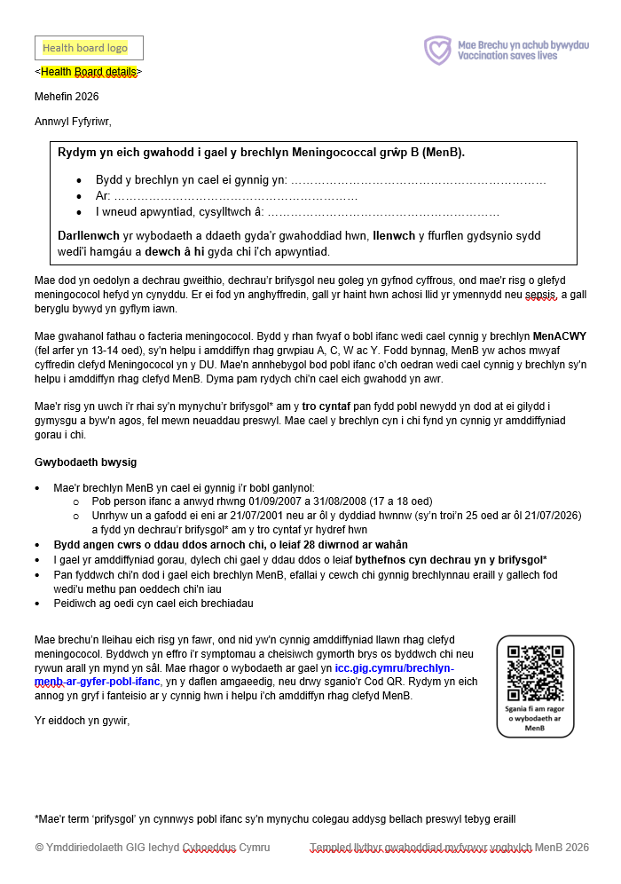
Template invitation letter
Available bilingually here: MenB student invite letter template - Public Health Wales

Slide 8
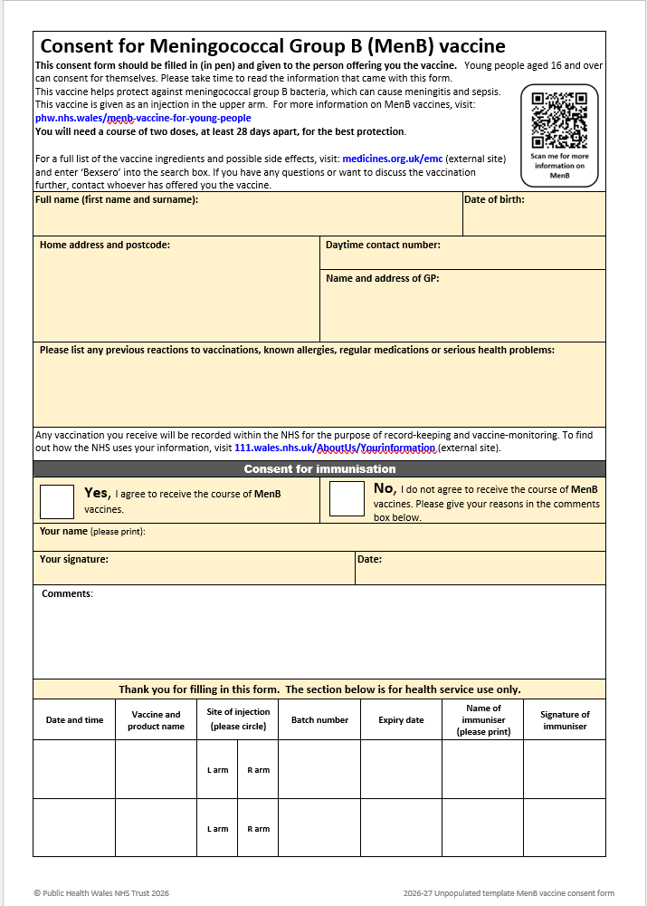
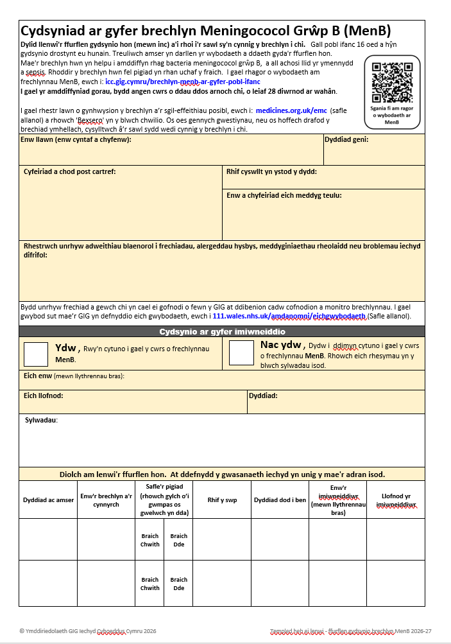
Template consent form
Available bilingually here: MenB vaccine consent form – Unpopulated template - Public Health Wales

Slide 9

Record card
Available to order from Vaccination Record Card - Public Health Wales
These are recommended for individuals to track doses, particularly where vaccinations may be received across different countries.

Slide 10
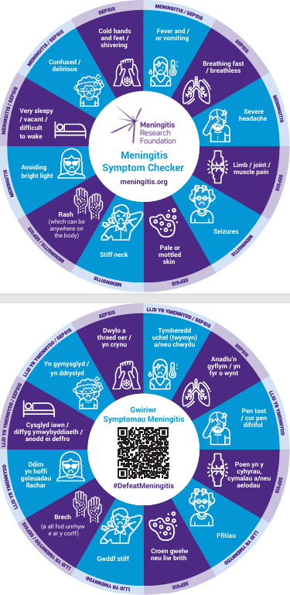
Meningitis & Sepsis Signs and Symptoms checker
Bilingual drinks coasters, available free to order from
Request printed material - Meningitis Research Foundation
(stipulate Bilingual Welsh version on request form)
Further Downloadable materials - Meningitis Research Foundation

Slide 11
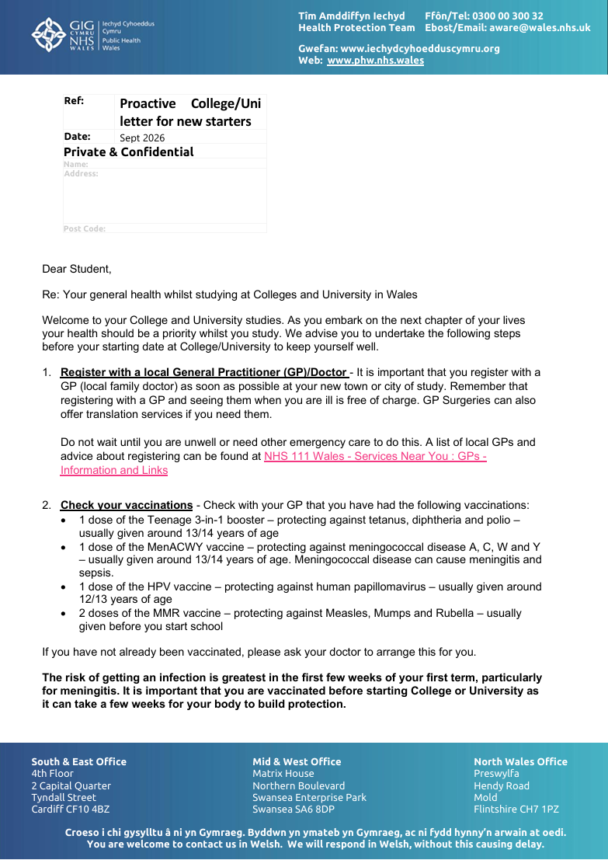
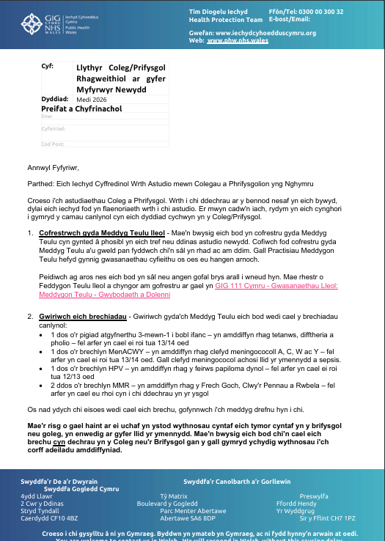
University and college new starters proactive letter
This proactive letter for university and college new starters provides important guidance for new college and university students in Wales.
Welsh version available here: Llythyr rhagweithiol ar gyfer myfyrwyr newydd mewn prifysgolion a cholegau - Iechyd Cyhoeddus Cymru
English version available here: University and college new starters proactive letter - Public Health Wales

Slide 12
Welsh Health Circular
Meningococcal B (MenB) vaccination programme: urgent time-limited response to recent outbreaks (WHC/2026/026) [HTML] | GOV.WALES

Slide 13
PGD
Available from the WMAS website: Patient Group Directions (PGD) - Welsh Medicines Advice Service
Men-B-autumn-offer-PGD-Advisory-Document-v1.0-FINAL.pdf

Slide 14
Information for HCP - UKHSA
MenB time limited vaccination offer: information for healthcare practitioners - GOV.UK

Slide 15
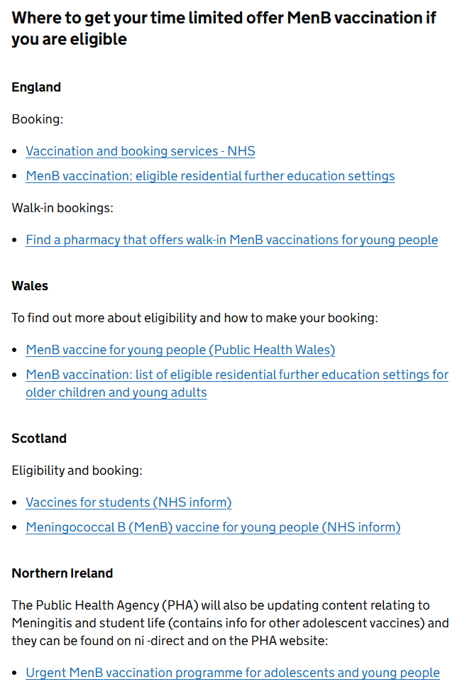
Other UK countries
Information for other UK countries can be found here: Meningococcal B (MenB) time limited vaccination offer - GOV.UK

Slide 16
Contacts for queries
In the first instance, please contact your local vaccine health board contact. They should be able to help you.
Vaccine contacts - Public Health Wales
Contact the Vaccine Preventable Disease Programme at phw.vaccines@wales.nhs.uk
The delivery of this programme is via local health board vaccination teams and not through general practitioners or pharmacies. Therefore, if queries are mistakenly directed to GPs or pharmacies about the programme, individual queries should be signposted to their local health board
39

