Slide 1


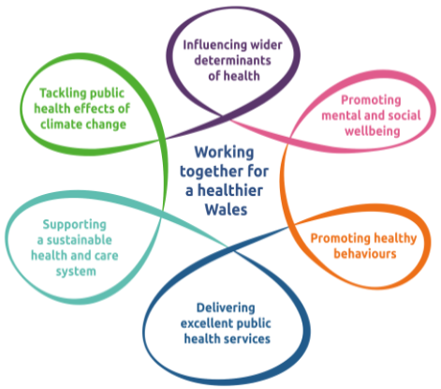
Public Health Wales
Research & Evaluation
Highlights 2024-2025

Slide 2

Contact details
Home
Home
Home
Research & Development Office
Research, Data and Digital
Public Health Wales
2 Capital Quarter
Cardiff, CF10 4BZ
Email the R&D team:
PHW.Research@wales.nhs.uk
Public Health Data, Knowledge and Research - Home (sharepoint.com)
Public Health Wales

Slide 3
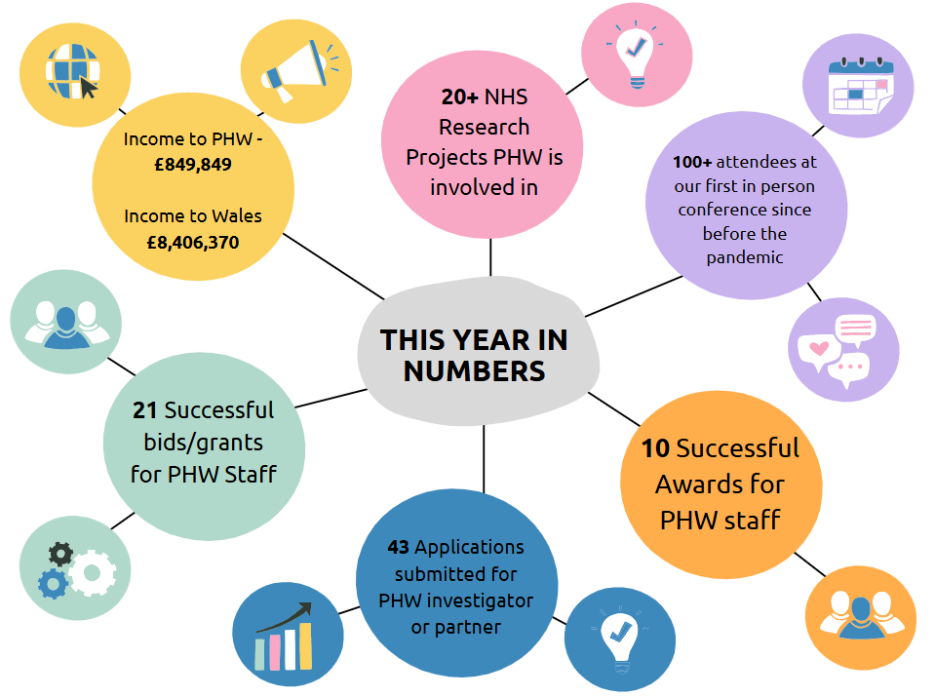

Slide 4

Public Health Wales Research and Evaluation Strategy 2023-2026
Research and Evaluation is a core remit of PHW. Our R&E Strategy sets out our commitment to work with others to lead research and evaluation to improve the health and wellbeing of the people in Wales and to reduce health inequalities.
To make our plan work, we will:
  Build a culture of research and evaluation
  Improve the way we manage and support research and evaluation
  Work together with others and share our research and evaluation findings with everyone
  Ensure that partners, stakeholders and the public are included in our research and evaluation
We will enable the delivery of our strategy through focusing on conducting research and evaluation that is rigorous, meaningful, and addresses gaps in our knowledge to improve health.

Slide 5
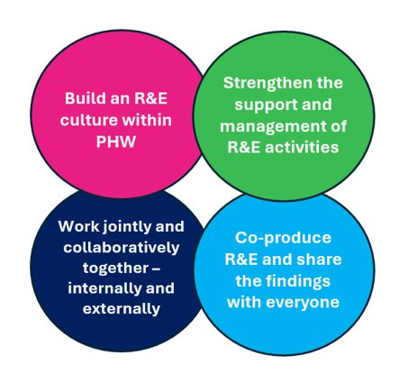
Public Health Wales Areas of Research and Evaluation Interest
We have published our Areas of Research and Evaluation (R&E) Interest which lists the research questions we are interested in learning more about in relation to our six strategic priorities. This is to enable researchers, funders and collaborators to understand our priorities and focus their efforts to make the biggest impact.
Why Collaborate With Us?
To support partnerships and collaborations with the research community we have a number of research assets, programmes and strengths which are outlined in our R&E Strategy and long-term strategy, as well as cross-cutting and enabling areas helping to deliver work within PHW.
We are keen to discuss and engage with stakeholders including researchers and funders to draw on a wide range of strengths and expertise to address these questions. Please contact the R&E Office for more details.
These questions are updated on an annual basis.

Slide 6

Undertaking research with impact
Our staff continue to deliver high quality and innovative research which spans many disciplines in an increasingly competitive funding market.
This has demonstrable impact on population health, policy and practice at national and international level.
The diversity of activity undertaken is reflected in this report.
Public Health Wales

Slide 7

NHS Studies snapshot
The third study of Infectious Intestinal Disease in the UK (IID3 study)
IRAS: 314268 | PHW Lead: Rachel Chalmers Timeline: May 2023 – Sept 2026
Children and Young People’s experience of seeking mental health support in Wales
IRAS: 324375 | PHW Lead: Diana Bright Timeline: Feb 2023 – Mar 2025
HOUSTON – Impact of long-term antibiotic use on HOUSehold TransmissiON of bacteria
IRAS: 308815 | PHW Lead: Mandy Wootton Timeline: Dec 2023 – Oct 2024
Development of Pathways for the Diagnosis and management of Latent Tuberculosis Infection in Wales
IRAS: 321836 | PHW Lead: Tamas Barry Timeline: Mar 2024 – Jun 2026
Exploring the perspectives of individuals using outreach services to identify cirrhosis: A qualitative study
IRAS: 344995 | PHW Lead: Michelle Hughes Timeline: Jan 2025 – Mar 2025
Understanding the barriers and facilitators to engagement with Diabetes services to improve outcomes and prevent complications from Type 2 Diabetes Mellitus (T2DM) among adults living with T2DM in Wales: a qualitative study
IRAS: 353106 | PHW Lead: Esther Mugweni Timeline: Jan 2025 – Jul 2025
The CONNECT Study: Understanding the Impact of Remote Consultations in Sexual and Reproductive Health Services on Health Inequalities
IRAS: 324066 | PHW Lead: Zoe Couzens Timeline: Dec 2023 – Jan 2025
Future strategic aims and objectives

Slide 8
Research Highlights

Slide 9
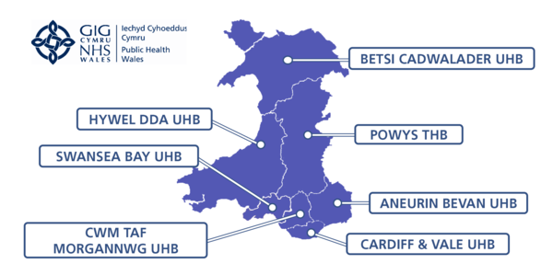
Lead site for the One site Wales study COLOSPECT
PHW PI Steve Court, Head of Programme BSW and the PHW Research & Development Team.
Outline of key projects in Public Health Wales
COLOSPECT is a groundbreaking study exploring how a simple blood test could enhance current screening methods. Already, over 1,200 participants have signed up, with the research sponsored by Swansea Bay University Health Board and funded by Cancer Research Wales.
Public Health Wales (PHW) is proud to be the lead site for this study, continuing its commitment to advancing research across Wales. PHW also champions the One Site Wales model—an approach that proved crucial during the pandemic, when PHW led the setup of the national vaccine hub. Now, it’s driving better access to research, enabling more questions to be answered, faster.
The One Wales model ensures Health and Care Research Wales (HCRW) maintains full oversight of studies from launch to delivery—boosting collaboration, efficiency, and impact across the nation.

Slide 10

Better outcomes for vulnerable populations through linked data research (BOLD)
Outline of key projects in Public Health Wales
BOLD is a HM Treasury funded, cross-governmental programme (2021-2025) designed to demonstrate how people with complex needs can be better supported by linking and improving the government data held on them in a safe and secure way.
A series of Data Insights reports have been published by Public Health Wales (PHW) as part of the Better Outcomes Through Linked Data (BOLD) programme. The BOLD programme aimed to link administrative datasets to bring new insights to inform policy and transform services for vulnerable individuals and people with complex needs.
The BOLD Wales research team, involving PHW, SAIL Databank and ADR Wales, developed an ambitious and cross-cutting substance misuse research programme, adopting a life course approach and covering four key areas for policy and service improvement:
Intergenerational substance use
Prevention and early engagement to reduce escalation
Reducing reoffending
Substance misuse treatment effectiveness

Slide 11
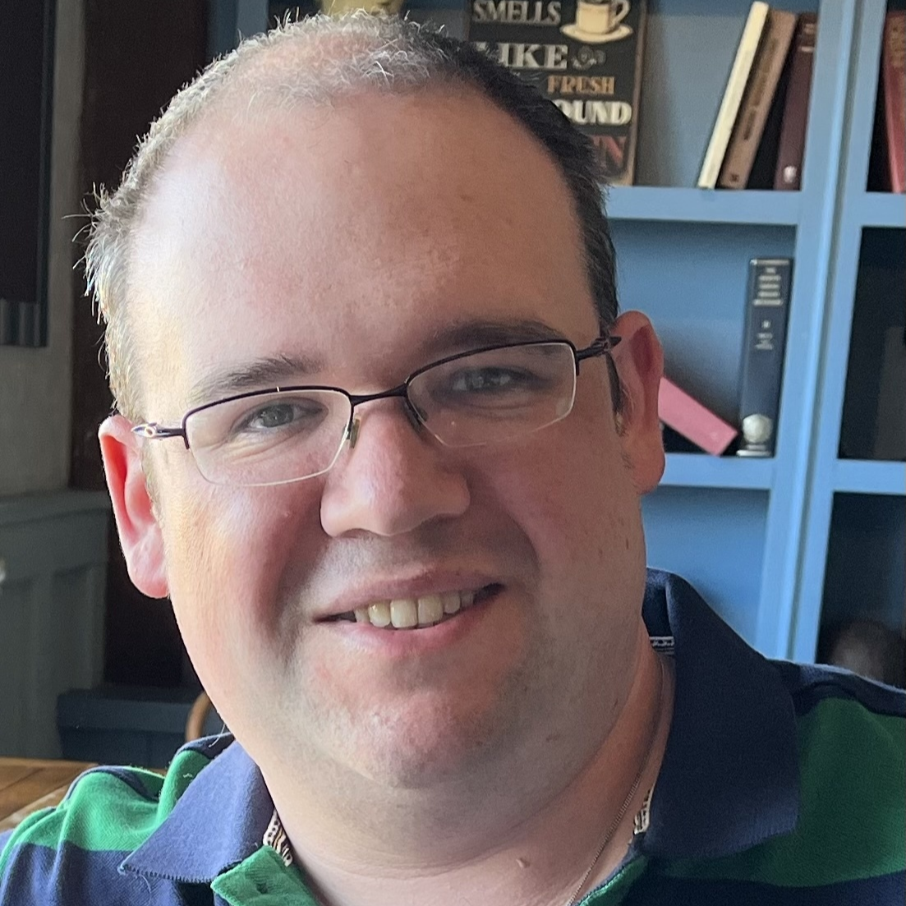

ISO in a Box: Genomics Accreditation Framework
Outline of key projects in Public Health Wales
Led by Professor Tom Connor from the PHW Genomics team, the "ISO in a Box" project developed a framework to enable the creation of genomics-based services with ISO 15189 and ISO 17025 accreditation worldwide.
Funded by the Wellcome Trust, this project brought £306,987 to PHW.
Professor Tom Connor, Head of Public Health Genomics at Public Health Wales, recently visited West Africa to share his specialist knowledge and insight with scientists there. On the visit, he said: "Wales has established itself as a global leader in the field of pathogen genomics and it was a privilege to be able share our knowledge and insight with African colleagues.
“The sessions were highly productive, and despite the challenges posed by reduced aid funding, we remain optimistic about a future where genomics plays a key role in reducing the burden of infectious diseases in Africa. To build on the momentum from this visit, further meetings and activities are already being planned.”

Slide 12
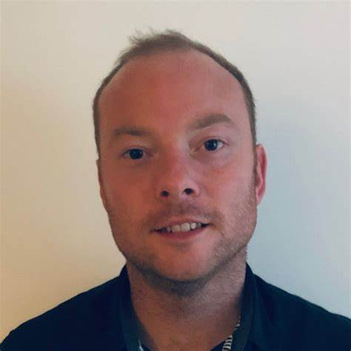
Successful Award Applications for Public Health Wales staff
Dr Benjamin Gray, Principal Researcher for the Communicable Disease Inclusion Health Programme
Dr Benjamin Gray has been awarded research funding to undertake a two-year project looking at reducing substance use-related harm among people in prisons and on probation.
The programme received £256,840 funding from Health Care Research Wales to explore ‘Reducing substance use-related harm among people in prison and on their release: A qualitative study’.
The aim of the study is to find out - how can substance-related deaths and harm be reduced among people in prison and on their release?
The research will include semi-structured interviews with 60 participants, with at least one participant from each of the 25 probation offices situated in Wales. The findings from the two-year project will be widely disseminated through reports and training materials, which will be presented in four workshops across Wales.
The research funding has also been instrumental in bringing together a new research partnership between Public Health Wales, University of South Wales, Kaleidoscope and G4S.
Dr Benjamin Gray, reflecting on the award and the research says;
”We are really delighted to receive the research funding to undertake this important piece of work. There was a real positive atmosphere among the Research Advisory Group, and an appetite for change so I am really excited to see how this research develops over the next two years."

Slide 13


Bowel Screening Interventions to Reduce DNA Rates
Outline of key projects in Public Health Wales
Steven Court, Head of Programme for Bowel Screening Wales, and his team secured £198,796 from Cancer Research UK (CRUK).
The project is primarily focused on the exploration of interventions for reducing DNA (Did Not Attend) rates in screening colonoscopy amongst participants who receive a positive FIT result. The innovation focuses on enhancing communication strategies to achieve this.
This funding also supported the creation of a two new patient navigator roles within Bowel Screening Wales.

Slide 14

EDICTS-M Ethical Determination In sequenCing diagnosTics developmentS-Metagenomics
Outline of key projects in Public Health Wales
This laboratory-based protocol leverages surplus or discarded clinical samples collected during routine care to support diagnostic innovation. It is strictly non-commercial and designed to:
· Develop novel assays for pathogen identification.
· Optimise existing agnostic assays using anonymised, surplus clinical material.
Lewis White, Clinical Scientist at PHW Microbiology, is collaborating with Cardiff University.
Nucleic acid extracts from patient samples — exceeding standard diagnostic needs — will be transferred to Cardiff University. These extracts will be used for:
Library construction
Nanopore metagenomic sequencing
This partnership aims to enhance diagnostic capabilities through advanced sequencing and assay development

Slide 15




Consolidating a digital exclusion typology and stakeholder engagement exercise to inform future evaluation of digital exclusion initiatives
Outline of key projects in Public Health Wales
Dr Diana Bright and team successfully secured £153,275.58 from NIHR Public Health Research (PHR) Programme to perform an evidence synthesis on the topic of ‘Consolidating a digital exclusion typology and stakeholder engagement exercise to inform future evaluation of digital exclusion initiatives.
The project involving PPI co-applicants will be a collaboration with the University of Oxford, Cwmpas, Newydd Housing Association and Displaced People in Action.
“Our digital exclusion typology will guide the evaluation of key initiatives –providing the evidence needed to identify and implement the most effective measures to mitigate digital exclusion and reduce health inequalities” Dr Diana Bright.

Slide 16
A Mixed-Methods Evaluation of a Cross-Sectoral Partnership to Promote Mental Wellbeing in Wales (2022-2027) p.1
Dr Jack Walklett, Dr Alex Christensen, Dr Charlotte Grey, Dr Esther Mugweni, Emily van de Venter, Carol Owen & Dr Alisha Davies
Supporting our priorities - Promoting mental and social well-being
What was the challenge?
Good mental wellbeing impacts upon both physical and mental health. Hapus is a population-level, multi-faceted approach to promoting mental wellbeing, being implemented in Wales from 2022-27 by Public Health Wales (PHW). One of the Hapus workstreams aims to establish a cross-sectoral strategic partnership to facilitate collective action across national partners to promote and protect the population’s mental wellbeing. This presentation details the first data collection points of a long-term evaluation of the partnership.
What was done?
In-depth interviews were conducted with representatives of the strategic partners to explore their organisation’s role in promoting mental wellbeing in Wales and the impact of joining the partnership. Eight of the twelve organisations engaged in the partnership since 2022 were interviewed. Interviews were supplemented by a survey of strategic partner staff to further explore these areas and assess the value of the partnership, using the Partnership Analysis Tool. Representatives from all twelve organisations were invited to complete the online survey.
Public Health Wales

Slide 17
Supporting our priorities - Influencing the wider determinants of health
A Mixed-Methods Evaluation of a Cross-Sectoral Partnership to Promote Mental Wellbeing in Wales (2022-2027) p.2
Dr Jack Walklett, Dr Alex Christensen, Dr Charlotte Grey, Dr Esther Mugweni, Emily van de Venter, Carol Owen & Dr Alisha Davies
What was the outcome?
Data is currently being analysed. Early themes indicate that the partnership has improved members’ understanding of mental wellbeing. Hapus has facilitated new connections between partners and supported them to refine, sustain and widen the reach of mental wellbeing-promoting activities. Partners have suggested how PHW can best support them moving forward.
To date, the partnership has been beneficial to most organisations involved. In its early stage, Hapus has led to a shared understanding of mental wellbeing and facilitated and strengthened partnerships across sectors. A key role for PHW will be the dissemination of evidence around mental wellbeing-promoting activities and defining partner roles in Hapus. With cross-sectoral action being a potential approach to influencing complex public health challenges, the findings from this evaluation may inform practitioners in their efforts to facilitate partnership working in mental wellbeing and other areas of public health.

Slide 18
Supporting our priorities - Influencing the wider determinants of health
The Networked Data Lab Wales: Impact of hospital to Healthier Homes on health study protocol. (2024) p1.
Jerlyn Peh, Laura Bentley, Manar AlShams, Giles Greene, Ashley Akbari, Claire Newman, Owen Davies, Emma Taylor-Collins, Walid Chehtane, Gareth john, Joanna Dundon & Alisha Davies
What was the challenge?
In line with the aims of A Healthier Wales, services should endeavour to support individuals to live safely and independently at home through a collaborative approach. Community-based services are encouraged to support individuals at home to reduce hospital pressure. Care and Repair Cymru (C&RC), a primary provider of private home adaptations in Wales, plays a vital role in this effort. Their national Hospital to Healthier Homes programme (H2HH) facilitates hospital discharges for individuals aged 60 and over to a safe home environment by adding home adaptations to enable patients to live independently and safely after discharge.
What was done?
This is a longitudinal observational cohort study of individuals who received C&RC’s H2HH program between January 2019 and March 2023. This population will be linked to demographic, primary care and secondary care data sources within the Secure Anonymised Information Linkage (SAIL) Databank to address the following objectives:
Describe trends in demographics, health and housing quality.
Describe the number of new and repeat C&RC clients introduced through H2HH over time.
Describe the trends in reasons for hospital admissions resulting in any H2HH support overall and by demographics, geographical area, health and housing factors.
Describe the difference in the proportion of hospital admissions with an emergency hospital readmission (for any reason and falls) within 30 days of discharge between the study population and the matched cohort.
An age, sex, local authority and frailty-matched cohort with similar admission dates will be created for comparison.
Public Health Wales

Slide 19
The Networked Data Lab Wales: Impact of hospital to Healthier Homes on health study protocol. (2024) p2.
Jerlyn Peh, Laura Bentley, Manar AlShams, Giles Greene, Ashley Akbari, Claire Newman, Owen Davies, Emma Taylor-Collins, Walid Chehtane, Gareth john, Joanna Dundon & Alisha Davies
Supporting our priorities - Influencing the wider determinants of health
What was the outcome?
We will be reporting proportions of the study population by age, sex, deprivation quintile, rurality, number of long-term conditions, frailty and housing quality. Where data quantity allows, changes in these characteristics over time will also be reported. Reasons for hospital admissions resulting in H2HH support will be categorised and reported as counts and proportions, both overall and trends over time. Differences in the proportion of hospital readmissions due to falls and other reasons between H2HH recipients and controls will also be reported within 30 days after discharge.
This research will provide valuable insights to local and national stakeholders interested in understanding which health and social care interventions are effective, especially as funding for these services is a limited resource. Our analysis will demonstrate the demographic distribution, health service use, and housing quality of C&RC clients who received support from the H2HH program over time. Additionally, our analysis will assess if H2HH has had any impact on health and health service outcomes as evidence of its impact.

Slide 20
Supporting our priorities - Influencing the wider determinants of health
Health and Well-being in schools (2024)
Rochelle Embling, Sara Jayne Long, Prof. Graham Moore
What was the challenge?
Curriculum for Wales represents a national reform of the Welsh education system, placing a renewed and unprecedented focus on health and wellbeing for children and young people. Implementation requires a systems-based and data and evidence informed approach, where schools are encouraged to understand the needs of pupils and staff before embarking on health and wellbeing interventions. This qualitative study aimed to explore secondary school staff perceptions of, and preparation for, delivering the Curriculum for Wales.
What was done?
Interviews were conducted in secondary schools, with staff members who held a leading role in the implementation of the reform (e.g., headteachers, deputy headteachers, health and wellbeing leads). Thematic analysis was completed using an inductive and partly deductive approach to summarising data, guided by an existing framework of thematic areas summarising the wider perspectives of senior stakeholders in the Welsh education system (e.g., at policy-level).
What was the outcome?
Five preliminary themes were developed. Interviewees discussed ‘traditional’ pressures on schools to maintain high academic performance, which was sometimes at odds with the more ‘holistic' view of life-long pupil development that the reform encouraged. A ‘pupil-centred’ approach to learning was often at the centre of operationalisation for the reform, whilst the ability of schools to remain practical and sustain intervention in the longer-term was key to expectations for success. Where professional culture change and ‘top-down’ governance were perceived to be leading factors at a national-level, support for partnership working was most important at school-level.
These results suggest a need to support practice of schools across multiple levels of the system, to align views of senior stakeholders and practitioner staff, and equip schools with the appropriate resources to respond to a changing environment.
Public Health Wales

Slide 21
Supporting our priorities - Promoting healthy behaviours
Secondary school children and young people's perceptions of vaping and nicotine dependence Insights from a qualitative focus group study
Rochelle Embling, Lorna Bennett, Niamh McHugh, Anna Kolosowska & Chris Emmerson
What was the challenge?
Implications
Some key implications of this study include:
Further supported evidence of a current vaping culture among young people that highlights potential drivers of use (peer influence among older age groups, exposure and access to devices)
What was done?
Documents experiences of high nicotine use and dependency among young people suggesting the need to provide stronger intervention for those already using vape
  Emotional attachment to devices
  A Lack of clarity communicating evidence of vaping harms to children
As a result of feeding this work back to the IRG, we identified the need to collect additional views from other stakeholders, including parents.
What was the outcome?
Next steps for Public Health Wales…
The findings of this study have been disseminated within the Incident Response Group and aim to support them develop recommendations for how different stakeholders may respond or intervene.
  This work will inform the IRGs recommendations regarding vaping that will be fed to policy makers within Welsh Government
Public Health Wales

Slide 22
COVID-19 Personal Protective Behaviors during Large Social Events: The Value of Behavioral Observations (2024)
Ashley Gould, Lesley Lewis, Lowri Evans, Leanne Greening, Holly Howe-Davies, Jonathan West, Chris Roberts & John A Parkinson
Supporting our priorities - Supporting the development of a sustainable health and care system focused on prevention and early intervention
What was the challenge?
Within the context of reopening society in the summer of 2021, as the UK moved away from ‘lockdowns’, the Government of Wales piloted the return of organized ‘mass gatherings’ of people at a number of test events. The current study reports behavioral observations that were made at two of the test events to inform this process. The researchers were particularly interested in four key factors: how (1) context within a venue, (2) environmental design, (3) staffing and social norms, and (4) time across an event, affected the personal protective behaviors of social distancing and face-covering use.
What was done?
Data collection was undertaken by trained observers. Adherence to protective behaviors was generally high, but there is clear evidence that these behaviors were shaped in a systematic way by the environment, situational cues, and the passage of time during the events. Some instances of large-scale non-adherence to personal protective behaviors were documented. An analysis within a dual-process framework suggests ways to understand and respond to supporting target health behaviors in groups of people where intervention is deemed valuable, such as in complex or ambiguous contexts.
What was the outcome?
This is one of the first studies to include a ‘true’ behavioral measure in understanding human responses to COVID-19. It demonstrates that behavioral observations can add precision and granularity to understanding human behaviour in complex real-world contexts. Given the significant physical and mental health burden created acutely and chronically by COVID-19, this work has implications for how governments and organizations support target populations in other complex challenges facing us today, such as in sustainability, and healthy lifestyle behaviors. An individual’s intentions are not always matched by their actions, and so the findings support a balanced liberal paternalistic approach where system-level changes support appropriate individual-level decisions to engender collective responsibility and action.
Public Health Wales

Slide 23
“I can't be dealing with this brain fog”: A workplace focus group study investigating factors underpinning the menopausal experience for NHS staff (2024) p.1
Gemma Hobson, Nicola Dennis
Supporting our priorities - Promoting mental and social well-being
What was the challenge?
Multiple studies highlight that individuals undergoing menopause are not receiving sufficient support at work. An improved menopausal experience in the workplace has been found to be associated with increased job satisfaction, increased economic participation and reduced absenteeism. This work was undertaken to explore the impact of menopause on the working lives of NHS staff working in Wales, with specific emphasis on their experience of menopausal symptoms and management strategies in the workplace.
What was done?
This was a qualitative study using semi-structured focus groups and thematic analysis. 14 women working in the NHS in Wales attended four focus groups, lasting up to 1.5 h. Stem questions focused on participants' positive and negative experiences in the workplace, and their receipt of support. Transcripts were analysed using the framework approach.
What was the outcome?
Results
Three major themes were identified: experiences of menopausal symptoms and symptom management, the impact of menopause on work and the impact of work on the menopause. Menopause symptom experience in the workplace was multifaceted and varied, depending on factors such as ongoing or past symptom experience, expectations, social support and effectiveness of management strategies. Inconsistent information was highlighted as a reason why some participants felt confused both about the symptoms that they could attribute to the menopause and the management strategies available to them.
Public Health Wales

Slide 24
“I can't be dealing with this brain fog”: A workplace focus group study investigating factors underpinning the menopausal experience for NHS staff (2024) p.2
Gemma Hobson, Nicola Dennis
Supporting our priorities - Promoting mental and social well-being
A variety of symptom management strategies had been used by participants, including hormone replacement therapy, flexible working hours, working from home, changes to uniform, peer support and lifestyle changes, with varying levels of success. Some women were reticent to ask for support at work even though they felt the workplace response was likely to be supportive. Almost all the women felt that they had to persuade their GP to prescribe HRT and felt that their doctors were too reticent in prescribing this treatment.
Conclusions
Employers have a key role in supporting their staff experiencing menopausal symptoms, and such support has the potential to reduce sickness absence and boost retention. Based on the findings we recommend creating an open culture to break down taboos; protected time for peer support around shared experiences and effective symptom management techniques; and maximising the impact of non-menopause-specific policies such as flexible working to help all staff manage fatigue and become more productive in their roles.

Slide 25
Supporting our priorities - Supporting the development of a sustainable health and care system focused on prevention and early intervention
Identifying the public health needs of a UK probation cohort: a cross-sectional analysis (2024)
O Williams, B. J. Gray, S. E. Perrett
What was the challenge?
The health needs of those under probation are likely high, but they have received very little public health attention. Limited evidence exists on the public health needs and interventions to support this cohort.
What was done?
Surveys were completed by 257 people on probation as part of a local health needs assessment. Results were compared with the general population responses from the National Survey for Wales (2021–22).
What was the outcome?
Results
People on probation were 4.2 times more likely to self-report not-good general health (fair, bad or very bad) than the general population (adjusted Odds Ratio [aOR] 4.2, 95% Confidence Intervals [CI] 3.2–5.4). The odds of having a mental health condition were over eight times higher than the general population (aOR 8.8, 95% CI 6.8–11.4). Prevalence of smoking (52%), drug use (60%), attention-deficit hyperactivity disorder (21%), autism (4%) and dyslexia (15%) were all higher than the general population. General Practitioner usage and hospital stays were higher, but dentist or optician usage lower than the general population (P < 0.05). Emergency departments were accessed by 35%, with 9% frequenting them three or more times.
Conclusions
People on probation have poorer self-reported health, higher prevalence of unhealthy behaviours and higher accessing of reactive health services than the general population.
Public Health Wales

Slide 26
Supporting our priorities - Supporting the development of a sustainable health and care system focused on prevention and early intervention
Prevention of oral diseases for the older person (Part 2) (2024) p.1
Rosalyn Davies & Mili Doshi
What was the challenge?
Older adults often experience poorer levels of oral health than younger adults, especially if they have become dependent on a third party to support their daily oral care routine. However, the deterioration of oral health does not need to be a part of the ageing process. Most oral diseases are largely preventable with the daily removal of dental plaque that forms on teeth and dentures, using a fluoride toothpaste, eating a healthy diet and reducing any tobacco consumption. The dental team have a duty of care to ensure that older people receive evidence-based oral health preventative advice tailored to the individual, taking into account individual risk factors that can increase with age. This can include the clinical application of topical fluoride and minimally invasive dentistry.
Older people at an increased risk of poor oral health include those with cognitive conditions, physical impairments and certain medical conditions. Care home residents face particular barriers to attaining a satisfactory standard of oral care which are discussed herein. Good oral health preventative routines must be established early after the diagnosis of progressive chronic conditions and will help to prevent the need for dental intervention later in life when treatment can be more difficult to tolerate. Inclusion of oral health prevention within health policy and legislation is necessary to improve the oral health for older people living in all health and care settings.
What was done?
Adaptations to mouth care products can help older people independently clean their mouths for longer.
Care staff in hospitals and care homes must undertake oral health assessments to assess oral health risk factors and the level of support needed.
A range of behavioural techniques may be needed to provide effective daily mouth care for adults with cognitive conditions to maintain oral health.
Public Health Wales

Slide 27
Prevention of oral diseases for the older person (Part 2) (2024) p.2
Rosalyn Davies & Mili Doshi
Supporting our priorities - Supporting the development of a sustainable health and care system focused on prevention and early intervention
What was the outcome?
Good oral health is linked to general health and wellbeing in older adults. As people age, their oral health risk factors will change, and preventative advice will need to be adapted for the individual. Prevention can be delivered by all dental care professionals and should form part of dental treatment planning. Clinical prevention should include the importance of dietary sugar, regular mouth care and topical fluoride. Older people with multimorbidity, especially those living in care homes or requiring care in their own homes, will face increased barriers in maintaining oral health and accessing routine and urgent dental care. To help address this, health policies for older adults needs to include oral health, including regular oral health care training for carers and appropriate commissioning of dental services.

Slide 28
Validity and timeliness of cancer diagnosis data collected during a prospective cohort study and reported by the English and Welsh cancer registries: a retrospective, comparative analysis (2024) p.1
Prof Dyfed Huws FFPH, Dwan Allan MSc, Stephanie Smits PhD
Supporting our priorities - Delivering excellent public health services to protect the public and maximise population health outcomes
What was the challenge?
Cancer places a high burden on society and health-care systems. Cancer research requires high-quality data, which is resource-intensive to obtain. Using administrative datasets such as cancer registries could improve the efficiency of cancer studies if data were valid and timely. We aimed to compare the validity and timeliness of diagnostic cancer data on-site during the SYMPLIFY study to that obtained from the cancer registries of England and Wales.
What was done?
Cancer data were collected from 5461 participants across 44 hospital sites during a prospective observational study in England and Wales, SYMPLIFY (ISRCTN10226380). Linked cancer data were obtained from Digital Health and Care Wales (DHCW), the Welsh Cancer Intelligence and Surveillance Unit (WCISU), and the English National Cancer Registration Dataset (NCRD) and Rapid Cancer Registration Dataset (RCRD), regularly between April 2022, and September 2023. The primary objectives of the study were to evaluate the validity (via assessment of the proportion of completed data fields and concordance with SYMPLIFY sites), and timeliness of the data in all datasets, for all cancers diagnosed within 9 months of study enrolment. Data fields investigated were cancer site via International Classification of Disease, 10th Revision (ICD-10) code; cancer morphology via International Classification of Diseases for Oncology, 3rd Edition (ICD-O-3) morphology histology code and broad morphological grouping; overall stage; and TNM classification.
Public Health Wales

Slide 29
Validity and timeliness of cancer diagnosis data collected during a prospective cohort study and reported by the English and Welsh cancer registries: a retrospective, comparative analysis (2024) p.2 Prof Dyfed Huws FFPH, Dwan Allan MSc, Stephanie Smits PhD
Supporting our priorities - Delivering excellent public health services to protect the public and maximise population health outcomes
Findings
For data collected between April 2022, and September 2023, completeness at the last data cut available for each dataset ranged from 84% to 100% for ICD-O-3 morphology, from 43% to 100% for overall stage, and from 74% to 83% for TNM stage. The concordance between SYMPLIFY data and NCRD was 96% (95% CI 92–98) for ICD-10, 60% (53–66) for ICD-O-3 morphology, 83% (78–88) for ICD-O-3 broad morphology groupings, 73% (67–78) for stage, and 51% (44–59) for TNM; and with WCISU was 89% (95% CI 81–94) for ICD-10, 63% (53–73) for ICD-O-3 morphology, 80% (70–87) for ICD-O-3 broad morphology groupings, 83% (74–90) for overall stage, and 49% (38–61) for TNM stage. Concordance between SYMPLIFY and RCRD was 95% (95% CI 92–98) for ICD-10, 67% (60–74) for ICD-O-3 morphology, 85% (79–90) for ICD-O-3 broad morphology groupings, and 73% (65–80) for overall stage; and between SYMPLIFY and DHCW was 96% (91–99) for ICD-10, 74% (64–83) for ICD-O-3 morphology, 84% (75–91) for ICD-O-3 broad morphology groupings, and 87% (74–95) for stage. The SYMPLIFY dataset reached completion at 12 months post-enrolment in November 2022, compared with 13 months for NCRD in December 2023. RCRD and DHCW reached completion at 13 months and 15 months post-enrolment, in December 2022, and February 2023, respectively.
What was the outcome?
We report similar completeness of data fields, concordance, and timeliness between on-site and centrally collected cancer outcomes data. Our findings suggest that central registry data can help alleviate the resource burden in clinical trials and improve cancer research. Cancer registries might need additional resources to provide data for registry-based trials at scale.

Slide 30
Supporting the next generation of public health researchers

Slide 31



PHW Microbiology Collaborative Commercial Partnerships and Research Activity
PhD - Functional Genomics of Cryptosporidium spp – Rachel Chalmers
This study involves the Cryptosporidium Reference Unit providing samples, data and expertise in collaboration with the University of East Anglia, The Francis-Crick Institute (London) and The Wellcome Institute of Anti-Infectives Research (Dundee, Scotland).
This study is focused on the disease Cryptosporidiosis which is a disease that affects the gut caused by consuming water, food, or by contact with animals or their faeces carrying the parasite Cryptosporidium. The management of patients is difficult as there are no effective drugs against Cryptosporidium, with none licensed for use in the UK or EU.
The samples will be used in experiments investigating the mechanisms behind parasite invasion of host cells and determining if these mechanisms can be used as targets for drug development.

Slide 32


PHW Microbiology Collaborative Commercial Partnerships and Research Activity
One Zoo (PhD)
Through the One Zoo funding our Microbiologists have been working in partnership with Cardiff University looking into environmental health and infectious diseases.
They have been exploring pathways and connectivity of drivers of infection and how diseases spread. There is a wealth of expertise across the fields of virology, diagnostics, toxicology and immunology. As the environment has changed since the original application, the viruses being focussed on has evolved looking at a variety such as rodent-borne infections, environmental pollutions, respiratory viruses and zoonotic infections.
This helps us better understand transference of viruses so that we are more prepared for pandemics. One of these studies is the Otter Project.

Slide 33


PHW Microbiology Collaborative Commercial Partnerships and Research Activity
WGSSS PhD Studentship Application
Climate change and the future of health and care service delivery:
Building resilience to rising sea levels in Wales
This interdisciplinary project—led by Prof. Bahman Rostami-Tabar and Dr Thomas Woolley (Cardiff University), in collaboration with Dr William Bennett (Swansea University)—aims to explore how health and care services in Wales can adapt to the challenges posed by rising sea levels and increased flooding due to climate change.
Dr Rosemary Walmsley (Public Health Wales) brings her expertise in climate change, climate modelling, and health to the project. She will contribute to the interdisciplinary training programme and facilitate two-way knowledge exchange between academia and public health practice.

Slide 34
Personal Development Research Awards for PHW Staff

Slide 35

Successful Personal Award Applications for Public Health Wales staff
Michelle Hughes, Senior Health Protection Nurse, Communicable Disease Inclusion Health Programme (CDIHP)
“I am extremely grateful to have been awarded the Research Capacity Building Collaboration Wales (RCBCW) First into Research Fellowship Award. This award has afforded me the opportunity to progress my research career and work collaboratively with Cardiff University to complete a qualitative research project exploring the perspectives of individuals using outreach services to identify cirrhosis.
This project aligns with the Welsh Government Together for Health - Liver Disease Delivery Plan to reduce inequity in service accessibility. A key challenge for Wales currently is reaching people who are at risk of liver disease but are not engaged with conventionally delivered health care services.
This research project presents the opportunity to increase our understanding from the client’s perspective of the acceptability of providing FibroScan in an outreach setting.
This will enrich our knowledge and understanding of the barriers and facilitators that impact on engagement with care and treatment, to inform future service provision and improved outcomes of liver disease in inclusion health populations in Wales.”
Michelle Hughes

Slide 36

Successful Personal Award Applications for Public Health Wales staff
Matthijs Backx, Consultant infectious diseases and medical microbiology and Clinical Lead for the Wales Centre for Mycobacteriology and the Regional Mycology Reference Unit, Cardiff
Dr Backx has successfully been granted the Personal Accelerator Award (MRC CARP Scheme) which he believes would be invaluable to advance his research career and build upon pilot data generated by the department on the risks of developing invasive fungal disease.
The award would allow him dedicated research time to apply for substantial funding which he would use to lead a study looking at a multicentre cohort of patients with Acute Myeloid Leukaemia and Stem Cell Transplant recipients. The study is predicted to have a significant health and financial impact for the haematology patient cohort and would be in line with the World Health Organisation’s priorities in fungal research and their commitment to combating antimicrobial resistance. In addition, this study would also be in line with the Welsh Government’s ‘A Healthier Wales’ that aims for improved population health and wellbeing through evidence-based personalised precision medicine.
Dr Backx’s aim is to use this opportunity to undertake long-term meaningful and impactful research. Any successful grant applications would demonstrate a record of securing funding and delivering research and would allow access to further funding opportunities only furthering the advancement in this field.

Slide 37
Research Partnerships and Collaborations

Slide 38


The SAIL Feasibility Hwb
SAIL Databank stands for Secure Anonymised Information Databank. It is a safe haven for billions of person-based records, which enables researchers to answer important questions for the benefit of society. Researchers can access a broad range of routinely collected data spanning up to 30 years from an entire population.
The Public Health Wales Linked Data Feasibility Hwb will use data-driven methods to
investigate research questions supporting public health actions and policies in Wales.
They will evaluate the feasibility of addressing priority questions using the SAIL Databank,
which contains extensive health-related data.
The Hwb will assess data availability, potential linkages, new data sources, coverage,
quality, completeness, control groups, and sample sizes.
Summarised figures and estimates will inform internal reports and research grant applications.
This work aims to enhance the efficiency of the scoping and approval process, ensuring resources are allocated to viable projects.
We can help you use limited resources best through amendments and subscription users.

Slide 39

Ymchwil Sgrinio
Ymchwil Sgrinio is a collaboration between Public Health Wales and Cardiff University to provide a dedicated, sustainable, and agile resource focused on population-screening in order to:
Promote and develop research, evaluation, and education.
Enhance the health of the population of Wales by improving screening uptake and decreasing inequalities of uptake.
Advance innovative practice, novel screening technologies and methodologies.
The group is currently in the process of developing its work plan and also formalising the working relationship between the two organisations.

Slide 40
Research Forums and Networks

Slide 41
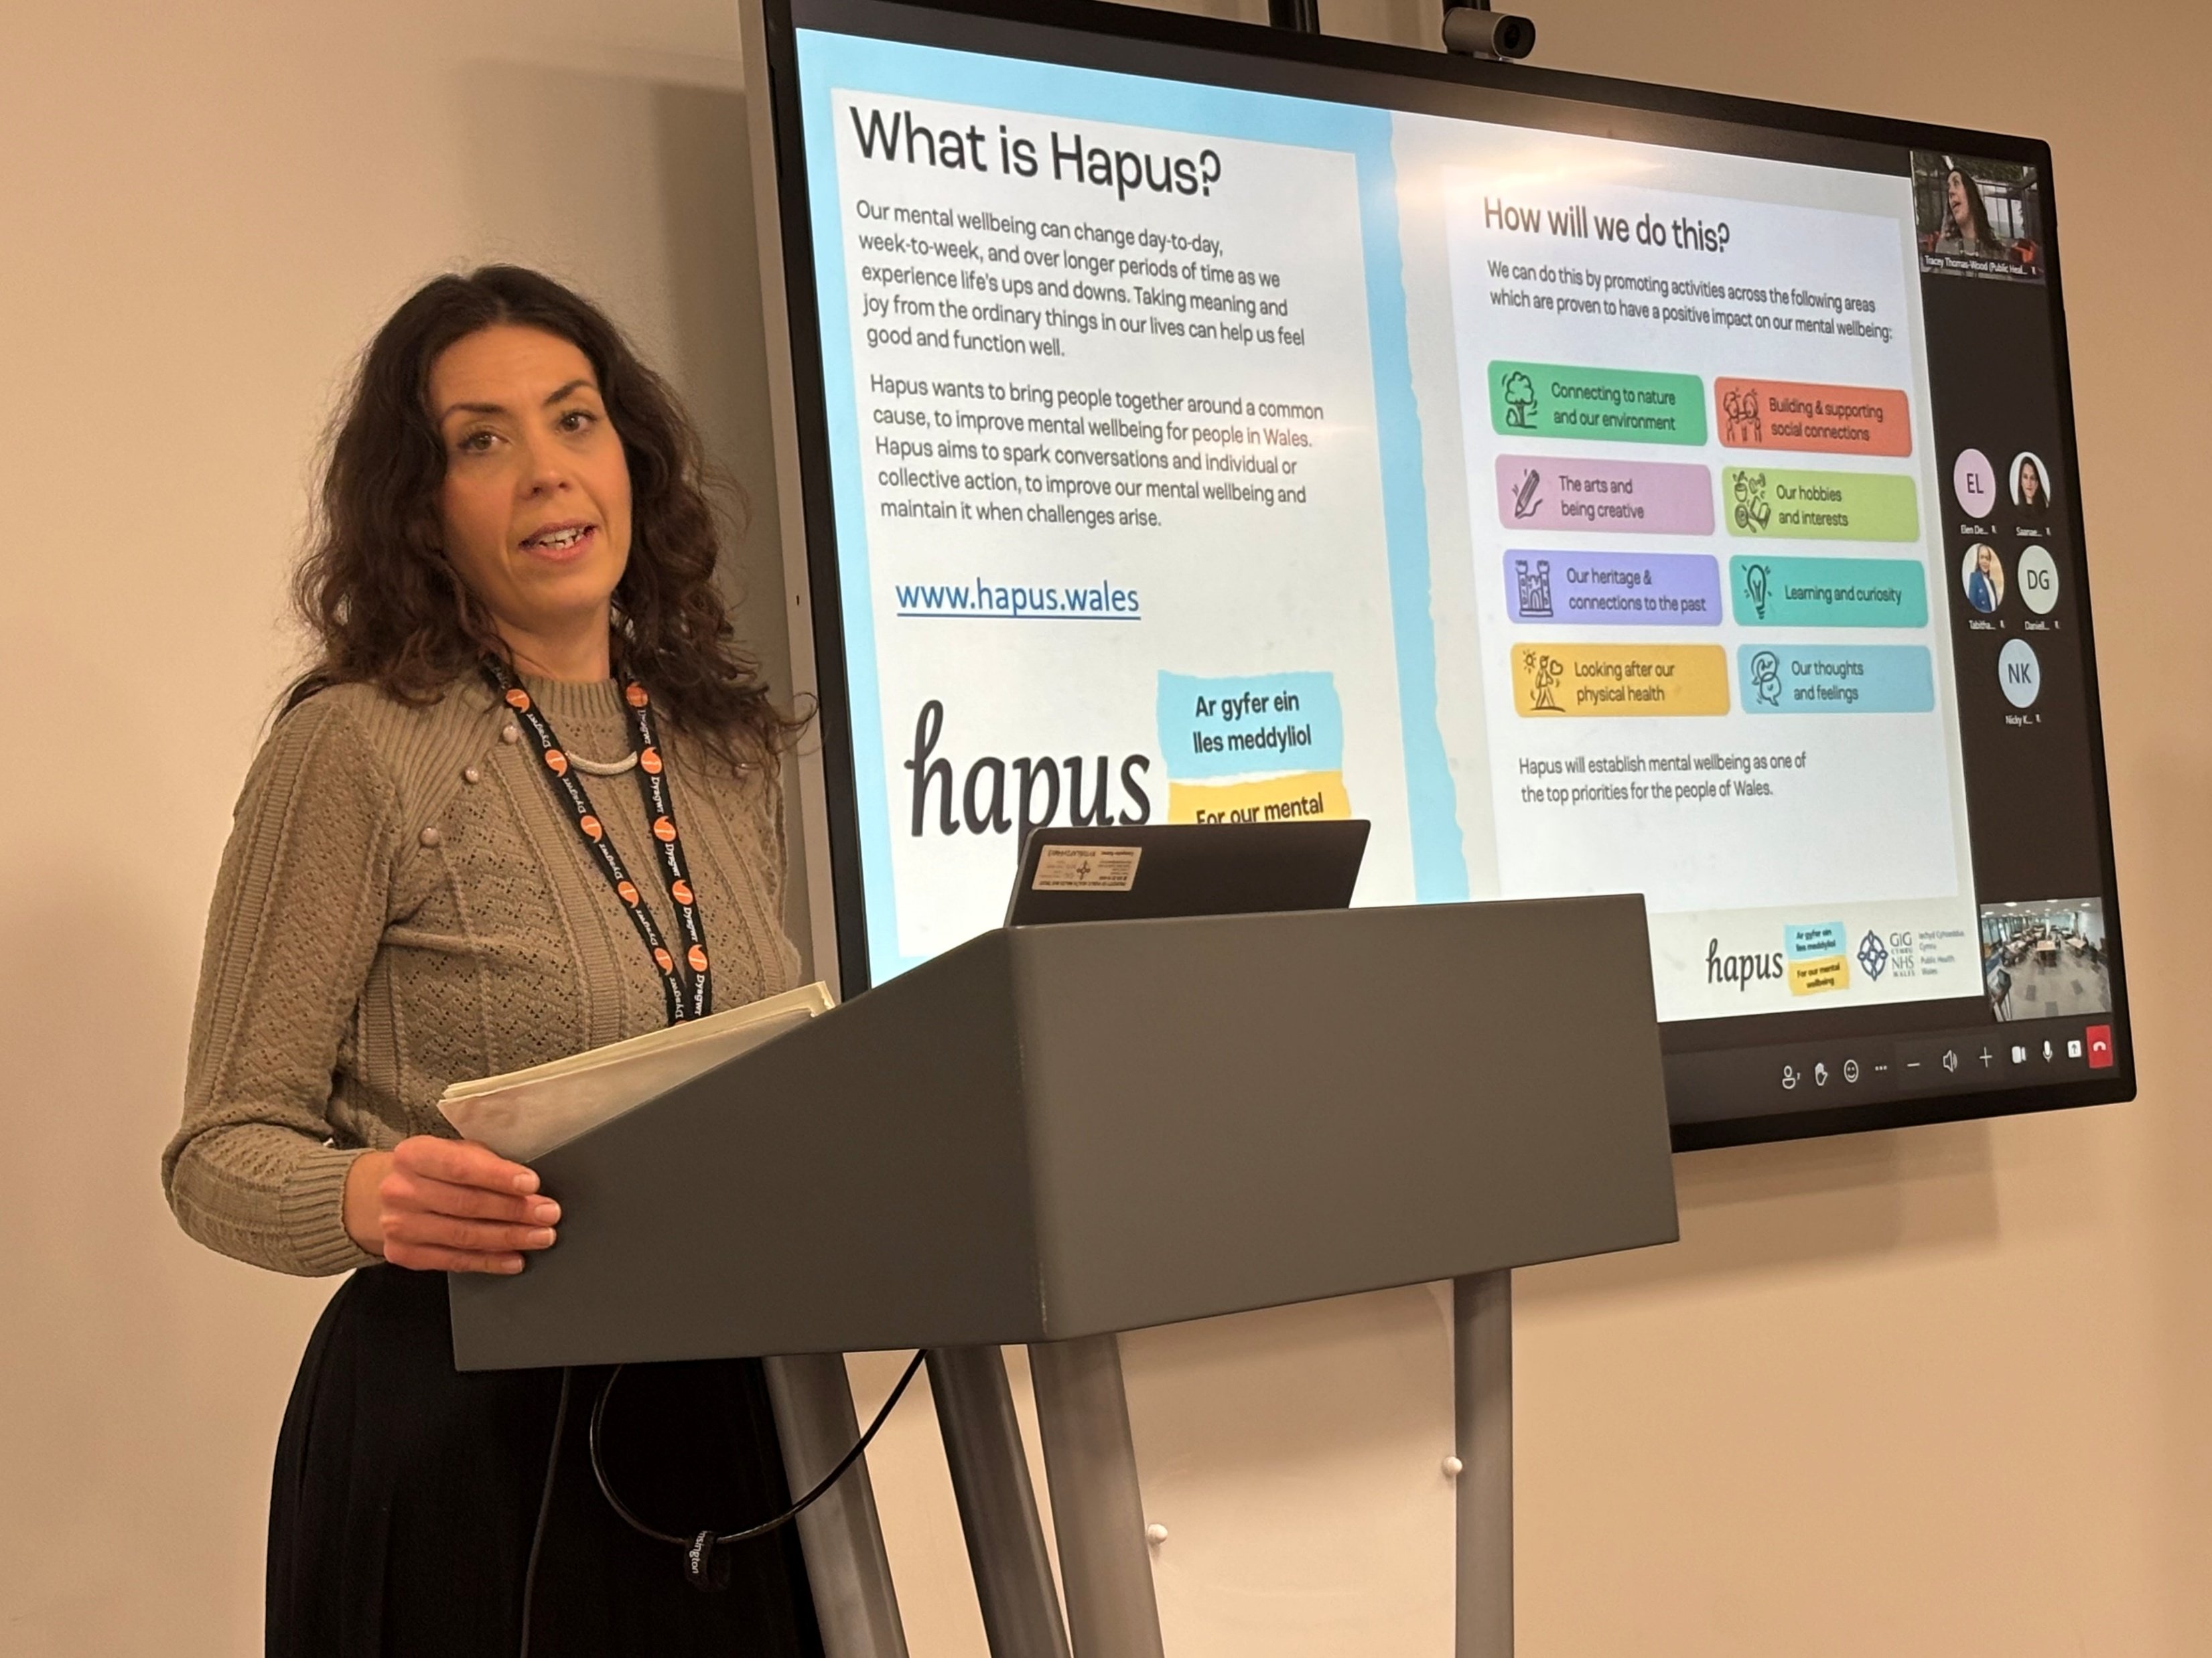
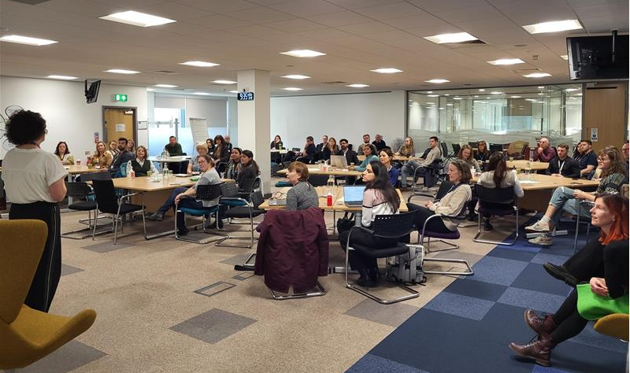
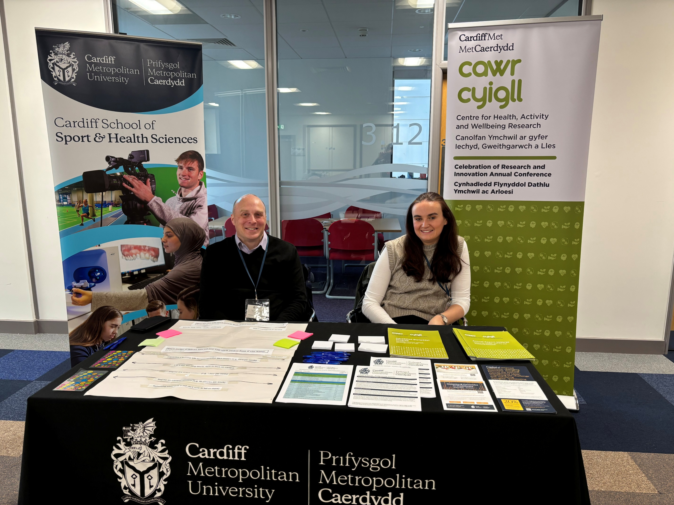
PHW Research & Evaluation Conference 2024
On 2 December 2024, our Research and Evaluation Conference united over 100 delegates, both in person and online. Embracing sustainability, we hosted the event at Cardiff’s Capital Quarter 2—an outstanding venue that was well received.
The conference showcased diverse work from Public Health Wales through presentations and posters, alongside partner stands from the Welsh Innovation Network, Welsh Ambulance Service NHS Trust, Cardiff Metropolitan University, and Care and Repair.
We look forward to delivering the same success for the 2025 conference on 3 December 2025

Slide 42

Public Health Wales Evaluation Community of Practice (ECOP)
The ECOP is a dedicated platform connecting staff with a shared interest in evaluation and improving public health in Wales. It fosters interaction, collaboration, learning, and knowledge-sharing to enhance individual evaluation skills and collective impact.
Our Goals:
Connect & Collaborate: Build a peer network for communication, support, and joint working via SharePoint, Teams, and Yammer.
Learn & Share: Provide access to evaluation resources, events, and forums to exchange expertise, best practices, and experiences.
Do & Learn Together: Create an active environment for conducting and learning about evaluations, supported by the Central Evaluation Team and shared organisational knowledge.
Progress Since March 2023:
Hosted 5 webinars with 70–100 attendees each, featuring expert guest speakers.
Grown to nearly 350 members across Public Health Wales and Local Public Health Teams.
Published 10 “Introduction to...” resources on evaluation methods, with positive feedback and more in development.

Slide 43
PHW Research – future plans

Slide 44
Future strategic aims and objectives
A key area for PHW development in 2025 is to increase our systems leadership
To advance Applied Public Health (APH) in Wales, collaboration with WIN, HCRW, and Higher Education Institutions (HEIs) will be key in shaping both the vision and its implementation. A strategic approach will involve broadening HEI partnerships across Wales through a series of workshops in Autumn 2025, aligning with Public Health Wales (PHW) priorities. Additionally, strengthening academic connections by developing PhD and joint opportunities with Bangor University and other institutions will ensure research efforts support PHW’s objectives.
Efforts will also focus on influencing funders and maximizing impact, beginning with initial discussions with UKRI PHI to integrate Wales into ongoing funded programs. New collaborations will be fostered, including PHW R&E and WAST working together on an NIHR bid, as well as engaging with Our Future Health and WHO CC in the digital health sphere. Addressing climate change through research will be a priority, facilitated by a new role within PHW and WIN.
Another key focus will be nurturing principal investigators (PIs) across the organisation while strengthening research opportunities within NHS and PHW. To enhance the quality of research and evaluation (R&E), emphasis will be placed on Patient and Public Involvement and Engagement (PPIE), ensuring alignment with PHW's engagement strategy and increasing visibility through improved communication channels, such as PHW’s updated website.

Slide 45
Gweithio gyda'n gilydd i greu Cymru iachach
Working together for a healthier Wales

