Slide 1




Safeguarding Scenarios
Training Pack
Drama based learning

Slide 2

Safeguarding Scenarios Training Pack
Drama based learning
The films you are about to view have been developed by AFTA Thought in collaboration with the National Safeguarding Service.
This video package comprises of a suite of 8 scenario-based learning videos,
each film spotlighting a different and complex safeguarding situation.
The scenarios are based on real life events and learning from statutory reviews. They are dramatised for
training purpose.
The videos are designed to strengthen safeguarding for children, young people and adults at risk by promoting better recognition and safeguarding practice across Wales.
These multi-agency resources will enable professionals to achieves learning competencies that meet Group C (Social Care Wales) and Level 3 (Intercollegiate Document).

Slide 3
Safeguarding Scenarios Training Pack
Drama based learning
Content Warning
This training includes powerful real-life scenarios of abuse, neglect, domestic violence and other forms of harm.
These are shared to promote learning
and support safeguarding practice.
It is recognised this training may evoke strong emotional responses. Some people may find this content distressing.
Please take care of your own wellbeing whilst watching and step away if you
need to.
Seek support through your own organisation and line management if
you are affected by any aspects of
this training.

Slide 4
Safeguarding Scenarios Training Pack
Drama based learning
Overarching aims
1
2
3
To provide safe opportunities to explore how practitioners might think, feel, and act in
real-world situations.
To create emotional engagement and encourage reflective group discussions.
To support discussion and shared learning between all professionals and agencies.

Slide 5
Safeguarding Scenarios Training Pack
Drama based learning
1
2
3
Exploring the voice of
the person at risk
Impact on the person
at risk
Safeguarding and
duty of care
4
5
6
Professional
reflections
Ethical and emotional dilemmas
Practical
learning

Slide 6
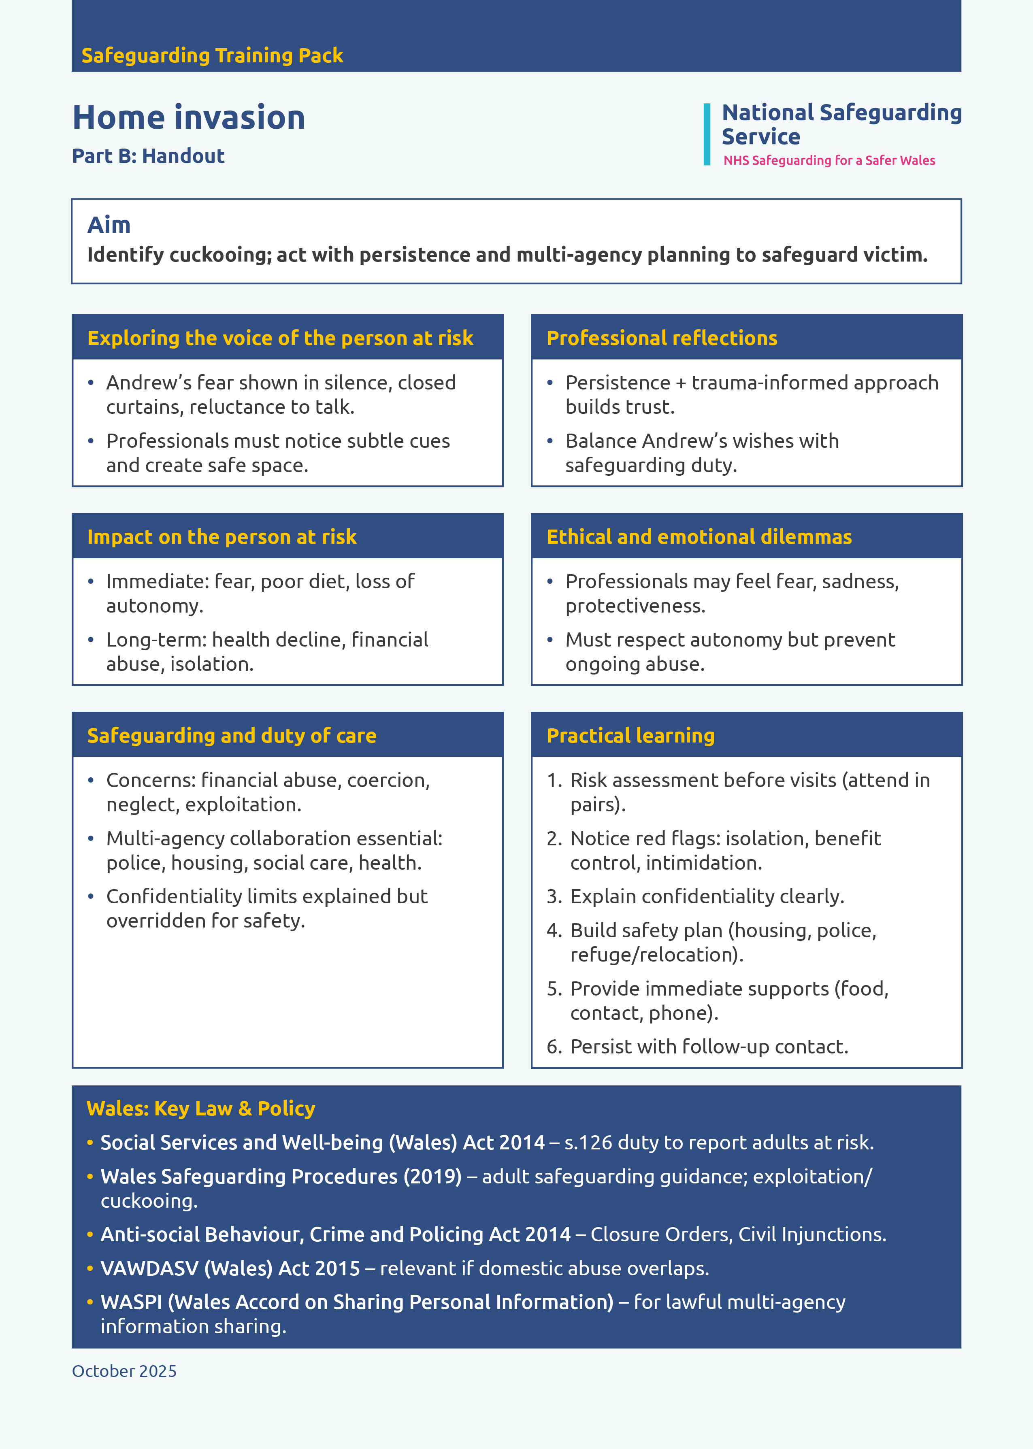
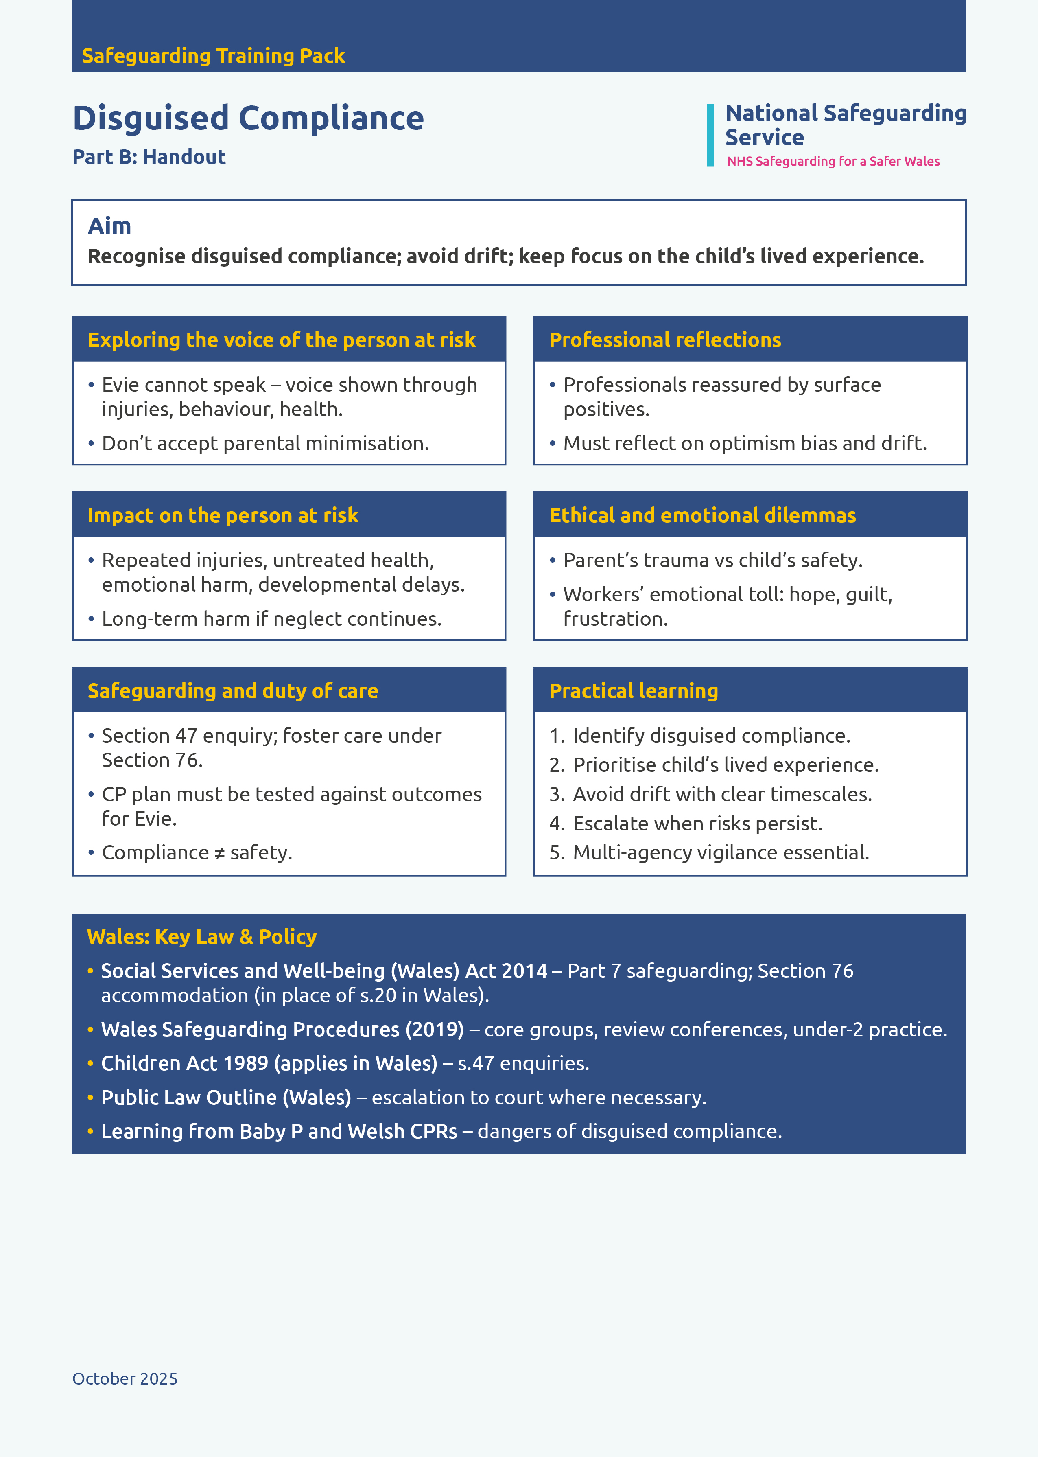
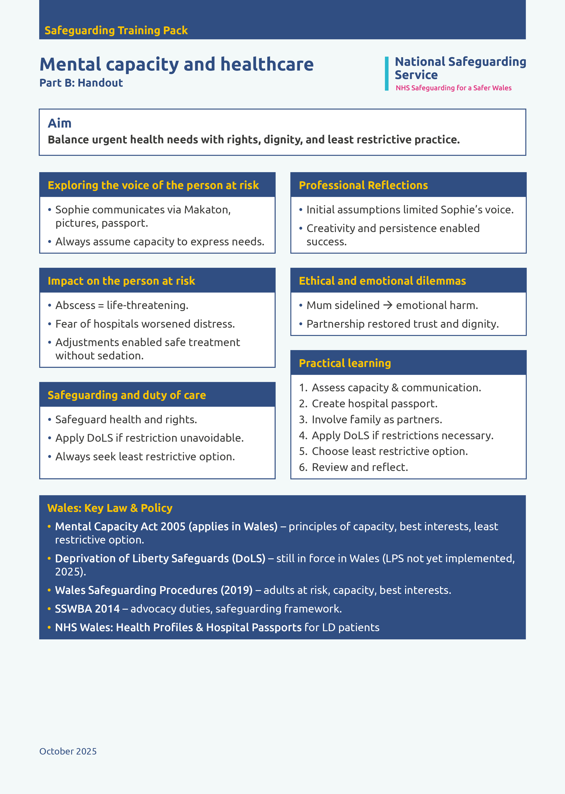
Safeguarding Scenarios Training Pack
Drama based learning
Links to training packs and videos
Link here to training packs
Link here to training videos

Slide 7
Contact info TBC

