Slide 1


Health and its determinants in Wales Informing strategic planning
2017
Report

Slide 2
Introduction
The Health and its determinants in Wales report provides an overview of the health and well-being of the population of Wales. It outlines the main areas of health need and presents the complex picture of health in Wales. It demonstrates the gains made but it also highlights the significant challenges faced both now and in the future.
This report aims to describe the epidemiology of health and its determinants in Wales in a way that can inform strategic public health planning into the future. Its initial purpose was to inform long term strategic planning of Public Health Wales, but we hope it will also be of value to others involved in strategic planning across Wales. The report provides high level information and illustrative examples covering broad themes. It uses a common currency for health and risk factors, the burden of disease, to assist with consideration of relative priorities. It also provides information on wider determinants of health with a particular focus on children. The report includes international comparisons, focusing on what those countries with the best outcomes achieve, and provides both past and projected future trends.
The Health and its determinants in Wales report is accompanied by an infographic, a summary containing the key messages and conclusions of the report, and a technical guide providing further guidance on how to interpret the data, any limitations, and the methods and data sources used.
Table of contents
Introduction | 2-7 | Healthy start | 57-69
Demography | 8-11 | Living conditions | 70-84
Life expectancy | 12-15 | Projections | 85-92
Burden of disease | 16-36 | Emerging threats | 93-98
Health behaviours | 37-56 | Acknowledgements | 99
2

Slide 3
Introduction
LE – life expectancy is an estimate of the average number of years a person can expect to live based on the year of their birth, their current age and other demographic factors including gender. The estimate assumes that current mortality rates for the area in which they were born applied throughout their lives.
HLE – healthy life expectancy is the average number of years a person can expect to live in good health, assuming that current mortality rates and levels of good health for the area in which they were born applied throughout their lives.
YLL – years of life lost, the number of years of life lost due to premature mortality.
YLD – years lived with disability, the number of incident cases in the period is multiplied by the average duration of the disease and a weight factor that reflects the severity of the disease on a scale from 0 (perfect health) to 1 (dead).
DALYs – disability-adjusted life years, the sum of years of life lost (YLL) and years live with disability (YLD). One DALY can be thought of as one lost year of "healthy" life. The sum of these DALYs across the population can be thought of as a measurement of the gap between current health status and an ideal health situation where the entire population lives to an advanced age, free of disease and disability.
3

Slide 4
Introduction
Comparators
Where comparative data are available, the UK nations, Republic of Ireland, Iceland and Sweden have been used. England, Scotland, Northern Ireland and Republic of Ireland have been used as they have broadly similar demographic and social characteristics to Wales.
In 2015, the UN General Assembly established the Sustainable Development Goals (SDGs) and using 33 health-related SDG indicators, 188 countries were ranked from best to worst. Iceland (1st) and Sweden (3rd) were chosen as nations which also shared similar demographic characteristics to the UK (5th).
Reference: GBD 2015 SDG Collaborators (2016), Measuring the health-related Sustainable Development Goals in 188 countries: a baseline analysis from the Global Burden of Disease Study 2015. Lancet. 388, 1813–50.
Deprivation
The Welsh Index of Multiple Deprivation (WIMD) 2014 is an area-based rather than individual-based measure. It must therefore be noted that not everyone living in a deprived area is necessarily living in deprived circumstances and, equally, some people living in an area classed as least deprived may experience deprivation.
4

Slide 5
Introduction
Global Burden of Disease
The Global Burden of Disease study 2016 (GBD, Global Health Data Exchange) is a data source that provides internationally comparable burden of diseases estimates.
The methods allow for differing availability and quality of data.
The study provides modelled estimates, not direct measurements, and the results should therefore not be compared to any direct measures or alternative estimates reported for Wales.
Uncertainty in any of the raw data or parameters used in the model will result in imprecision in the estimates themselves.
The rankings provided are only an indication of the relative contribution of different risk factors to the burden of disease and the certainty of the ranking will depend on the strength of underlying evidence.
The methods used to produce DALYs in the Global Burden of Disease reports produced before 2010 has been criticised for favouring younger adults and immediate years of life gained; more recent reports use a method that has rectified this.
5

Slide 6
Introduction
Global Burden of Disease contd.
The Global Burden of Disease study has identified eight risk categories:
Social, cultural, economic
Behavioural
Metabolic
Health intervention
Microbiome and host
Pathogens
Environmental or occupational
Genes
Of these, only the behavioural, environmental or occupational, and metabolic risk categories have been investigated which account for 84 individual risks. Therefore, only a proportion of total DALYs can be attributed to GBD identified risk factors.
The sum of DALYs from individual risks is higher than the total number of DALYs attributable to a particular risk category. This is because DALYs can be attributed to more than one risk factor. For example, a single person could be affected by poor diet and alcohol use but these will only count once towards the total attributable DALYs for ‘behavioural risks’.
6

Slide 7
Introduction
Projections
Projections are estimates based on various assumptions about the future.
Projections assume the population projections are an accurate reflection of future population change.
Short term projections are reasonable indications of the direction of travel over the next three years if the pattern in the observed data persists.
Longer term projections must be viewed with extreme caution due to the likelihood that observed past trends will change.
The Daffodil system applies Wales-level prevalence figures from the 2012 WHS to projected population estimates; they do not take past trends into account.
7

Slide 8
Contents
Demography
Life expectancy
Burden of disease
Health behaviours
Healthy start
Living conditions
Projections
Emerging threats
8

Slide 9
Demography
9

Slide 10
Demography
10

Slide 11
Demography
Please note: The relative change chart has a logarithmic x-axis.
11

Slide 12
Contents
Demography
Life expectancy
Burden of disease
Health behaviours
Healthy start
Living conditions
Projections
Emerging threats
12

Slide 13
Life expectancy
Please note: Axes have been adjusted to start at 45.
13

Slide 14
Life expectancy
Since 2010 life expectancy has increased more slowly than the preceding 20 years.
14

Slide 15
Life expectancy
15

Slide 16
Contents
Demography
Life expectancy
Burden of disease
Health behaviours
Healthy start
Living conditions
Projections
Emerging threats
16

Slide 17
Burden of disease
17

Slide 18
Burden of disease
18

Slide 19
Burden of disease
19

Slide 20
Burden of disease
Please note: Crude rates do not take into account the precise age structure of a population.
20

Slide 21
Burden of disease
Please note: The relative change chart has a logarithmic x-axis.
21

Slide 22
Burden of disease
22

Slide 23
Burden of disease
23

Slide 24
Burden of disease
24

Slide 25
Burden of disease
25

Slide 26
Burden of disease
26

Slide 27
Burden of disease
27

Slide 28
Burden of disease
28

Slide 29
Burden of disease
29

Slide 30
Burden of disease
30

Slide 31

Burden of disease
31

Slide 32
Burden of disease
32

Slide 33
Burden of disease
¹Based on telephone surveys conducted during the 2015/16 and 2014/15 influenza seasons, during the peak two weeks of activity (in Wales).
33

Slide 34
Burden of disease
34

Slide 35
Burden of disease
Please note: Data are as at 1st January 2017 for E.coli bacteraemia and 2nd March 2017 for Clostridium difficile.
35

Slide 36
Burden of disease
36

Slide 37
Contents
Demography
Life expectancy
Burden of disease
Health behaviours
Healthy start
Living conditions
Projections
Emerging threats
37

Slide 38
Health behaviours
38

Slide 39
Health behaviours
39

Slide 40
Health behaviours
Please note: The total number and proportion of DALYs that can be attributed to known risk factors varies substantially by cause (see slide 38).
40

Slide 41
Health behaviours
Please note: The relative change chart has a logarithmic x-axis.
41

Slide 42
Health behaviours
42

Slide 43
Health behaviours
43

Slide 44
Health behaviours
44

Slide 45
Health behaviours
45

Slide 46
Health behaviours
46

Slide 47
Health behaviours
47

Slide 48
Health behaviours
48

Slide 49
Health behaviours
49

Slide 50
Health behaviours
50

Slide 51
Health behaviours
51

Slide 52
Health behaviours
52

Slide 53
Health behaviours
53

Slide 54
Health behaviours
54

Slide 55
Health behaviours
55

Slide 56
Health behaviours
Please note: England BMI data have been calculated using nurse measured heights and weights. The other surveys use self-reported data which can potentially underestimate BMI due to reporting bias (overestimating height and underestimating weight).
56

Slide 57
Contents
Demography
Life expectancy
Burden of disease
Health behaviours
Healthy start
Living conditions
Projections
Emerging threats
57

Slide 58
Healthy start
58

Slide 59
Healthy start
59

Slide 60
Healthy start
60

Slide 61
Healthy start
61

Slide 62
Healthy start
62

Slide 63
Healthy start
63

Slide 64
Healthy start
Boys
Girls
64

Slide 65
Healthy start
Boys
Girls
65

Slide 66
Healthy start
Boys
Girls
66

Slide 67
Healthy start
Boys
Girls
67

Slide 68
Healthy start
Boys
Girls
68

Slide 69
Healthy start
Boys
Girls
69

Slide 70
Contents
Demography
Life expectancy
Burden of disease
Health behaviours
Healthy start
Living conditions
Projections
Emerging threats
70

Slide 71
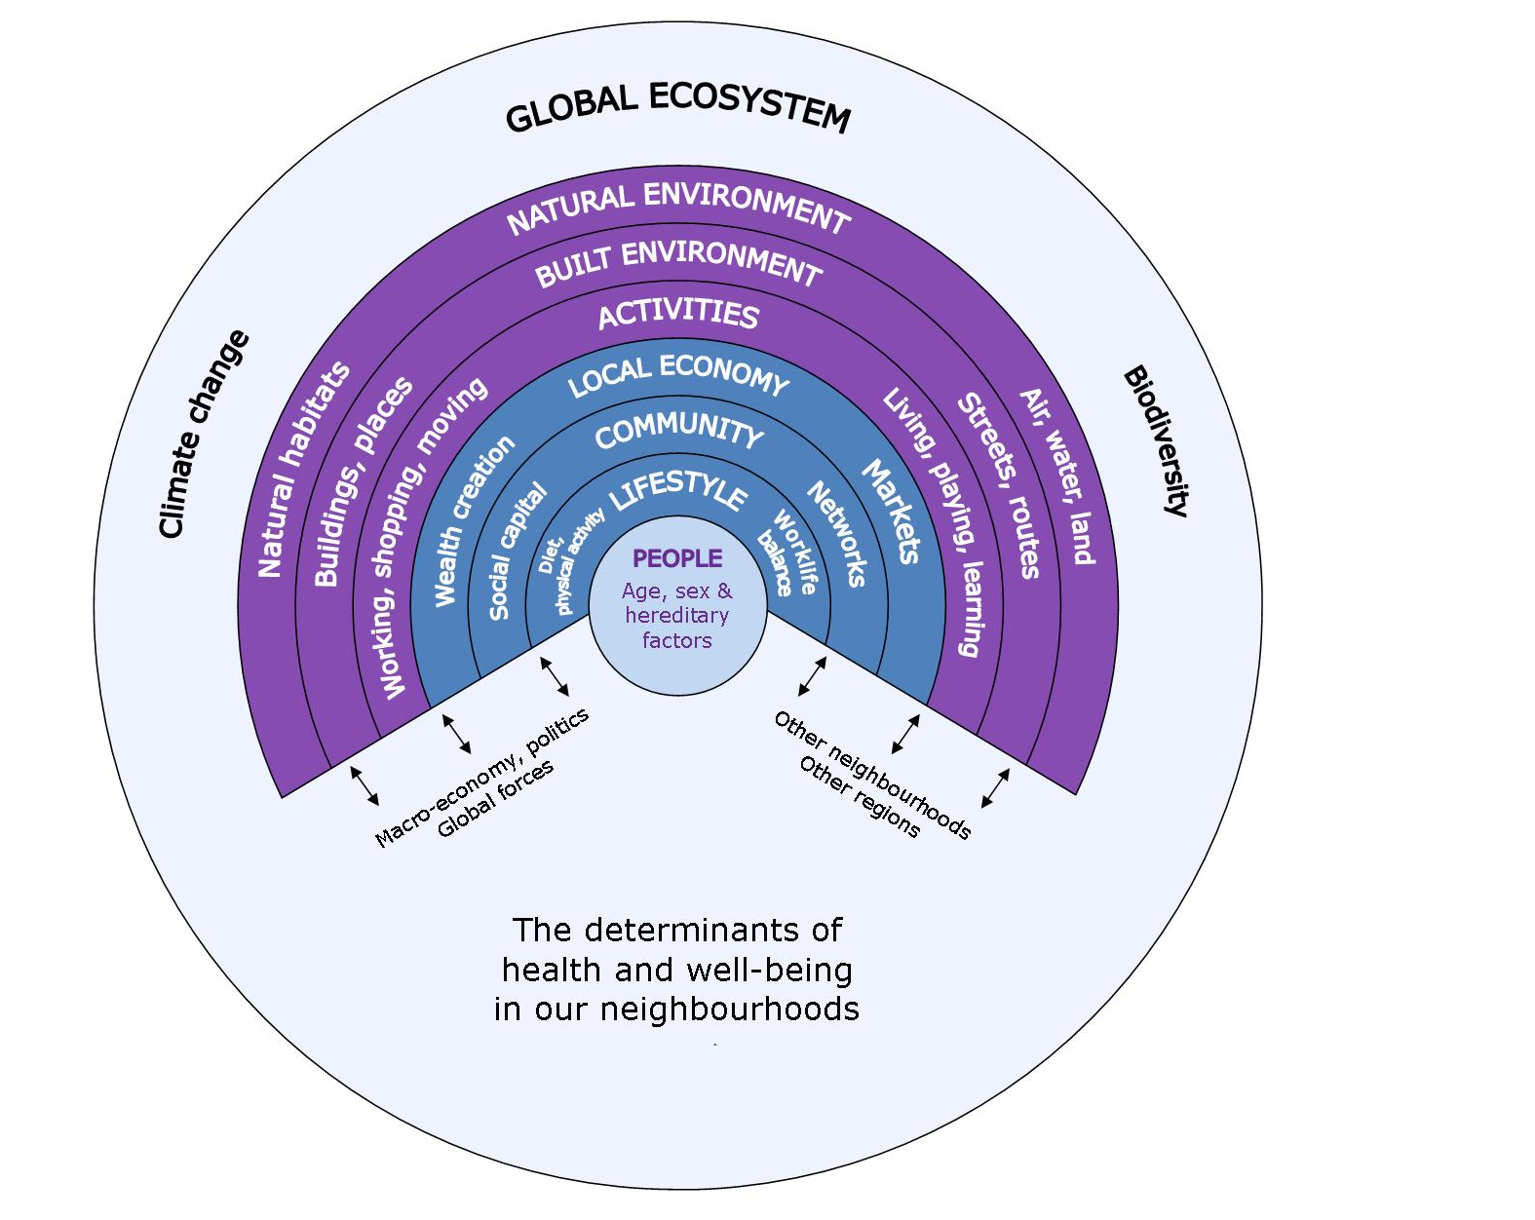
Living conditions
Source: Barton & Grant, 2006
71

Slide 72
Living conditions
72

Slide 73
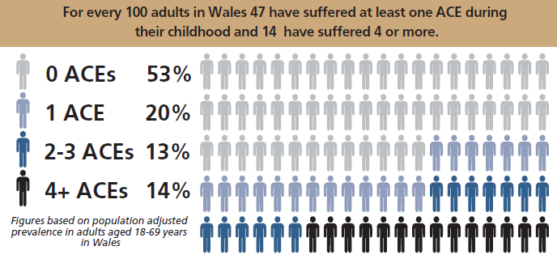
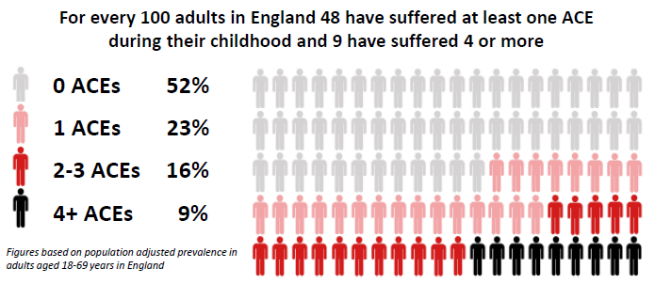
Living conditions
73

Slide 74
Living conditions
74

Slide 75
Living conditions
Please note: Level 2 qualifications consists of 5 A*-C GCSEs or equivalents (including English or Welsh First Language and Mathematics).
75

Slide 76
Living conditions
76

Slide 77
Living conditions
77

Slide 78
Living conditions
78

Slide 79
Living conditions
79

Slide 80
Living conditions
80

Slide 81
Living conditions
81

Slide 82
Living conditions
82

Slide 83
Living conditions
83

Slide 84
Living conditions
Please note: Air quality varies with geographical area, for example between urban and rural areas. Area specific trends in air pollution may not be possible to discern when using the Wales average.
84

Slide 85
Contents
Demography
Life expectancy
Burden of disease
Health behaviours
Healthy start
Living conditions
Projections
Emerging threats
85

Slide 86
Projections
Please note: An extrapolated projection method uses historical trends and cycles to extrapolate to the future. The extrapolation method assumes that past patterns will continue into the future. While this is often a valid assumption in the short term, the further we attempt to forecast, the less certain we become of the forecast.
86

Slide 87
Projections
Constant quit rate of 2.5%
8.5% of 15 year olds are already smoking
0.2% of 16+ year olds start to smoke each year
Please note: The projections of smoking prevalence are estimates. They are based on the smoking point prevalence for 2016/17 and various assumptions which may or may not hold true in the future.
87

Slide 88
Projections
Increasing quit rates by 1.0% each year (max quit rate 6.0%)
Reducing the rate of 15 year olds already smoking by 0.5% each year
Reducing 16+ year olds starting to smoke by 0.05% each year
Please note: The projections of smoking prevalence are estimates. They are based on the smoking point prevalence for 2016/17 and various assumptions which may or may not hold true in the future.
88

Slide 89
Projections
Please note: An extrapolated projection method uses historical trends and cycles to extrapolate to the future. The extrapolation method assumes that past patterns will continue into the future. While this is often a valid assumption in the short term, the further we attempt to forecast, the less certain we become of the forecast.
89

Slide 90
Projections
Please note: The projected prevalence changes of the Daffodil projections do not take account of any existing temporal trends in prevalence, such as the decline in cardiovascular disease or rise in diabetes prevalence. They represent the effects of anticipated population demographics only on prevalence at a point in time.
90

Slide 91
Projections
Please note: The projected prevalence changes of the Daffodil projections do not take account of any existing temporal trends in prevalence, such as the decline in cardiovascular disease. They represent the effects of anticipated population demographics only on prevalence at a point in time.
91

Slide 92
Projections
Please note: The projected prevalence changes of the Daffodil projections do not take account of any existing temporal trends in prevalence. They represent the effects of anticipated population demographics only on prevalence at a point in time.
92

Slide 93
Contents
Demography
Life expectancy
Burden of disease
Health behaviours
Healthy start
Living conditions
Projections
Emerging threats
93

Slide 94
Emerging threats
94

Slide 95
Emerging threats
Notes:
2005 baseline assumes no policy changes from 2005
Conditional and unconditional Intended Nationally Determined Contributions (INDC) scenarios represent the differing level of commitments made in Paris that could be implemented
1.5ºc and 2ºc scenarios represent the least expensive paths with a greater than 50% likelihood of limiting warming below the scenario level.
95

Slide 96
Emerging threats
Please note: Axes do not start at 0. Data is only available for Cardiff and caution must be used in generalising these projections to the whole of Wales.
96

Slide 97
Emerging threats
Please note: The projected heat and cold-related death rates do not take into account changes from the baseline of the relative risks, temperature thresholds and baseline mortality rates for each region. They do reflect a pattern of increasing mean daily temperature and the increasing size of the region’s populations.
97

Slide 98
Emerging threats
98

Slide 99
Project members
Team (analysis and writing): Holly Walsh (Project Manager), James Allen, Hugo Cosh, Andrew Dring, Arthur Duncan-Jones, Rhian Hughes, Grace Jefferies, Leon May, Rhys White
Project Board: Alisha Davies, Ciaran Humphreys, Nathan Lester, Kirsty Little
Acknowledgements
Our thanks go to Chrissie Pickin, Chris Williams (Public Health Wales Communicable Disease Surveillance Centre) for slides 31-36, and Simon Cottrell (Public Health Wales Vaccine Preventable Disease Programme) for assistance with slide 61.
Health and its determinants in Wales
99

Slide 100
For more information, please see the accompanying:
Infographic
Summary
Technical Guide
Health and its determinants in Wales
100

