Slide 1


All Wales Diabetes Prevention Programme (AWDPP)
Equity Toolkit
Diane Kirkland, Alice Cline, Catherine Washbrook, Nicholas Gregory, Amrita Jesurasa
Publication date November 2024

Slide 2
Contents
1. Introduction Slide 3
2. What is health equity and why is it important to the AWDPP? Slide 4
3. What is already known about equity of diabetes prevention programmes? Slide 7
4. What are we aiming to achieve? Slide 9
5. Key behaviours to support equity at each step of the AWDPP Slide 10
6. What do we need to do to support these behaviours? Slide 11
6a. Monitoring equitable access and uptake for quality improvement Slide 12
6b. What action can be taken to improve equitable uptake? Slide 13
6c. Examples of barriers identified through local engagement Slide 14
7 . Addressing barriers to access and uptake Slide 15
Actions to achieve key behaviours required from Health Care professionals Slide 16
Actions to achieve key behaviours required from people eligible for AWDPP Slide 17
8. Relevant NICE guidance Slide 18
AWDPP Equity Toolkit

Slide 3
1. Introduction
In 2021, baseline data found that there was an inequitable approach across Wales to diabetes prevention
The All Wales Diabetes Prevention Programme (AWDPP) is a Wales wide prevention programme which aims to reduce the risk of developing type 2 diabetes (T2D) in those identified to be at high risk
It aims to facilitate a systematic and equitable approach to T2D prevention across Wales to reduce the variation in T2D prevention in primary care
Health Boards and Primary Care Clusters (PCC) have a duty to provide equitable and fair health care services and have systems and processes to support this. Local service providers will therefore need to consider and support equitable access and uptake of the AWDPP across diverse groups and communities within the population they serve
This toolkit aims to support those planning, managing and delivering the AWDPP, to take a behaviourally informed approach to promote and enable equitable access and uptake of the programme
AWDPP Equity Toolkit

Slide 4

2. What is health equity?
AWDPP Equity Toolkit

Slide 5
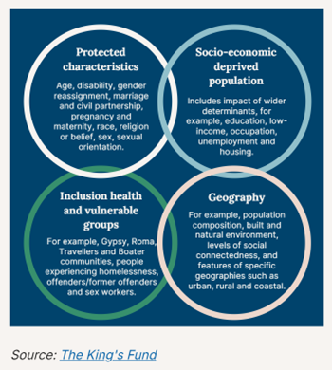
2a. Dimensions and drivers of health inequalities
Health inequalities in Wales exist across a range of dimensions or characteristics, including the 9 protected characteristics in the Equality Act,, socioeconomic position, occupation, geographic deprivation and membership of a vulnerable group. As shown in Figure 1, these dimensions overlap.
Action on health inequalities requires improving the lives of those with the worst health outcomes, fastest.
Health inequalities may be driven by:
Wider determinants of health, e.g. environment
Individual health behaviours, such as poor diet
Psychosocial factors, e.g. social connectedness
Unequal access to or experience of health services
Figure 1 Population groups commonly considered for health inequalities
Source: NICE
AWDPP Equity Toolkit

Slide 6
2b. Why is equity important to the delivery of the AWDPP?
The AWDPP will only be effective and cost effective at the population level if there is:
a. sufficient overall uptake
b. sufficient uptake by those who would otherwise have poor outcomes
If not delivered equitably, the introduction of this prevention programme potentially risks increasing health inequities, due to the realities of the inverse care law i.e. those with the greatest need for medical care are least likely to access health services, for a combination of reasons.
At the individual level, only people who access and engage with the AWDPP service can benefit directly from it. Optimising equitable access and uptake is about enabling all eligible people to have a fair chance to benefit from the AWDPP programme.
AWDPP Equity Toolkit

Slide 7
3. What is already known about equity of diabetes prevention programmes?
Learning can be taken from a paper published in 2020 reporting finding of a prospective cohort study of 99,473 adults with non-diabetic hyperglycemia, who were invited into the NHS England Diabetes Prevention Programme (NHS England DPP). The paper examines the relationship between uptake of the programme and participant characteristics and service delivery models. Headline findings regarding equitable access and uptake are given in section 3a
Further evaluation was reported in ‘Diabetes prevention at scale: Narrative review of findings and lessons from the DIPLOMA evaluation of the NHS Diabetes Prevention Programme in England’ which examines fidelity to the programme.
The AWDPP Intervention Design and Protocol are informed by the AWDPP Equality Impact Assessment (EqIA). This is available on request from PHW.AWDPP@wales.nhs.uk
Information regarding uptake of the AWDPP in the first two years since the programme commenced can be found on the PHW AWDPP webpage, including both the Process Evaluation and Activity Reports
Whilst national level data are helpful to understand patterns of uptake, local services need to take into account the specific demographics and needs of their local populations. Therefore, Local Health Needs Assessment, local assets –based mapping and local intelligence may also inform service delivery to facilitate equitable access and uptake
AWDPP Equity Toolkit

Slide 8
3a. Headline findings from the NHS England DPP evaluation
Of those invited to attend the NHS DPP, 56% attended the initial appointment, (44% did not)
Only 22% of those invited to the programme completed the full course. That means more than half of those who attended the initial appointment, but did not complete the programme ( this is known as ‘implementation decay’)
Uptake varied across different groups and services providers
Uptake increased incrementally to the age of 70 years of age (57% of those accessing the service were retired)
Uptake was associated with quintiles of deprivation; with highest uptake being in the least deprived quintile- (Inverse Care Law)
Uptake was lower in those from Black and Minority Ethnic Communities
Uptake was lower in people with physical and learning disabilities
Higher levels of retention and completion were achieved where some out of hours provision was provided
Whilst the model and delivery of the AWDPP differs from that in England, it is likely that issues affecting equitable access and uptake are similar
AWDPP Equity Toolkit

Slide 9
4. What are we aiming to achieve?
All eligible people, where clinically appropriate are offered an AWDPP intervention. This includes those with protected characteristics, identified as being at increased risk of T2D due to a specific characteristic and across all socio-economic and vulnerable groups.
AWDPP services are delivered in a way that all eligible people, have a fair opportunity to access and benefit from the AWDPP service and to reduce their risk of developing T2D.
Specific inclusion and exclusion criteria can be found in the Intervention protocol, via this link.
Whilst the AWDPP appears to be a relatively simple programme, there are several steps in its protocol, all of which potentially influence equitable delivery.
Key behaviours (what, when, where) required at each step, by both the person receiving the service and health care professionals need to be considered. Key behaviours are given in the table in section 5
AWDPP Equity Toolkit

Slide 10
5. Key behaviours to support equity at each step of the AWDPP
Workforce delivering the AWDPP | People using the AWDPP
GPs systematically order HbA1c in line with NICE Guidance | Eligible individuals attend to get HbA1c blood test
All people eligible for the AWDPP are systematically invited as per AWDPP protocol | Eligible individuals accept the invitation for AWDPP and make an appointment
HCSW adheres to the intervention protocol | Eligible individuals attend and engage in the AWDPP consultation
HbA1c annual review is offered systematically, in line with NICE Guidance | Eligible individual attends the follow up HbA1c after 12 months if invited
The AWDPP workforce is planned and resourced to meet forecast demand | Eligible individuals attend annual review with AWDPP if invited
Minimum data set input is complete and enables systematic monitored and evaluated | AWDPP consultation and resources are received by individuals, in a format that is accessible to them
AWDPP consultation and resources are provided in a format that is accessible to each individual | Individuals inform the AWDPP service if adaptations are required e.g. translation services, British Sign language etc
AWDPP Equity Toolkit

Slide 11
5a. What do we know already regarding these key behaviours?
Workforce delivering the AWDPP | People using the AWDPP | AWDPP Two Years On
GPs systematically order HbA1c in line with NICE Guidance | Eligible individuals attend to get HbA1c blood test | Data needed
All people eligible for the AWDPP are systematically invited as per AWDPP protocol | Eligible individuals accept the invitation for AWDPP and make an appointment | 49% of invitations sent result in consultations attended 7% did not attend following a booked appointment
HCSW adheres to the intervention protocol | Eligible individuals attend and engage in the AWDPP consultation | PREM report: insights on initial engagement of those who responded to questionnaire
HbA1c annual review is offered systematically, in line with NICE Guidance | Eligible individual attends the follow up HbA1c after 12 months if invited | Data needed
The AWDPP workforce is planned and resourced to meet forecast demand | Eligible individuals attend annual review with AWDPP if invited | Data needed
Minimum data set input is complete and enables systematic monitoring and evaluation | AWDPP consultation and resources are received by individuals, in a format that is accessible to them | Outcome evaluation in progress
AWDPP consultation and resources are provided in a format that is accessible to each individual | Individuals inform the AWDPP service if adaptations are required e.g. translation services, British Sign language etc | Data needed
AWDPP Equity Toolkit

Slide 12
6. What do we need to do to support these behaviours?
Understand the equity of access and uptake, and gaps to this through monitoring and insight gathering
Take a ‘behaviourally informed’ approach to address those gaps
Evaluate the effectiveness of actions taken in improving equitable access and uptake
AWDPP Equity Toolkit

Slide 13
6a. Monitoring equitable access and uptake for quality improvement
It is important to monitor equitable access and uptake to inform any quality improvement activities required
As per the AWDPP protocol, a ‘minimum data set’ was agreed to enable relevant data to be collected to support appropriate monitoring and evaluation
The completeness of the data collected underpins the ability to monitor equitable access and uptake
Standard templates on the primary care Vision and EMIS systems are used for ease of data collection, recording and input, to facilitate good quality data completion
An extension to the diabetes audit plus module to capture AWDPP data has been developed. Plans to finalise this extension are awaiting confirmation. However, since the Audit + system is being withdrawn, there is uncertainty in the short term regarding the IT solution. Whilst alternative solutions are being explored, some data continues to be collated locally but this it is not possible to collect data in this way to adequately assess equity of access and uptake
AWDPP Equity Toolkit

Slide 14
6b. What action can be taken to improve equitable uptake?
Where inequitable uptake is identified, engagement work with relevant local stakeholders to identify barriers and co-produce solutions to improve equity should be undertaken, using an assets-based approach
Equitable access and uptake of the AWDPP will be determined by the behaviours of both people eligible for the programme and members of staff involved in service delivery. Therefore, understanding what drives the behaviours of each of these groups is necessary, if behaviour change is desired
Topic guides to support engagement work with individuals, groups or communities and relevant staff groups, to gain insights into what drives their current behaviour, to identify facilitators and barriers to AWDPP access and uptake have been developed, informed by the COM-B model of behaviour change (available on request)
a. Topic guide for engagement work with people receiving the service
b. Topic guide for engagement work with Health Care Professionals planning and delivering the AWDPP
AWDPP Equity Toolkit

Slide 15
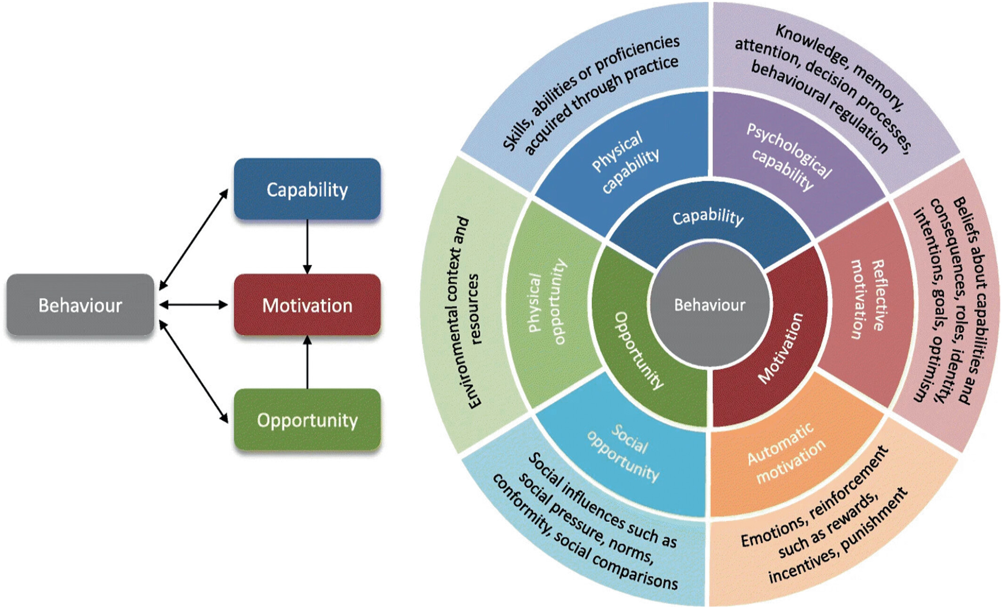
6c. Examples of barriers identified through local engagement
In 2022, focus groups and interviews were conducted with members of weight management services in deprived areas of North Wales and communities in Cardiff, to gain insights into the use of health services and the barriers and enablers to a programme such as the AWDPP. Barriers identified included:
Capability
  Lack of culturally appropriate advice regarding food preparation and physical activity
  Language barriers
Opportunity
  Social anxiety (meeting a new person)
Motivation
  Time to access a simple blood test
  Distance to access a blood test
  Cost of getting to the appointment
  Timing of the appointment (difficult to access in work time)
  Caring responsibilities (difficulty to prioritise own health)
  Lack of appropriate childcare availability
Source: The behaviour change wheel: A new method for characterising and designing behaviour change interventions | Implementation Science | Full Text
AWDPP Equity Toolkit

Slide 16
7. Addressing barriers to access and uptake
Once barriers are identified, consideration is needed regarding:
Which part(s) of COM-B it relates to, recognising solutions will depend on whether the barriers relate to capability, opportunity and/or motivation.
  For example, opportunity refers to things like time, money and the environment. Therefore, if a common barrier relates to lack of transport required to attend an appointment, providing information on the health risks associated with diabetes will not be an effective way of overcoming the barrier related to transport
What type of things might help, e.g. changing a physical or social environment to support a change
What the change might look like. Ideally, solutions will be co-produced with your target groups (people with lived experience). You could do this through focus groups, interviews or workshops
Examples of identified barriers and possible solutions, are given in sections 7b and 7c
AWDPP Equity Toolkit

Slide 17
7a. Examples of action to achieve key behaviours
Workforce delivering AWDPP | Examples of local actions * | Examples of system-wide actions *
GPs systematically order HbA1c in line with NICE Guidance (Including annual reviews) | Gather insights to barriers to ordering HbA1C Address barriers e.g. capacity for phlebotomy, laboratory capacity, primary care capacity Communicate value of AWDPP to promote the service | Leverage contractual levers Provide education and training regarding clinical guidance Emphasise importance of annual review of HbA1c for those at increased risk of T2D
All people eligible for the AWDPP are systematically invited as per AWDPP protocol | Gather insights regarding barriers to systematically inviting all eligible people Assign clear roles and responsibilities in relation to the tasks involved e.g. reviewing test results, inviting individuals, monitoring their responses | Implement changes to systematically flag for action, HbA1c results of 42-47 mol/mol Advocate for timely access to data management systems (EMIS/VISION) in GP practices Offer in person, virtual or telephone appointments
HCSW adheres to the intervention protocol | Quality assurance processes in place to check behaviour change techniques in protocol are included in delivery Support staff to provide culturally appropriate advice to different groups | Fidelity to the protocol to be considered in future evaluation
Minimum data set (MDS) input is complete and enables systematic monitoring and evaluation | Gather insights regarding barriers to completing the full MDS Address any physical barriers e.g. lack of weighing scales | Provide data templates on clinical systems to simplify data recording Provide training e.g. ‘how’ to ask relevant questions regarding protected characteristic
The AWDPP workforce is planned and resourced to meet demand | Active workforce /succession planning & career progression Improved efficiency of processes Upskilling of staff to maximise the roles they can undertake within their level of competency | Sustainable, adequate funding for AWDPP posts Roll out of the AWDPP to all Primary Care Clusters in Wales
*This is not exhaustive list
AWDPP Equity Toolkit

Slide 18
7b. Examples of actions to achieve key behaviours
People using the AWDPP | Examples of local actions * | Examples of systems actions *
Eligible individuals attend to get HbA1c blood test, including annual review, if invited | Offer phlebotomy appointments at accessible venues, across a range of times Be clear regarding the purpose of the blood test and its importance | Visibility of Diabetes UK ‘Know Your Risk’ campaign and tool to public
Eligible individuals accept the invitation for AWDPP and make an appointment | Provide easy and quick means to book appointments Make it easy for people to reschedule AWDPP appointment Identify convenient (and inconvenient) times and venues for easy access, including offering clinics in community venues Appointments out of usual hours for those in full time work Child/ baby friendly facilities for those with young children Contact non-responders, considering different communication method to invite | Provide behaviourally informed templates for AWDPP invitation letters, considering need for easy read/ alternative languages Consider SMS/ other methods to letters for invitations Ensure contact details up-to-date, including for carers Support understanding regarding Health Inclusion and barriers to people accessing health services such as feeling shame, stigmatised, lack of trust, powerless etc
Eligible individuals attend and engage in the AWDPP consultation | Send reminders in advance of appointment Offer opportunity to reschedule if unable to attend | Consider how to proactively invite translators or carers where needs are known or could be identified at booking
Eligible individuals attend annual review with AWDPP if invited | HSCW to explain at initial appointment that an annual review may be required, explain the purpose | Clarify the position regarding AWDPP annual review as the programme transitions to a prospective model
AWDPP consultation and resources are received by individuals, in a format that is accessible to them | Teach/demonstrate to staff how to deliver culturally appropriate advice regarding physical activity and diet/food preferences Offer adaptations to reflect individual needs. For example, extended appointments for people with learning difficulties, and who require translation | Collate Programme resources in different languages Easy Read / pictorial infographic Large Print resources
*This is not exhaustive list
AWDPP Equity Toolkit

Slide 19
8. Relevant NICE Guidance
NICE Guidance in relation to equitable access to diabetes prevention in people at high risk of developing T2D, including those in vulnerable groups https://www.nice.org.uk/guidance/ph38
Public Health NICE Guidance PH35 ; Type 2 diabetes prevention: population and community-level interventions includes recommendations specifically for interventions https://www.nice.org.uk/guidance/PH35/chapter/1-Recommendations#recommendation-4-interventions-for-communities-at-high-risk-of-type-2-diabetes
AWDPP Equity Toolkit

