Slide 1
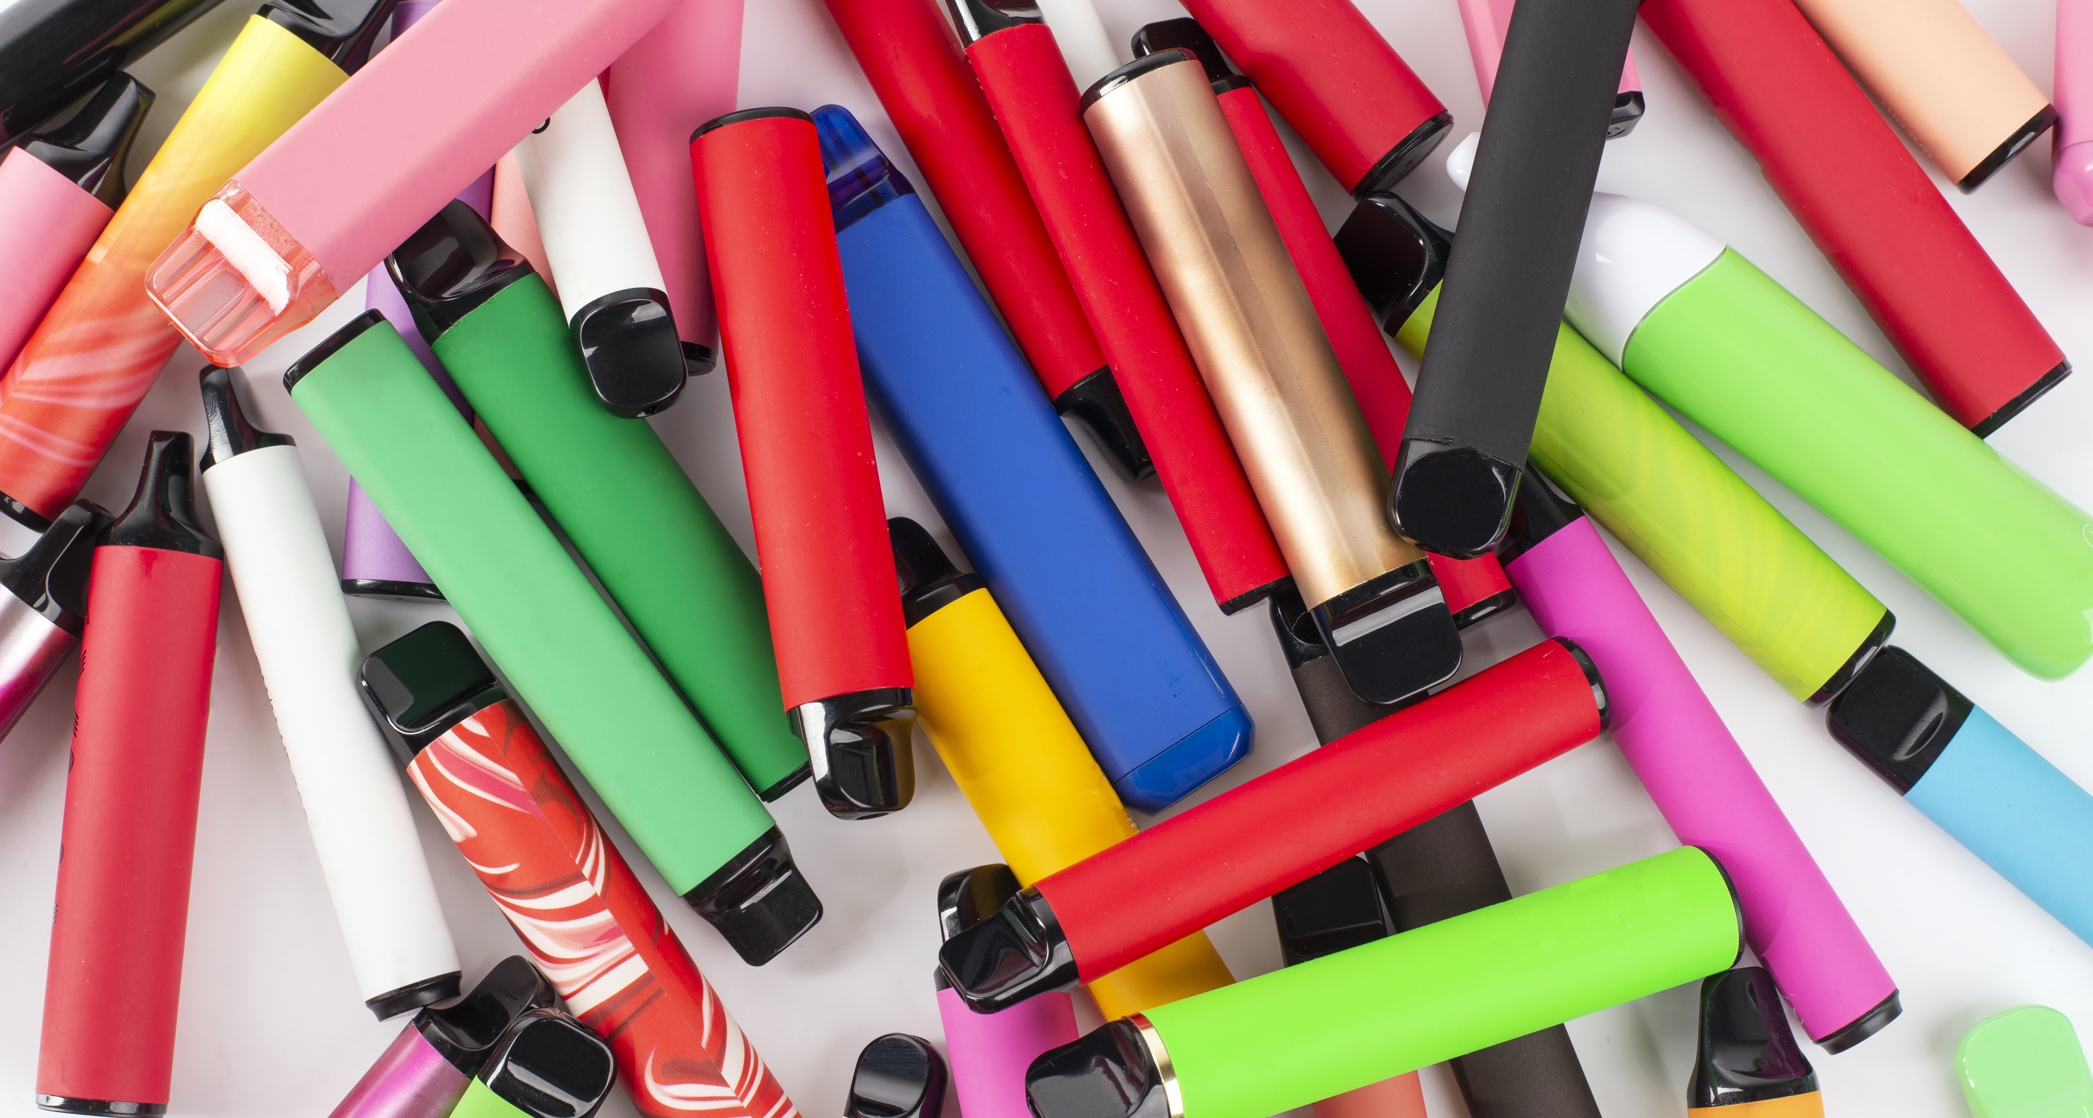
Data and Statistics
Vaping

Slide 2
Key sources of data
School Health Research Network student Health and Well-being Surveys are undertaken every two years and provide a regular snapshot of the health behaviours of children and young people in Wales.
An interactive data dashboard is available which shows patterns of experimental and regular vape, cigarette and other substance use relating to area, age, gender and family affluence at local authority, health board and All Wales level.
A national report is also available.
Schools can currently access their SHRN data via a bespoke school report sent directly to participating schools. A school-level interactive dashboard is currently in development; the prototype for this work is available.
Action on Smoking on Health (ASH) is a charity that conducts research and provides data on smoking and vaping. Use of e-cigarettesamongyoungpeopleinGreatBritain - ASH

Slide 3
How many children and
young people use vapes?
Studies including the School Health Research Network (SHRN) Student Health and Well-being Survey in Wales have shown that the use of vaping devices among children and young people in the UK has been on the rise in recent years.
The vast majority of children and young people in Wales do not vape. The 2023 SHRN survey report found:
  95% of young people reported they did not currently use vapes*
  80% of young people reported they had never tried a vape
  97% of young people reported they do not smoke tobacco*
*answered I do not use or use less than once a week.

Slide 4
How many children and
young people use vapes?
• 1 in 5 secondary aged learners (20%) from Year 7 to 11 had ever tried vapes.
• 7% of secondary aged learners reported use of vapes regularly (defined as at least weekly).
• Year 11 learners were more likely to use a vaping device at least weekly (16%) compared with Year 7 learners (1%).
• Secondary aged learners from less affluent families were the most likely to have tried vapes and to use them regularly.
• A higher proportion of year 7 to 11 girls (8.6%) reported vaping at least weekly compared with boys (5%). Amongst young people who identified as neither a boy nor a girl, 15% reported vaping at least weekly.
Data from: Information and Guidance on Vaping for Schools in Wales

Slide 5


Learners regularly using vapes
•7–8% of secondary-aged learners (year 7 to 11) report using vapes regularly (at least weekly)
The vast majority of children and young people in Wales do not vape
1 in 14
Secondary aged learners
reported using vapes regularly
Based on findings from the 2023 School Health Research Network Health and Well-being Survey, Public Health Wales.

Slide 6
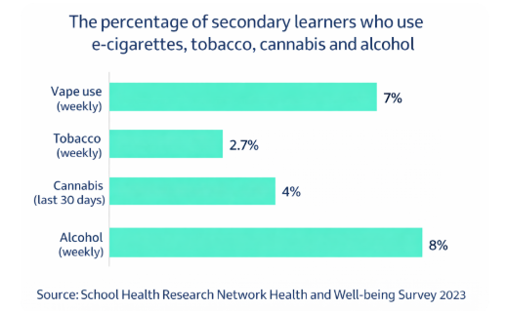
Vape use compared to
other substances
Use of vapes, tobacco, alcohol and cannabis amongst learners in secondary years 7-11 in Wales in 2023
​
A higher proportion of secondary aged learners drink alcohol weekly compared to vape weekly.

Slide 7
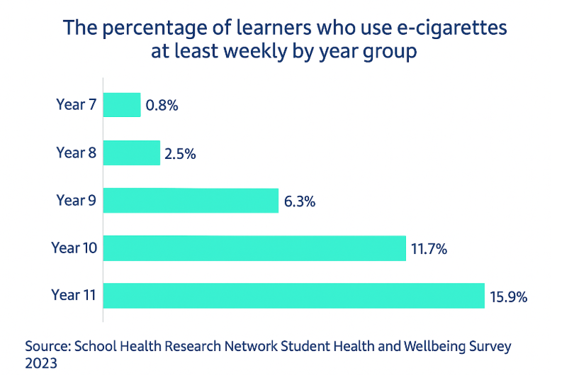
Learners regularly using vapes
by year group
Weekly vape use increases with age and year group.
Year 11 learners are more likely to use a vaping device at least weekly (16%) compared with Year 7 learners (1%).

Slide 8
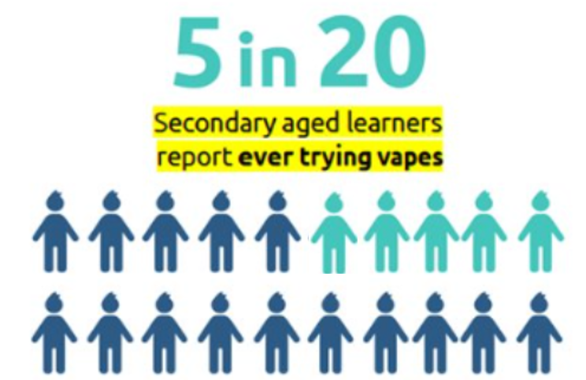
Learners ever using vapes
25.7% of secondary aged learners from Year 7 to 11 have ever tried vapes
The vast majority of children and young people in Wales do not vape
Based on findings from the 2023 School Health Research Network Health
and Well-being Survey.

Slide 9
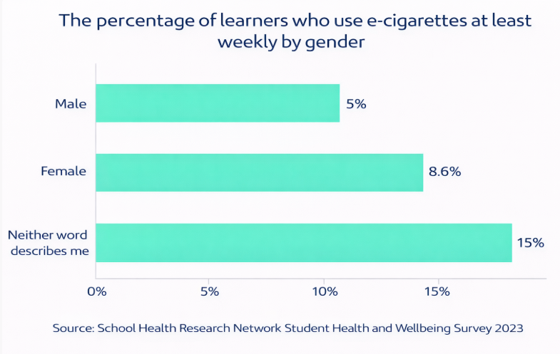
Vape use by gender
A higher proportion of Year 7 to 11 girls (8.6%) report vaping at least weekly compared with boys (5%).
Amongst young people who identify as neither a boy nor a girl, 15% reported vaping at least weekly.

Slide 10
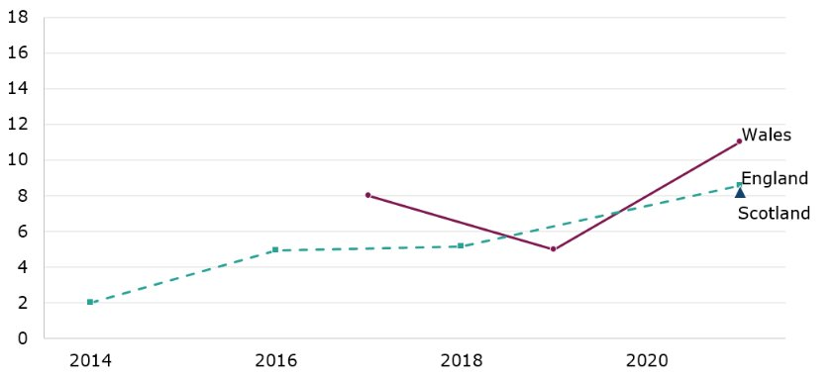
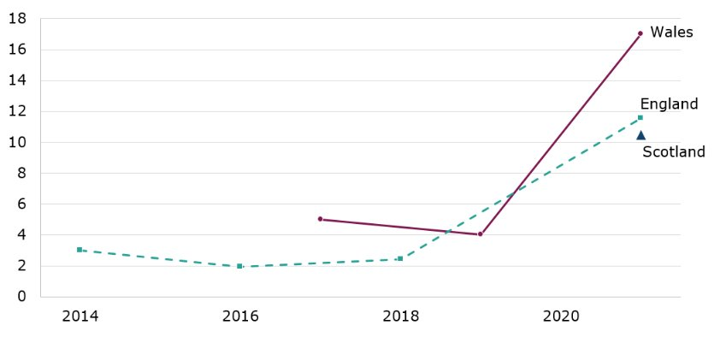
Vape use by gender in Wales compared to England and Scotland
Boys in year 11 reporting regular e-cigarette use
Girls in year 11 reporting regular e-cigarette use
Wales: School Health Research Network (SHRN), DECIPHer​
England: Survey of smoking, drinking and drug use among young people in England (SDD), NHS Digital​
Scotland 2021: HealthT
In 2021, Wales had the highest proportion of girls and boys in year 11 using e-cigarettes regularly compared to England

Slide 11
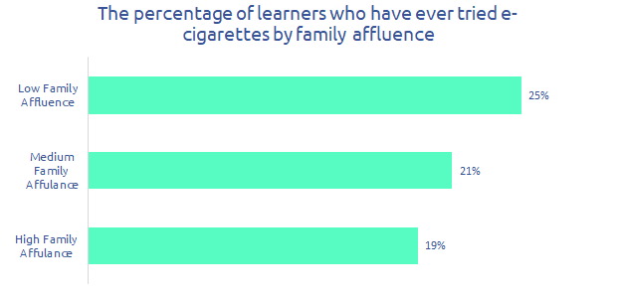
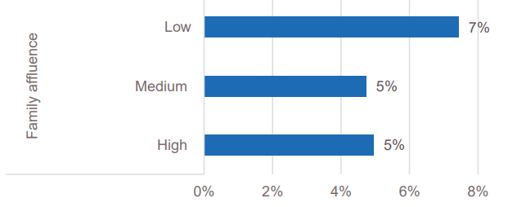
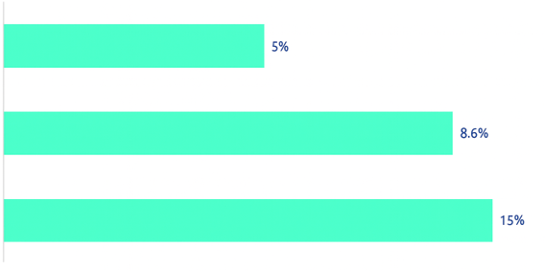
Vape use by family affluence
Secondary aged learners from less affluent* families were the most likely to have ever tried vapes.
* SHRN use the ‘Family Affluence Scale’ to estimate young people’s social-economic status. This is a well-established measure used internationally.
Based findings from the 2023 School Health Research Network Health and Well-being Survey.

Slide 12
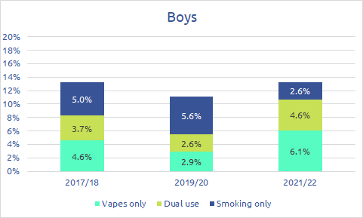
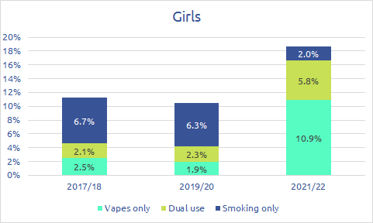
Only smoking, dual use, and only vaping
The proportion of boys and girls in year 11 only smoking is decreasing. ​
However, the proportion who are dual users and only vaping is increasing.
Figure 4: Percentages in year 11 of secondary education in Wales by gender who i) smoke regularly ('smoking only'), ii) use vapes regularly (‘vapes only’), iii) use both regularly ('dual use'). (Source: SHRN, additional analysis by Public Health Wales Observatory)

Slide 13
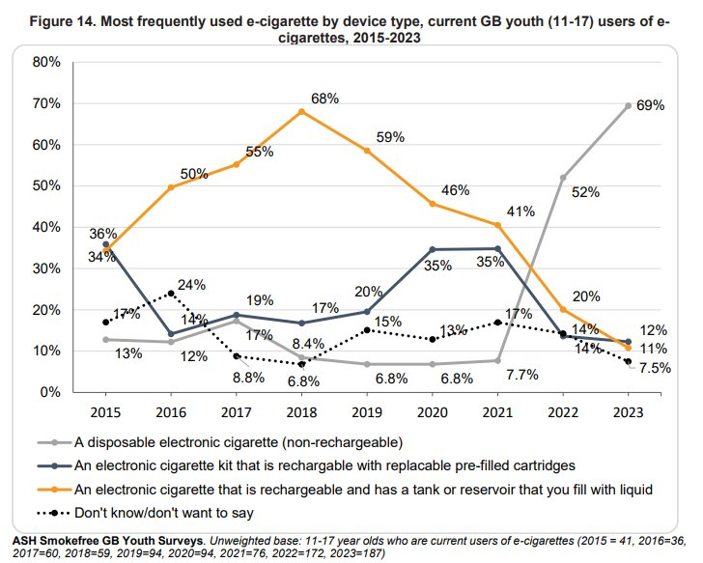
Most frequently used vape
by device type
Action on Smoking and Health (ASH) carry out an annual survey of vape use amongst young people (under 18) across Great Britain.
This showed the proportion of young people using non-rechargeable disposable vapes had increased significantly since 2021.
The sale of disposable vapes is now banned across the UK (since June 2025).
(Source: ASH: Use of e-cigarettes among young people in Great Britain June 2023)

Slide 14
Emerging data
Some queries about vaping cannot currently or easily be answered due to the lack of available or reliable data/information, for example:​
​
How much nicotine does a vape contain compared to a cigarette?​
How many school exclusions cite vaping as a factor?​​
Where do young people obtain vapes (e.g. shops, parents, other)?​
​
As the evidence builds and we have more reliable data sources to respond to such queries, we will be able to update future iterations of this knowledge bank.

