Slide 1
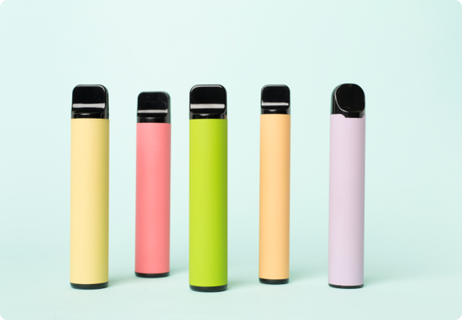
True or False
Vaping

Slide 2
Read the statements below.
Discuss whether you think they are true or false.
Vaping devices should not be used by children and young people
Young people using vapes are more likely to become addicted to nicotine, have more difficulty quitting and are at higher risk of addiction to other substances in the future
Vapes and cigarettes are equally as harmful to health
Vapes are available in a variety of flavours because they are suitable for children and young people
It is illegal to sell nicotine-containing vaping devices to anyone under 18 or for adults to buy them on behalf of under-18s
Vaping is harmless and will not damage your health
Sharing or passing around a vape with others is safe if it’s with people you know
1 in 4 secondary aged learners from Year 7 – 11 have tried vapes
In Wales you can legally buy single‑use disposable vapes from shops after 1 June 2025
Illegal vapes containing ingredients banned in the UK have been found in secondary schools in Wales
Boys are more likely to vape regularly (at least weekly) than girls
Vaping helps reduce anxiety levels and is good for stress relief
It is illegal for an adult to buy (or try to buy) vaping devices on behalf of anyone under-18

Slide 3
True
False
Boys are more likely to vape regularly (at least weekly) than girls
Vaping devices should not be used by children and young people
It is illegal to sell nicotine-containing vaping devices to anyone under 18 or for adults to buy them on behalf of under-18s
In Wales you can legally buy new single‑use disposable vapes from any shop after 1 June 2025
It is illegal for an adult to buy (or try to buy) vaping devices or e-cigarettes on behalf of anyone under-18
Sharing or passing around a vape with others is safe if it’s with people you know
Young people using vaping devices are more likely to become addicted to nicotine, have more difficulty quitting and are at higher risk of addiction to other substances in the future
Vapes are available in a variety of flavours because they are suitable for children and young people
Illegal vapes containing ingredients banned in the UK have been found in secondary schools in Wales
Vapes and cigarettes are equally as harmful to health
1 in 4 secondary aged learners from Year 7 – 11 have tried vapes
Vaping is harmless and will not damage your health
Vaping helps reduce anxiety levels and is good for stress relief

Slide 4
False
Boys are more likely to vape regularly (at least weekly) than girls
In Wales you can legally buy new single‑use disposable vapes from any shop after 1 June 2025
The statements on the left are false.
What are the truths?
Sharing or passing around a vape with others is safe if it’s with people you know
Vapes are available in a variety of flavours because they are suitable for children and young people
Vapes and cigarettes are equally as harmful to health
Vaping is harmless and will not damage your health
Vaping helps reduce anxiety levels and is good for stress relief

