Slide 1
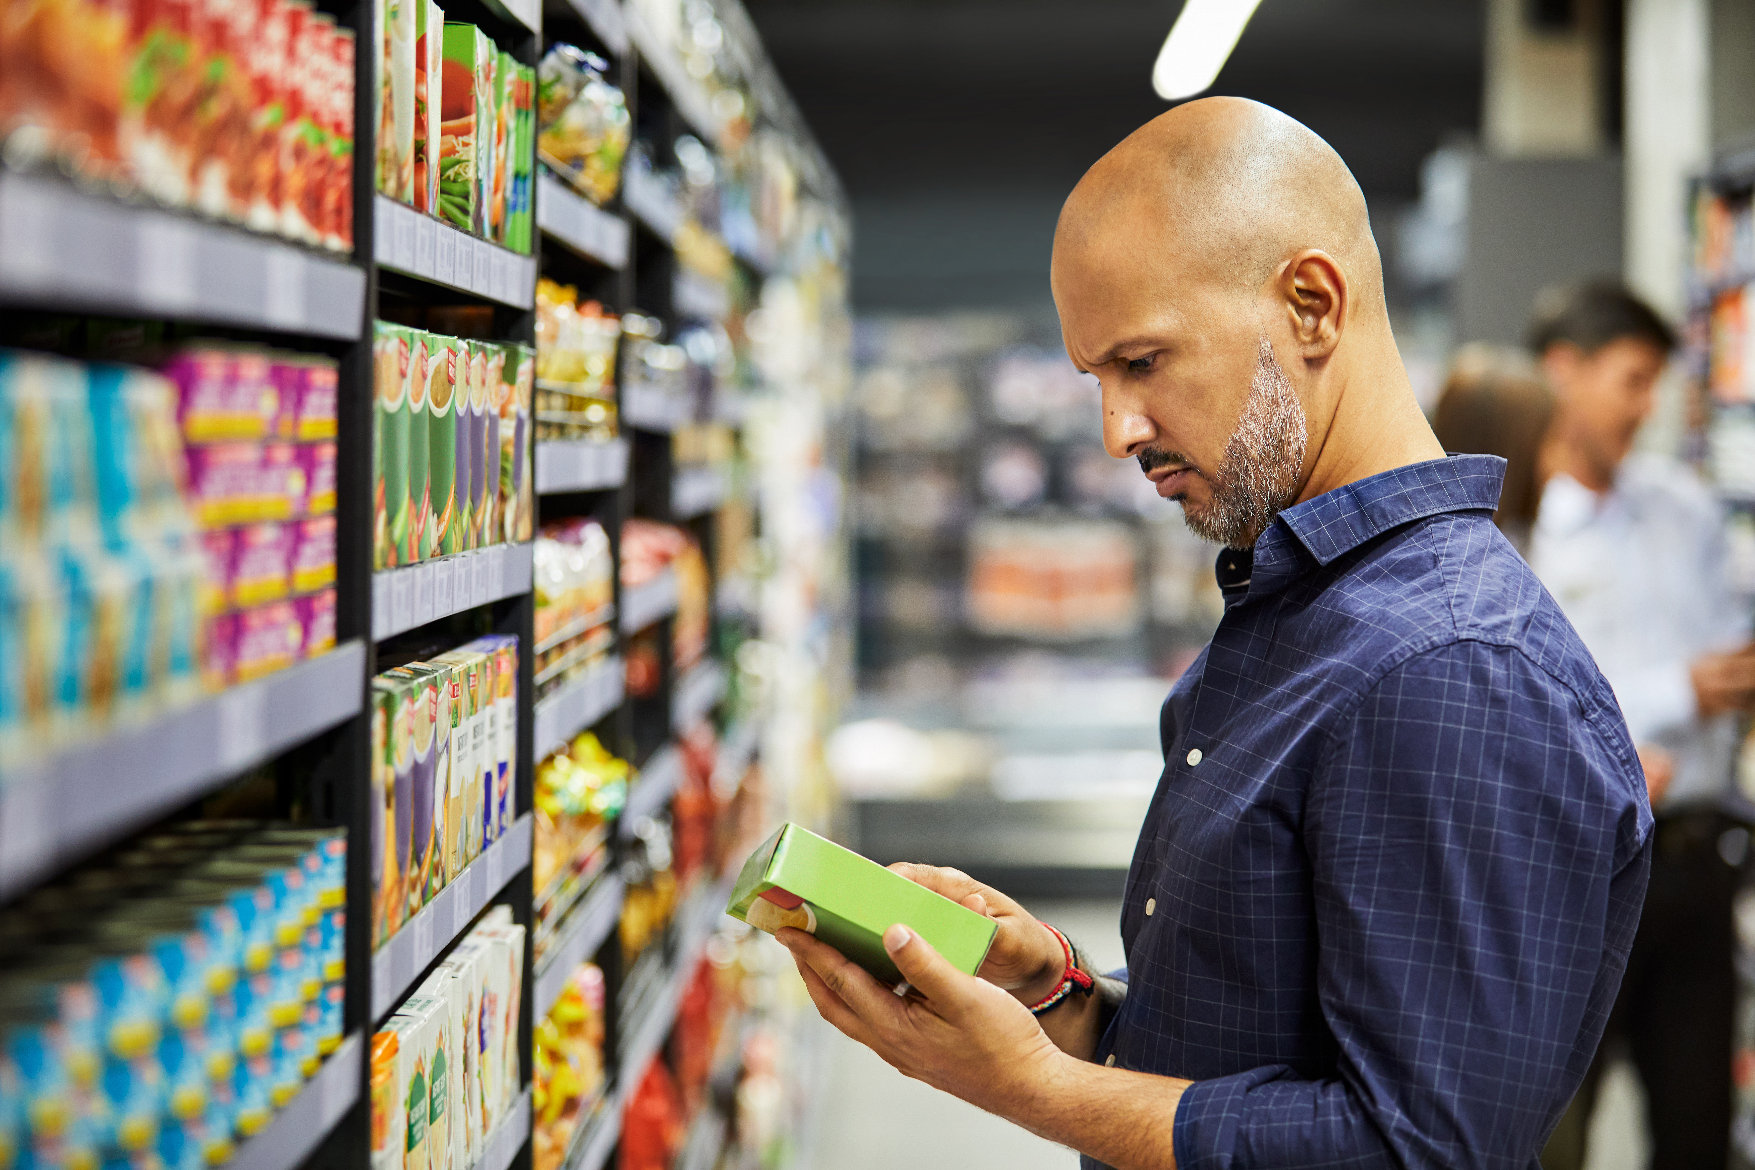
This or that?
This activity links to the following Knowledge Banks:
Why do people eat what they eat?
Where food come from
Food labels
The Laws and Regulations
This activity explores considered decision making and critical thinking regarding food choices.
Possible Health and Well-being descriptions of learning:
Progression step 1 I have developed an awareness that my decisions can affect me and others. | Progression step 2 I can recognise that my decisions can impact on me and others, both now and in the future. | Progression step 3 I can recognise that some decisions I make will have a long-term impact on my life and the lives of others. | Progression step 4 I can consider relevant factors and implications when making decisions individually and collectively. | Progression step 5 I can critically evaluate factors and implications, including risks, when making decisions individually and collectively.

Slide 2
This or That?
Discuss the two choices given on each slide.
Which option would you choose and why?
What does the packaging tell you about each option?
What factors would influence your decision to choose one over another?
Consider the following factors in your decision making:
size, packaging, labelling, appearance, brands, cost...
Use the hyperlinks on each slide if you would like to find out more information about each of the products

Slide 3
Food and Nutrition Labels
We need information that can help support us to eat the food and drink that will provide our bodies with the nutrients needed to grow and stay healthy.
Nutrition information labels can help you choose between products and keep a check on whether the foods (and drinks) you're eating are high in fat, saturated fat, salt and sugars.
Pre-packed foods must have a nutrition information label on the back or side of the packaging. You can use nutrition information labels to help you eat a balanced diet.
How can we use nutrition labels to help us with the options available to us between two products or recipes?
Food labels - NHS

Slide 4
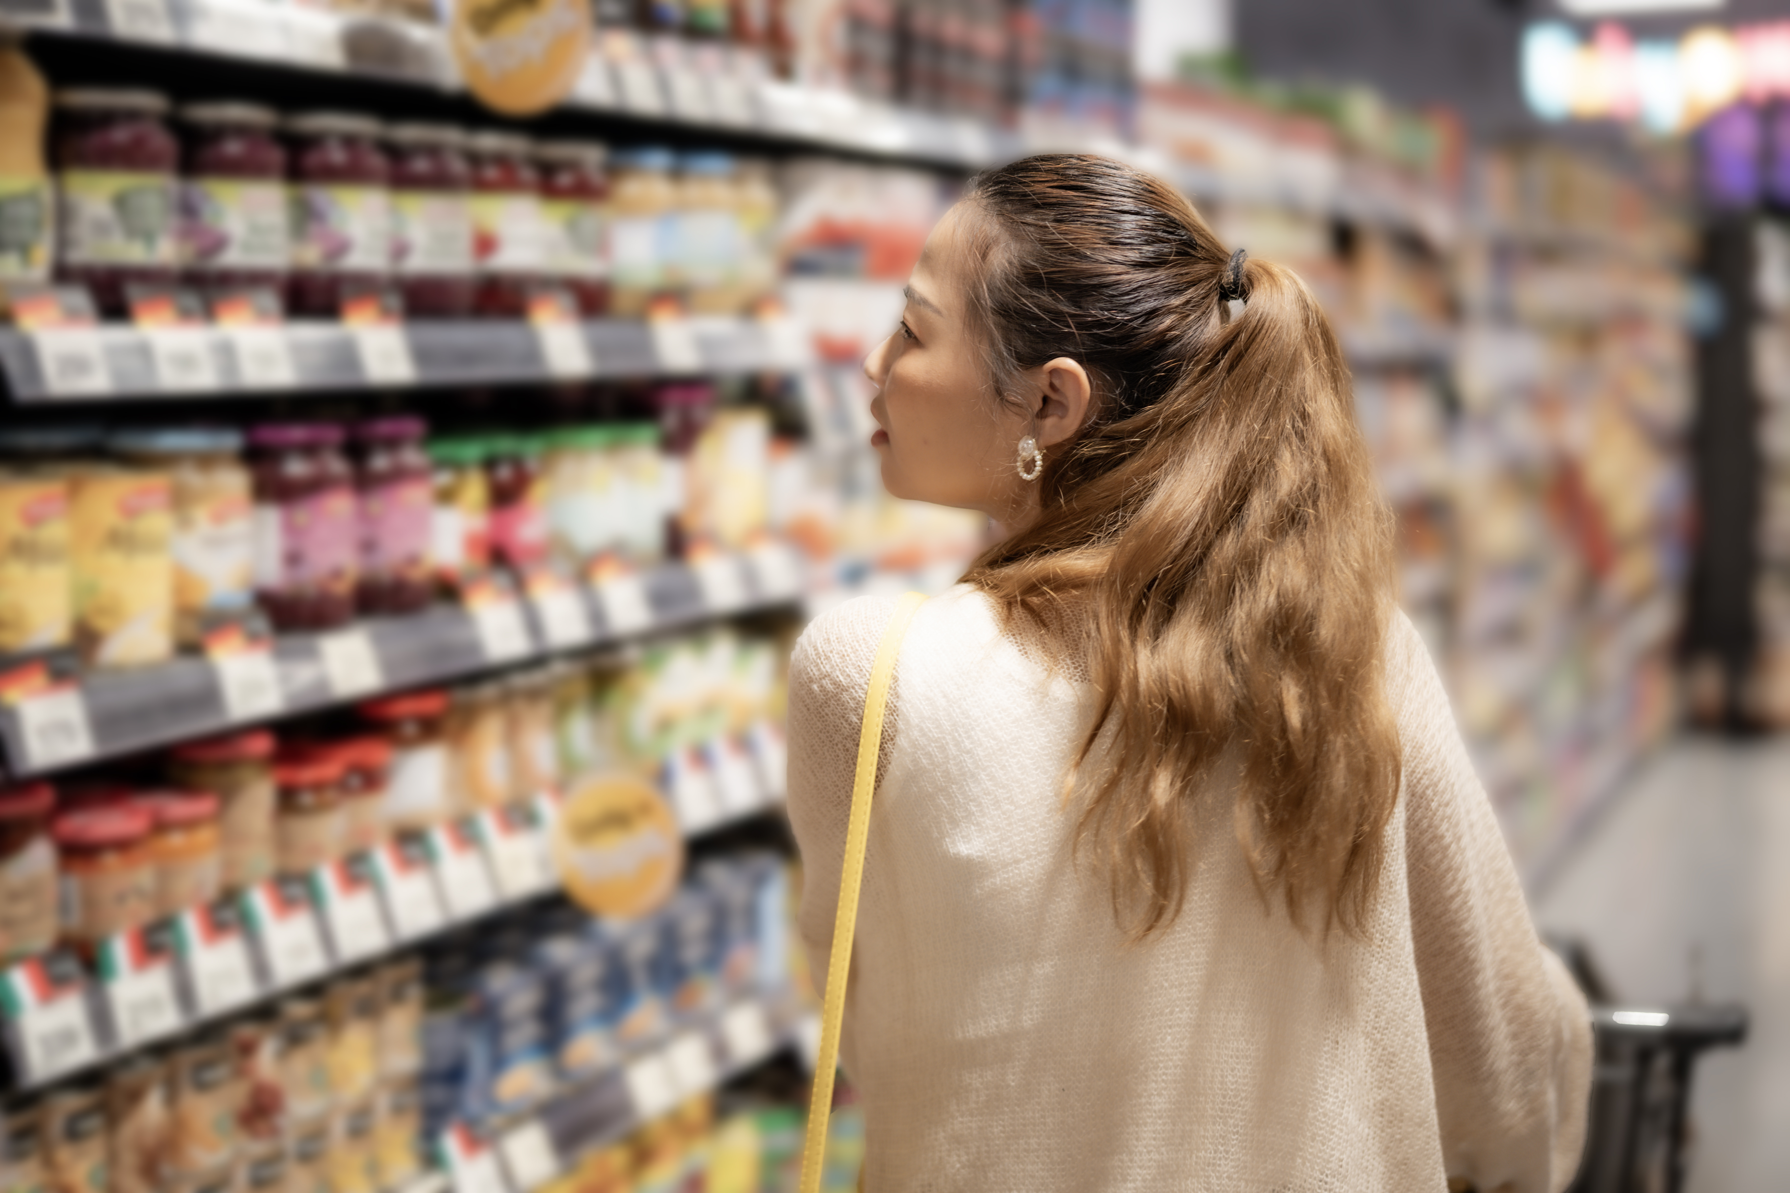
There are many other factors that influence what we eat, including:
Your food skills such as budgeting, shopping, preparing and cooking
The food available around you and how much it costs
The food marketing and advertising you see
Habits – household/ family/ individual
Your culture
Your preferences, what you like and dislike
Food allergies and intolerances
Check out the 'Why do people eat what they eat?' Knowledge bank for more information on this.
Food labels - NHS

Slide 5
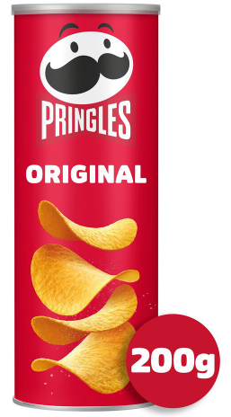
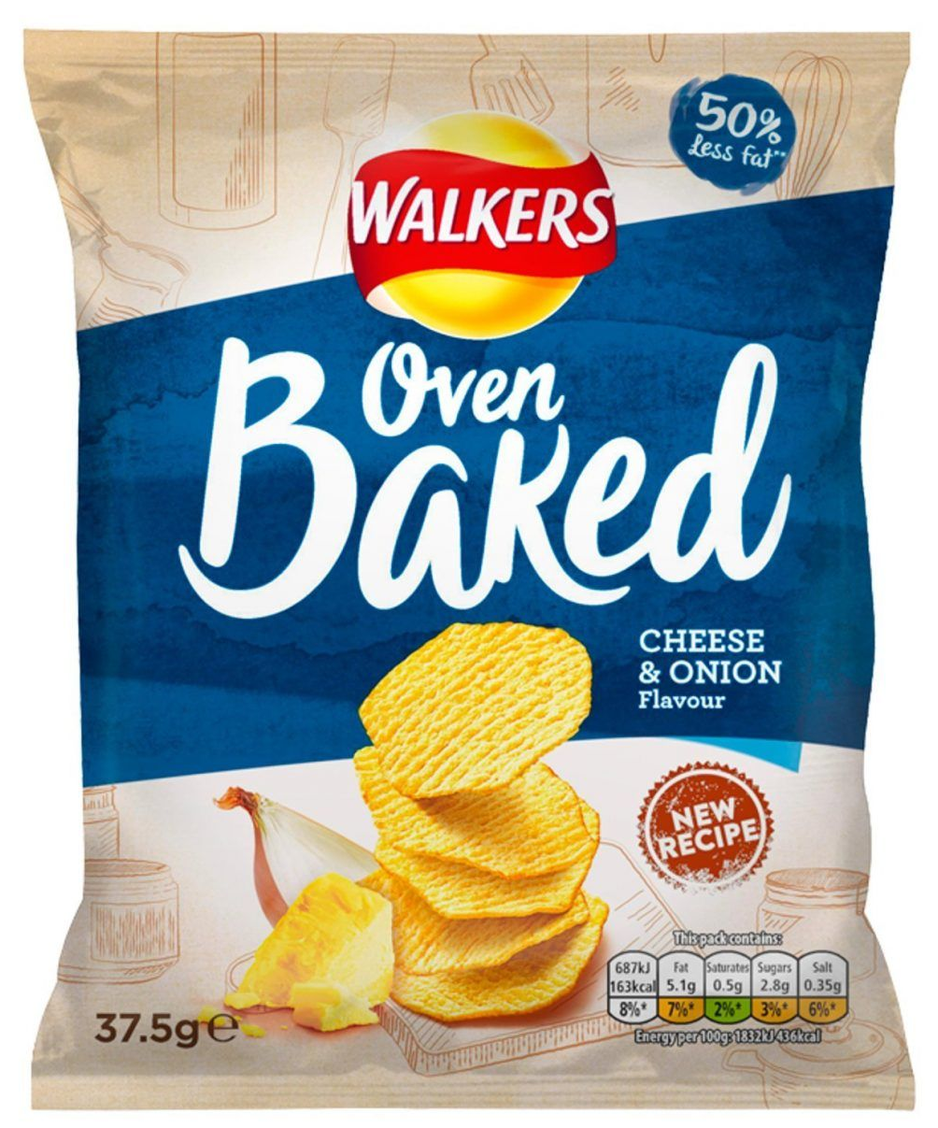
Crisps are not part of a balanced diet, and there are healthier everyday snack options such as plain popcorn, rice cakes, nuts, seeds, fruit and vegetables.
If choosing crisps think about:
1. Portion Size
Large “sharing bags” are often eaten by one person, meaning you may eat far more than you realise.
2. Nutritional Content
The pringles are higher in fat and salt, and the serving size is larger.
The Oven‑baked crisps are a smaller portion and are reduced‑fat, so you will generally consume less in one sitting.
3. Label Reading
Check and compare nutrition labels, especially saturated fat and salt content for crisps.
Discuss the Two Products:
Why would you choose one or the other?
Pringles Original Crisps 200G
Walkers Baked Cheese & Onion
Grab Bag Crisps 37.5g

Slide 6
What Choice Would You Make?
Why would you choose one or the other?
Does the size effect your choice? Would you realistically share the larger pot?
Do you think one product is better for you than the other? Take a look at the nutrition labelling.
Does the labelling affect your choice?
What are the pros and cons to making a choice based on how a
product looks?

Slide 7
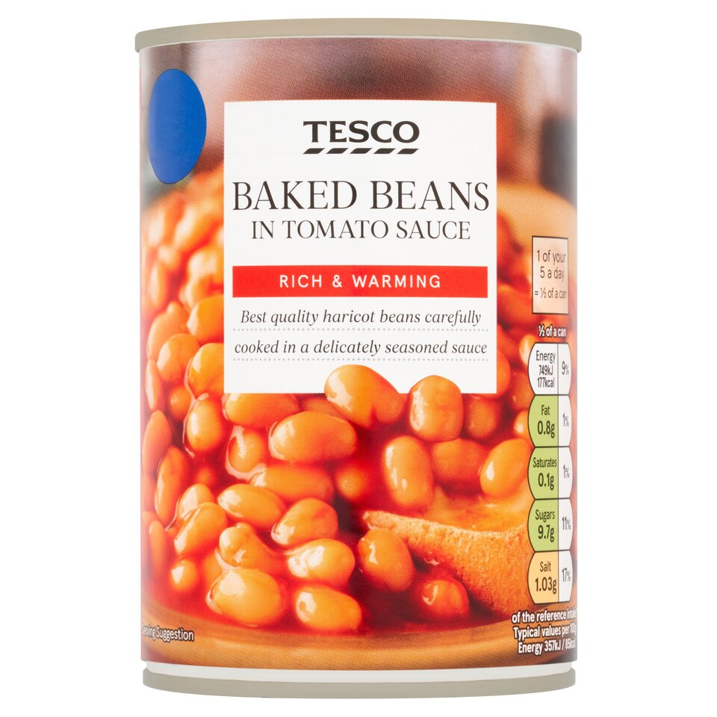
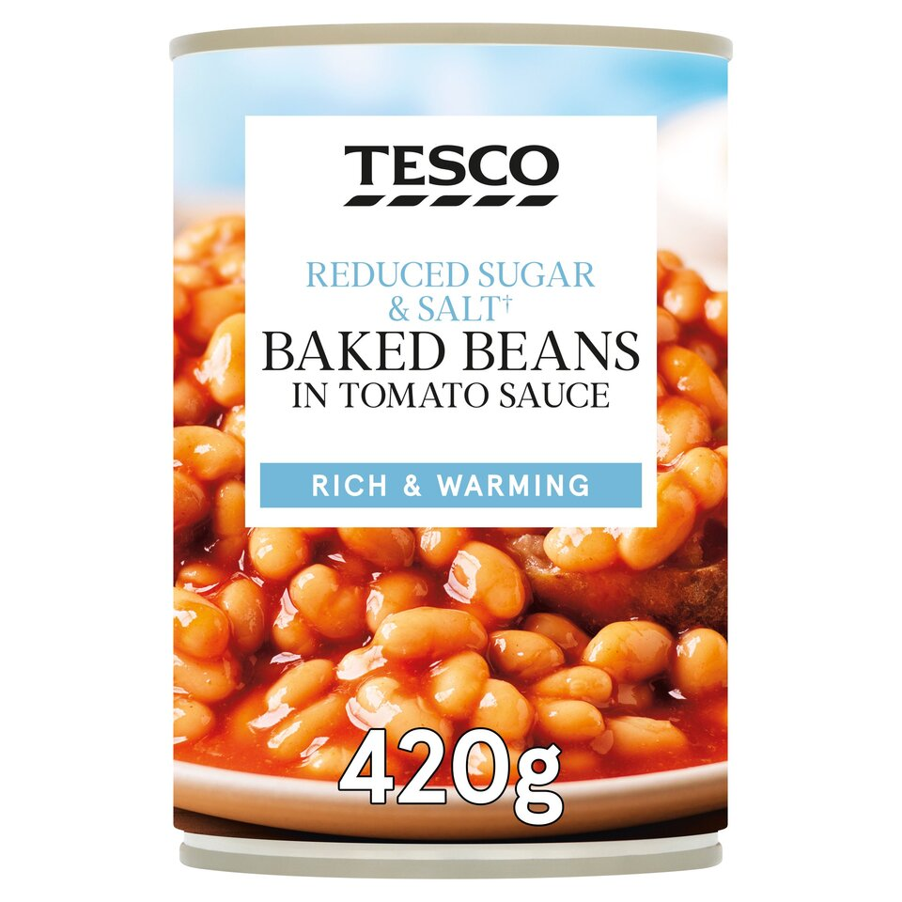
Discuss the Two Products:
Why would you choose one or the other?
Baked beans Baked beans reduced salt/ sugar

Slide 8
What Differences Do You Notice?
What are the main differences in the products?
How much does the packaging affect your choice?
Which one would you think is a healthier choice?
Which would you choose and why?
Answers to include:
Check and compare nutrition labels carefully.
Choose items that have lowest amounts of fat, salt and sugar.
In this example, the reduced salt, reduced sugar beans are the healthier option than the standard versions.

Slide 9
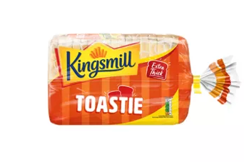
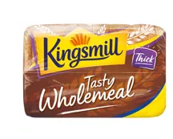
Discuss the Products:
Kingsmill Extra Thick Toastie Bread 800g
Kingsmill Tasty Wholemeal Medium Bread 800g

Slide 10
Which Would You Choose and Why?
What are the main differences in the products?
Which do you think is a healthier choice?
Why do you think this?
Where would we find this information?
Answers include:
Check and compare nutrition labels carefully.
In this example check the fibre content of the bread.
Choose higher fibre options where possible.
The wholemeal contains more fibre than the white bread making it a healthier option.

Slide 11
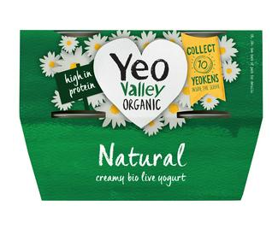
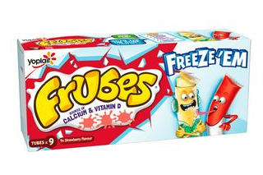
Discuss the Products:
Check out the 'nutrition claims' section in 'The Laws and Regulations' Knowledge Bank
Yeo Valley Organic Natural Yogurt 4x110g
Frubes Kids Strawberry Yoghurt Tubes 9x37g

Slide 12
Which Would You Choose and Why?
When looking at yoghurt options:
Check and compare nutrition labels, especially for sugar content, as many yoghurts are surprisingly high in sugar.
Choose products that are lower in sugar wherever possible.
Marketing vs. Nutrition
Front‑of‑pack messages can be misleading.
For example, Frubes are brightly packaged and promoted as a good source of calcium and vitamin D, which appeals to children. But they are high in sugar.
Natural yoghurt also provides calcium and vitamin D, but is low in sugar, making it the healthier option.
Who do you think these different yoghurts are marketed at?
Does the packaging make it easy to tell which is the healthier choice?
What do you think the main differences are between the two yoghurts?
Which yoghurt do you think contains more sugar?
Have you ever seen natural plain yoghurt sold in convenient lunchbox sized tubes?

Slide 13
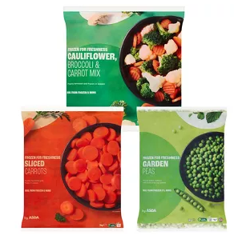
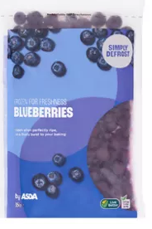
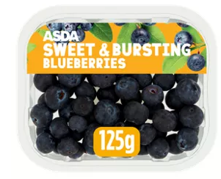
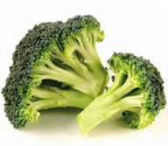
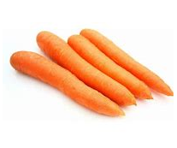
Discuss the Products: Frozen vs Fresh
Frozen
Fresh

Slide 14
Fresh and frozen fruit and vegetables both count towards 5 A Day.
One is not healthier than the other.
Frozen options can be more economical.
They are often cheaper, can be stored for longer and may help reduce food waste.
Buying fresh produce in season is another way to access lower‑cost fruit and vegetables.
Remember fresh, frozen, tinned (in juice) and dried fruit and vegetables all count towards your 5 A Day.
What is the Difference?
Do you think one is healthier than the other?
What are the benefits of frozen fruit and vegetables?
What do you think is the difference in cost?
Which one would you choose? Why is this?
Check out the 'Where food comes from' Knowledge Bank for some tips

Slide 15
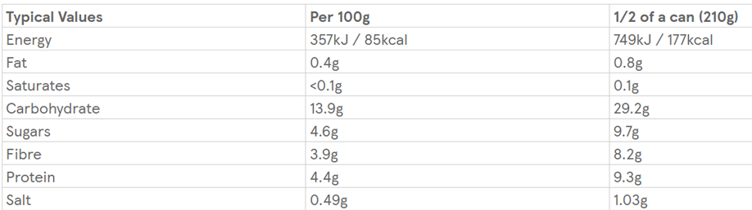
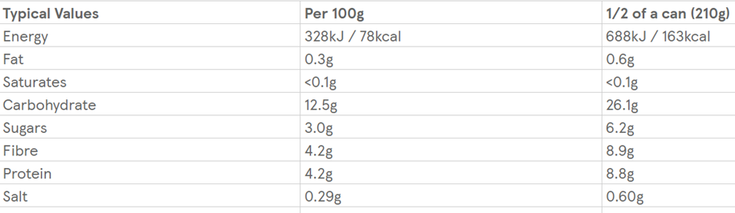
Food Labels
These are 2 labels from similar products, which is healthier?
Option 1:
.
Option 2:
Option one is higher in sugar and salt.

Slide 16
Food Labels
What did you notice about the two food labels?
Which one do you think could be a healthier choice?
Why is this?

Slide 17
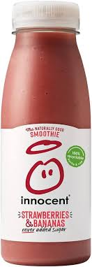
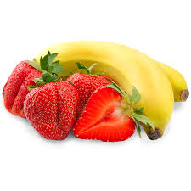
Smoothie or Whole Fruit?

Slide 18
Smoothie Vs Whole Fruit
Which one of these products would you think is a healthier choice?
Why is this?
Which one has more sugar?
Which product do you think has more fibre?
How many of your 5 A Day does the smoothie contain?
Smoothies contain free sugars, while whole fruit does not.
This means smoothies are high in sugar, even if no sugar is added.
Whole fruit is higher in fibre because the structure of the fruit is kept intact.
Whole fruit counts towards 5 A Day, but smoothies do not.

Slide 19
Further possible learning suggestions:
Ready meal vs home-cooked
Provide learners with ready meal labels (Can be found on supermarket websites) and task them with finding a homemade version of the same ready meals (BBC Good Food provides the nutritional values).
What is the difference in nutrition between the two? For example, does one contain more vegetables, or does one contain more salt? How could this affect our health?
Do you think the ready meal or the home version is cheaper / more expensive? And why?
Why might people choose the ready meal or the homemade version?
Example: Tomato Soup
Baxters Favourites, Cream Of Tomato Soup 400g | Sainsbury's
https://www.bbcgoodfood.com/recipes/tomato-soup

